Slide 1
IEEE Local Elections
Theresa Brunasso, Past Director
theresa.brunasso@ieee.org
SoutheastCon 2024 Atlanta, Georgia

Slide 2
Agenda
Why have Section, Chapter & Affinity Group elections?
Election Requirements
Election Committee
Schedule
Candidates
Tools

Slide 3
Why Elections?
Elections are required by the MGA Operations Manual
https://mga.ieee.org/images/files/Current_MGA_Operations_Manual_2024__17_Feb_2024.pdf
Section Officers, Paragraph 9.5 F 7a: “All officers shall be elected by Section members of Graduate Student Member, Member, Senior Member, and Fellow grade. Elections for all officers shall take place every one or two years, in accordance with the term of office as defined by the Section.”
Chapter Officers, Paragraph 9.7 D 5b “All officers shall be elected by Chapter members of Graduate Student Member, Member, Senior Member, and Fellow grade. Elections for all officers shall take place every one or two years, in accordance with the term of office as defined by the parent geographical unit that assumes responsibility for the Chapter management”
Affinity Group Officers, Paragraph 9.10 D 6a: “All officers shall be elected by Affinity Group members of Graduate Student Member, Member, Senior Member, and Fellow grade. Elections for all officers shall take place every one or two years, in accordance with the term of office as defined by the Section.”

Slide 4
Why Elections? (continued)
Section, Chapter and Affinity Group Officers have term limits!
The consecutive period of service in any one office shall normally not exceed four years.
All officers shall not serve in any one position, in any single organizational unit, more than six years in total.
Exceptions to this rule require approval by the Region Director who will annually report such exceptions to the MGA Board.
Members have the right to choose their officers
Electing new officers guards against volunteer burn out
Electing new officers brings new volunteers and ideas to your organization
MGA is using vTools data to share all election and officer terms with Area Chairs and Region Directors.

Slide 5
Election Committee
Approved by the Geographic Unit ExCom
Composition:
Minimum of three Voting Members
No more than one members can be a current officer (typically outgoing chair)
Chair of the Elections Committee cannot be a current officer
Responsibilities:
Ensure a fair and transparent election
Distributes a call for nominations to all active members of the Geographic Unit
• Candidate and voter eligibility date (30 June) and criteria
• Election dates
• Positions with descriptions being solicited
• Election committee contact information
• Instructions on how to self-nominate or nominate others
• Petition dates
Actively solicits volunteers to run for office
Prepares a recommended slate of candidates for approval by the ExCom
No single candidate slate shall proceed without Region Director approval.
Reviews any petition candidates

Slide 6
Election Schedule

Slide 7
Candidate Requirements
IEEE member in good standing as of June 30th
Must provide IEEE member number to Election Committee
Eligible Member grades:
Graduate Student Member
Member
Senior Member
Fellow
For ballot:
Photo
Biography
Candidate statement

Slide 8
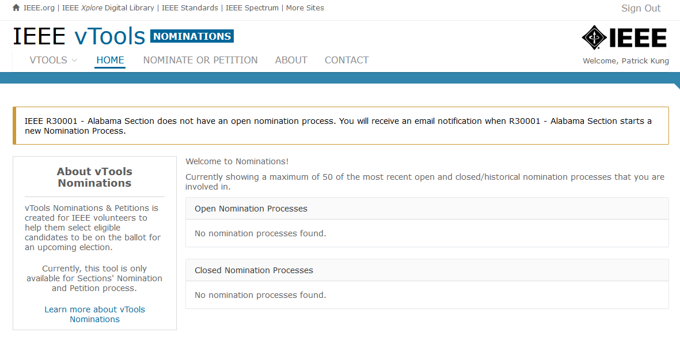
Election Tools
All voting in Geographic Unit elections should be electronic via secret ballot within vTools
http://nominations.vtools.ieee.org/ to access vTools nominations (Sections only)

Slide 9
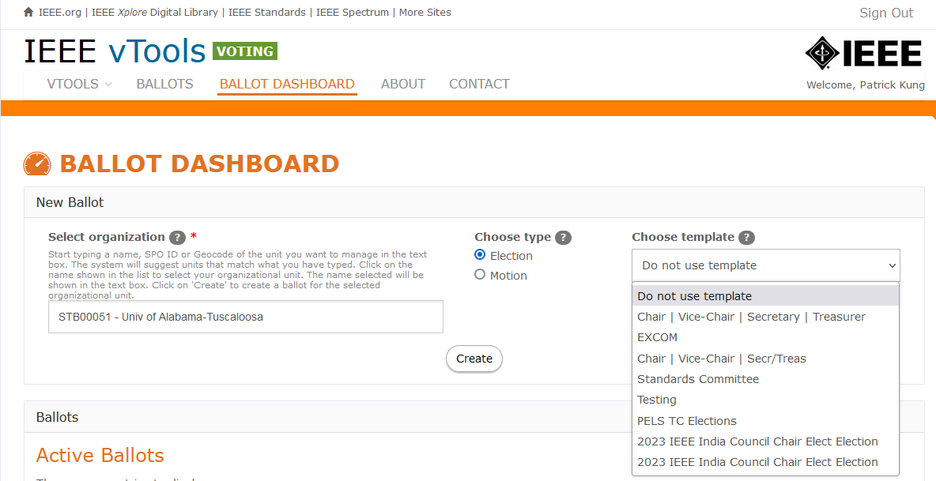
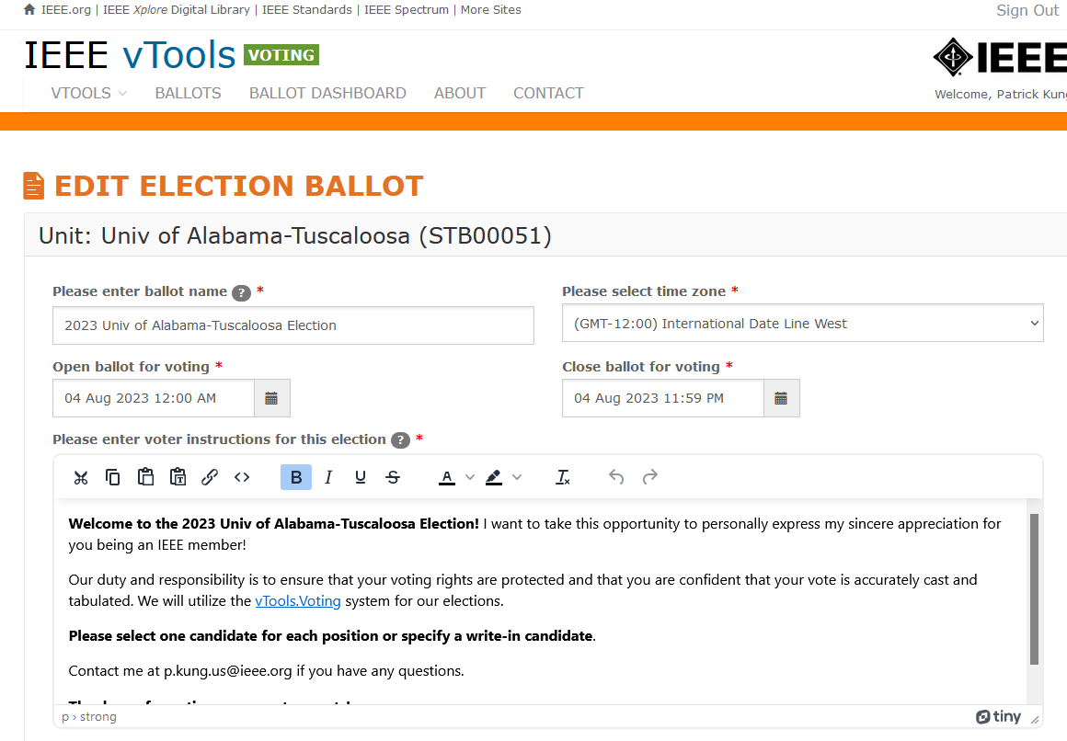
vTools Ballot Creation
https://voting.vtools.ieee.org/tego_/ballot_admin/index to create a ballot

Slide 10
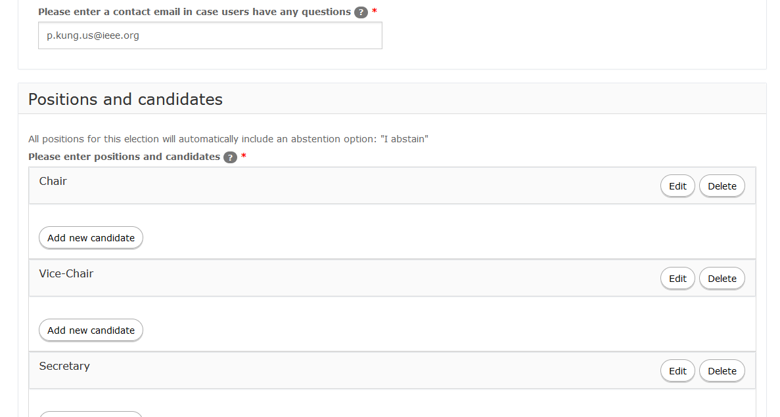
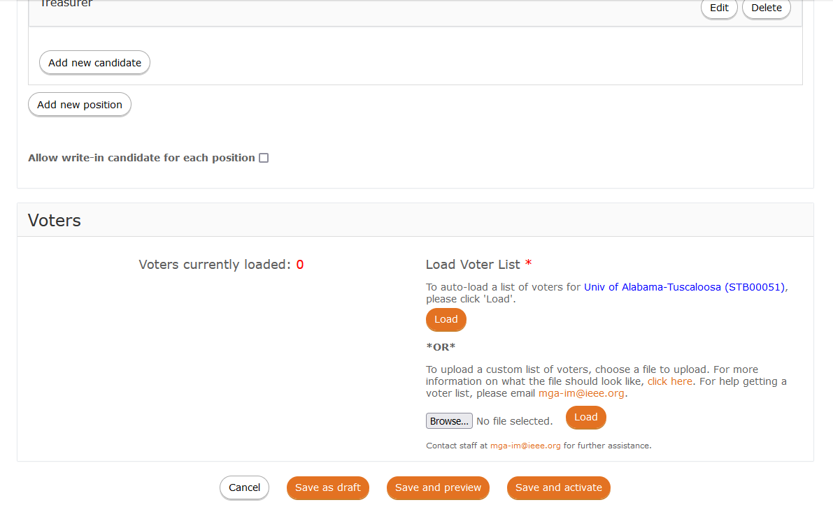
vTools Ballot Creation (continued)
Bio, statement, photo

Slide 11
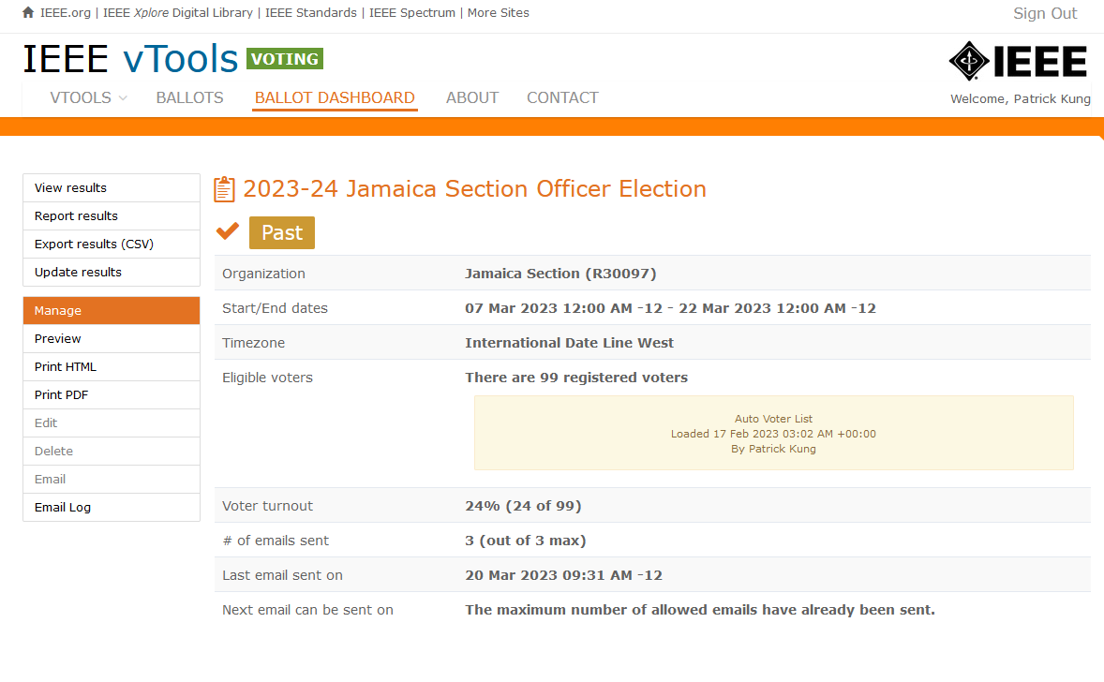
vTools Election Management

Slide 12
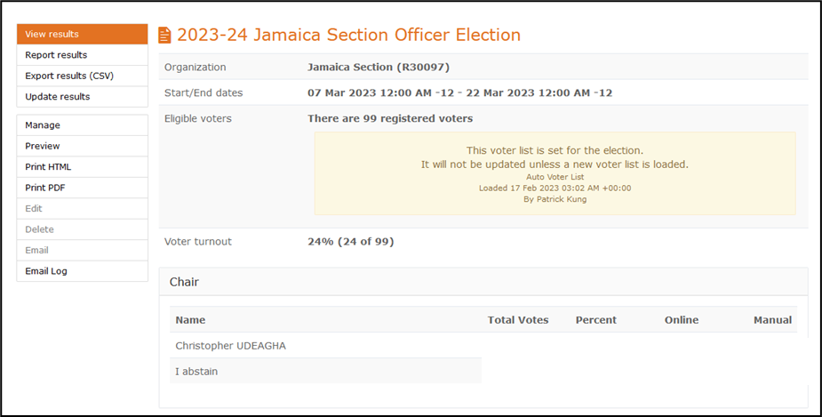
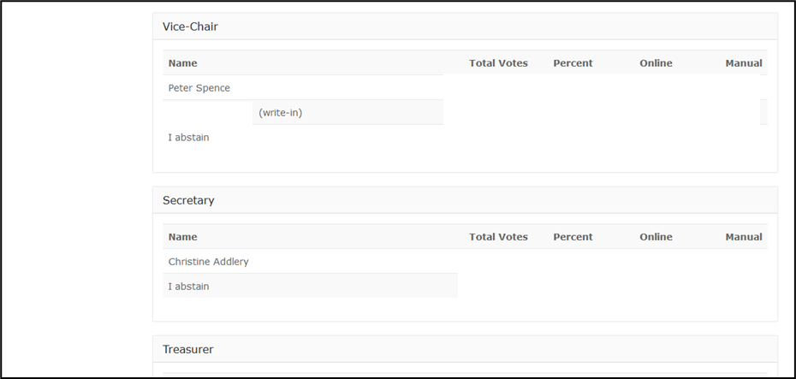
vTools Election Results

Slide 13
Summary
We appreciate your years of service, but elections are required
There are many more volunteer opportunities at the Region, MGA and IEEE level!
vTools makes it easy to hold elections
Your Area Chairs are available to help
Your Area Chairs, Director-Elect and Director will know if you don’t hold your required elections.
A training plan is being prepared for this year's local elections.
All local units will receive a communication in early April with information resources, FAQs and training webinar schedules

Slide 14
Thank you for all you do for IEEE! Any questions?
theresa.brunasso@ieee.org

