Slide 1
Membership Development
Patrick Kung
Member Recruitment and Retention Coordinator
p.kung.us@ieee.org
22 March 2024

Slide 2
Region 3 Membership Status
Data from OU Analytics (can appear daunting to use) as of March 21, 2024.
Not all Sections are similar.
Can be provided to you anytime if of use.

Slide 4
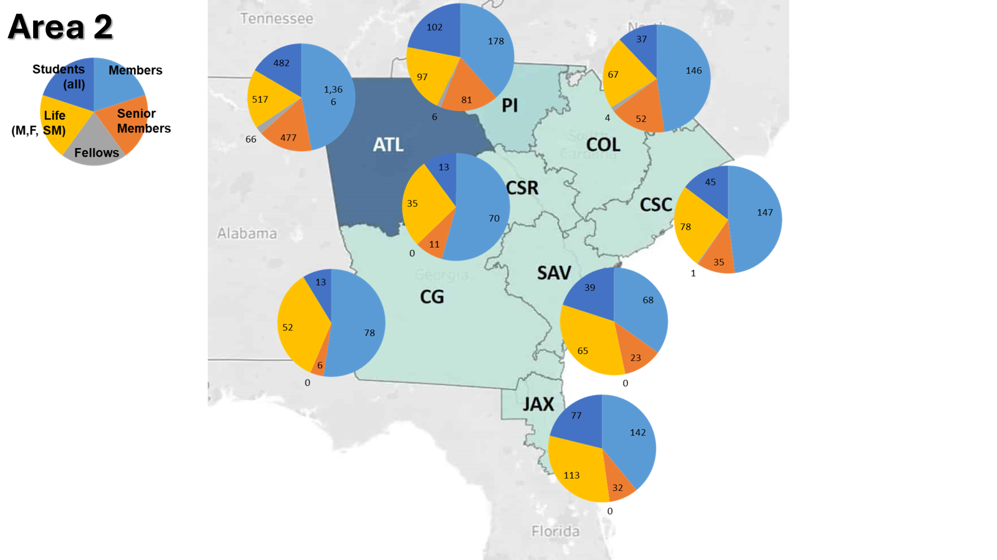

Slide 5
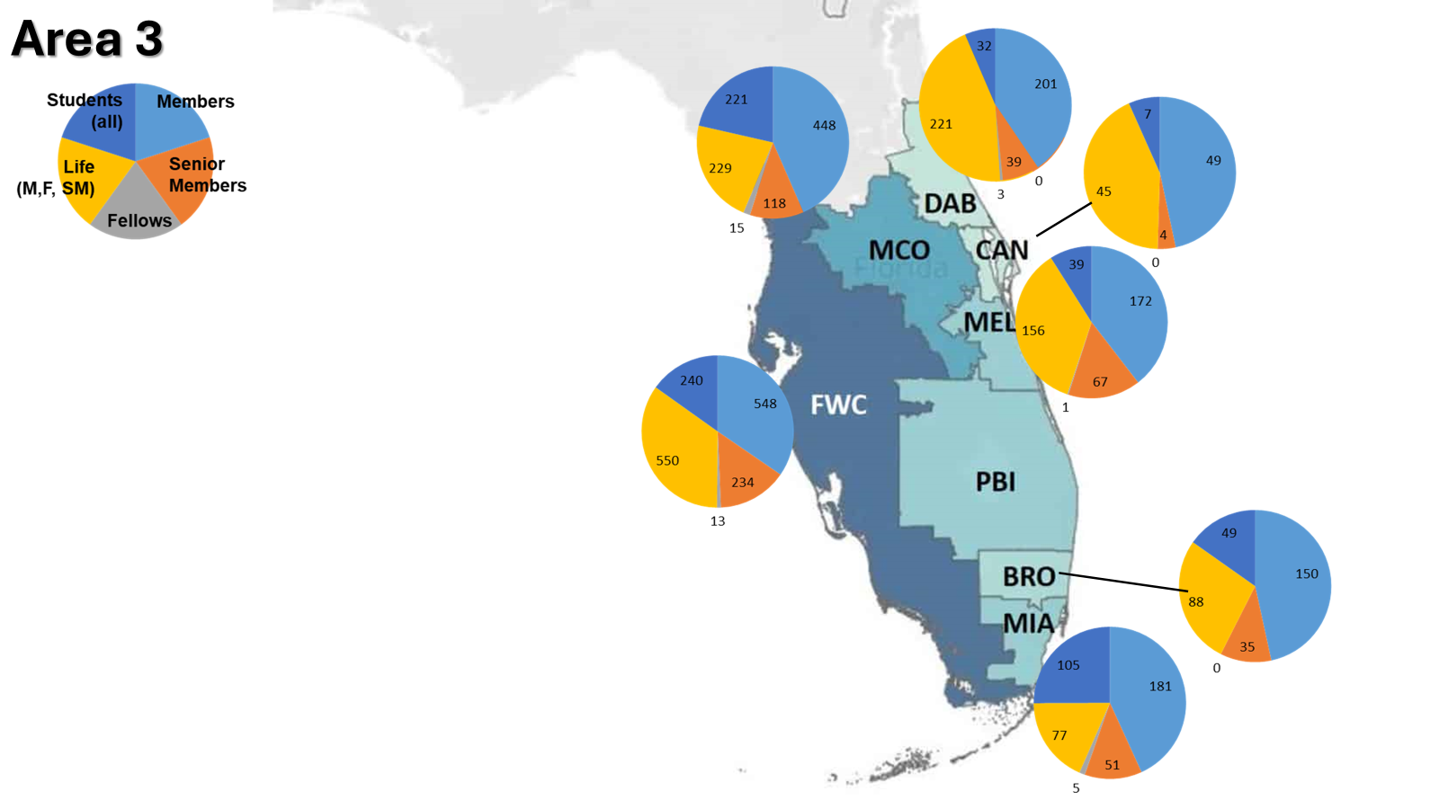

Slide 6
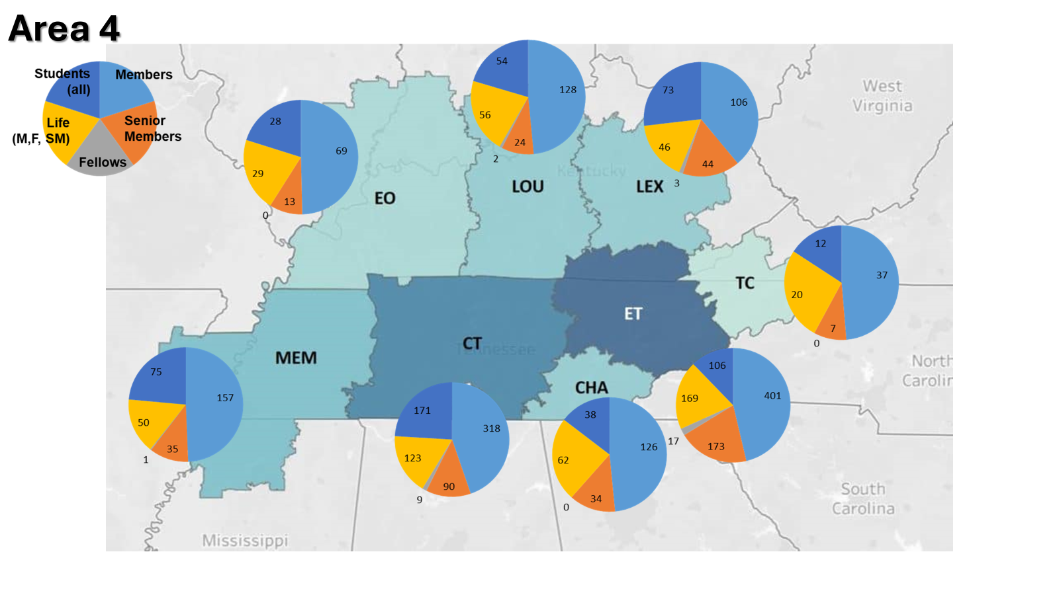

Slide 7
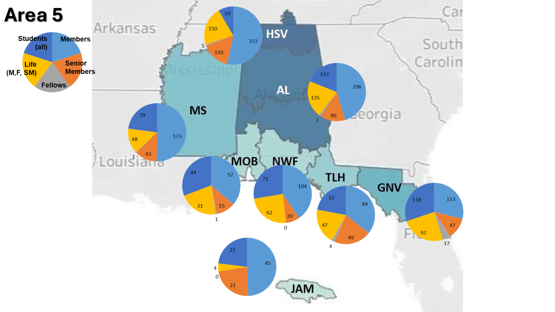

Slide 8
Region 3 Membership Development
Some thoughts.
Your thoughts.
Get thoughts of past and potential IEEE Members in your Sections.

Slide 9
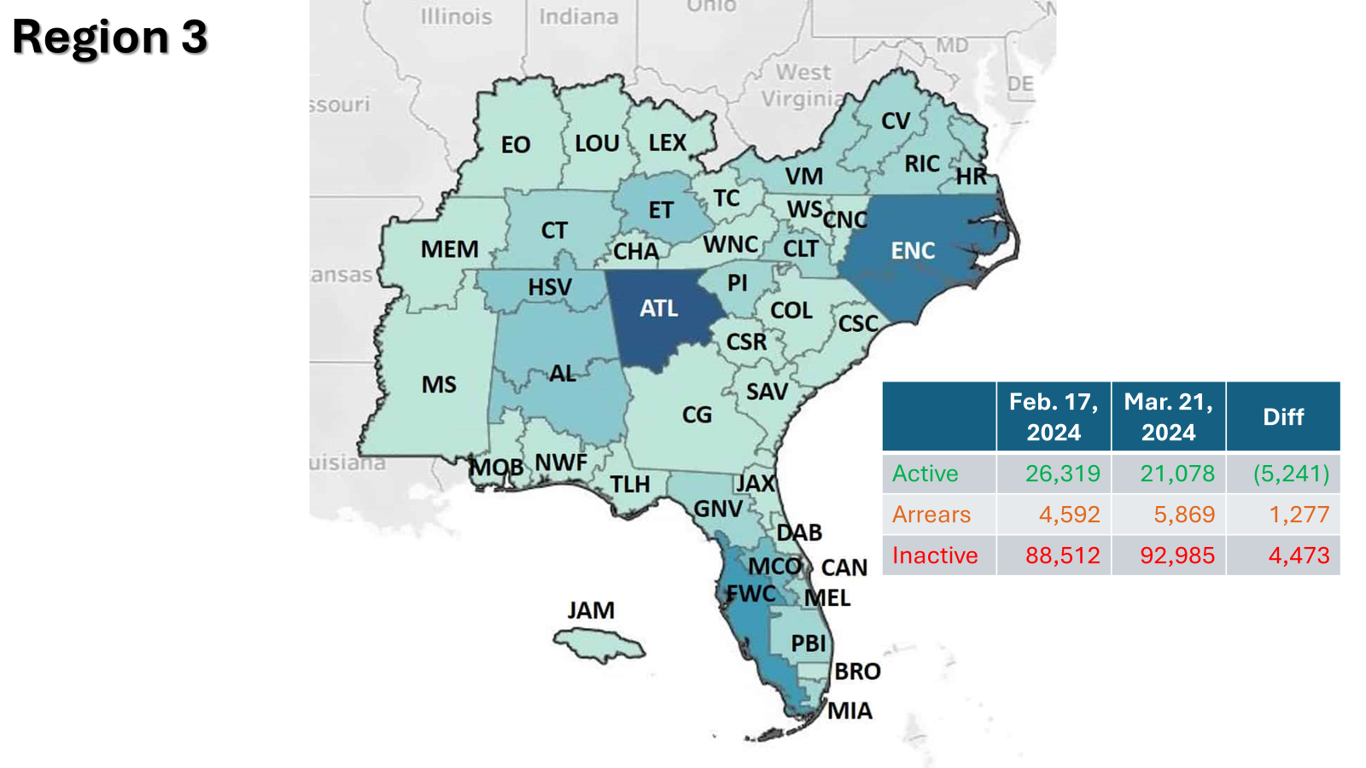
Focusing on Arrears is a priority.
Are there opportunities to reconnect with Inactives? (by date?, by grade?)

Slide 10
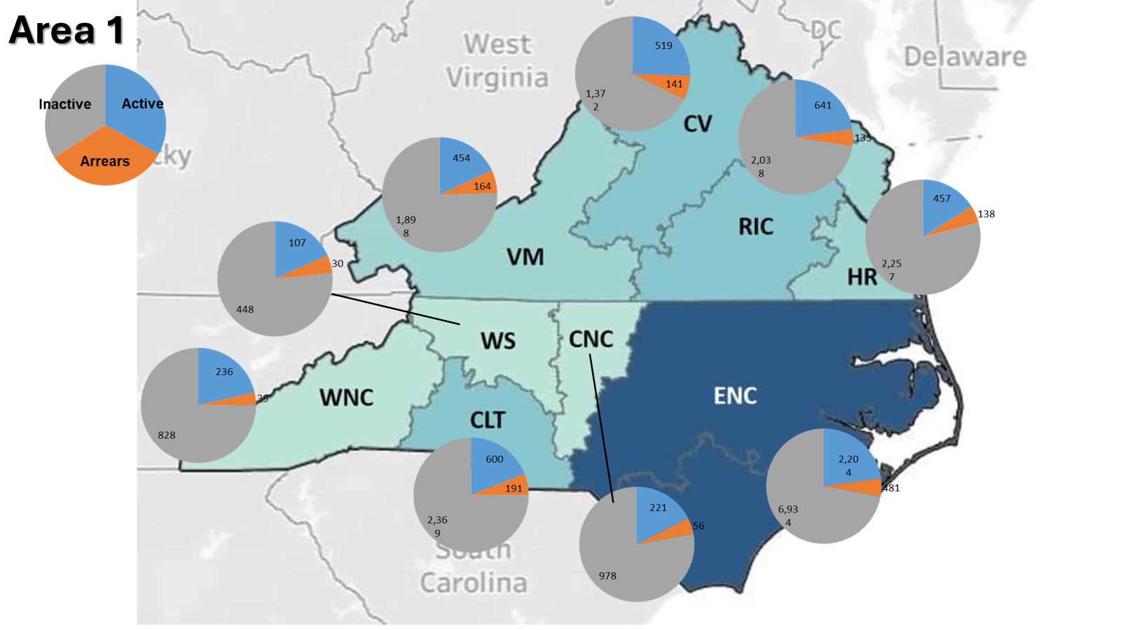

Slide 11
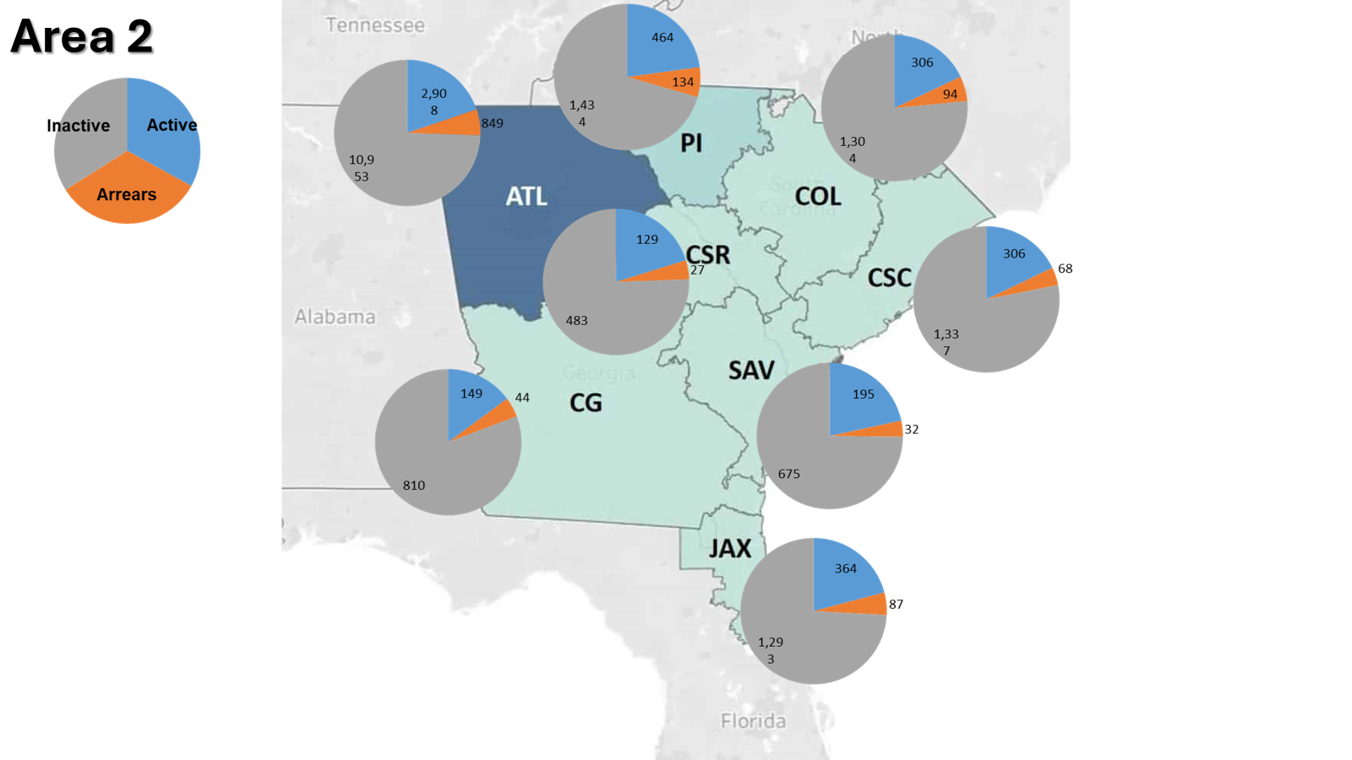

Slide 12
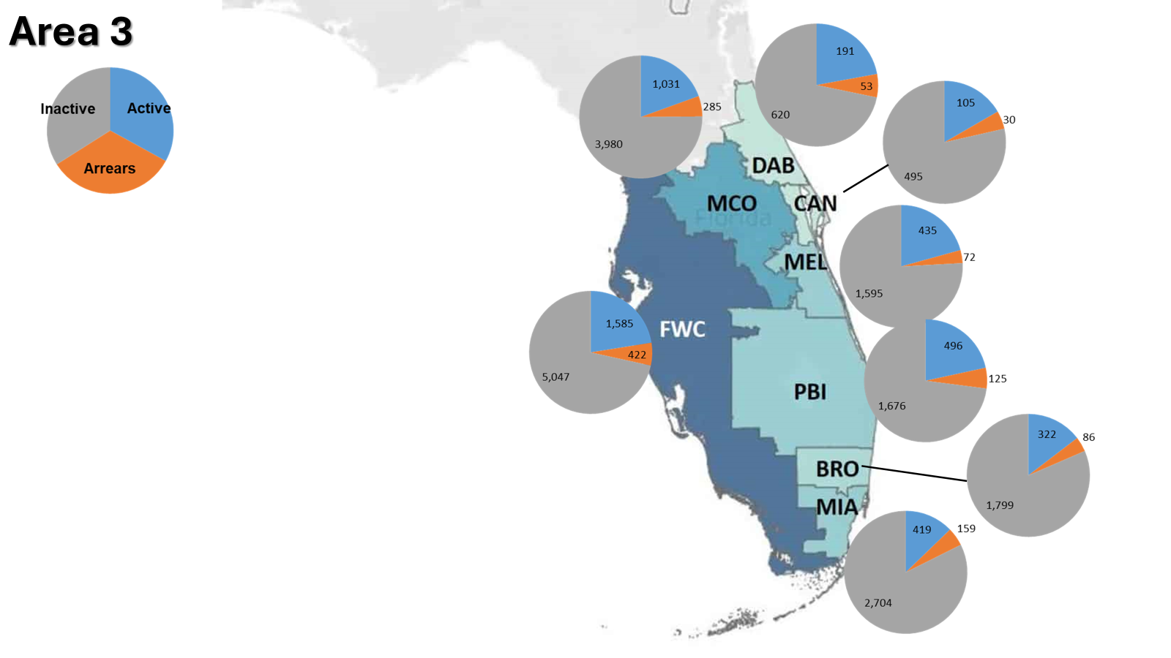
Can provide more granularity of last grade for Inactives, and dates.
Useful?

Slide 13
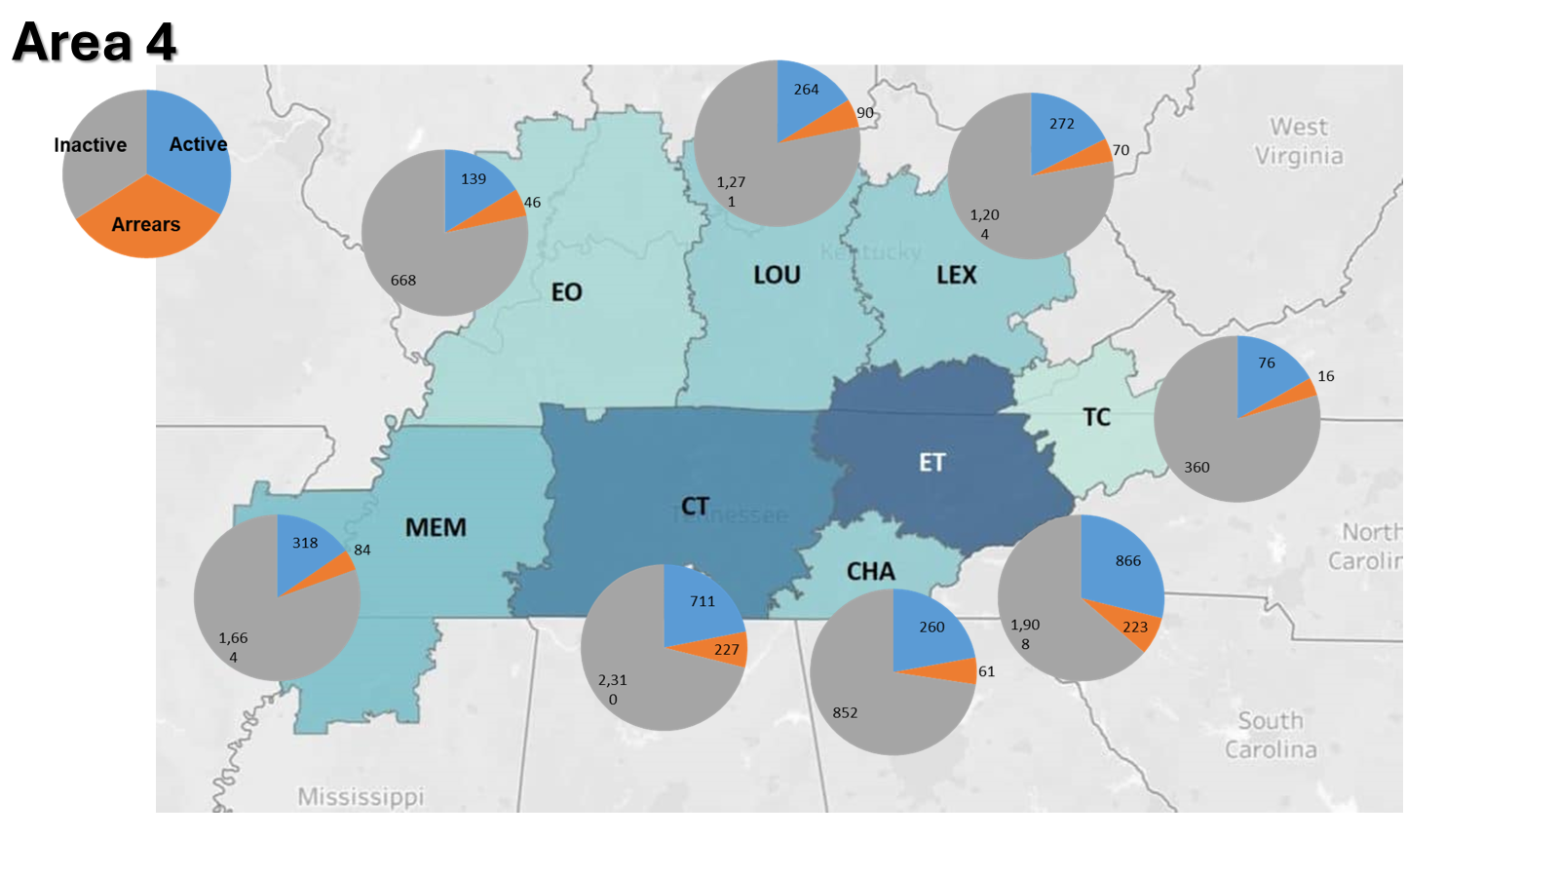

Slide 14
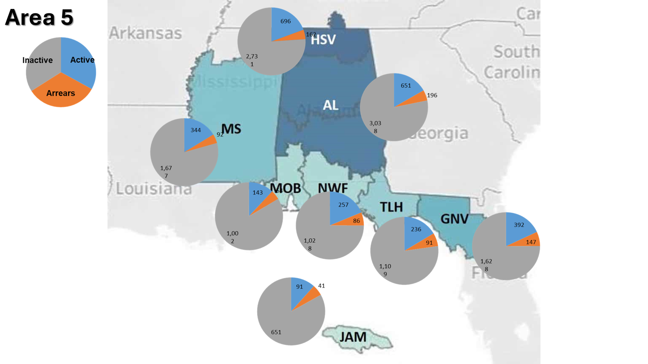

Slide 15
3
5
5
Student Branch
1
2
2
1
Students
3

Slide 16
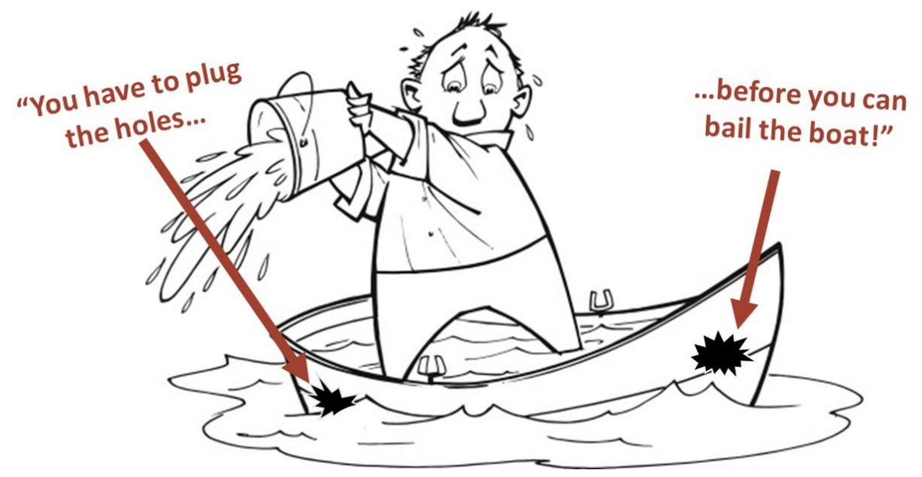
Bailing vs. Plugging?

Slide 17
Why Join and Stay in IEEE?
Loyalty
Value
(Tangible) Benefits

Slide 18
Not 1 Recipe for All
Student
Member
Senior Member+
Value
Loyalty
Loyalty
Value
Loyalty
Value
(Tangible) Benefits
(Tangible) Benefits
(Tangible) Benefits

Slide 19
Region 3 Membership Development
Some thoughts.
Your thoughts.
Get thoughts of past and potential IEEE Members in your Sections.

