Slide 1
Recognizing Contributions
Nelson Lourenco
IEEE Region 3 Awards and Recognition Committee (ARC) Chair

Slide 2
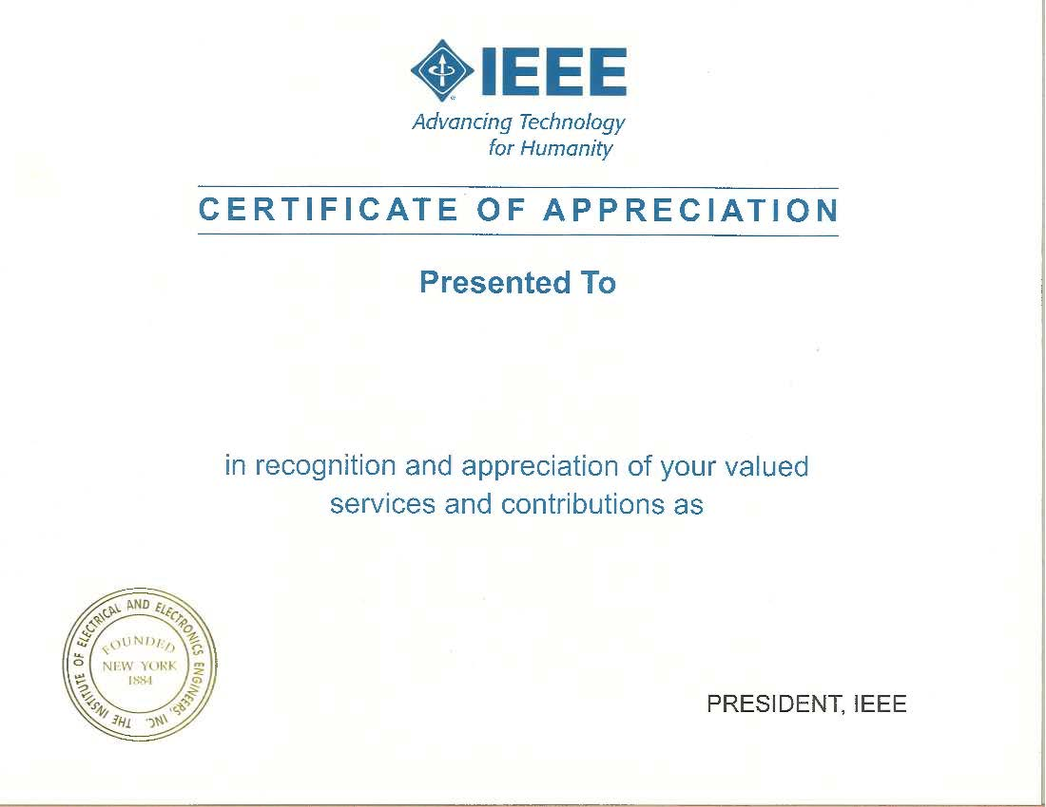
How Important Are Awards?
We are a volunteer-driven organization
Awards show that volunteer’s hard work is recognized and appreciated
Awards encourage current volunteers to continue serving across multiple levels
Awards inspire other members to volunteer
Awards are a sign of Section health and vitality

Slide 3
Overview of IEEE Awards
Technical Chapter/Affinity Group Awards
Section Awards
Council Awards
Region Awards
Society Awards
Technical-Area Council Awards
Community Awards
Entity Board Awards
Institute Awards

Slide 4
Region 3 Awards and Recognition Committee
2023 Region 3 Awards and Recognition Committee
Chair: Nelson Lourenco
Vice Chair: Devon Gale (non-voting)
PAC Representative: David Fillion
Region 3 Area Chairs
Area 1 Chair (North Carolina and Virginia): James Imanian
Area 2 Chair (Georgia and South Carolina): Wyman Williams
Area 3 Chair (Florida): Raul Ortega
Area 4 Chair (Kentucky and Tennessee): Paul Kuban
Area 5 Chair (Mississippi, Alabama, and Jamaica): Patrick Kung
Past R3 director/delegate serves as mentor (Gregg Vaughn)
IEEE SoutheastCon 2024 Atlanta, Georgia

Slide 5
Region 3 Awards and Recognition Committee
2024 Region 3 Awards and Recognition Committee
Chair: TBD
Vice Chair: TBD
PAC Representative: Kristin Bing
Region 3 Area Chairs
Area 1 Chair (North Carolina and Virginia): James Imanian
Area 2 Chair (Georgia and South Carolina): Alessio Medda
Area 3 Chair (Florida): Raul Ortega
Area 4 Chair (Kentucky and Tennessee): Paul Kuban
Area 5 Chair (Mississippi, Alabama, and Jamaica): Daniel Diaz
Past R3 Director/Delegate serves as mentor (Gregg Vaughn)
Past ARC Chair*: Nelson Lourenco
IEEE SoutheastCon 2024 Atlanta, Georgia

Slide 6
Overview of IEEE Awards
Technical Chapter/Affinity Group Awards
Section Awards
Council Awards
Region Awards
Society Awards
Technical-Area Council Awards
Community Awards
Entity Board Awards
Institute Awards

Slide 7
Responsibilities of Awards Chair
The responsibilities of Awards Chairs vary depending on the geographical organizational unit of focus
At the Section Level:
Oversee Section Awards Program in accordance with Section Bylaws and/or Operations Manual
At the Society and Council Level:
Lead or assist with nominations of worthy Section members for Society and Council awards
IEEE SoutheastCon 2024 Atlanta, Georgia

Slide 8
Responsibilities of Awards Chair
At the Region Level:
Publicize Region awards within Sections
Lead in identifying worthy nominees for Region awards
Assist in developing formal nominations
Ensure timely submission of nomination
Publicize (locally) award recipients
IEEE SoutheastCon 2024 Atlanta, Georgia

Slide 9
Responsibilities of Awards Chair
At the Institute Level:
Forward names/nominations of Section members for consideration for higher-level IEEE awards given by:
Entity Boards
Educational Activities Board
IEEE-USA Board
Member and Geographic Activities Board (MGA Board)
Publication Services and Products Board
Standards Association Board
Technical Activities Board
the Institute (IEEE Corporate Awards)
IEEE SoutheastCon 2024 Atlanta, Georgia

Slide 10
Award Areas
All IEEE Societies sponsor awards
Technical-Area Councils sponsoring awards:
Biometrics Council
Electronic Design Automation
Nanotechnology Council
Sensors Council
Council on Superconductivity
Systems Council
Technology Management Council
Affinity Groups sponsoring awards:
Life Members
Women in Engineering
Young Professionals
Work with your local chapter and affinity group leadership to identify potential candidates and track awards
IEEE SoutheastCon 2024 Atlanta, Georgia

Slide 11
Award Areas
Entity Boards sponsoring awards:
Educational Activities Board (6 May)
Member and Geographic Activities Board
Friend of IEEE Member and Geographic Activities Awards (rolling submissions)
Outstanding Section Awards (15 May)
MGA Individual Awards (15 October)
MGA William W. Middleton Distinguished Service Award (offered every three years, next offered in 2016)
Standards Association Board (31 July)
Technical Activities Board (varies)
IEEE-USA Board (15 September)
IEEE SoutheastCon 2024 Atlanta, Georgia

Slide 12
Award Areas
Institute Awards (highest level of recognition):
Medals (15 June)
Recognitions (15 June)
Technical Field Awards (15 Jan)
IEEE SoutheastCon 2024 Atlanta, Georgia

Slide 13
Region 3 Professional Awards
Daniel W. Jackson Award
Purpose: To recognize a Past Director who, through continuing service to the Region and to the Institute, has made exemplary contributions to the electrotechnology profession.
Joseph M. Biedenbach Outstanding Engineering Educator Award
Purpose: To recognize a member of Region 3 who has shared technical and professional abilities through teaching in industry, government, or in an institution of higher learning and in so doing has made an outstanding contribution to the electrotechnology profession.
Region 3 Outstanding Engineer Award
Purpose: To recognize a member of Region 3 who, through technical and professional abilities, has made an outstanding contribution to the electrotechnology profession.
IEEE SoutheastCon 2024 Atlanta, Georgia

Slide 14
Region 3 Professional Awards
Region 3 Outstanding Service Award
Purpose: To recognize a member of Region 3 who, through service to the Region and the Institute, has made an outstanding contribution to the electrotechnology profession.
Professional Leadership Award
Purpose: To recognize a member of Region 3 for outstanding leadership efforts in achieving the professional [economic, ethical, legislative, social] aims of IEEE in the United States.
Employer Professional Development Award
Purpose: To recognize an employer in Region 3 for outstanding contributions in advancing the professional development of employees.
IEEE SoutheastCon 2024 Atlanta, Georgia

Slide 15
Region 3 Professional Awards
Young Professional Award
Purpose: To promote, recognize and support contributions from young professional members within IEEE Region 3. This award recognizes leadership in service, education, innovation, entrepreneurship or in furthering the goals of the IEEE Young Professionals.
The Region 3 Young Professional Award was introduced in 2020.
Educational Activities Chair Award
Purpose: To promote and recognize leadership in service, education, innovation, entrepreneurship or in furthering the goals of the IEEE Educational Activities in Sections. Eligible candidates must be IEEE Sections' Education Activity Committee Chairs (or equivalent role) in Region 3 at the time of the nomination deadline. The Region 3 Educational Activities Award was introduced in 2022.
IEEE SoutheastCon 2024 Atlanta, Georgia

Slide 16
Region 3 Professional Awards
Exemplary Section Award
Purpose: To recognize outstanding Section leadership, management, and administration for the immediate past Section year. To provide a mechanism that allows the Regional Director to visit, recognize the Section leadership and make the award presentation.
Exemplary Student Branch Award
Purpose: To encourage, though public recognition, exemplary Student Branch operation.
Student Professional Activities Service Award
Purpose: To recognize Student Branch and/or student member specific achievements and efforts in advancing the professional aims of IEEE in Region 3.
IEEE SoutheastCon 2024 Atlanta, Georgia

Slide 17
Region 3 Professional Awards
New award for this year!
James H. Graham Cybersecurity Scholarship
Purpose: To encourage graduate study in the area of cyber-security by well-qualified graduate students, who are members of the IEEE, at universities and colleges in IEEE Region 3. Mentors for these graduate students should be faculty members and hold current membership in a Region 3 IEEE Section.
IEEE SoutheastCon 2024 Atlanta, Georgia

Slide 18
Region 3 Awards Site
Region 3 now uses Open Water for awards nominations
New portal for 2025 Awards will open up in the July-August time frame.
May use IEEE credentials to log on
Fill in requested information; you will receive an email confirmation
Start early!
Familiarize with awards website
Gather information on candidate
Get two endorsement letters
Allow time for “features” of website
IEEE SoutheastCon 2024 Atlanta, Georgia

Slide 19
Nominations – Best Practices
For a nomination to be complete, it must have endorsements (two for most awards)
Responsibility lies with the nominator
ARC can help if there are issues with an endorser (e.g., unable to access OpenWater) – reach out to us!
Self-nominations are allowed but are usually weaker than standard nominations
Nominator essentially acts like a third endorsement
Focus on impact!!!
Nominations aren’t “apples to apples” so ARC focuses on impact to distinguish great nominations from good nominations
In a way, ARC evaluates both nominee and nominator
Don’t make it difficult for ARC to find information
IEEE SoutheastCon 2024 Atlanta, Georgia

Slide 20
Wrap-up
IEEE is a volunteer-driven organization
Awards allow us to recognize the hard work being done by our members and volunteers
IEEE sponsors many awards across various levels of the Institute
IEEE Awards Chairs are vital positions at the Section level
Oversee Section Awards Program; lead or assist with nominations at the Chapter, Council, Region level (and beyond)
The Awards and Recognition Committee administers Region 3’s professional awards, but also helps identify potential candidates for other IEEE awards (IEEE-USA, MGA, etc.)
If you have any questions or need help, you are welcome to reach out to your local ARC representative (Area) or the ARC chair (Me!)
Make sure you start your award nominations early!
It is very easy to wait until the last minute and submit a sub-par nomination
IEEE SoutheastCon 2024 Atlanta, Georgia

Slide 21
Thank You!
Nelson Lourenco
IEEE Region 3 Awards and Recognition Committee (ARC) Chair
R3-awards@ieee.org
nelson.lourenco@ieee.org
IEEE SoutheastCon 2024 Atlanta, Georgia

