Slide 1
IEEE-USA Candidate Presentation
Bob Becnel, Nominee for IEEE-USA President-Elect Candidate
IEEE SoutheastCon 2024 | March 23, 2024

Slide 2
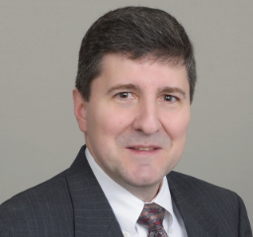
ABOUT
Professional Career:
Professional Engineer – Missouri
Boeing Company Associate Tech Fellow (St. Louis) - ~20 years
Lucent/Bell Labs - ~ 8 years
30+ years in airborne and terrestrial communications and sensors
Adjunct Instructor for Washington University in St. Louis
Education:
MSEE – Washington University in St. Louis
BSEE/BSCoE – University of Missouri
Personal:
Married to Verla w/2 Adult Children (Reagan and Madison)

Slide 3
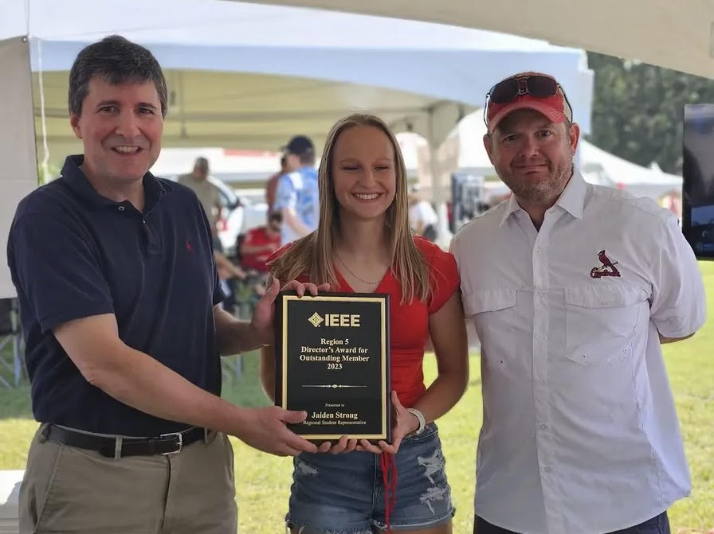
Volunteer activities
IEEE:
Senior Member of IEEE
HKN Member of IEEE
AESS, COMSOC and AP Member
Saint Louis Section Officer (2008-12)
Region 5 Treasurer (2014-17)
Washington University in St. Louis Branch Counselor (2014 - Current)
Region 5 Director, IEEE BOD, IEEE-USA, MGA VP (2022-23)
IEEE Audit Committee, Chair (2023), Past Chair (2024)
IEEE-USA Career and Professional Development Committee (2024)
IEEE TAB/PSPB Products and Services Committee MGA Appointed Rep. (2024)
Many other positions …
National Society of Professional Engineers:
Fellow
Chapter and State Officer
Board of Directors
Professional Engineers in Industry Chair

Slide 4
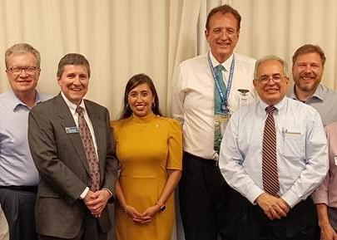
Acomplishments
As Treasurer, consistently kept 100% financial reporting compliance and rebate among all Sections
Led the Region out of the Covid Pandemic period to resume in person activities and conferences.
Region 5 hosting of the first IWRC Conference in Arkansas in 2023.
Launched the process to establish an engineering licensure pilot program with IEEE-USA and IEEE YP with the focus on using it as for recruitment and retention of YP Members.
As IEEE Audit Committee Chair, launched a Risk AdHoc to improve training and oversight of Enterprise Risk Compliance within IEEE.
Establishment of a twice a year virtual graduation ceremony for the past 2 years for all graduating undergraduate student members in the Region.

Slide 5
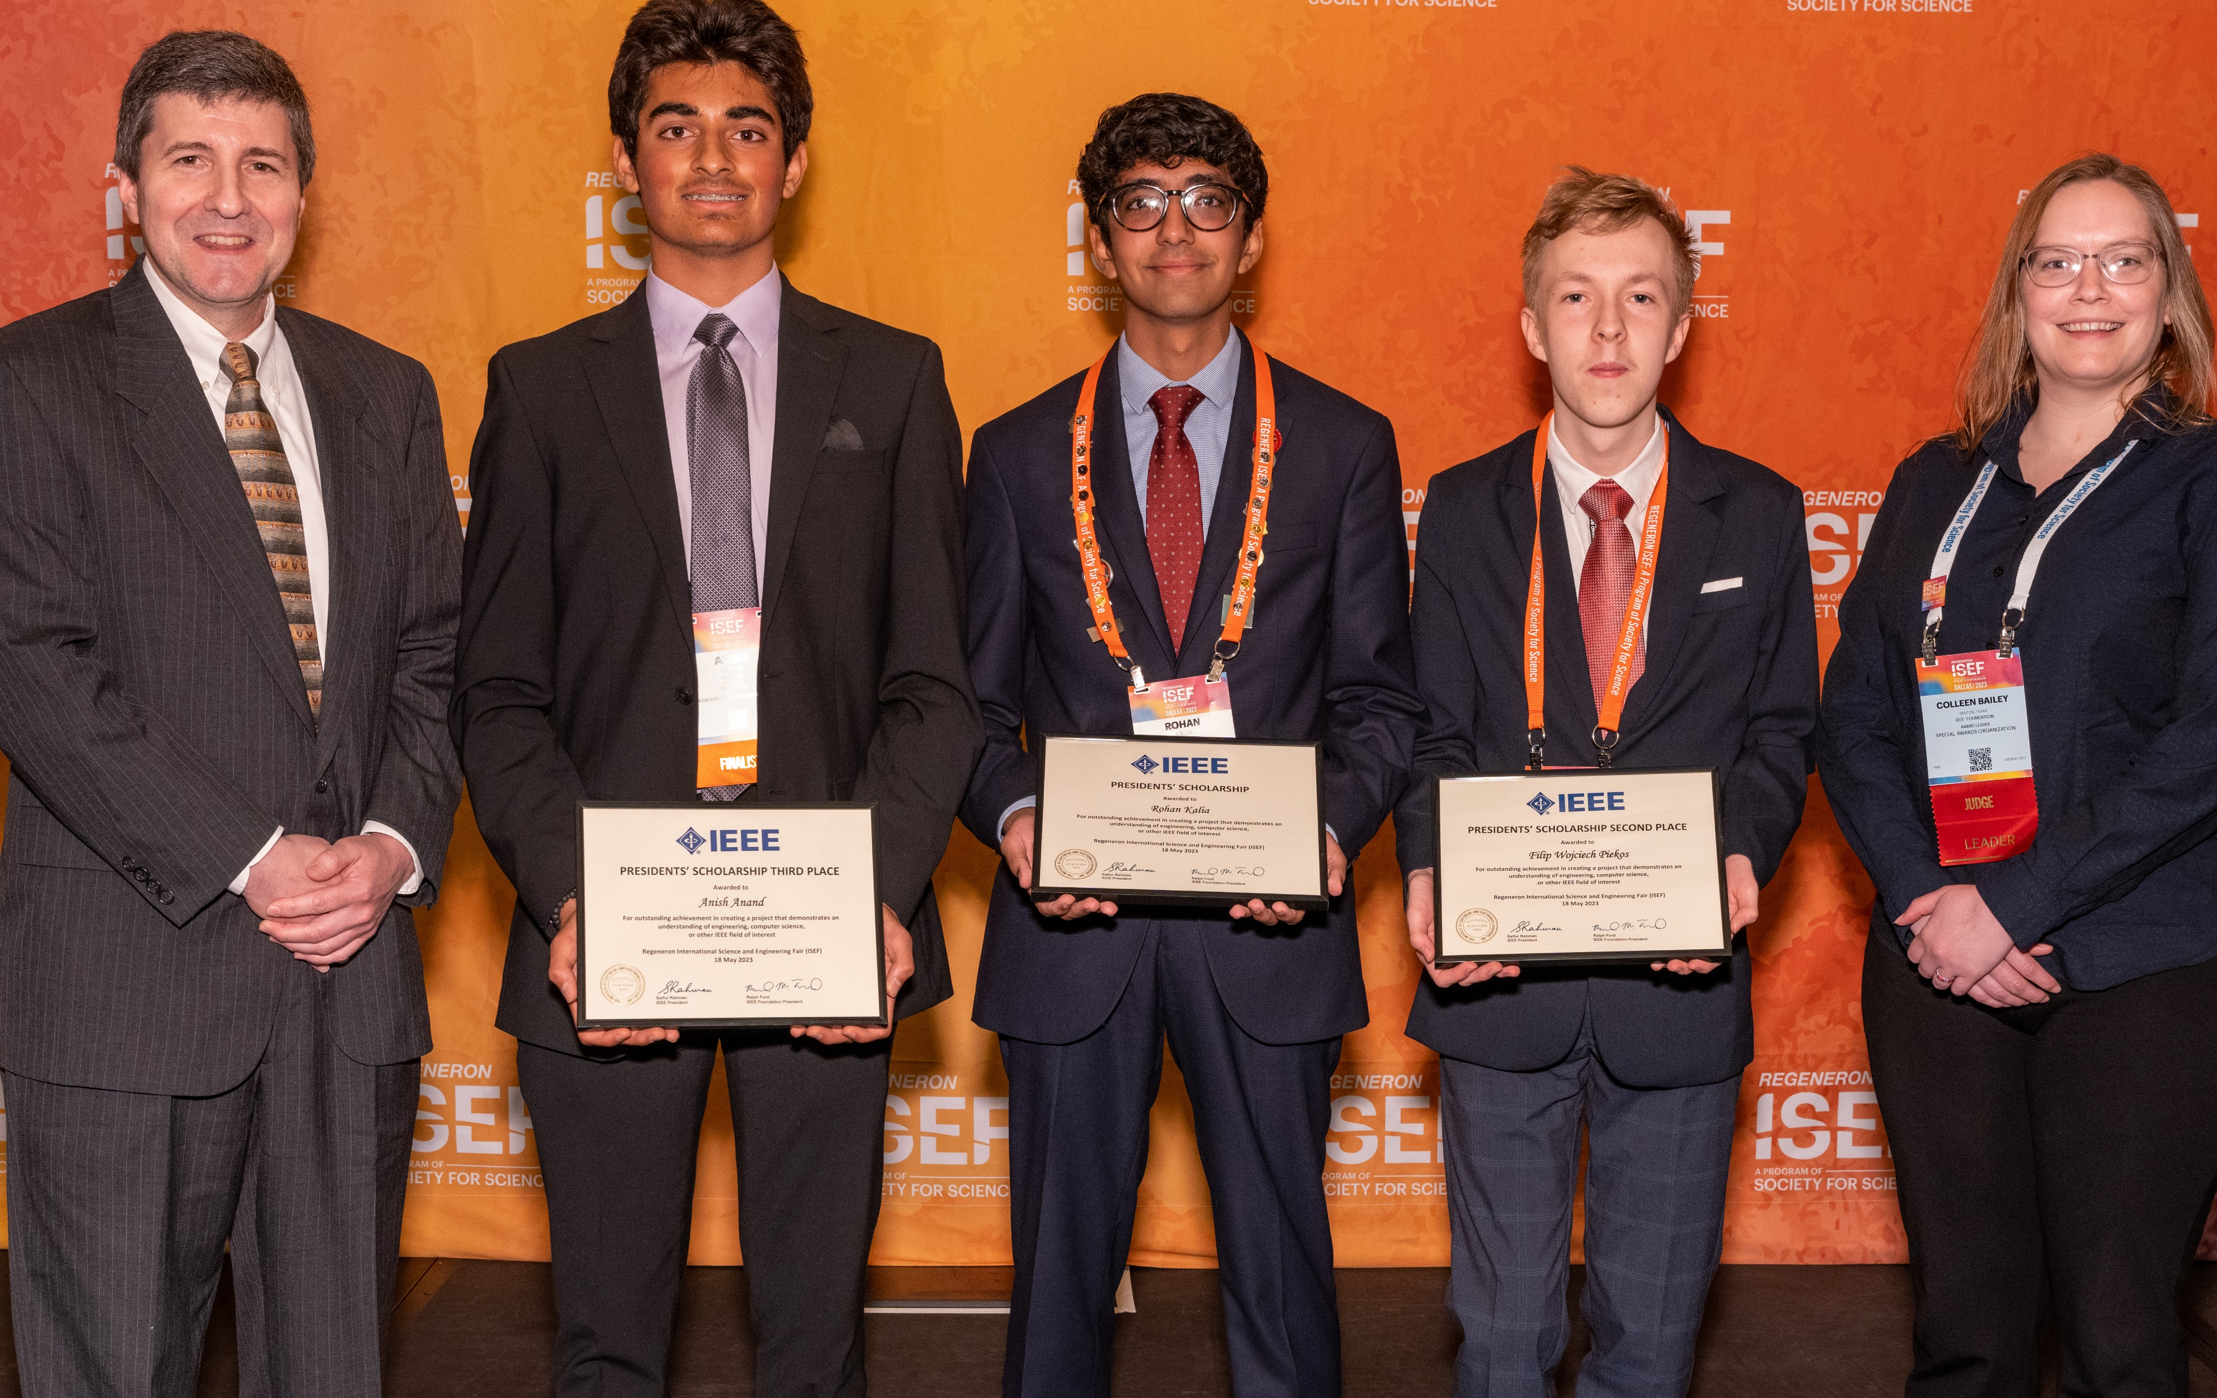
POSITIONS 1/2
Consultants Network engagement with semiconductor technology in the USA and NSPE Private Practice Interest Group.
K-12 and Student Member Education and Inspiration in careers related to Semiconductor Industry..
(Students) Establish a Student Led IEEE-USA branded student competition for use at at Branches, Sections and Region events to foster relations with branches. Perhaps cyber related competition.
Salary survey re-think.

Slide 6
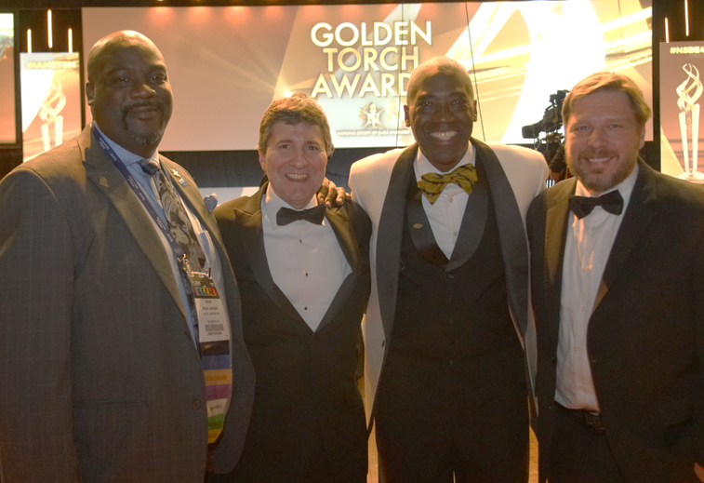
POSITIONS 2/2
(IEEE YP // IEEE-USA) Continue to develop the in person PE and FE Pilot instructor led program.
Stronger outreach with the GeoUnits by rebranding the Professional Activities Region Rep with an annual in person workshop.
Promote IEEE-USA to other Professional Societies through visits to the various Board of Directors.
Extend the IWRC Concept by focusing on aerospace and taking a more visible exposure at the Oshkosh Air Show as a marquee event.
Create a joint push from IEEE-USA for HKN induction and Senior Membership at events and general promotion of IEEE-USA to our members.

Slide 7
QUESTIONS

