Slide 1
IEEE-USA 2024
Keith Moore
2024 President, IEEE-USA

Slide 2
IEEE-USA Mission and Vision
Mission
“To recommend policies and implement programs specifically intended to serve and benefit the members, the profession, and the public in the United States in appropriate professional areas of economic, ethical, legislative, social and technology policy concern. “
Vision
“To serve the U.S. IEEE member by being the technical professional’s best resource for achieving lifelong career vitality and by providing an effective voice on policies that promote U.S. prosperity.”

Slide 3
CHIPS Act
Legislative efforts to protect funding
Programs to keep IEEE members informed
Webinars & conferences
On-going dialog with government agencies
Programs to take advantage of CHIPS programs
Workforce development
IWRC

Slide 4
IEEE-USA IWRC (Innovation, Workforce Resources Conference)
Bringing the 21st century tech-based economy to the entire country
Pulling together, in partnership with the NSF:
Small researchers & universities
Small businesses
Small government
Big government
CHIPS Act programs targeting rural America

Slide 5
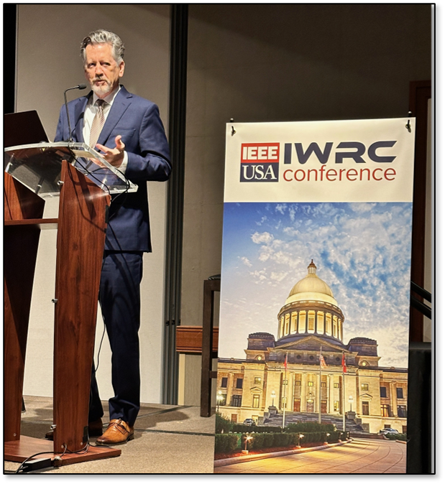
2024
South Dakota, early June
New Hampshire/Maine, early September
Alabama, TBA
Notes:
Speaker is Hugh McDonnald, Arkansas’ Sec. of Commerce

Slide 6
Enhanced Products
Improved Consultant Finder & products for consultants
Mini-conferences for industry
Designing Chips with CHIPS, San Diego
One-day industry event to help companies associated with chip manufacturing understand how the CHIPS Act will impact them
Webinars
Partnership with Stony Brook Univ: short videos for the general public
Soft-skills, life skills, leadership, ….

Slide 7
Public Imperatives
Activities designed to help the public, but not IEEE or its leaders, could be “public imperatives.”
The definition is, unfortunately, vague
The US government knows public imperatives when they see them
Currently, about 1.5% of IEEE’s operating budget is spent on public imperatives, which is very low

Slide 8
Public Policy
IEEE-supported efforts to help policy makers enact technically sound laws and regulations COULD be public imperatives if…
Educating policy makers about technology and its impact of society
Advocating for policies that would improve society
Advocating for policies that would help all technology professionals
Efforts that help just IEEE or IEEE members are not public imperatives …
Advocating for policies to strengthen IEEE’s publication or conferences businesses.
Advocating for benefits that only IEEE members can access

Slide 9
Examples of Public Imperatives
Pre-college activities designed to expose students to engineering
Publicly available webinars on engineering and the engineering profession
Public service projects providing electricity, internet connectivity, or other technology to disadvantaged communities
Mid-career professional support for the public to help people transition into engineering careers

Slide 10
IEEE-USA Public Imperatives
IEEE-USA historically produces many of IEEE’s US based public imperatives
Most products that can be accessed by the public for free or at a subsidized price
Webinars, eBooks, audio books, some consultant & PE content
Some advocacy work counts
Legislative work to create policies that benefit the general public count
Legislative work to benefit IEEE or IEEE members does not
FYI – 501(c)3 organizations can “lobby”

Slide 11
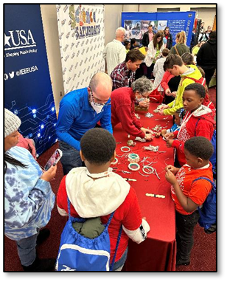
IEEE-USA Public imperatives
Publicly available webinars on patent law, retirement planning, building a career in technology and other topics of value to technologists
Help preparing professional licensure exams
K-12 STEM education programs
MOVE Truck
Employment reports & data
eBooks and audio books on technology and technologists

Slide 12
9-16 September 2024
SEATTLE | SITKA | SKAGWAY
JUNEAU | VICTORIA, BC
Join us on a bucket-list, 7-night cruise to the breath-taking scenery of Alaska, aboard Royal Caribbean’s Quantum of the Seas, featuring entertainment, exploration, networking, learning and so much more.
BOOK NOW for best rates and availability!
cruise.ieeeusa.org

Slide 13
Keith Moore 2024 IEEE-USA President keith.moore@ieee.org

