Slide 1
No Borders – Finding your home in IEEE Technical Activities
March 2024
Fred Schindler, VP Technical Activities
m.schindler@ieee.org

Slide 2
IEEE Organization
M E M B E R S
Board of Directors (BoD)
Assembly
MGA
TAB
PSPB
EAB
SA
IEEE-USA
ED
Member and Geographic Activities
Board
Technical Activities
Board
Publication Services and Products Board
Educational Activities Board
Standards Association
IEEE USA
Executive Director
10 Regions
10 Divisions
Staff & Society Executive Directors/
Administrators
Sections & Geographic Councils
Societies & Technical Councils
Chapters
ta.ieee.org

Slide 3
Finding my home in MGA

Slide 4
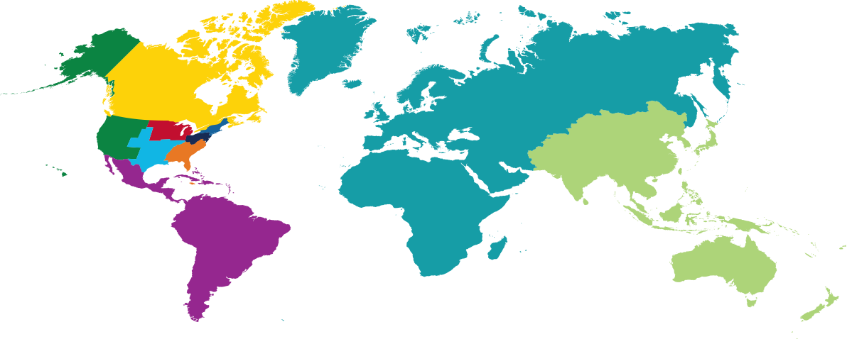
IEEE Regions
2024
Credit: https://www.ieee.org/communities/regional-world-map.html

Slide 5
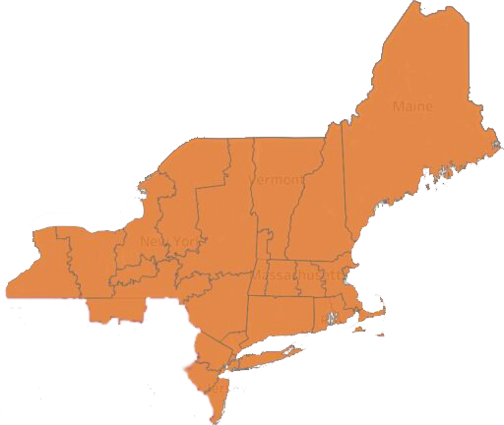
IEEE Region 1
2024
Credits: https://ieeer1.org/sections/
https://brand-experience.ieee.org/guidelines/sub-brand-resources/ieee-sections-raise-your-flags/

Slide 6
Finding my home in TA

Slide 7
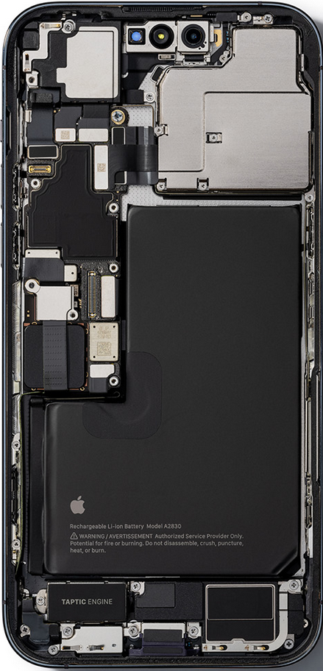
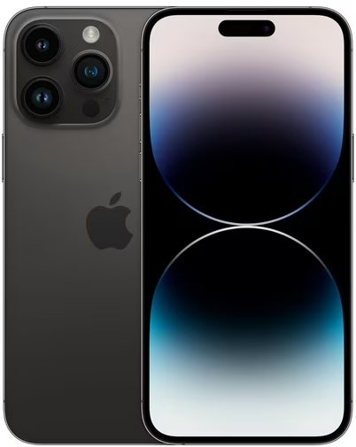
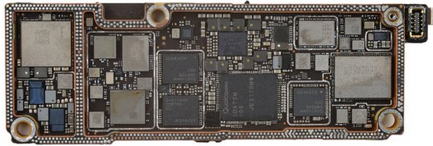
What is my Technical Area?
Front End Modules
RF Semiconductor product development
Developing Front End Modules for Smartphones
Contain:
- GaAs PAs
- SOI switches
- CMOS controller
- Acoustic Filters
source: ifixit.com

Slide 8
Technical Activities: 47 Societies and Technical Councils
There are no hard borders in IEEE Technical Activities

Slide 9
Divisions
I II III IV V&VIII VI VII IX X

Slide 10
Finding your place in Technical Activities

Slide 11
Technical Activities: 47 Societies and Technical Councils
Review the Fields of Interest
https://ta.ieee.org/operations/governing-documents

Slide 12
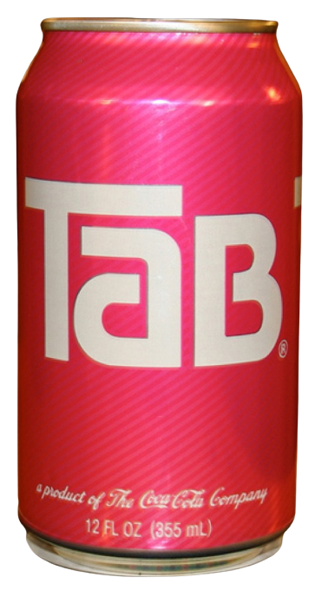
What’s in TAB? (Technical Activities Board)
Ingredients – Societies (39), Technical Councils (8), Division Directors (10), VPs (3), IEEE Conferences Committee Chair, Periodicals Committee Chair, Products and Services Committee Chair
Sugar free!

Slide 13
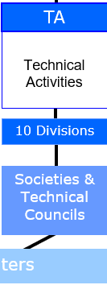
What’s in Technical Activities?
Societies
Technical Councils
Technical Communities
Future Directions
Initiatives
Roadmaps
Strategic Programs
Committees
Conferences
Periodicals
PSC
TMC
SPC
…
391,074 memberships

Slide 14
TA Programs, Incubation, Initiatives and Resources
Strategic Programs
IEEE Entrepreneurship
IEEE TechEthics
TA Climate Change
TA Diversity, Equity and Inclusion
Coordination with MGA Affinity Groups:
Future Directions Initiatives
Resources & Platforms
IEEE Resource Centers – education
IEEE DataPort – platform for data and project ideas
ta.ieee.org
Notes:
Program Mission: coordination, amplification, and aggregation as well as programmatic gap analysis across all of TA.

Slide 15
Technical Communities in TA - Future Directions
2023
2024
Became Quantum TC managed by Computer Society in 2024
Wireless Power Technologies
Wireless Power Technologies**
AI Coalition**
**
New Initiative 1
**
New Initiative 2
Global Semiconductors
Ad Hoc**
TechNav AI
Global Semiconductors
Ad Hoc
TechNav AI
**New in 2023
ieee.org/futuredirections
**New in 2024
15

Slide 16
IEEE Organization
M E M B E R S
Board of Directors (BoD)
Assembly
MGA
TAB
PSPB
EAB
SA
IEEE-USA
ED
Member and Geographic Activities
Board
Technical Activities
Board
Publication Services and Products Board
Educational Activities Board
Standards Association
IEEE USA
Executive Director
10 Regions
10 Divisions
What technical local communities do you have?
Build (joint) chapters for them.
Staff & Society Executive Directors/
Administrators
Sections & Geographic Councils
Societies & Technical Councils
Technical and Geographic organizations
Chapters
ta.ieee.org

Slide 17
It’s a complex organization
With something for everyone

Slide 18
IEEE Technical Activities
Technical diversity
There is a community for almost everyone
Societies, Councils, TC’s
Dedicated volunteers, rich traditions
Technical content – periodicals and conferences
What if there isn’t a community that suits your needs?
Create one – TC’s, Future Directions, within Societies & Councils

Slide 19
A Collaboration
Improve collaboration and amplify Impact in an ever
more interdisciplinary world
Societies & Technical Councils and beyond

Slide 20
Goal: TAB-wide, IEEE-wide activity
Joint Conference
Plan in 2024, hold in 2025
Work with IEEE Conferences Committee’s (ICC) Event Innovations and Enhancements Committee
A produced event (similar to Convene)
No call for papers
Invited content – the best from across TA
Complementary outside content
Planned topic – Clean Tech Solutions

Slide 21
CleanTech Solutions – Event Outline
Target a produced event in 2025
Short term goals
Outreach, build team, identify leaders
Identify operating (sponsoring) entity
Survey content and activities with TAB and IEEE
Target date and location
Invited contributions from within IEEE (Societies, Councils, Communities, Georgraphies etc.) and outside IEEE
An opportunity for Societies and Councils to collaborate
Not a scholarly event with contributed papers etc.
Curated event, similar to Convene
Audience and outcome focused

