Slide 1
Region 2 Update, Spring 2024
Drew Lowery, Region 2 Director

Slide 2
Who am I? Drew Lowery, Ph.D., SM-IEEE-HKN
E-mail: dlowery@ieee.org
Phone: +1 (301) 697-7199
LinkedIn: www.linkedin.com/in/drewlowery
Engineer. Educator. Innovator.
Member of IEEE since 2001 and active volunteer since 2015
Region 2 Director
Past Region 2 RSAC, Past Pittsburgh Section Chair
Have worked in academia (teaching and research), transportation industry, and start-up companies.

Slide 3
2024 Priorities
Local Activities and Region Realignment Activities: Recognize and share the best of Section activities through an initiative that helps to capture activity in one section that can be used in another Region Realignment Activities this year will focus on joint opportunities in the areas of Professional Activities and Young Professionals.
Training and Leadership Continuity: Develop and roll-out training for section and region officers. Outline and establish a leadership pipeline for current and future volunteers in local sections.
Financial Transparency and Growth: Regional funds support all members, and members should be easily able to see how funds are being, and planned on being, used. Changes in membership seem to be on the forefront of everyone’s mind, the Region needs to investigate additional sources of income, including actively growing our conference portfolio.

Slide 4
Who is Region 2?
United States, Mid-Atlantic

Slide 5
Who is Region 2?
Membership by Technology Focus, Grade

Slide 6
Who is Region 2?
Membership by Society/Affinity Group
 | % of Total | Quantity
IEEE Young Professionals | 19.32% | 4165
IEEE Computer Society Membership | 14.25% | 3073
IEEE Power & Energy Society Membership | 8.11% | 1748
IEEE Communications Society Membership | 6.53% | 1408
IEEE Signal Processing Society Membership | 4.22% | 910
IEEE Robotics and Automation Society Membership | 3.45% | 743
IEEE Antennas and Propagation Society Membership | 2.79% | 602
IEEE Microwave Theory and Technology Society Membership | 2.72% | 587
IEEE Aerospace and Electronic Systems Society Membership | 2.63% | 566
IEEE Industry Applications Society Membership | 2.61% | 563

Slide 7
Regional Realignment Update
Region 1/2 Updates
2023 Alignment
Joint regional committee meetings
Alignment on Secretary role (same format on messages and minutes)
Start joint activities within Student Activities, Women in Engineering AG committees
2024 Alignment
Alignment on Treasurer role (same format on budgets)
Alignment on stand
Start Joint activities within Professional Activities and Young Professional AG committees
2025 Alignment (future activities)
Bylaw (draft) creation for joint region
Communication plan
Working towards joint regions before January 2028!

Slide 8
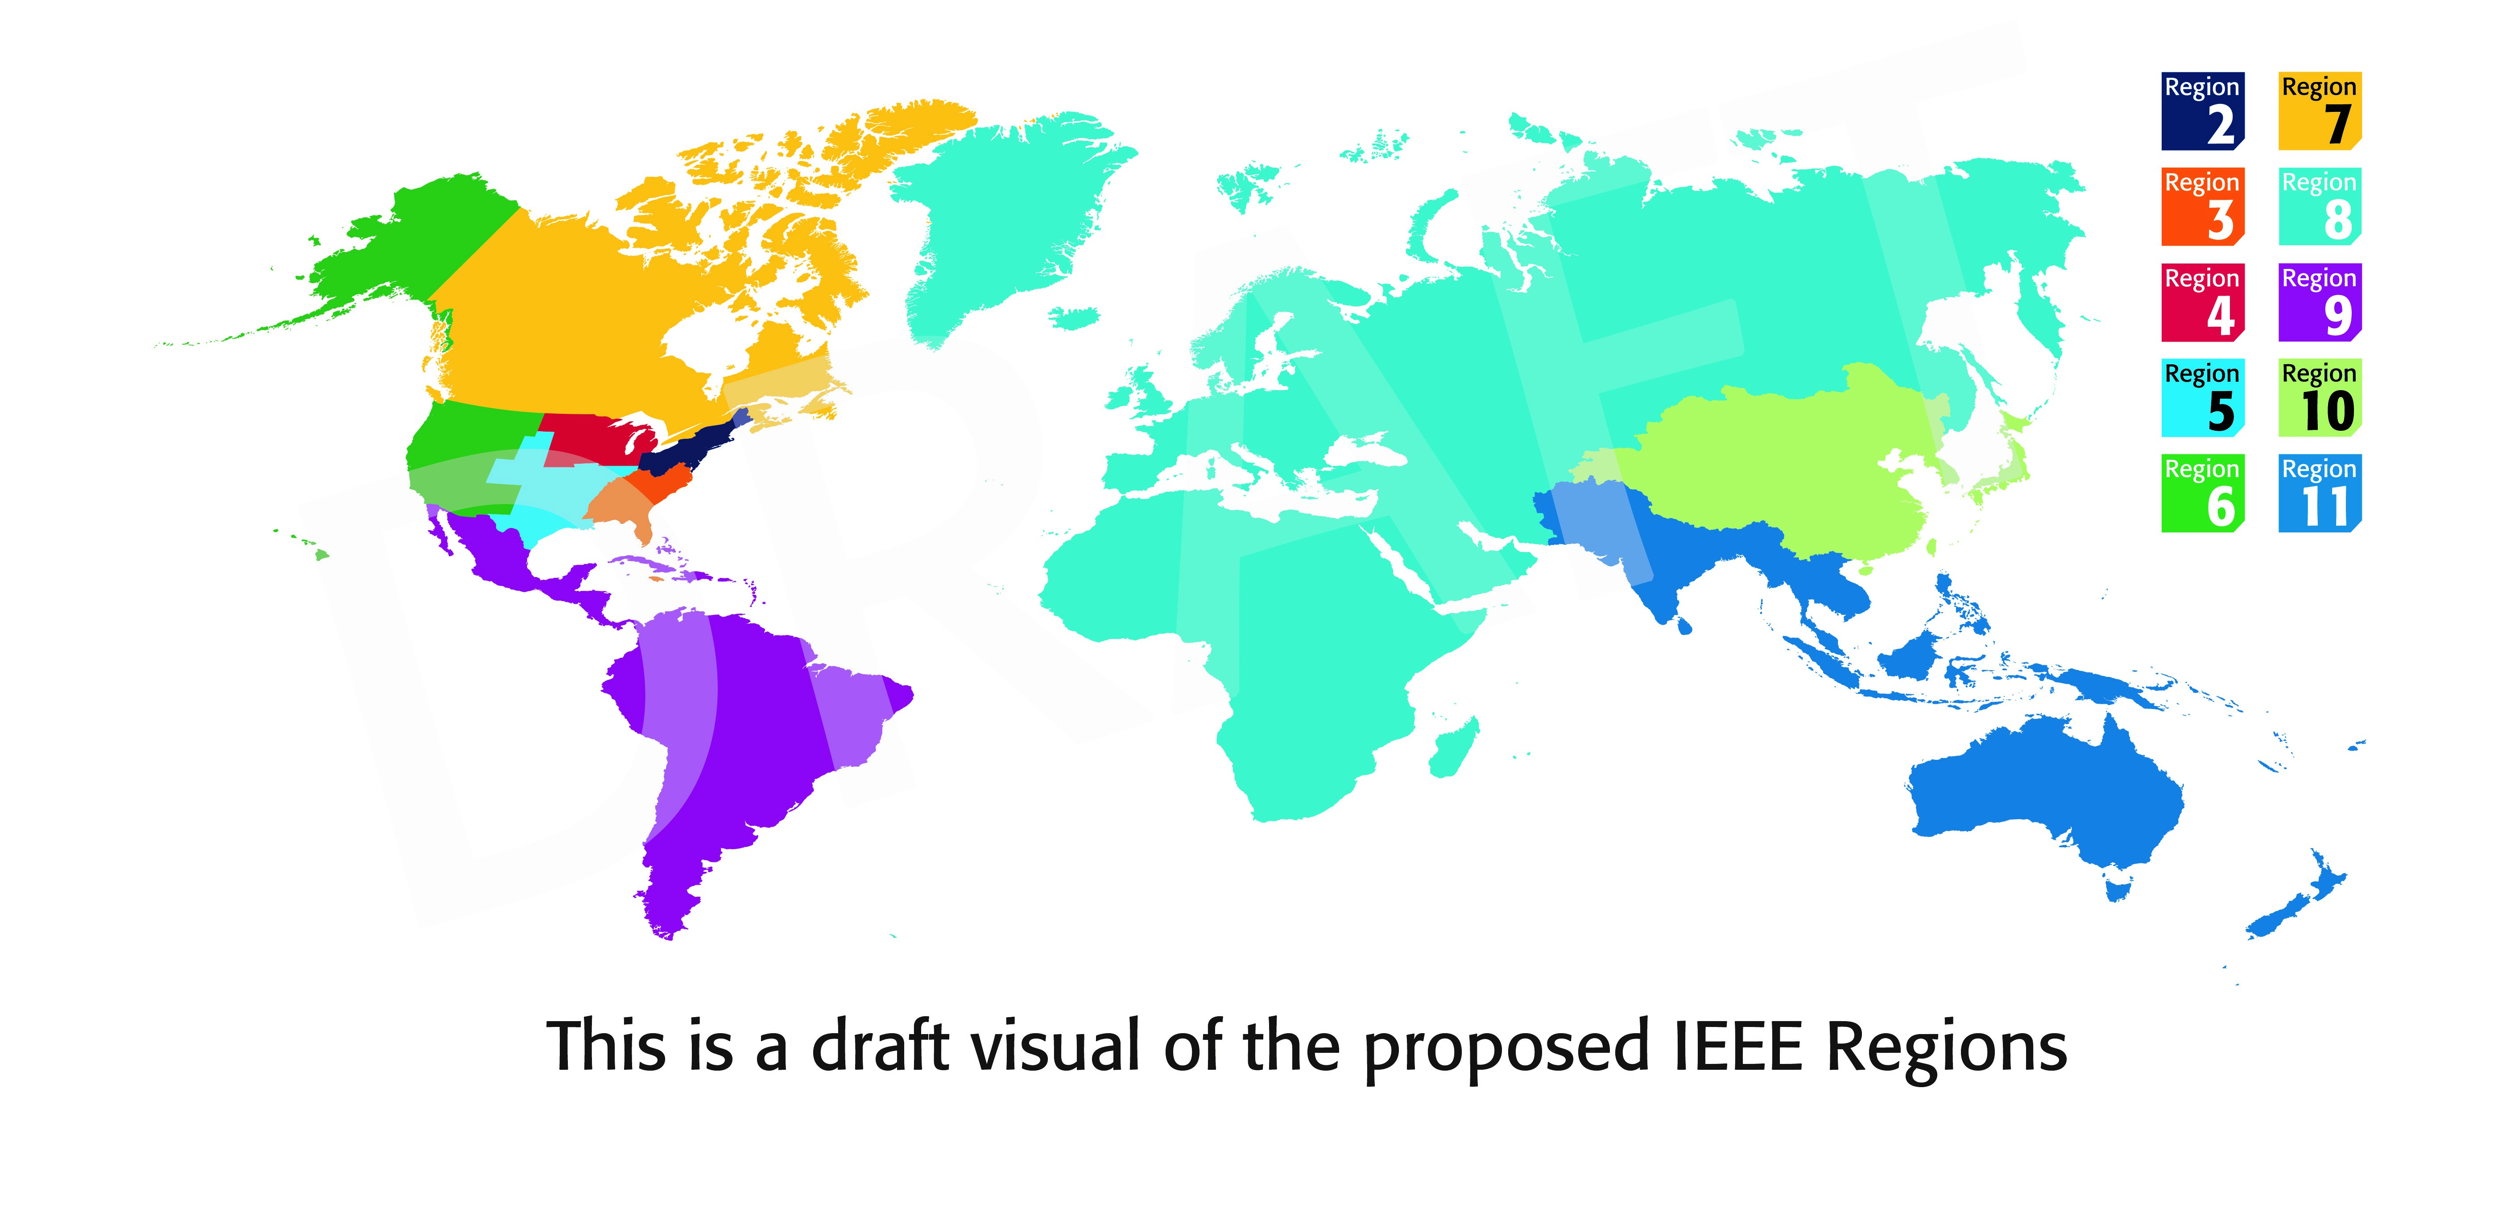
Regional Realignment Update
Future IEEE Regional Map (January 2028)

Slide 9
Questions? Comments?
Please feel free to reach out to me!

Slide 10
Who is Region 2?
Leadership Team

Slide 11
Who is Region 2?
Jim Beck
Area Chair
Executive Committee
Drew Lowery
Region Director
Neeta Basantkumar
Secretary
Chang Liu
Area Chair
Felicia Reinhart
Director-elect
Barb Frantom
Treasurer
Richard Jessop
Area Chair
Barry Tilton
Past Director
Li Bai
Student Activities
Joe Kalasky
Professional Activities

Slide 12
Engagement in Conferences
Technical Conferences in Region 2
2024 IEEE Power & Energy Society Innovative Smart Grid Technologies Conference
19 - 22 February 2024 | Washington, District of Columbia, USA | Event Format: In-person
Sponsors: IEEE Power & Energy Society
2024 IEEE R1/ R2 Joint Student Activities Conference
5 - 7 April 2024 | Villanova, Pennsylvania, USA | Event Format: In-person
Sponsors: Region 01- Northeastern USA; Region 02 - Eastern USA
2024 17th Specialist Meeting on Microwave Radiometry and Remote Sensing for the Environment
8 - 11 April 2024 | Alexandria, Virginia, USA | Event Format: In-person
Sponsors: IEEE Geoscience and Remote Sensing Society
2024 Integrated Communications, Navigation and Surveillance Conference
23 - 25 April 2024 | Herndon, Virginia, USA | Event Format: In-person
Sponsors: American Institute of Aeronautics and Astronautics - AIAA; IEEE Aerospace and Electronic Systems Society
2024 IEEE International Symposium on Hardware Oriented Security and Trust
6 - 9 May 2024 | Tysons Corner, Virginia, USA | Event Format: In-person
Sponsors: IEEE Computer Society
2024 IEEE 8th International Conference on Fog and Edge Computing
6 - 9 May 2024 | Philadelphia, Pennsylvania, USA | Event Format: In-person
Sponsors: IEEE Computer Society
2024 IEEE 24th International Symposium on Cluster, Cloud and Internet Computing
13 - 14 May 2024 | Philadelphia, Pennsylvania, USA | Event Format: In-person
Sponsors: IEEE Computer Society
2024 IEEE International Symposium on Dynamic Spectrum Access Networks
13 - 16 May 2024 | Washington, District of Columbia, USA | Event Format: In-person
Sponsors: IEEE Communications Society
2024 IEEE World Forum on Public Safety Technology
14 - 15 May 2024 | Herndon, Virginia, USA | Event Format: Hybrid (In-person and Virtual)
Sponsors: Future Directions Committee
2024 Annual Modeling and Simulation Conference
20 - 23 May 2024 | Washington, D.C., District of Columbia, USA | Event Format: In-person
Sponsors: Association for Computing Machinery - ACM; IEEE Computer Society; Society for Modeling and Simulation Int.
2024 International Conference on Smart Grid Synchronized Measurements and
Analytics
21 - 23 May 2024 | Washington, District of Columbia, USA | Event Format: In-person
Sponsors: IEEE Industrial Electronics Society; IEEE Industry Applications Society; IEEE
Instrumentation and Measurement Society; IEEE Power & Energy Society;
International Council on Large Electric Systems - CIGRE; SGSMA Association, LLC
2024 IEEE IAS Pulp and Paper Industry Conference
9 - 13 June 2024 | Charleston, West Virginia, USA | Event Format: In-person
Sponsors: IEEE Industry Applications Society

Slide 13
Engagement in Conferences
Technical Conferences in Region 2
2024 IEEE/MTT-S International Microwave Symposium
16 - 21 June 2024 | Washington, District of Columbia, USA | Event Format: In-person
Sponsors: IEEE Microwave Theory and Technology Society
2024 IEEE Radio Frequency Integrated Circuits Symposium
16 - 18 June 2024 | Washington, District of Columbia, USA | Event Format: In-person
Sponsors: IEEE Electron Devices Society; IEEE Microwave Theory and Technology Society; IEEE Solid-State Circuits Society
2024 IEEE/ACM Conference on Connected Health: Applications, Systems and
Engineering Technologies
19 - 21 June 2024 | Wilmington, Delaware, USA | Event Format: In-person
Sponsors: Association for Computing Machinery - ACM; IEEE Computer Society
2024 103rd ARFTG Microwave Measurement Conference
21 June 2024 | Washington, District of Columbia, USA | Event Format: In-person
Sponsors: Automatic RF Techniques Group - ARFTG; IEEE Microwave Theory and Technology Society
2024 Device Research Conference
24 - 26 June 2024 | College Park, Maryland, USA | Event Format: In-person
Sponsors: Device Research Conference, Inc.; IEEE Electron Devices Society
2024 IEEE Cloud Summit
27 - 28 June 2024 | Washington, District of Columbia, USA | Event Format: In-person
Sponsors: IEEE Computer Society
2024 IEEE International Professional Communication Conference
14 - 17 July 2024 | Pittsburgh, Pennsylvania, USA | Event Format: In-person
Sponsors: IEEE Professional Communication Society
2024 IEEE National Aerospace and Electronics Conference
15 - 18 July 2024 | Dayton, Ohio, USA | Event Format: In-person
Sponsors: Dayton Section; University of Dayton
2024 IEEE AUTOTESTCON
26 - 29 August 2024 | National Harbor, Maryland, USA | Event Format: In-person
Sponsors: IEEE Aerospace and Electronic Systems Society; IEEE Instrumentation and
Measurement Society
2024 IEEE 69th Holm Conference on Electrical Contacts
6 - 10 October 2024 | Annapolis, Maryland, USA | Event Format: In-person
Sponsors: IEEE Electronics Packaging Society
2024 IEEE Secure Development Conference
7 - 10 October 2024 | Pittsburgh, Pennsylvania, USA | Event Format: Hybrid
Sponsors: IEEE Computer Society
2024 IEEE Frontiers in Education Conference
13 - 16 October 2024 | Washington, District of Columbia, USA | Event Format: In-person
Sponsors: ASEE Educational Research Methods Division; IEEE Computer Society; IEEE
Education Society
2024 IEEE International Professional Communication Conference
14 - 17 July 2024 | Pittsburgh, Pennsylvania, USA | Event Format: In-person
Sponsors: IEEE Professional Communication Society
2024 IEEE National Aerospace and Electronics Conference
15 - 18 July 2024 | Dayton, Ohio, USA | Event Format: In-person
Sponsors: Dayton Section; University of Dayton

Slide 14
Engagement in Conferences
Technical Conferences in Region 2
2024 IEEE AUTOTESTCON
26 - 29 August 2024 | National Harbor, Maryland, USA | Event Format: In-person
Sponsors: IEEE Aerospace and Electronic Systems Society; IEEE Instrumentation and
Measurement Society
2024 IEEE 69th Holm Conference on Electrical Contacts
6 - 10 October 2024 | Annapolis, Maryland, USA | Event Format: In-person
Sponsors: IEEE Electronics Packaging Society
2024 IEEE Secure Development Conference
7 - 10 October 2024 | Pittsburgh, Pennsylvania, USA | Event Format: Hybrid
Sponsors: IEEE Computer Society
2024 IEEE Frontiers in Education Conference
13 - 16 October 2024 | Washington, District of Columbia, USA | Event Format: In-person
Sponsors: ASEE Educational Research Methods Division; IEEE Computer Society; IEEE
Education Society
2024 IEEE Digital Platforms and Societal Harms
14 - 15 October 2024 | Washington, District of Columbia, USA | Event Format: Hybrid Sponsors: IEEE Computer Society; IEEE Society on Social Implications of Technology;
Northern Virginia/Washington Jt. C Chapter
2024 International Symposium on Networks, Computers and Communications
22 - 25 October 2024 | Washington DC, District of Columbia, USA | Event Format: Hybrid Sponsors: IEEE Communications Society; Tunisian Wireless Communications Society
2024 IEEE Military Communications Conference
28 October - 1 November 2024 | Washington, D.C., USA | Event Format: In-person
Sponsors: IEEE Communications Society
2024 IEEE 10th International Conference on Collaboration and Internet Computing
28 - 30 October 2024 | Washington, District of Columbia, USA | Event Format: In-person
Sponsors: IEEE Computer Society
2024 IEEE 6th International Conference on Trust, Privacy and Security in
Intelligent Systems, and Applications
28 - 30 October 2024 | Washington, District of Columbia, USA | Event Format: In-person
Sponsors: IEEE Computer Society
2024 IEEE 6th International Conference on Cognitive Machine Intelligence
28 - 31 October 2024 | Washington, District of Columbia, USA | Event Format: In-person
Sponsors: IEEE Computer Society
2024 IEEE 11th Workshop on Wide Bandgap Power Devices & Applications
4 - 6 November 2024 | Dayton, Ohio, USA | Event Format: In-person
Sponsors: IEEE Electron Devices Society; IEEE Power Electronics Society; Power Sources
Manufacturers Association
2024 IEEE International Conference on Big Data
15 - 18 December 2024 | Washington, District of Columbia, USA | Event Format: In-person
Sponsors: IEEE Computer Society; International Society of Big Data and Bioinformatics

