Slide 1
Region 6 Overview
Kathy Herring Hayashi, IEEE Director Region 6
Region 3 Meeting, Atlanta Georgia - March 2024

Slide 3
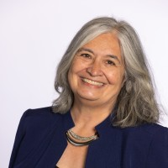
Meet the R6 Director
IEEE R6 Director, Kathy Herring Hayashi
Member IEEE Board of Directors, IEEE USA Board, IEEE MGA Board, IEEE Assembly
Region 6 Director 2023-2024.
From San Diego, CA working at Qualcomm, Inc
Chair IEEE Ad Hoc on Semiconductors
Member IEEE Global Public Policy, Public Visibility, Future Directions
IEEE Standards P1364 WG on HW IPSEC
Previous recipient of MGA Innovation Award, SD Women of Influence in Engineering, Athena Pinnacle Award , Dr. Thomas Avolt Kanneman Award
IEEE R6 Director, Kathy Herring Hayashi

Slide 4
Region Volunteers

Slide 5
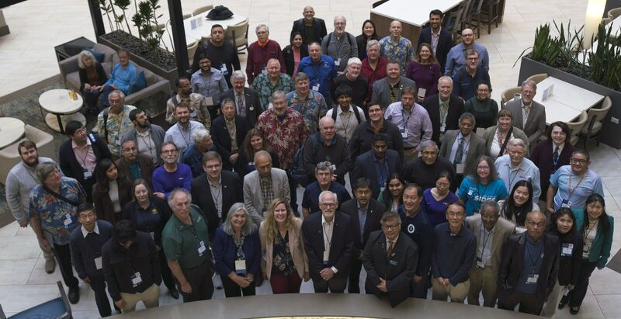
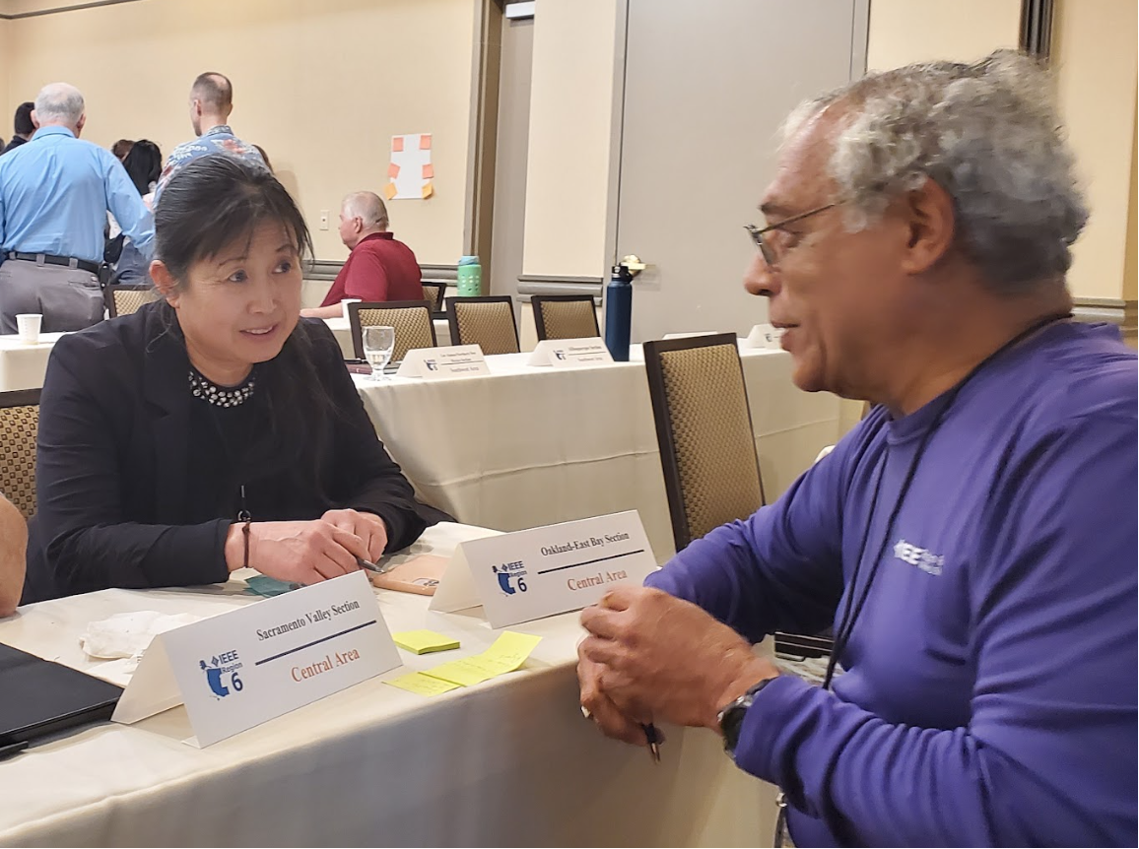
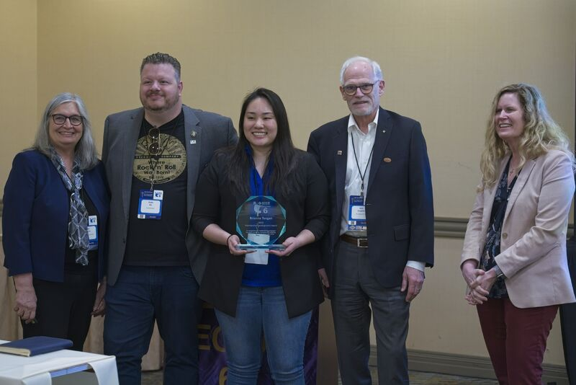
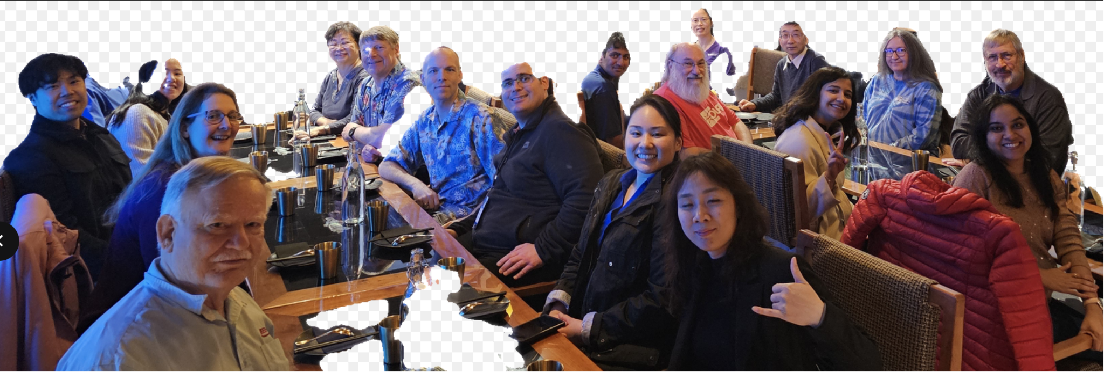
Region 6 Seattle OpCOM 2024

Slide 6
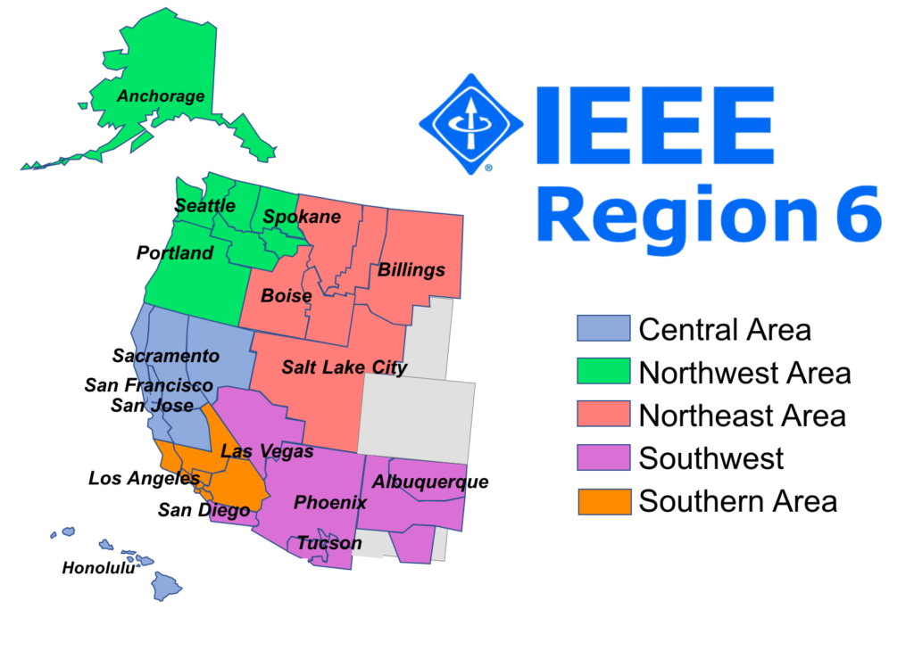
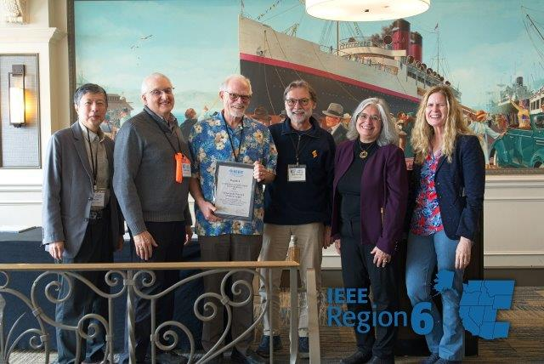
Region 6 Areas
Region 6 Overview
Region 6 Director
5 Area Chairs
35 Section Chairs

Slide 7
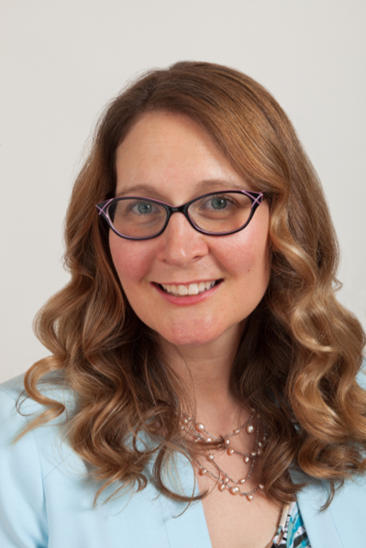
Region 6 Volunteers

Slide 8
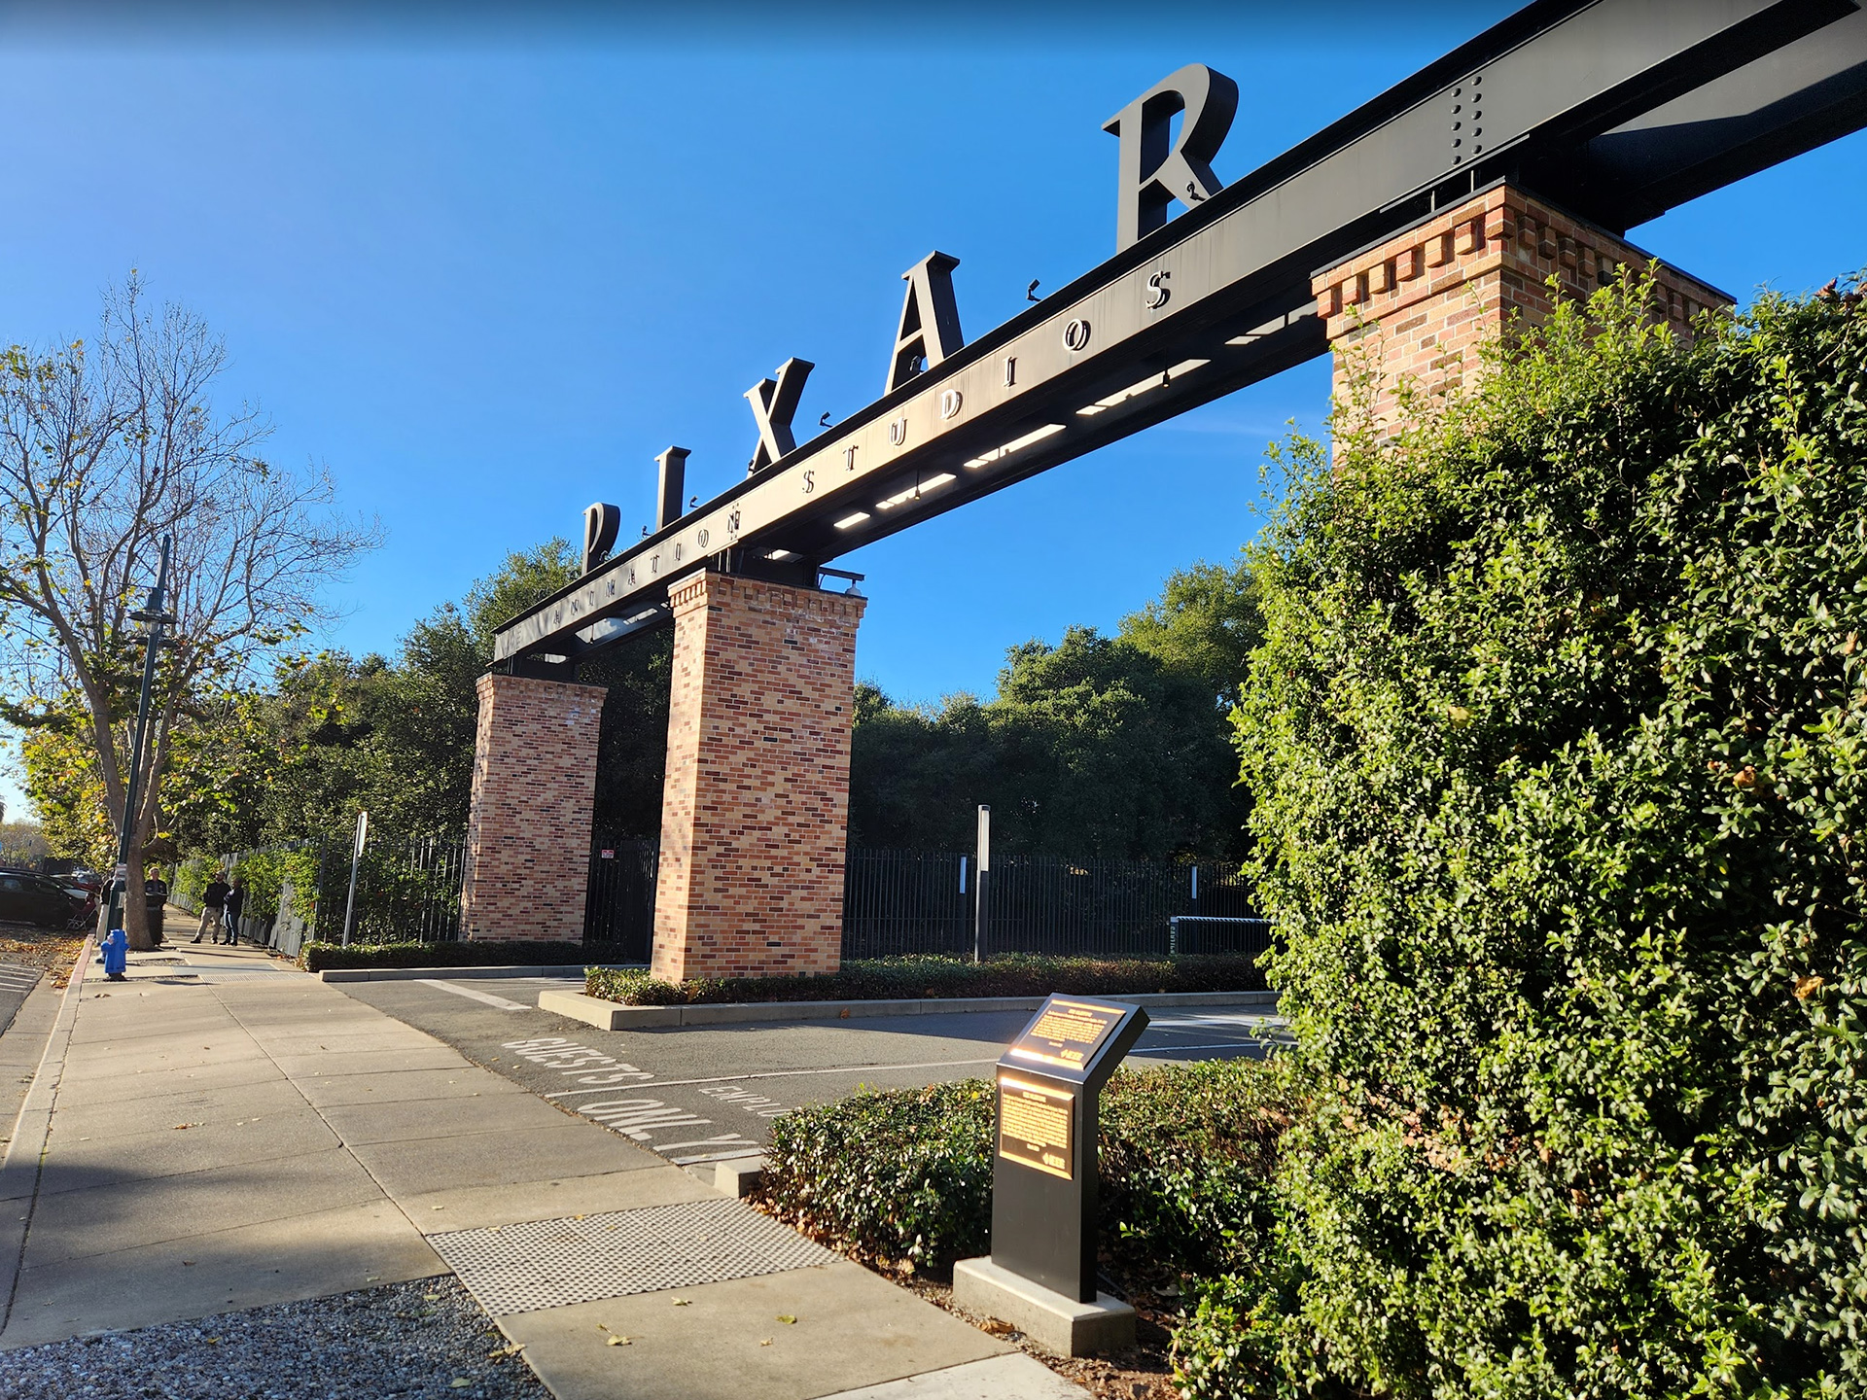
California - Milestones
IEEE Milestone: Pixar Renderman

Slide 9
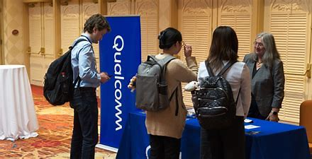
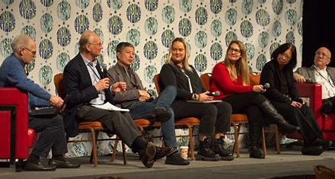
Nevada - Rising Stars Conference
Students and Young Professionals

Slide 10
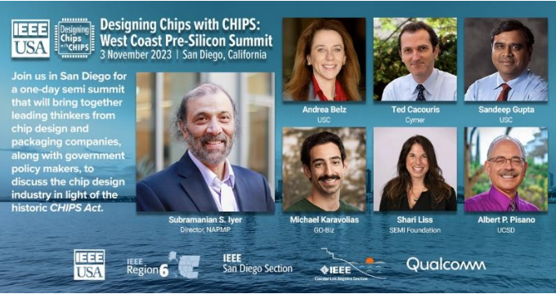
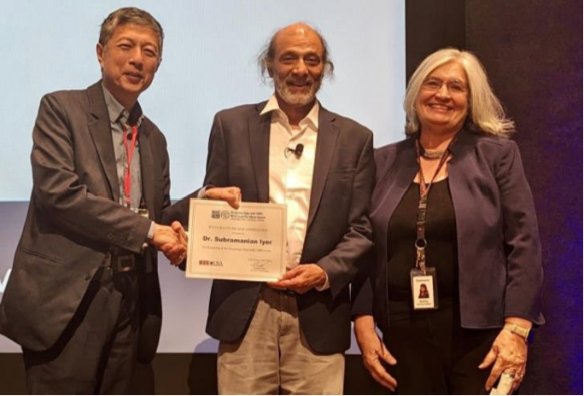
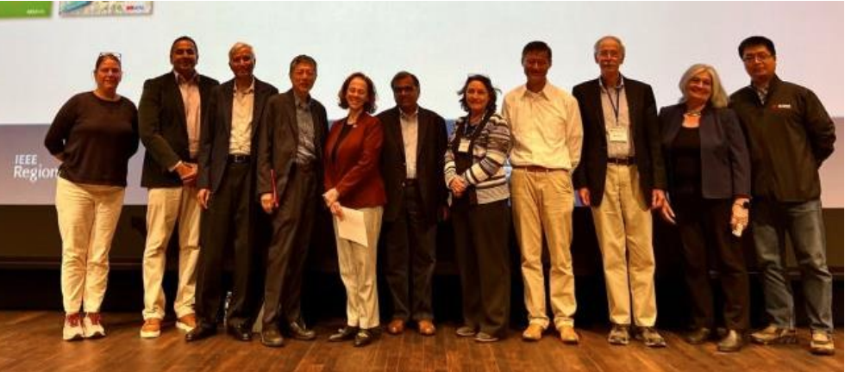
California - Designing Chips with CHIPS

Slide 11
Oregon - Sustech Conference
10th Anniversary of SusTech - Sustainability Conference

Slide 12
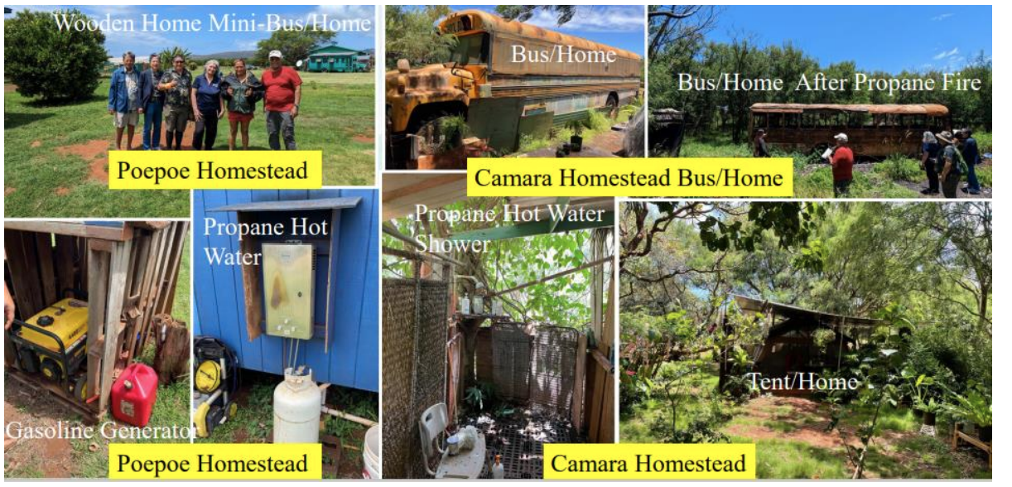
Hawaii - Sustainability
Molokai Energy Sustainability Project

Slide 13
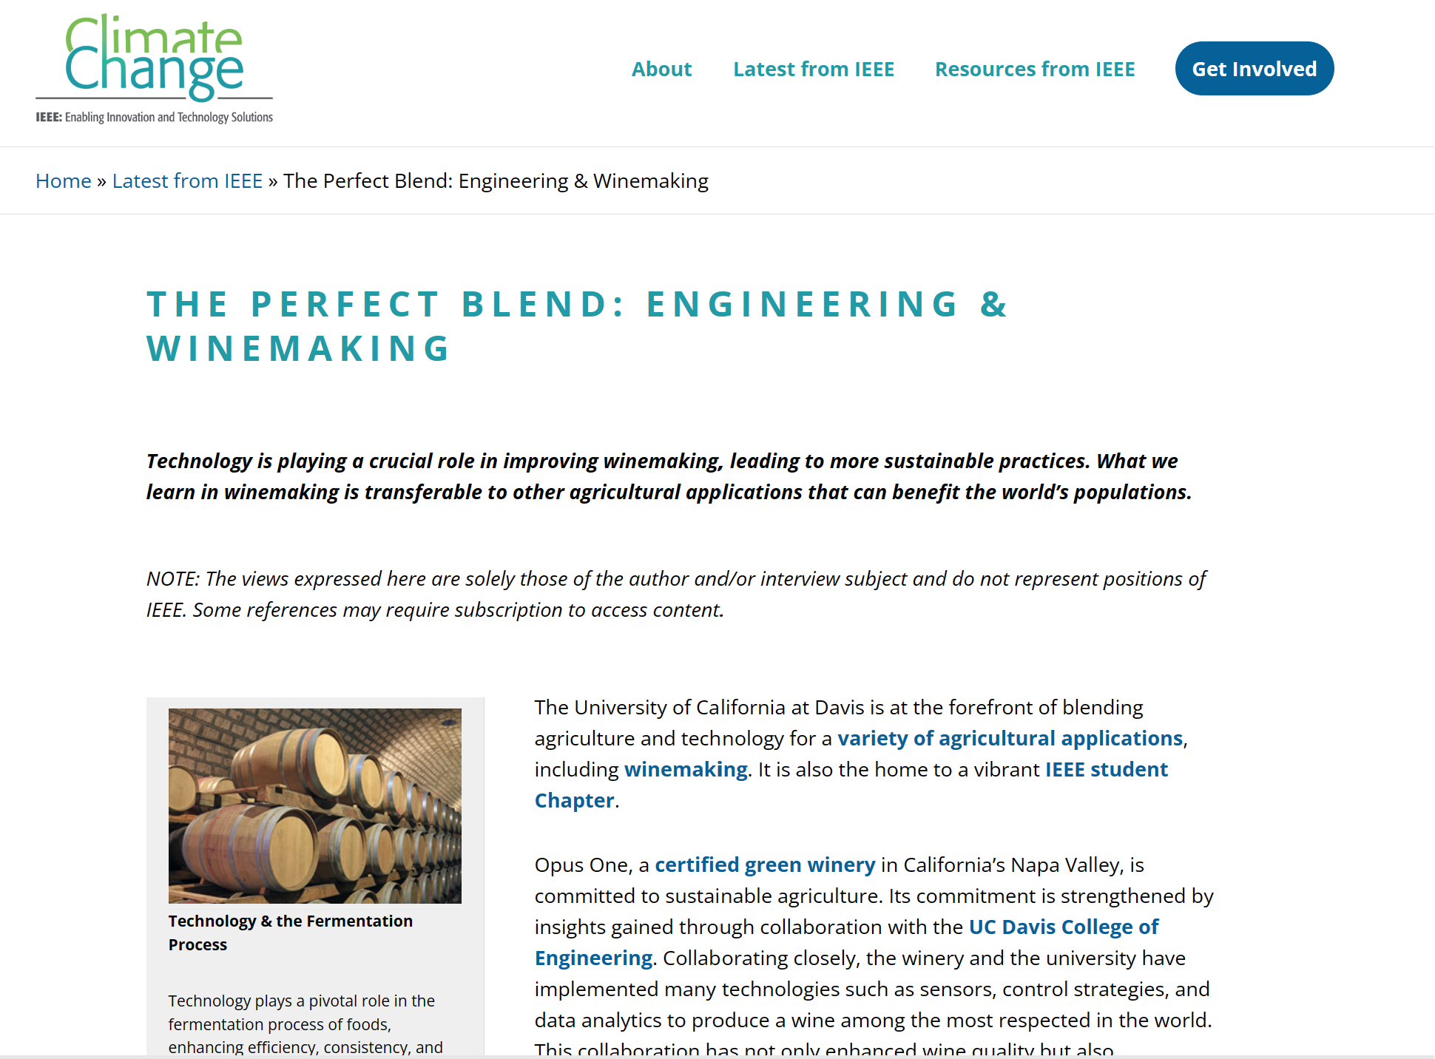
Climate Change - Sustainability
OPUS One - Napa Valley

Slide 14
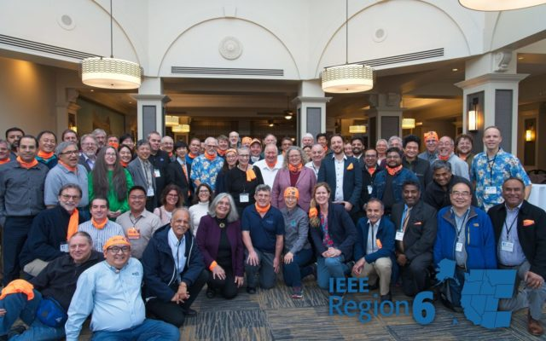
Region 6 2024 OpCom - March 15-17th, Seattle
R6 OPCOM
This is the annual meeting for Region 6. All R6 section chairs should attend (Region will support the section chair’s attendance) and please consider sponsoring others from your section to attend.
What to expect:
Meet the Area Chairs and other Section Chairs
Workshops on tools, best practices and more
Presentations by leads on IEEE’s overall 2024 Goals and the Region’s Goals and Objectives
Networking with R6 and IEEE leaders
…And have some fun!

Slide 15
May 3, 2024 - Boston Massachusetts, USA
May

Slide 17
Questions? kathyh@ieee.org
Be awesome!

