Slide 1
IEEE Region 8 and opportunities to collaborate
Vincenzo Piuri, IEEE Region 8 Director
1
Notes:
1

Slide 2
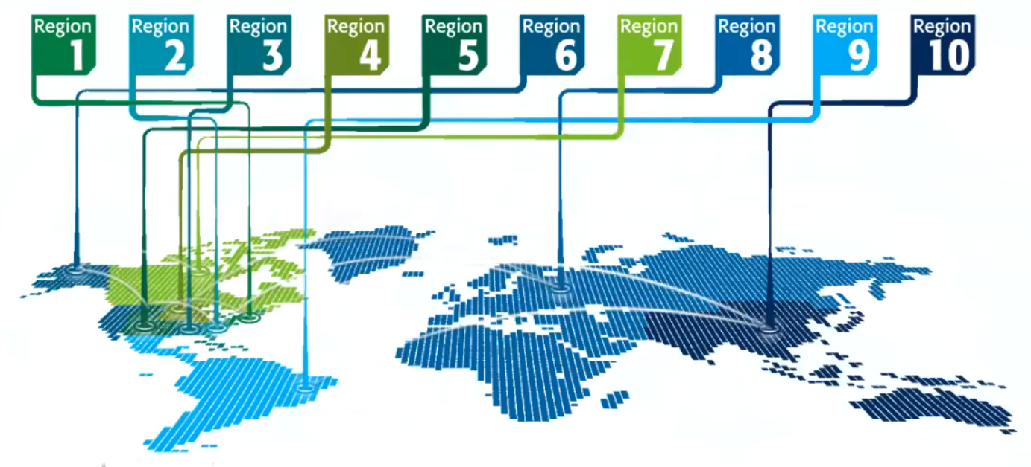
IEEE Region 8 at a glance
Who is Region 8?
87,000 members in over 100 countries
59 Sections, 13 Subsections and 1 Council
More than 43,000 Student members and GSM
645 Chapters that unite local members with similar technical interests.
762 Student Branches at colleges and Universities in 60 countries
640 Student Branch Chapters of IEEE Technical Societies
129 Affinity Groups and growing
169 Student Affinity Groups
2
Notes:
2

Slide 3
Goals
Home for everybody: inclusion and all diversities are a value
Address the evolving needs of all segments of our scientific and professional community
Expand cooperation for better serving our community

Slide 4
Areas of Actions
FOCUS ON THE ENTIRE SCIENTIFIC AND PROFESSIONAL COMMUNITY
WIE
Industry Professionals
Students
Young Professionals
Underserved Geographical Areas
Senior Members
Life Members
Academics
Fellow Members

Slide 5
Areas of Actions
Life-long Educational Activities
Industry Engagement
Retention and Recruitment
Volunteering and Recognition
Cooperation

