Slide 1
Member Communications Committee
Andy Seely, Chair, MCC - andrew.seely@ieee.org

Slide 2
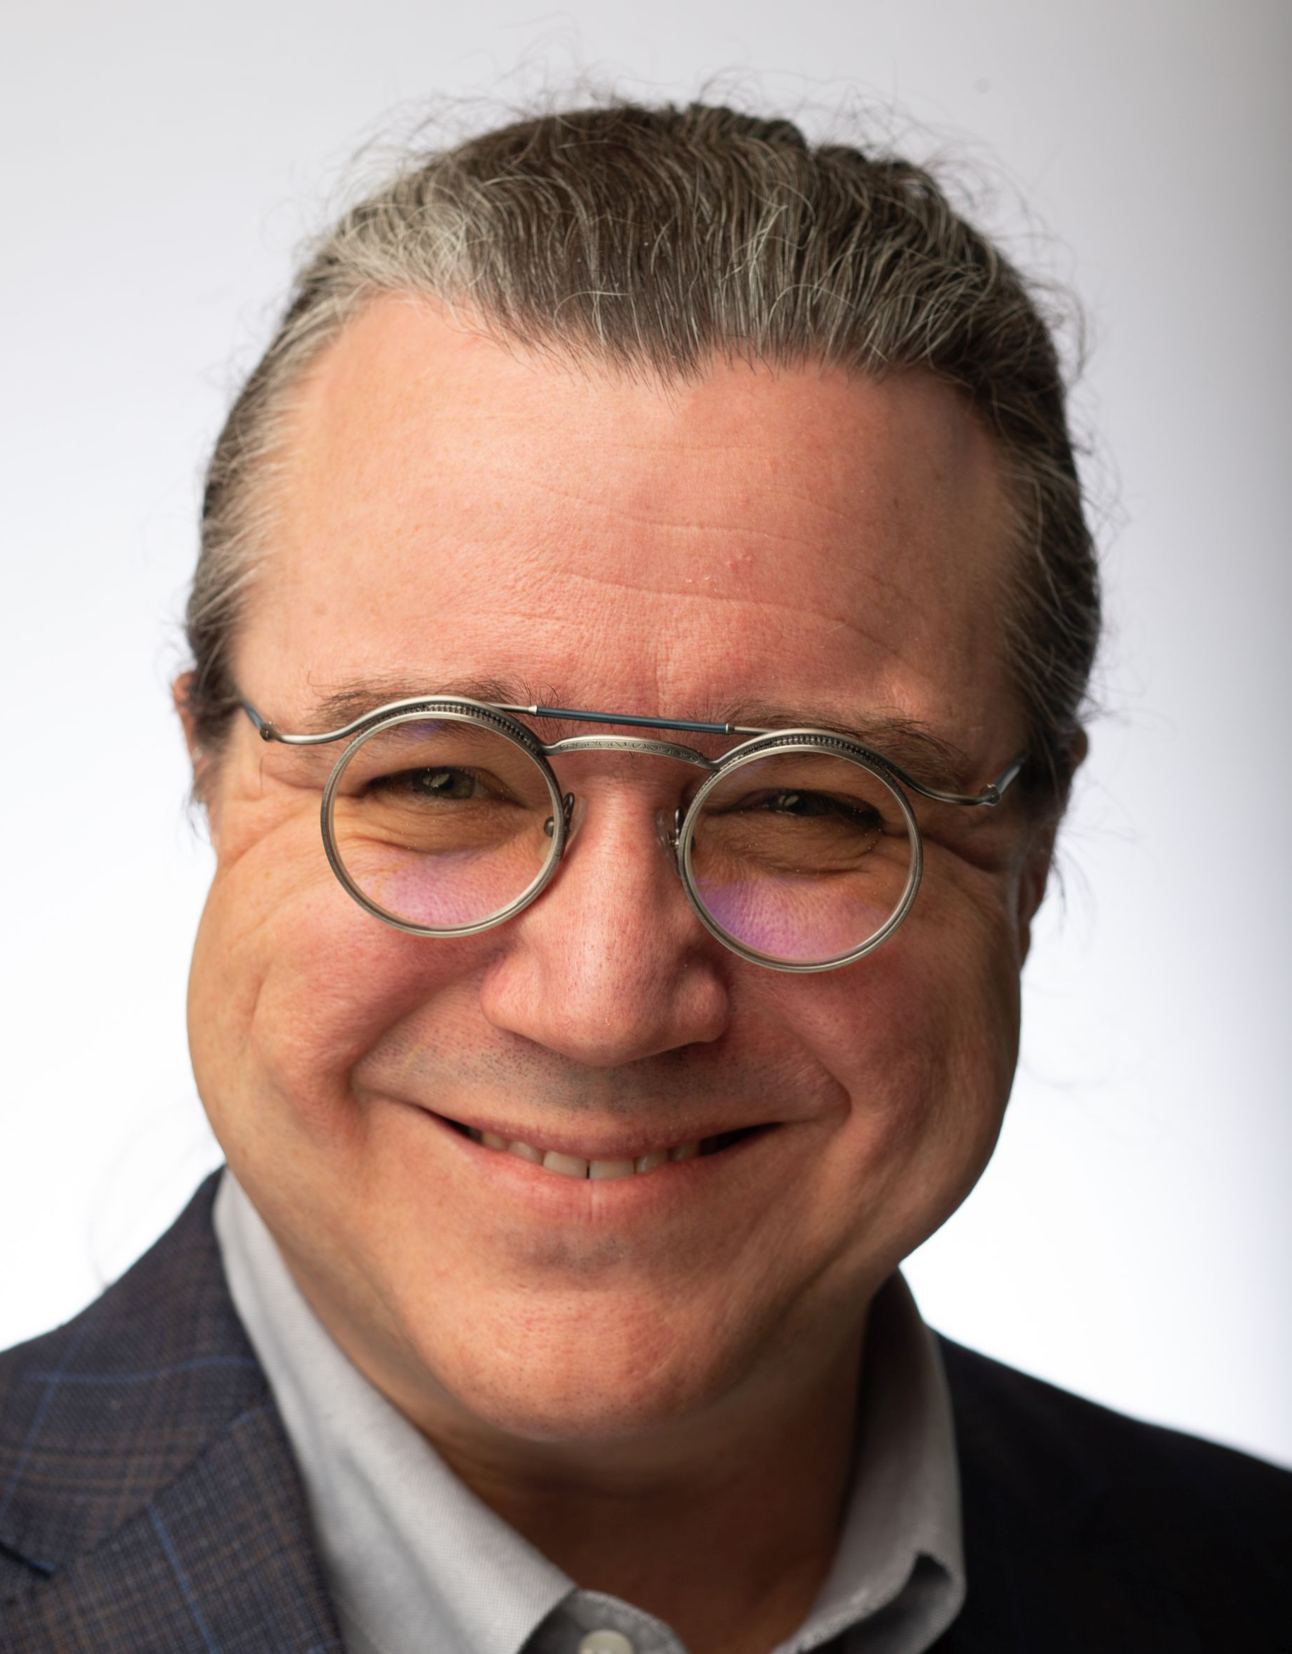
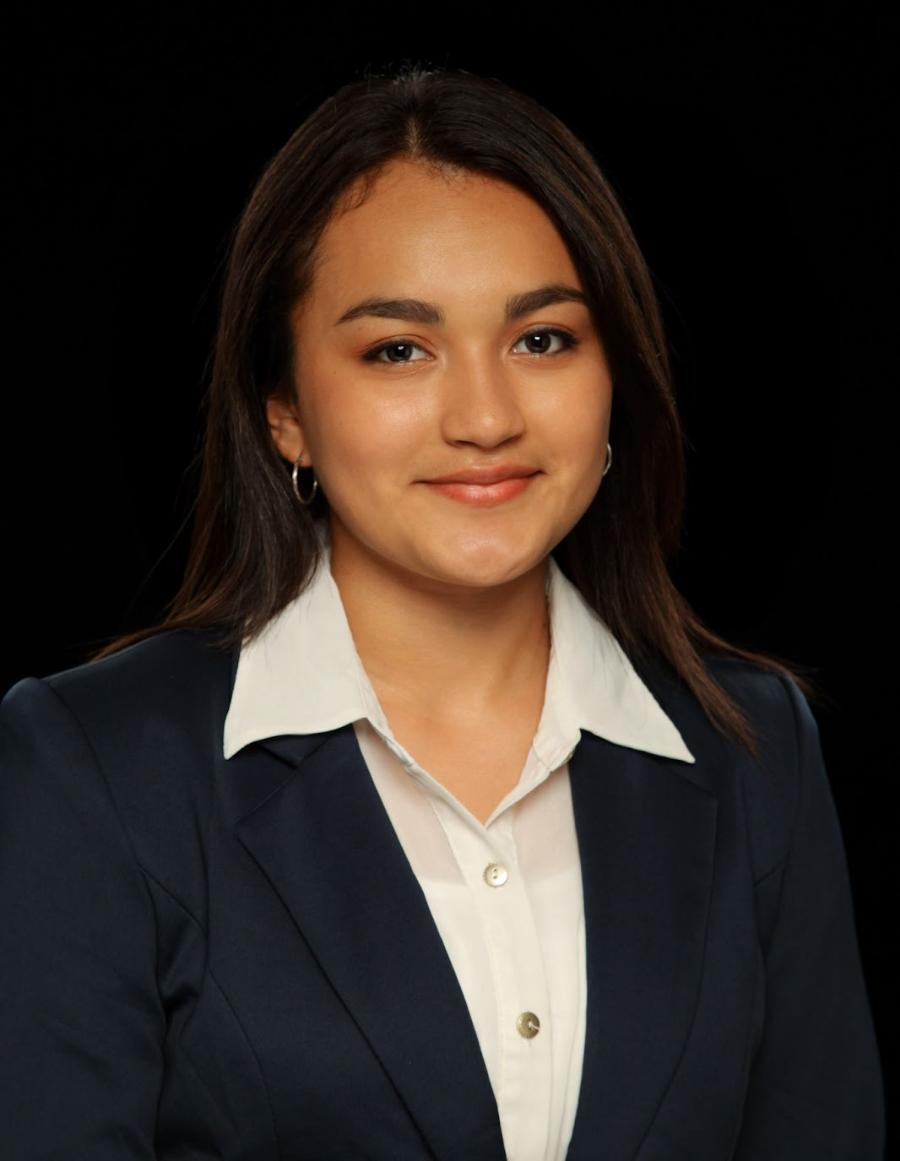
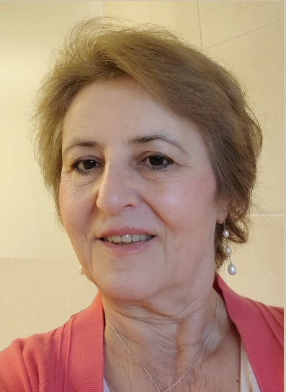
People of MCC
Andy Seely
MCC Chair
andrew.seely@ieee.org
Evelyn Licona
Assistant Newsletter Editor
ELicona@ieee.org
Lucas Sweet
Webmaster
lucassweet20@gmail.com
Hulya Kirkici
Region 3 Fellows Coordinator
hkirkici@southalabama.edu
Brian Page
Webmaster
bpage1@ieee.org
Vishwas Powar
Information Coordinator
vpowar@ieee.org
Patrick Kung
Member Recruitment and Retention Coordinator
p.kung.us@ieee.org
Bill LaBelle
Newsletter Editor
w.labelle@ieee.org
Sonya Dillard
MCC Mentor
sonya.dillard@ieee.org

Slide 3
Purpose of MCC
MCC supports the Region 3 mission, vision, and strategy
MCC is the primary communications tool for the Region 3 Director, Executive Committee, and region and section leadership to communicate with members
MCC establishes reliable, formal processes to inform Region 3 membership through multiple communications channels

Slide 4
MCC Channels and Functions
Region 3 Web Site
Region 3 Newsletter
Monthly member e-notice
Social media channels
Fellows Coordinator
Membership Retention

Slide 5
MCC in 2024
Established monthly cadence
Worked on MCC strategy and goals
Established new Google collaboration site
Published first Region 3 Newsletter
Started monthly membership e-notice mailings

Slide 6
MCC 2024 goals
Maintain current types and levels of member communication through 2024
By the end of the year:
Publish a communications calendar
Refine web site graphics
Update R3 form submissions
Establish metrics for all MCC channels
Survey current member preferences
Refine social media strategy
Embrace Collabratec (new volunteer role)
Document MCC processes
Prepare a 2025 MCC transformation plan

Slide 7
MCC Challenges
Signal to noise problem in our communications
Communications and work tools and preferences change faster than we do
Measurements of effectiveness don’t exist
“Build it and they will come” approach produces solutions searching for requirements
Knowledge Management principles: Discovery and access of authoritative sources

Slide 8
MCC Calls to Action
Do you need to communicate information to Region 3 membership?
Keep it short.
5W method.
Do you have ideas on how member communications can be more effective?
Transform from “messages sent” to “messages received” to “informed value”

Slide 9
Thank you.

