Slide 1
Section Support Committee
Kristin Bing
March 22, 2024

Slide 2
Assist Sections
Stimulating interest of IEEE members
Motivating members to volunteer
Encouraging professional and technical growth of all members
Sharing best practices with other Sections
Forming Engineering Affinity Groups

Slide 3
Responsibilities
Assist in training section volunteers
Provide assistance and support to those Sections and Chapters that are having problems in meeting the requirements to remain active and viable
Assist Sections in the use of collaborative tools and other technologies that support Section and Region activities
Encourage Sections to sponsor member grade elevation programs
Encourage Sections to sponsor programs that support the interest and continued activity of Life Members
Encourage Sections to sponsor projects to facilitate the active involvement of members in IEEE activities
Initiate project experiments with one or more sections to encourage member engagement
Assist sections in developing technical programs for their members and accessing other technical activities in the Institute

Slide 4
Who Are We?
Chair – Kristin Bing
Life Member Coordinator – Jacob Kulangara
Young Professional Coordinator – Binesh Kumar
Women in Engineering Coordinator – Ebonee Walker
Senior Member Elevation Coordinator – Hermann Amaya
Section Operations Specialists – Charles Lord and Mark Torres
Project Coordinator – Allen Jones
Technical Activities Coordinator – Arup Ghosh
Membership Recruitment & Retention Coordinator – Patrick Kung
Educational Activities Coordinator – Damith Wickramamayake

Slide 5

Region Goal 2: Provide all sections the training and support they need.
Lead
Progress
  SSC
Milestone | Target Completion | % Complete
9 Virtual Event Ideas and initial planning | 1Q2024
3 Virtual Events | 2Q2024
3 Virtual Events | 3Q2024
3 Virtual Events | 4Q2024
Detail
  Leverage 2023 SSC survey to determine 9 virtual training events to hold
Next quarter tasks to achieve goals
Create ideas for at least 9 virtual training event ideas
Plan for 3 virtual events per quarter for quarters 2 through 4
  It may be best to pick a certain day and time that is repeated each month so folks know training is available
Risks and Recommendations
Project Success - Metrics
Communication of the event details must get to everyone who may be interested. Due to how people configure their IEEE preferences, time should be allotted for the communications committee to promote each event on multiple platforms
Complete milestones
Get at least the number of people who indicated a need for the type of training in the survey to attend each event

Slide 6
5 Ensure Sections engage with their Student Branches and Branch Counselors at least quarterly.
Lead
Progress
  SSC and SAC
Milestone | Target Completion | % Complete
Have a list of all active sections and branches | 1Q2024
Have a place to post the final list | 1Q2024
Have a list of all active section and branches POCs | 2Q2024
Release the list to all sections and branches | 3Q2024
Detail
  Most students are unaware of what an IEEE Professional Section is or how to contact their local IEEE Professional Section. Students are passionate about IEEE but if information is not quick and easy for them to find, then they stop trying to find it. To best address this issue there needs to be a single place where students can look and easily find their section.
Next quarter tasks to achieve goals
Decide on a set space for students to be able to go to and find who to contact from their section with only one click.
Create a list that is easy to navigate and shows all sections, the student branches under that section, and the POCs for the section.
Release the list to the students.
Risks and Recommendations
Project Success - Metrics
There is a risk in setting up something that is well maintained and updated. If students have a single experience where the information was out of date then it will deter them in the future.
To mitigate this risk, set up a feedback/issue collector on the list/platform
Metric #1 – Amount of time it takes a branch to find a POC from their section with the new list/platform.

Slide 7
Goal 8 Engage members through new events and (micro-) volunteering opportunities.
Lead
Progress
  SSC
Milestone | Target Completion | % Complete
Develop event themes and invite first panelists | 1Q2024
Hold at least one themed event | 2Q2024
Hold at least one themed event | 3Q2024
Hold at least one themed event | 4Q2024
Detail
  Who members are influences what they will enjoy. By creating events based on newly elevated senior member panelists’ expertise, we will engage those members and organically hit upon areas practiced by members in our region
Next quarter tasks to achieve goals
Use 2023 senior member spreadsheet to develop ideas for event themes
Invite appropriate senior member panelists to participate in the first themed event
Risks and Recommendations
Project Success - Metrics
Risk that this will stop at the Region-level. Recommend sharing section-specific lists of newly elevated senior member grouped by technical specialties with section chairs
Meeting milestones
Having at least 20 participants per event

Slide 8
Bonus Goal: LM Engagement with Students and YPs
LMF (life member fund) is generated from the donations received from the IEEE life members (LF, LS & LM) for programs and activities of interest to LMs and LMC (life member committee) that foster innovative technology for human benefit.
Life members uses LMF to engage in supporting various programs, activities and projects including next generation innovators, students, HKN - Honor Society, young professional.
LMC provides project funding for Regional Student Competitions
  HKN and Student Branch activities
  WISE (Washington Intern for students in Engineering) for US students.
  Education STEM Outreach / Excite Students / Empower young
  Rising Star Conferences (Students / YP)
  LMAG Activities
  Grant Proposals - Student Activities
LMAG participate in local STEM activities for K-12 or with local college student branches and Mentor next generation technologists.
Other Ideas:
  Start a mentorship program in R3 between LMs (mentors) and YPs (mentees) by pairing LMs in the region with YPs/Students

Slide 9
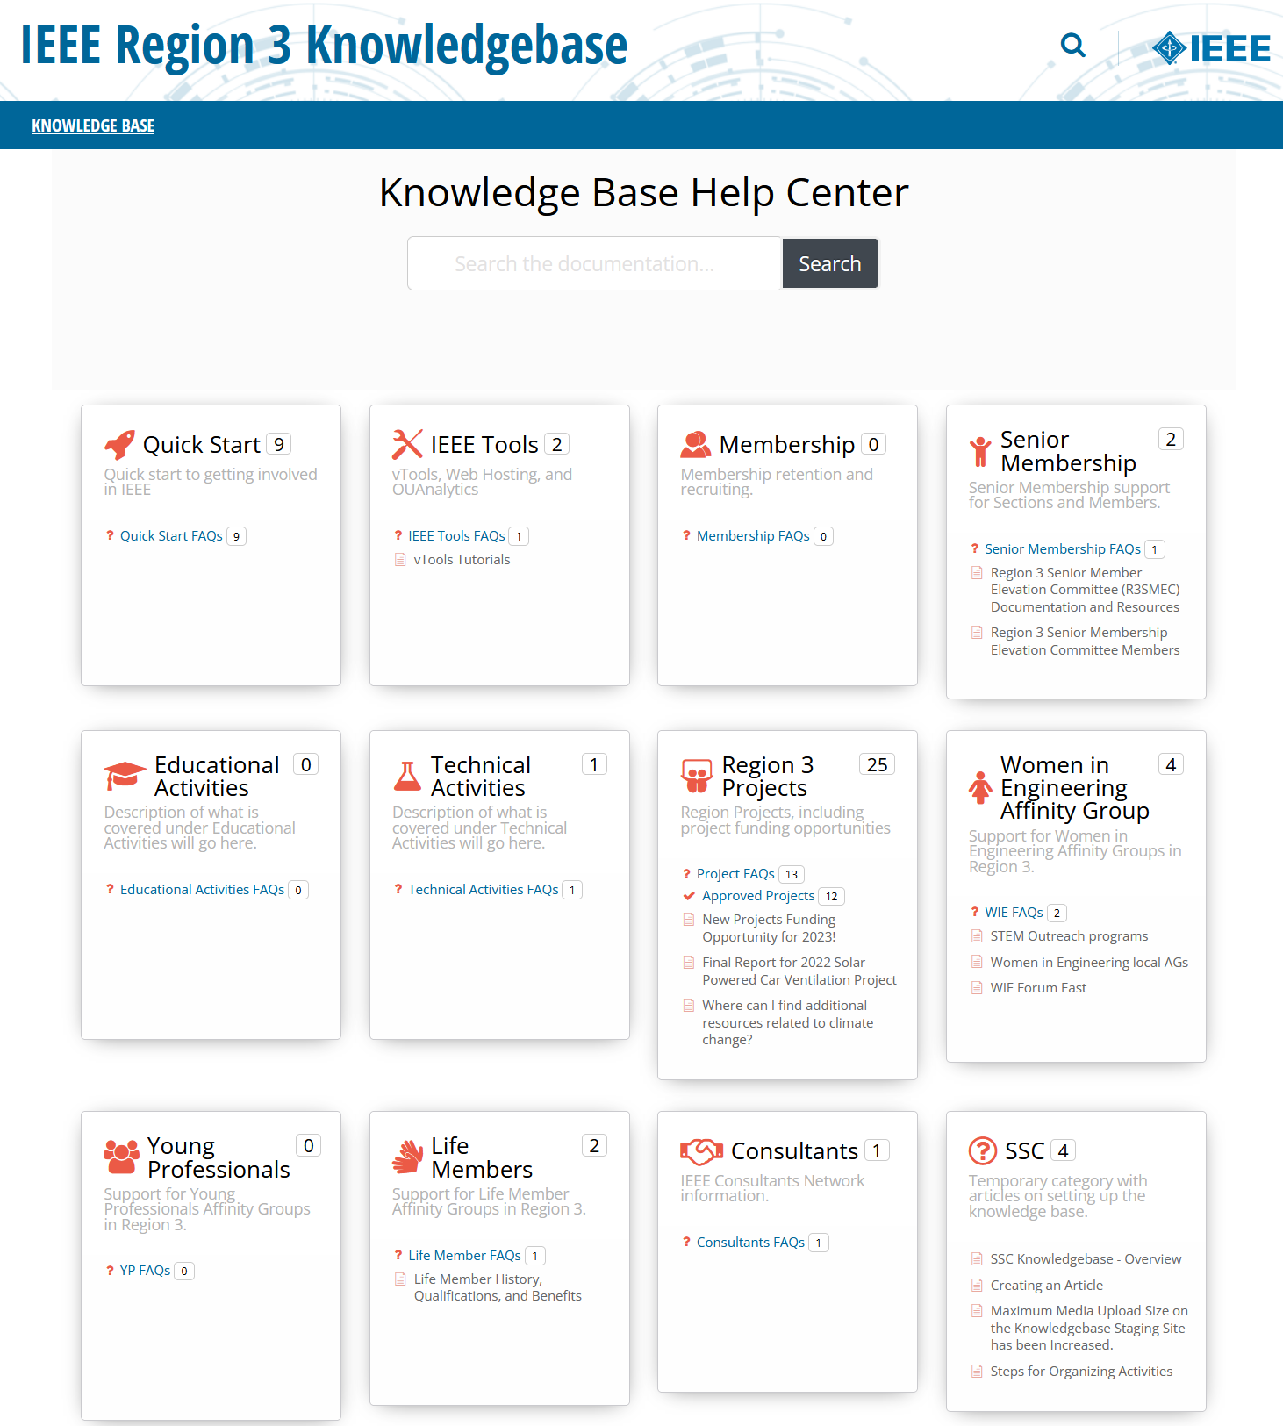
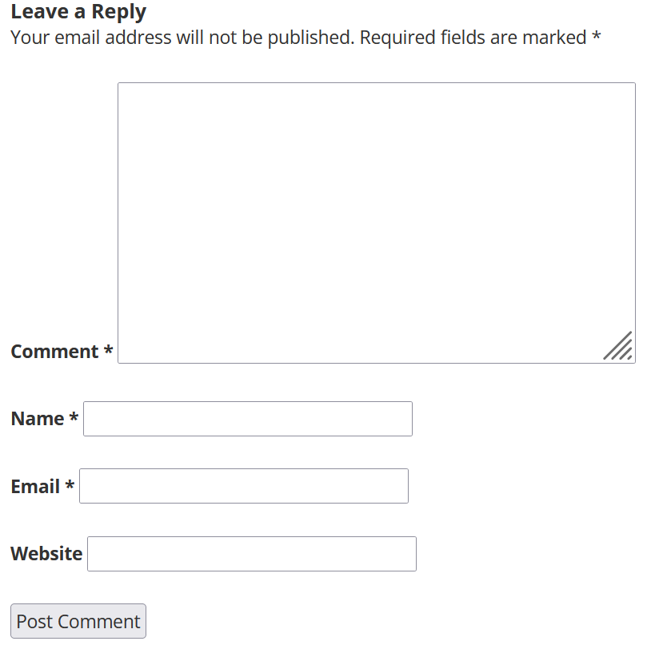
R3 Wiki Knowledgebase
https://kb.ieee.org/r3/ or navigate from the Region 3 website under Resources
Created and updated by the R3 Section Support Committee
Feedback welcome: r3-ssc@ieee.org or on wiki itself

Slide 10
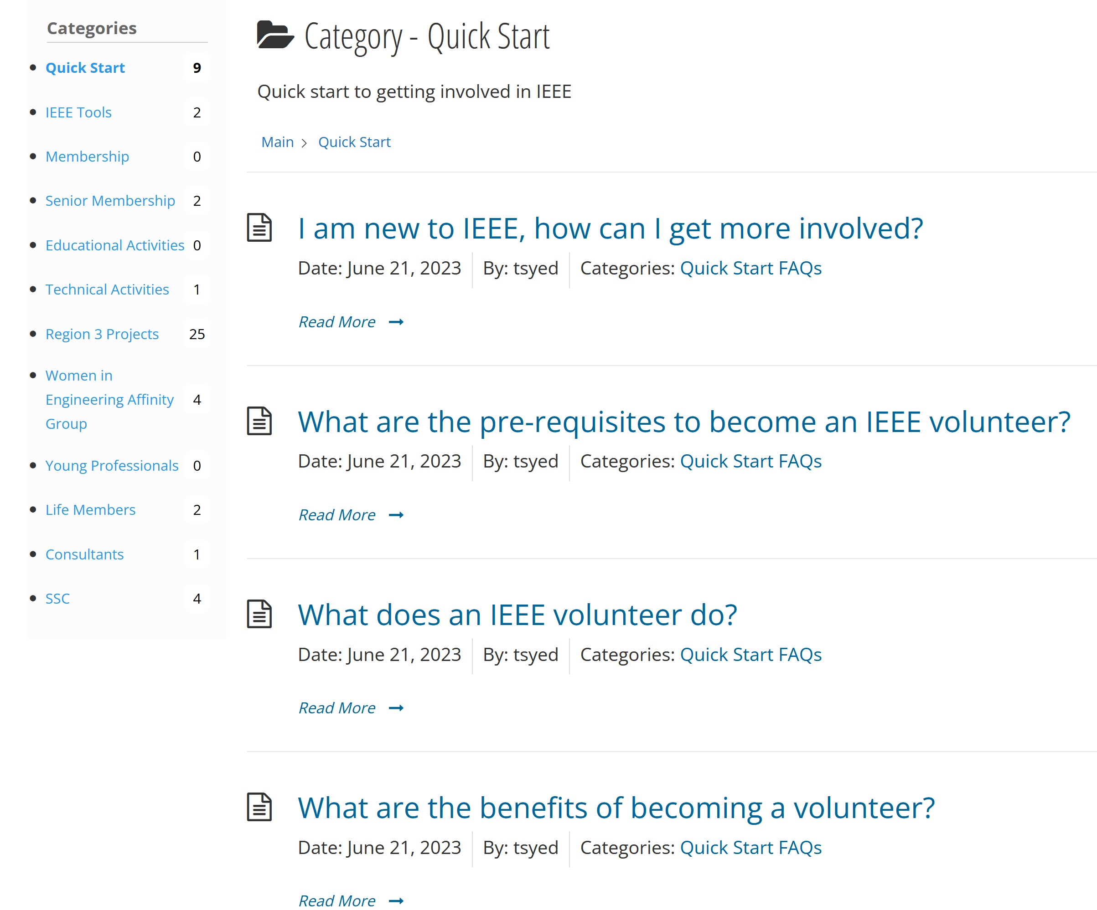
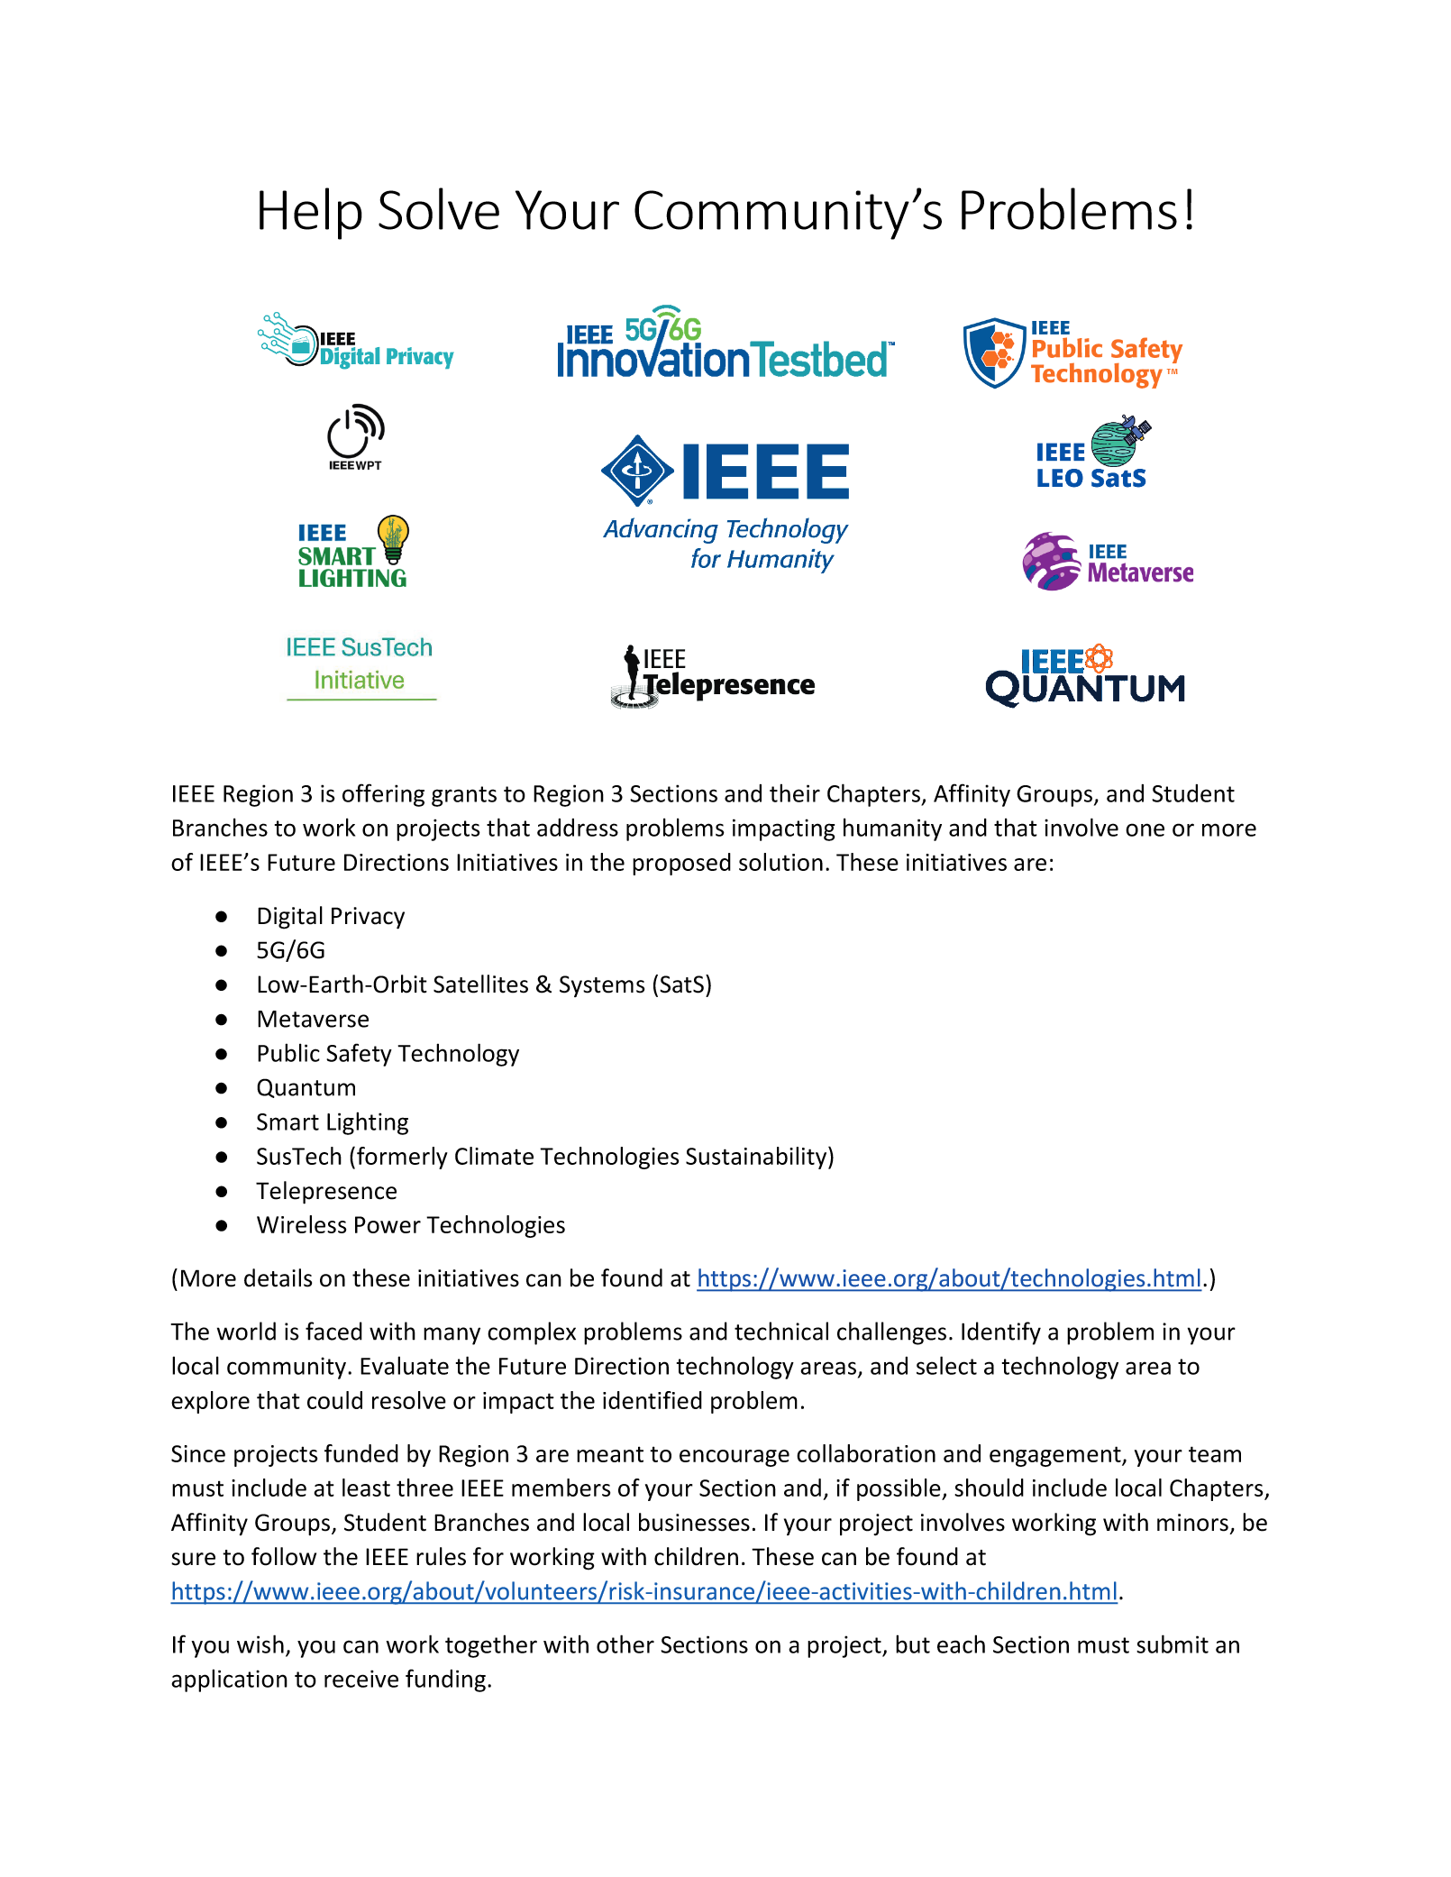
Example Content

