Slide 1
SOSC – Strategic Operations and Support Committee
Dave Green Chair
d.green@ieee.org
SoutheastCon 2024

Slide 2
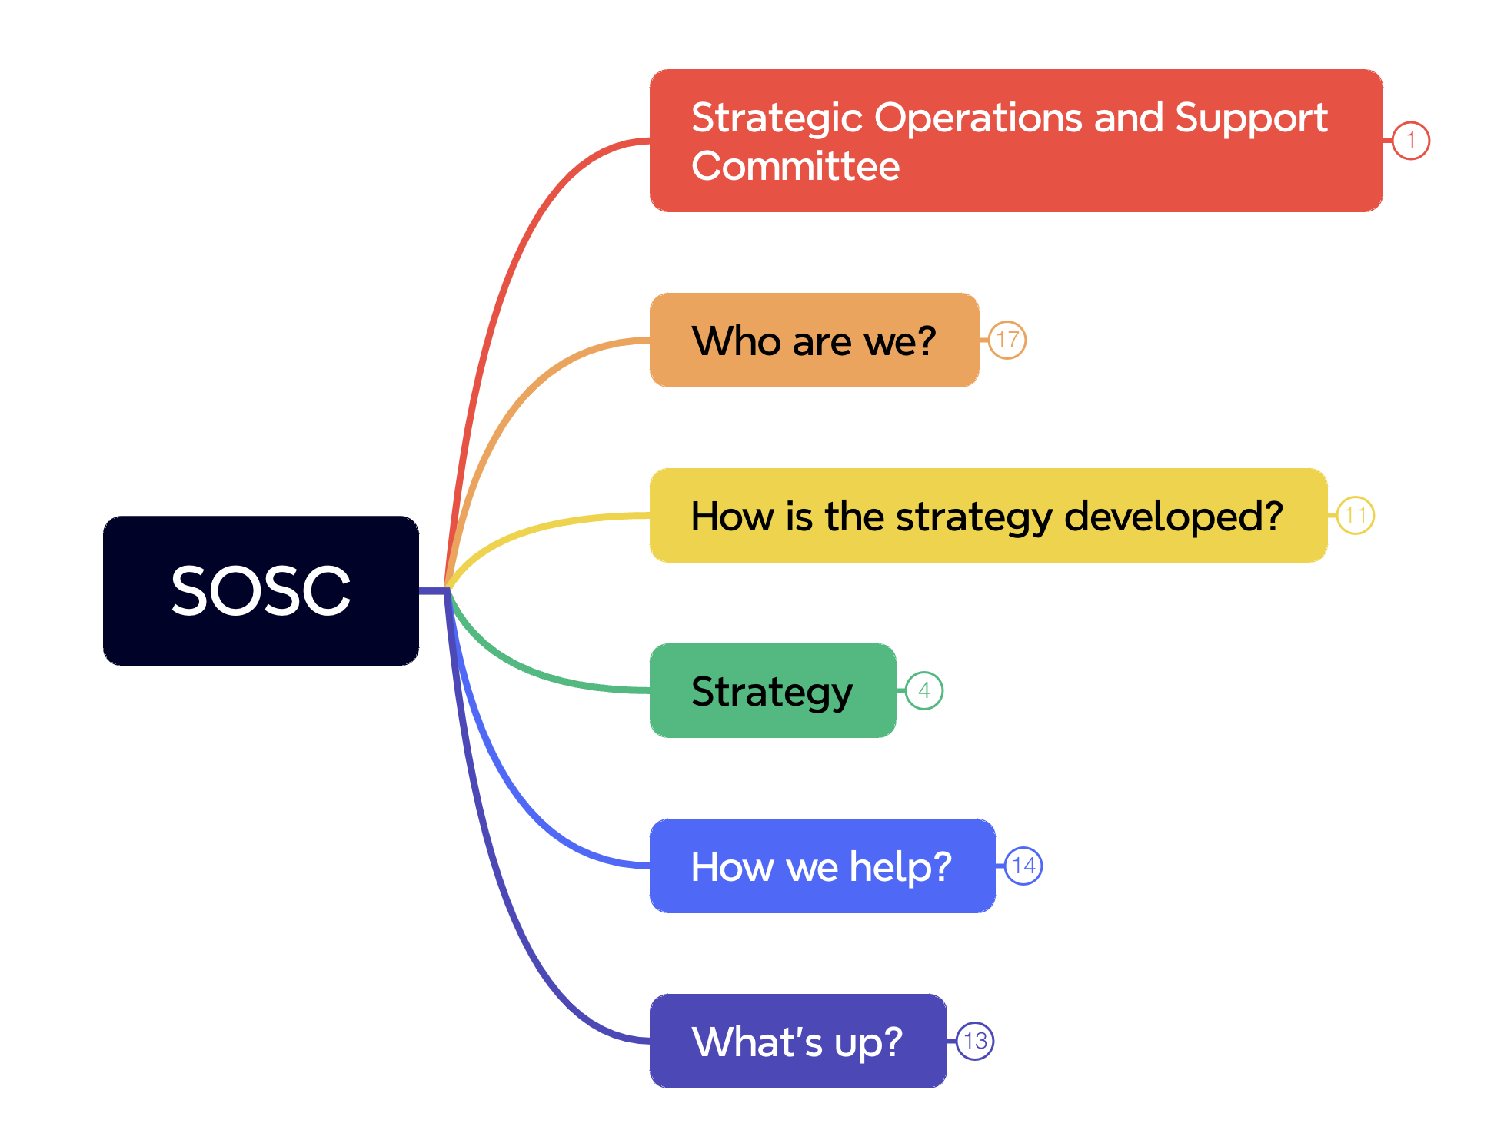

Slide 3
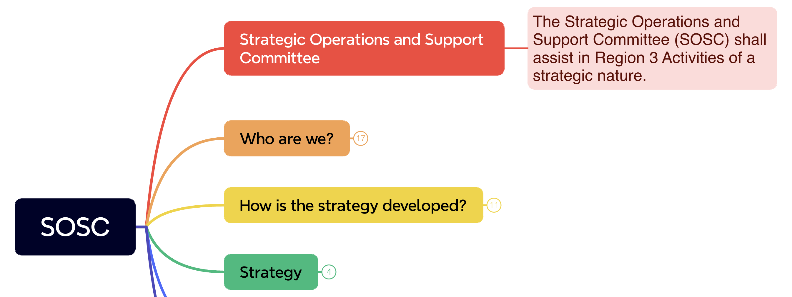

Slide 4
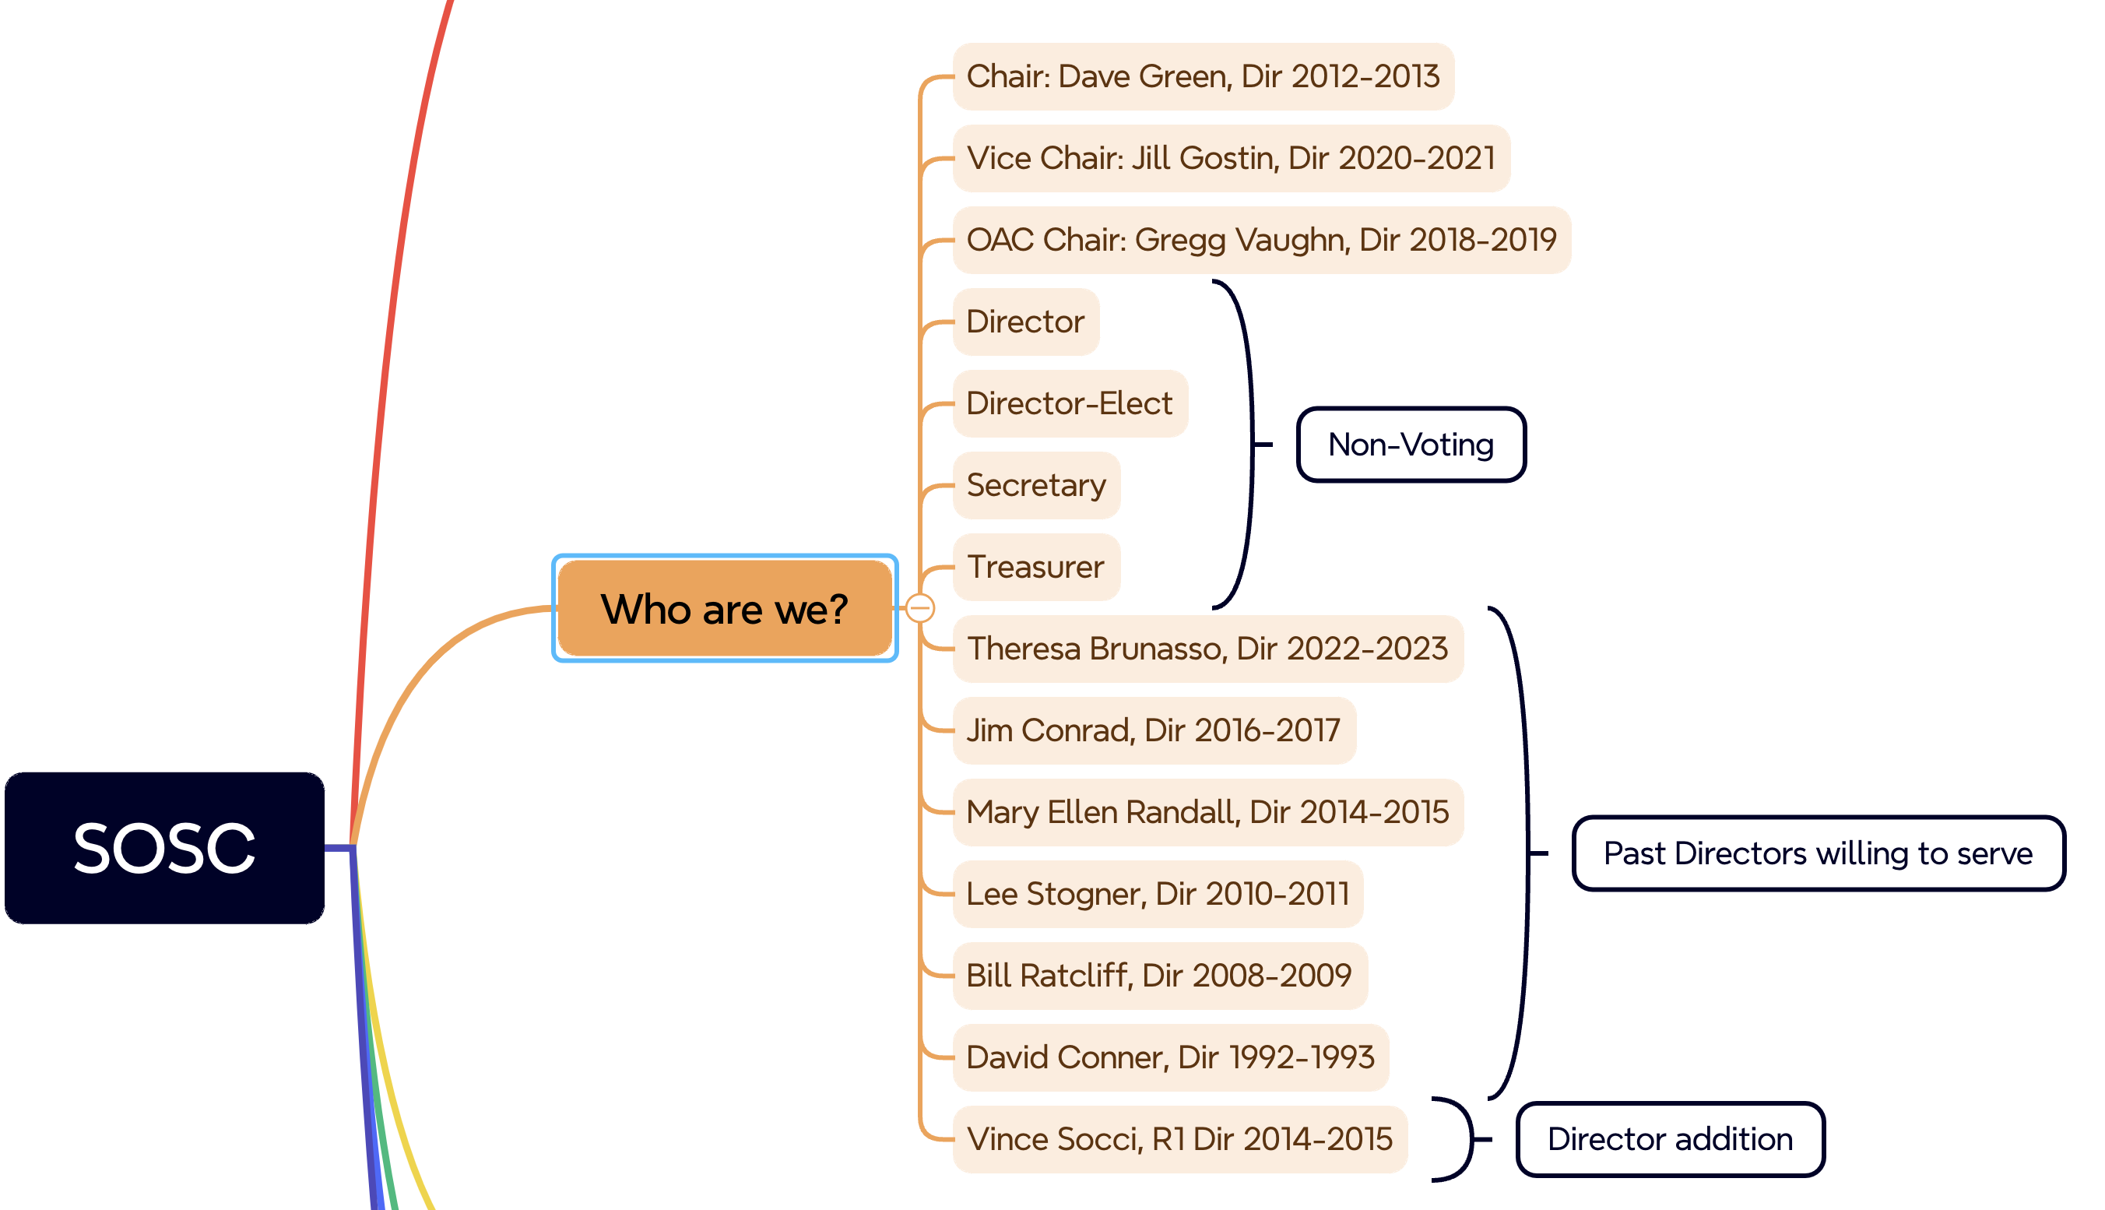

Slide 5
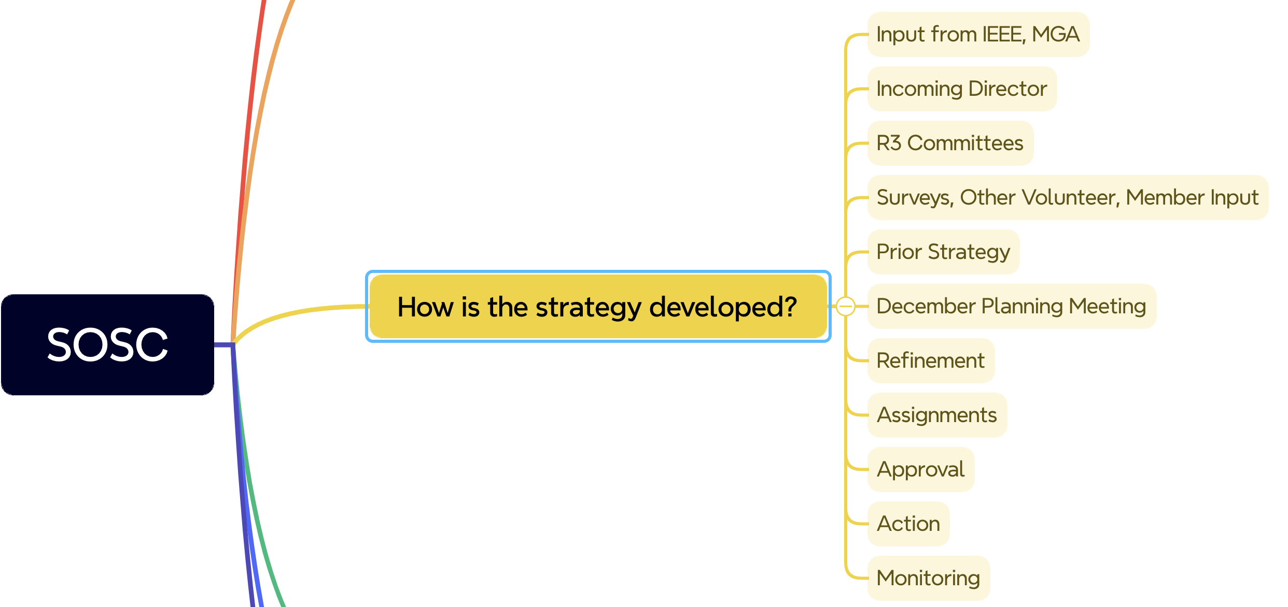

Slide 6
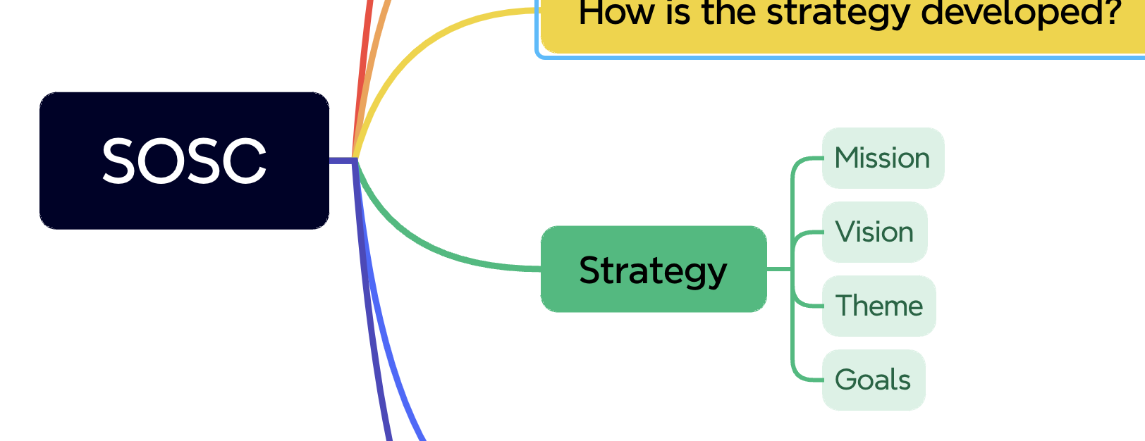

Slide 7
Region 3 Strategy - Mission
Focus on the growth and development of the member throughout the life cycle of the individual. Every member is an active participant, an informed and a satisfied member.

Slide 8
Region 3 Strategy - Vision
The Region shall fulfill the Member and Geographic Activities (MGA) strategic objectives at the local level by ensuring the enabling of the Sections, Chapters, Affinity groups, Student Branches, and Student Branch Chapters to engage the member.

Slide 9
Region 3 Strategy – 2024 Theme
Your Professional Home in Region 3.

Slide 10
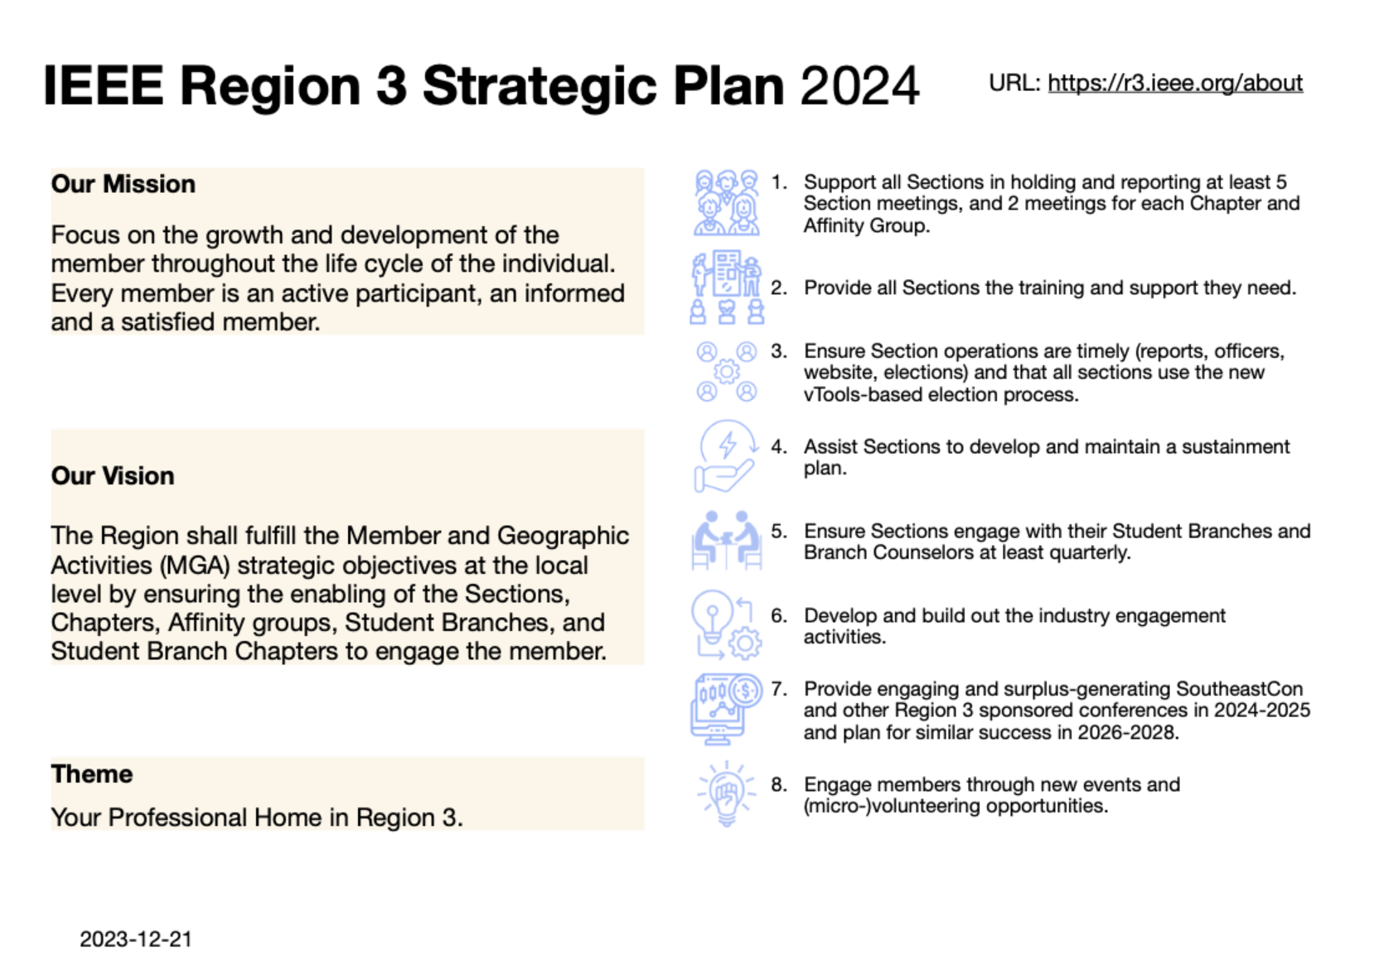

Slide 11
✔️
✔️
✔️
✔️

Slide 12
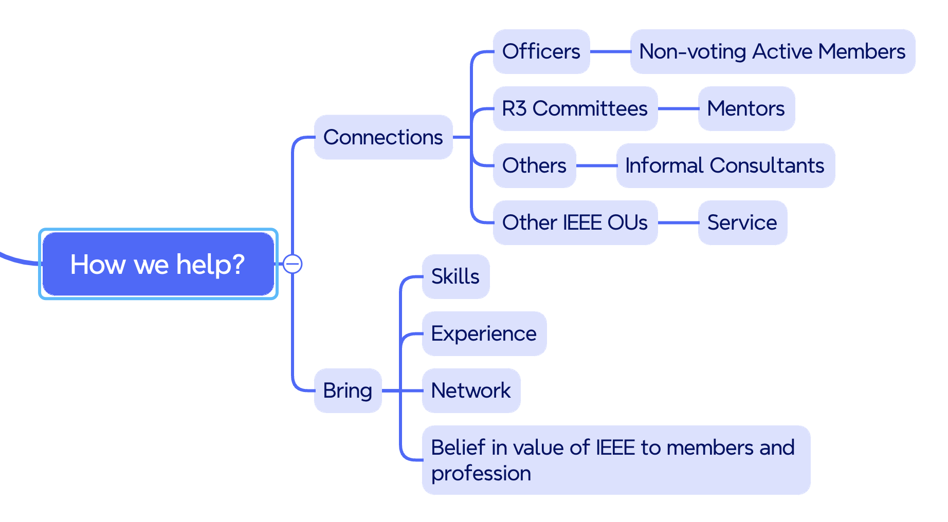

Slide 13
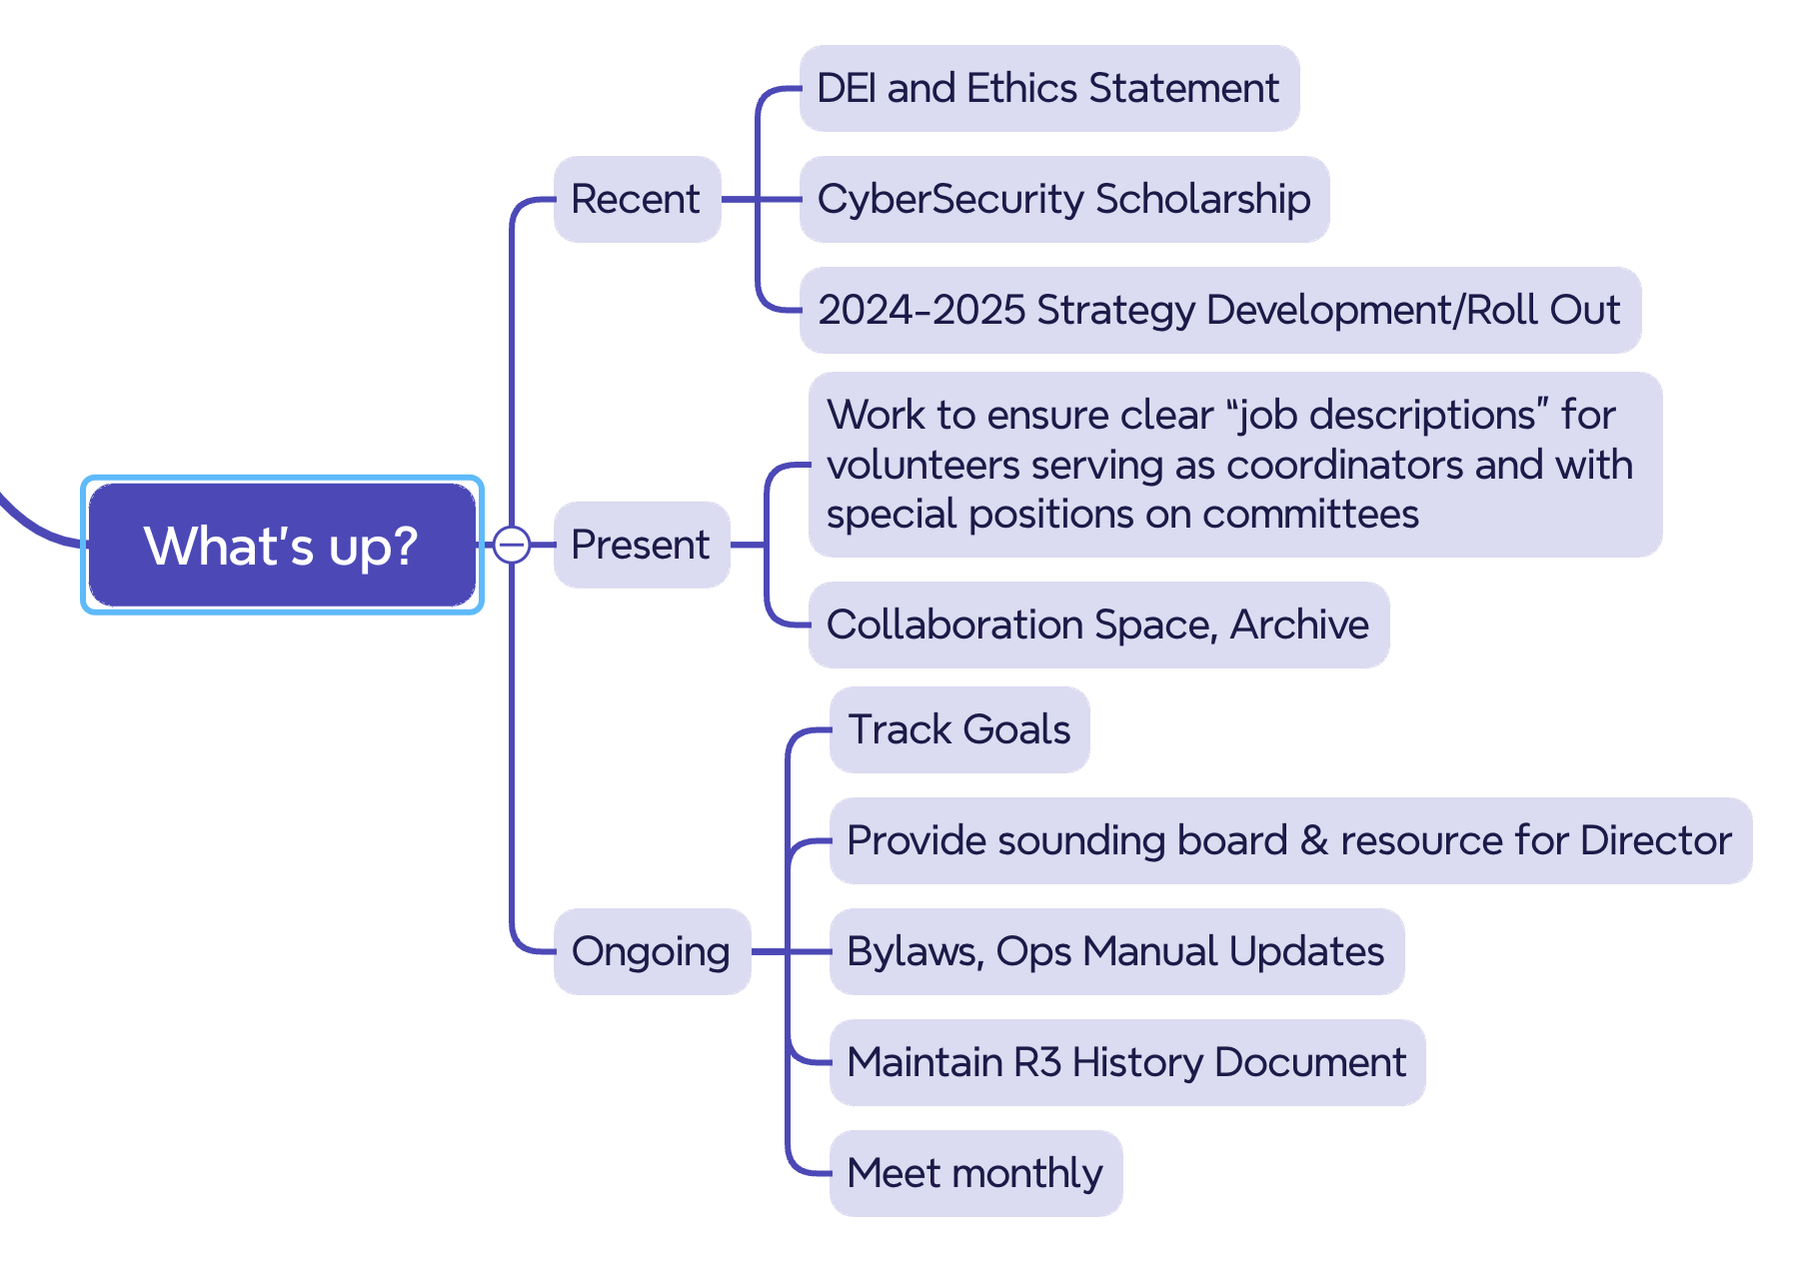

Slide 14
✔️
✔️
✔️
✔️
✔️
✔️

