Slide 1
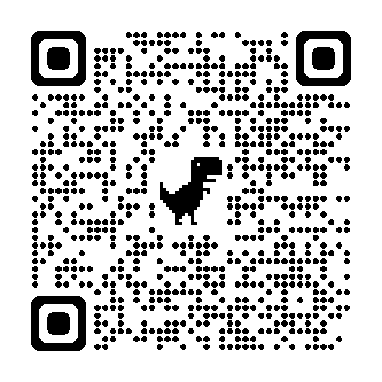
YP & Your Section
by Hasala Dharmawardena, PhD, PE

Slide 2
The Challenge
Young Professionals (YP) are an expensive investment
Stability and reliability of the YP Volunteers are much lower than the established professionals!!!
There is no advantage to a section to invest in the Young Professionals!

Slide 3
The Opportunity
Refresh your volunteer pool
Tap into new resources
New Ideas to attract more members!

Slide 4
I am
Hasala Dharmawardena
Past Region 3 YP Representative
Past IEEE-USA YP Representative
Past Piedmont Section YP Chair
Current YP Global Committee Chair
With me is
Binesh Kumar
Our Region YP Committee Chair

Slide 5
Where are we now
It all started in ………
We have 41 Sections with 2700 YPs but Only 12 YP AGs!
Doing great! Only 3 (small) YP AGs had no events in 2023!
4 YP AGs don’t have any officers!

Slide 6
Our Opportunity
30 Sections without YP AGs!
>120 YPs in (YP Counts)
Central Tennessee Section - 130
East Tennessee Section - 287
Orlando Section - 200
Virginia Mountain Section - 160

Slide 7
What next
Call for volunteers - eNotice?
Create petition
Train volunteers
Provide funding
A LOT OF WORK!!!

Slide 8
But we will do all that for you!
Find Volunteers
Train them
Fund them!
But ????

Slide 9
Let us know if you are interested!
Email us at yp@ieee.org
hasala@ieee.org
binesh.kumar@ieee.org

