Slide 1
Running Section Projects
Allen Jones, R3 Projects Coordinator, Richmond Section Chair

Slide 2
First, a Thank You
Thank you to my fellow committee members...
Damith Wickramanayake
Derik Pack
Thank you to Region 3...
For providing funding for groups of Region 3 members to work on projects.

Slide 3
What Kind of Projects are These?
What Kinds of Projects Get Funded through the Region 3 Projects Committee?
Projects funded through the Region 3 Projects Committee are of medium duration and are meant to:
Encourage Engagement
Encourage Collaboration
Demonstrate IEEE’s motto of Advancing Technology for Humanity
They encourage our members to work together and apply our special skills to solve the problems that our communities face.
Engagement
Advancing Technology for Humanity
Collaboration

Slide 4
What Kind of Projects are These?
Project Themes
Projects generally are based on some type of a theme that is determined by the Region Director and the Projects Committee.
Previous years’ themes include:
Solving problems related to the Pandemic
Solving problems related to Climate Change
Solving problems where the solution involves one of IEEE’s Future Directions Initiatives
Funding amounts vary but are generally on the order of a couple of thousand dollars. More exact amounts are specified when a new theme is announced.

Slide 5
How Long are These Projects?
Projects should normally be on the order of weeks or months.
A one-day or very short-term event would not normally be long enough to result in much engagement or collaboration.
Projects should not be so long that they are really Programs, although projects initially funded through this committee could eventually become standalone programs funded through other sources.

Slide 6
Where do I find the latest information?

Slide 7
Basic, Typical Rules include:
Rules for Applicants
You need at least 3 IEEE members of any grade who will be working on the project.
You promise to provide brief monthly status updates.
You agree to submit expense reports for reimbursements.
Rules for Sections
You agree that Region 3 will transfer the money for the project to your Section’s bank account and that your Section will be responsible for the financial management of those funds, including handling reimbursement requests from the funded team.
You agree to return unused funds to the Region when the project concludes.

Slide 8
Use of Project Funds by Students
IEEE student members may find that this is a useful source of funding for things such as Senior Capstone projects (that fit in with that year’s theme.)
But, this is not funding to write their research paper.
It is funding to reimburse applicants for materials that they needed to purchase to make something that addresses a humanitarian problem. Region 3 is funding that something they made, not the paper that they may or may not have written.

Slide 9
Projects Aren’t Just for Students!!!

Slide 10
Connection between Projects, Volunteers, and Member Retention
Follow the QR Code for a 2022 presentation on how Projects can help increase your number of volunteers and help with member retention.
https://ewh.ieee.org/reg/3/excom/meetings/2022-04-April1/fr1530t1.pptx

Slide 11
Recent Experience
Within the Richmond Section, both our YP and WIE Chairs recently told me that they were struggling to recruit new volunteers and that they were the only officers in their respective groups.
I had forgotten that they weren’t involved in YP when the Richmond YP Affinity Group first started and was struggling to gain any interest.
The previously mentioned URL with the QR Code discusses how YP’s choosing to work on an engaging project changed that.

Slide 12
Recent Experience
In both cases where those two Affinity Group Chairs told me that they were about to give up, I told them about the impact that an engaging project had had on the original YP AG.
In both cases, what they had originally planned to be a brief conversation turned into a two-hour conversation where they wanted to know more.
In both cases, the Chairs of these two groups reported at the last Section ExCom meeting that they had recruited some new volunteers.

Slide 13
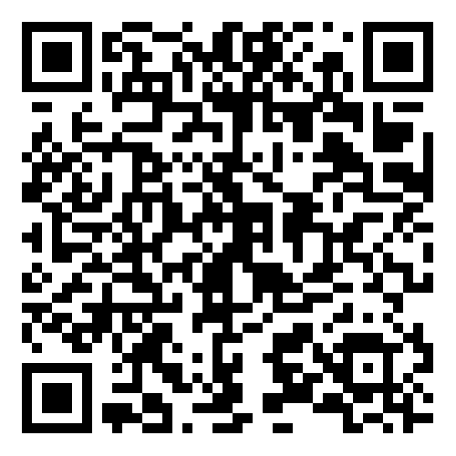
Thank you!
https://ewh.ieee.org/reg/3/excom/meetings/2022-04-April1/fr1530t1.pptx
Allen Jones, allen.jones@ieee.org
r3-projects@ieee.org
804-240-1182

