Slide 1
Professional Activity Events
David Fillion

Slide 2
Professional Activity Events
IEEE USA

Slide 3
Professional Activity Events
CPDC
Career and Professional Development Committee

Slide 7
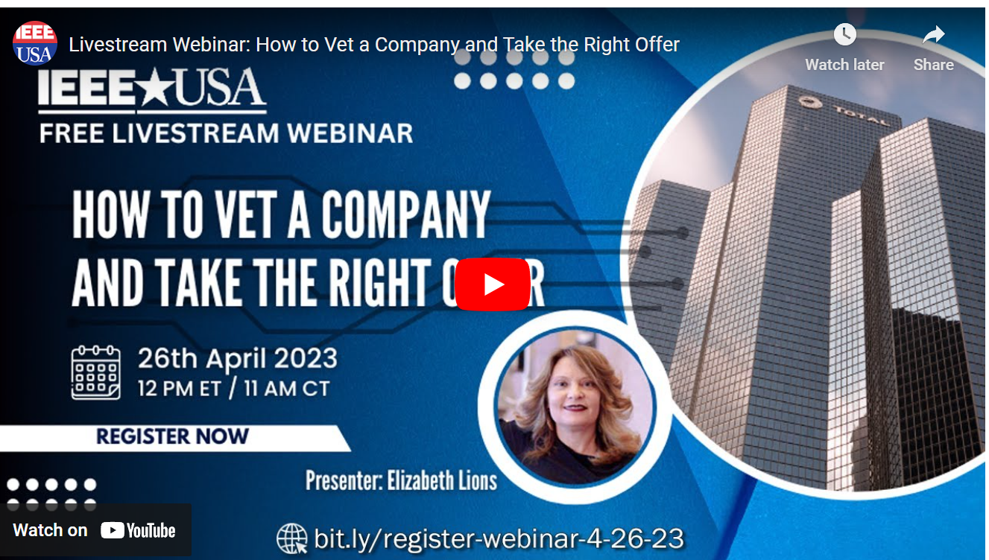

Slide 8
Consultants
Consultants Network
Charles Lord

Slide 9
PE – Professional Registration
PE
David Cotton, PE

Slide 10
David Fillion
dfillion@ieee.org

