Slide 1
How To Hold A Conference
IEEE SoutheastCon 2024
March 23, 2024

Slide 2
Agenda
Why host conferences?
Running a local conference
Sponsoring a society conference
Hosting IEEE Region 3 SoutheastCon

Slide 3
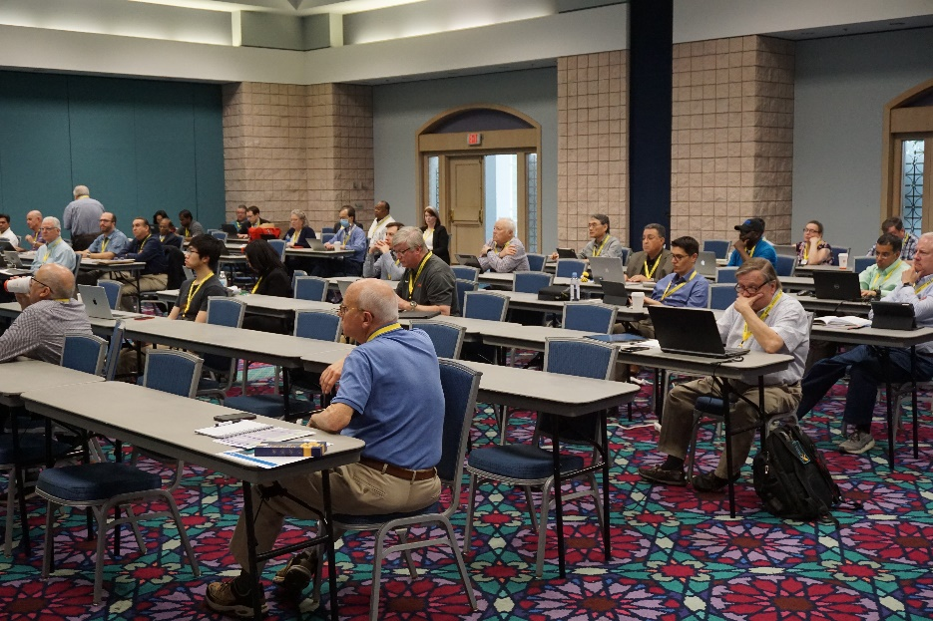
Why host conferences?
Engage your membership base
Network with others in the field
Experience in planning events
Reap benefits of conference surpluses

Slide 4
Running a local conference
Consider running a conference in your Section to engage members
Orlando Section Example
  Hold a Section Conference at local colleges in the fall in conjunction with the 10 Orlando Society Chapters and 3 Affinity Groups
    2019 – UCF
    2023 – Valencia
  The Section handles the logistics (location, food, registration, etc.)
  The Society Chapters and Affinity Groups bring a speaker
  Student Branch members help at the registration table and guiding attendees to the right rooms
  Society Chapters and Affinity Groups get one technical meeting credit towards their annual activity requirement
  Collect a fee to cover food or subsidize students

Slide 5
Running a Local Conference
Sample Agenda and Logistics Needs

Slide 6
Running a local conference
Planning for it
These cannot be planned in two weeks and be successful
Minimum 6 months of lead time
  Find a venue – Universities are great
  Commitment from Society Chapters to participate
  Society Chapters identifying speakers
  Finding a keynote speaker (if required)
  Collecting fees
  Ordering food
  And more ….

Slide 7
Sponsoring a Society conference
Societies may want financial assistance to bring a conference to a Section
  In return, the Section receives a portion of the conference surplus
Example: IEEE International Workshop on Antenna Technology
  March 2025
  Held at Hilton Cocoa Beach Oceanfront (Canaveral Section)
  Financially sponsored by Orlando Section
  Orlando Section members sit on the IWAT conference committee to ensure that the conference finances are in order
Build experience on the behind the scenes work of hosting conferences

Slide 8
Hosting IEEE Region 3 SoutheastCon
Overview
Three tracks
  IEEE Region 3 business meetings (80 participants)
  Technical paper presentations (240 papers in 2024)
  Student Competitions (430 students registered)
3-4 days in spring
  We are here in wonderful Atlanta, GA at the Westin Peachtree Plaza
4-year planning cycle from proposal to conference closure
  Proposal and budget to IEEE Region 3 Conference Committee
  Approval by Region 3 Committee (at SoutheastCon)
  Hardware rules and announcement at SoutheastCon N-1
  Planning leading up to the event

Slide 9
Hosting IEEE Region 3 SoutheastCon
Logistics Requirements
775+ room nights (peak at 250 rooms per night)
15,000 square foot hardware competition room
Banquet ballroom for 700+ guests
15-20 meeting rooms (papers, student programs, Region 3 meeting)
  1 – 100-person meeting room for Region 3 main sessions
  Up to 4 – 40-person meeting rooms for Region 3 breakouts
  Student Program
    3 – 30-person meeting rooms
    Up to 2 – 60-person meeting rooms
  Technical Programs
    Up to 6 30-person meeting rooms for paper presentations
    Additional meeting rooms for tutorials, workshop and demonstrations

Slide 10
Hosting IEEE Region 3 SoutheastCon
Finances
Seed Funding
  Section is expected to provide $5,000 in seed funding to the conference
  Region 3 will match $5,000 in seed funding
Expect to spend $215,000 to $275,000
  Major cost is food and beverage at the hotel
Income at $250,000+
Surplus and Deficit
  Surplus split 50:50 with region
    2023 surplus was almost $75,000
    Per Region 3 policy and the memorandum of understanding with the section, Region 3 covers losses

Slide 11
Next Steps
Interested in hosting IEEE Region 3 SoutheastCon
  Region 3 plans on awarding the next 3 SoutheastCons in 2024
  2027 is still up for grabs – endorsement by July 2024
  Region 3 plans on awarding 2028 and 2029 – endorsement by December 2024
  Formally award 2027, 2028, and 2029 at IEEE SoutheastCon 2025 in Charlotte
Contact Information
  Joe Juisai
  Joe.Juisai@IEEE.org
  +1 (415) 260-1980

