Slide 1
IEEE NextGen Tips
Mary Ellen Randall
21 March 2024

Slide 2
Agenda
NextGen Access
NextGen Banking
Budget Upload
Bank Account Transaction Entries
1099 Forms
Concur: Helpful Tips for Approvers
Expense Report Levels / Expense Report Lifecycle
How to edit a submitted report
How to Add Transfer Approval of Expense Report
View All Expense Reports You’ve Approved
Appendix: Concur Helpful Tips for Submitters

Slide 3
NextGen Access
Access the NextGen Applications through the Volunteer Experience Dashboard via ieee.org/nextgen
Chairs, Treasurers, and Secretary/Treasurers have been granted access to NextGen
Position status should be current and updated via vTools at https://officers.vtools.ieee.org
Single Sign-on (SSO) by using your own IEEE’s User ID and Password
For new Chairs and Treasurers, the system will prompt them to set up the PingID multi-factor authentication (NextGen Technical Specifications)
Note: PingIDs can be reset by the IEEE IT Team only. Please send an email to
finance-solutions@ieee.org for assistance.

Slide 4
NextGen Banking
Position status should be current and updated via vTools at https://officers.vtools.ieee.org
Access NextGen Banking through the Volunteer Experience Dashboard via ieee.org/nextgen
CB Bank Account Signature cards should be updated as soon as the Officer positions change. The IEEE Treasury Department manages the signature cards. Please send any inquiries regarding signature cards, Debit Card, or requests to open NextGen bank accounts to nextgenbanking@ieee.org

Slide 5
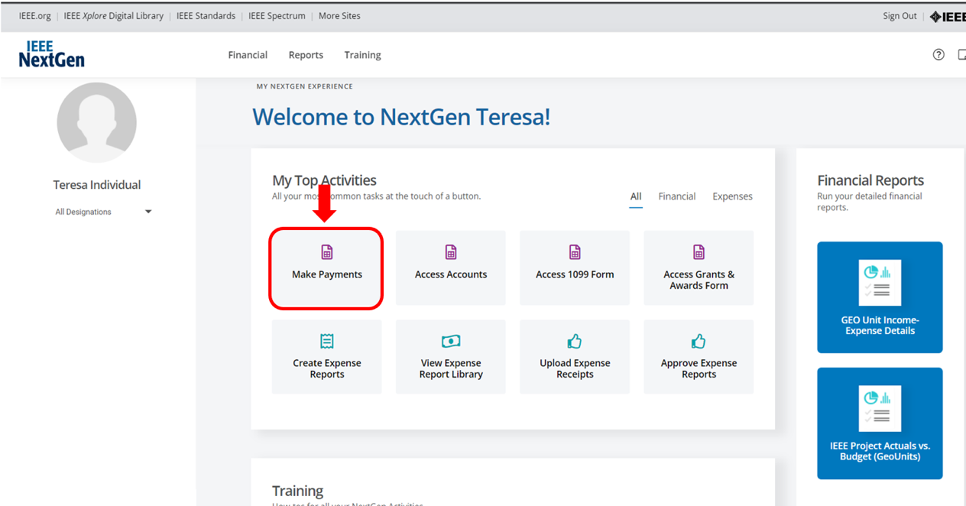
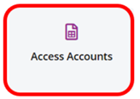
NextGen Banking

Slide 6
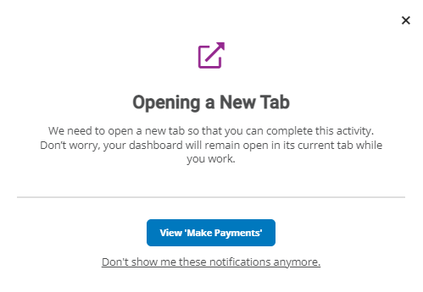
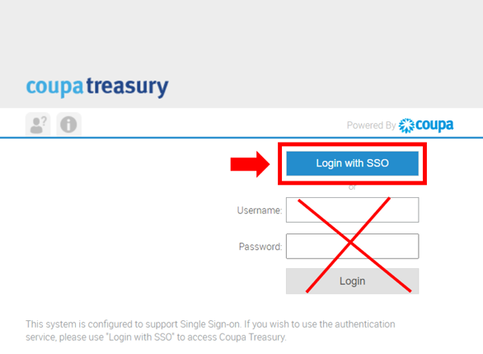
NextGen Banking Access
When clicking on any of the NextGen Banking tiles, another window will be displayed. Click on View ‘Make Payments’ (1).
If a second window is displayed, you don’t need to input your login credentials, instead you just need to click on the blue box labeled ”Login with SSO” and the login credentials will be populated automatically(2)
(1)
(2)

Slide 7
NextGen Banking
ACH Payments
Check Payment
Domestic Wire Payment
International Wire Payment
IC Payments
Account Balances – Cash Flows
Downloading Transactions into Excel format
Downloading Long-Term Investment Account Statements
Track Paper Checks
If you need assistance with NextGen Banking, please send an email to the MGA Finance Team at finance-solutions@ieee.org. We will be happy to assist you.

Slide 8
Budget Upload
If you would like to upload the 2024 Budget for your Geo Unit, please send an email requesting the Budget Template to the MGA Finance Team at
finance-solutions@ieee.org.
Budgets for the 2024 Reporting Period can be uploaded to the NextGen Financials Cloud starting on January 2, 2024

Slide 9
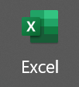
Bank Account Transaction Entries
The Bank Upload Template will be utilized to upload transactions from NextGen Banking and Local Bank Accounts to the NextGen Financials Cloud
CB Bank templates with all transactions as of Dec 31, 2023, and Local Bank Account templates will be sent to Geo Units starting on Jan 2, 2024, including the following:
WBS Task & Expenditure and Revenue Types Listings for each Geo Unit
Step-by-Step guide on how to complete the template
Information on where to send the complete templates

Slide 10
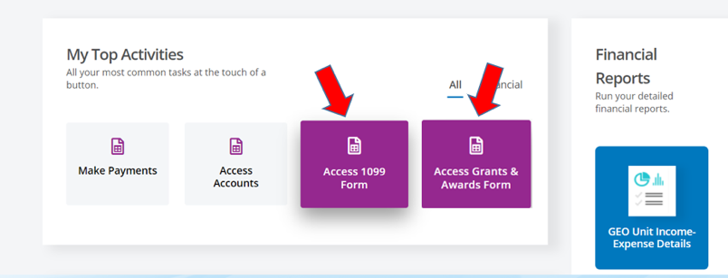
Tax Reporting
Payments such as awards, grants, honorariums, prizes, commission, hourly compensation, etc. must be reported to IEEE.
Expense reimbursements should not be included as long as the receipts and supporting documents are attached to the expense report
Each Form will have its own tile on the Volunteer Dashboard
1099 forms should be completed by Geo Units in Regions 1-6
Grants & Awards forms should be completed by Geo Units in Regions 7-10

Slide 11
Concur: Helpful Tips for Approvers

Slide 12
Always access Concur with your IEEE credentials via ieee.org/expense
For members that have access, you can always use Concur via the NextGen Dashboard (ieee.org/nextgen)
Self Service Featuring NextGen Help Menu
When Entering Transactions in a Foreign Currency
Use the currency shown on the receipt, Concur automatically converts the transaction to user’s local currency
If the currency conversion calculated by Concur differs from the conversion charged on your credit card, you can submit a separate expense line for Currency Exchange Fees to make your reimbursement whole
When Entering Expense Report Purposes (ERPs)
If you’re unsure which ERP to use, please contact your Region/Section Treasurer and/or your dedicated IEEE Staff Support Contact for assistance
Expenses must be recorded on the date the transaction occurred
Receipt Date = Transaction Date

Slide 13
Expense Report Life Cycle
Create Expense Report
Volunteers/Members select 4-tiered Expense Report Purpose (ERP) Levels & Expense Type, which generates the:
Approvers
IEEE financial accounting and CB Account/HOP # for NextGen Banking
ERP Level 3 = Oracle PPM Project # and Project Name/Description
ERP Level 4 = Oracle PPM WBS Task # and Task Description
Expense Report Processes through “Approval Flow”
Approver(s) – Treasurer (at a minimum)
Best Practice is to have 2 Approvers per expense report purpose
To change an Approver of an ERP, please send an email to: NextGenExpense@ieee.org
The NextGen Expense team will make the system change and notify the Finance Solutions team via email
Following approvals, Concur audit and payment processing begins
Report is Processed for Payment
Payment is made electronically directly to your bank account via Concur or Western Union
Standard Concur audit, IEEE review and payment processing typically takes 3-5 business days

Slide 14
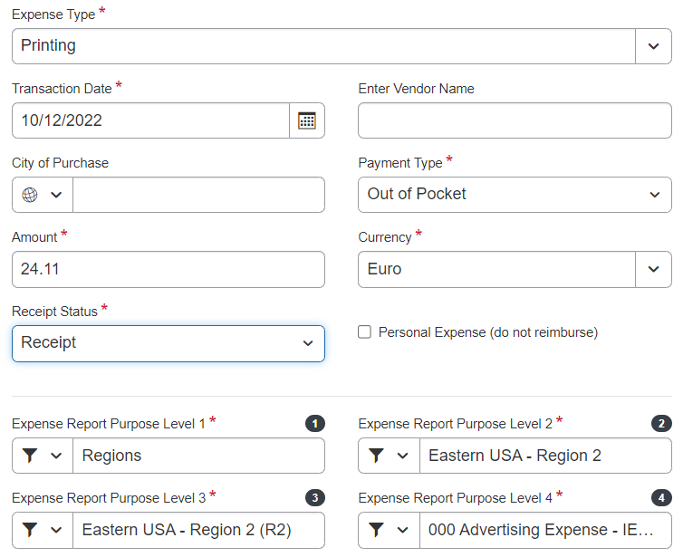
Tiered Expense Report Purpose (ERP) Levels
Report Header
Expense Line Entry
ERP 3 = Oracle
PPM Project
ERP 4 = Oracle
PPM Task/WBS

Slide 15
“Approver” – How to Edit a Submitted Report
Click on the “Expense Line” that you would like to Edit
On the Right Hand Side, anything that has a “red vertical bar” can be edited by the approver (highlighted yellow items)
1
2

Slide 16
“Approver” – How to Edit Expense Report Purpose Level
Click on the “Expense Line” that you would like to Edit
On the Right Hand Side, click the drop down arrows by expense report purpose levels 1 – 4 to update
Once updated, click save, then approve the expense report to push to new approval flow
Every expense line will need to be updated individually

Slide 17
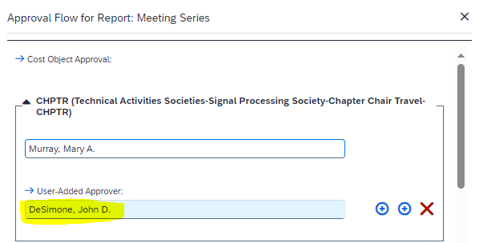
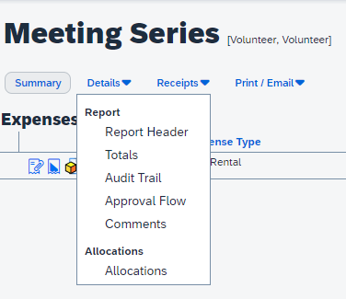
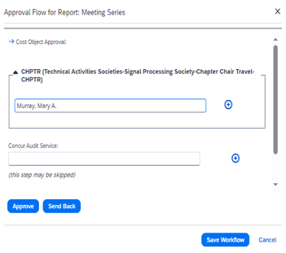
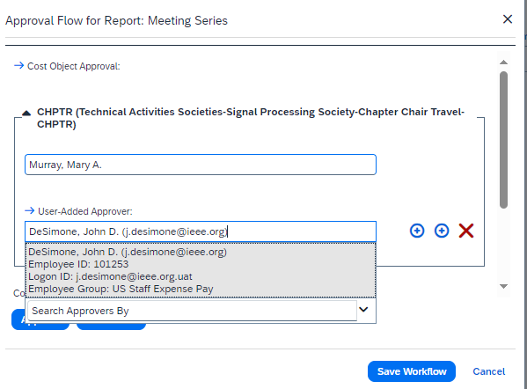
“Approver” – How to Add/Transfer Approval of Expense Report to Another Approver
Open the Expense Report
Click on “Details” then “Approval Flow”
Cost Object Approval Window Opens: click on the down arrow to expand the approval, then click on the + next to your name
Type in the name of the approver you would like to add and click save workflow, then click “approve” in top right-hand corner
1
2
3
4

Slide 18
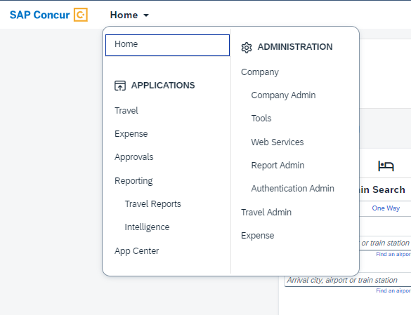
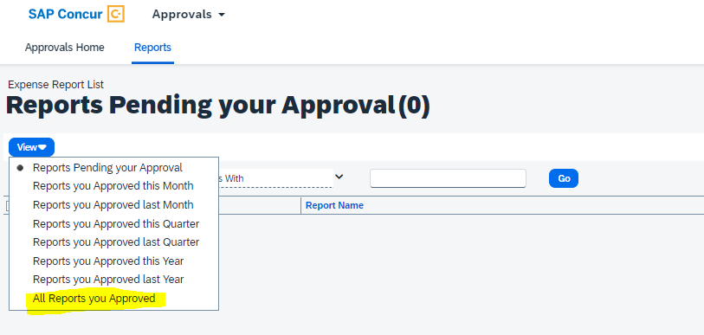
Approvers - View all Expense Reports You’ve Approved
View the expense reports that you have previously approved
Click Approvals > Reports > View – select your report criteria
Tip: if you do not see a report that you have approved listed in
report view this means the expense report has been returned to submitter

Slide 19
Appendix: Concur Helpful Tips for Submitters

Slide 20
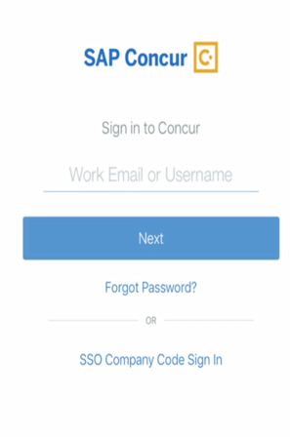
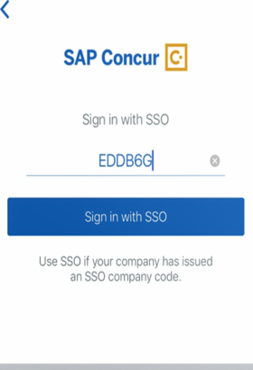
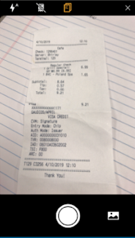
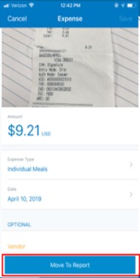
Mobile App – Access Anytime, Anywhere
Log into the mobile app securely using IEEE’s Single Sign On (SSO) passcode (EDDB6G):
Use the ExpenseIt feature to upload a receipt image directly into your Concur profile as seen below:

Slide 21
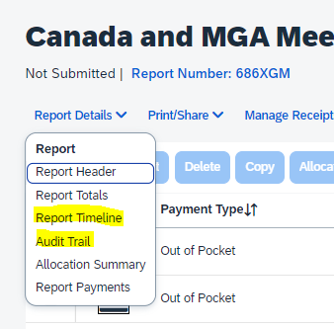
Report Submitter “Self Service” Features
View the Status of your Expense Report (Approval Flow & Audit Trail)
Real-time audit/status tracking visible to the submitter
To view the status of your expense report after it’s submitted
Report Details > Click on “Report Timeline” or “Audit Trail”
Receipt Options
Email receipts to: receipts@expenseit.com, they will automatically upload
into your Concur Profile (must verify email in Concur for this to work)
Integration with 3rd party applications (e.g., Uber, Lyft, etc.) which results
in electronic receipt creation

Slide 22
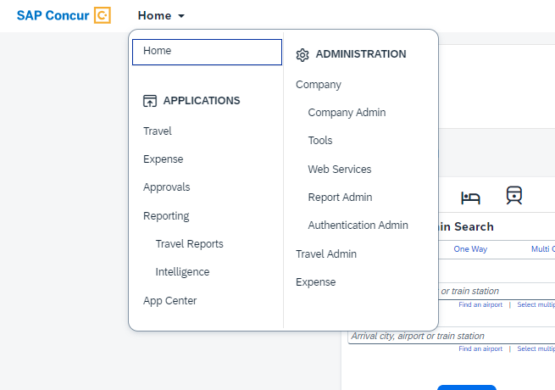
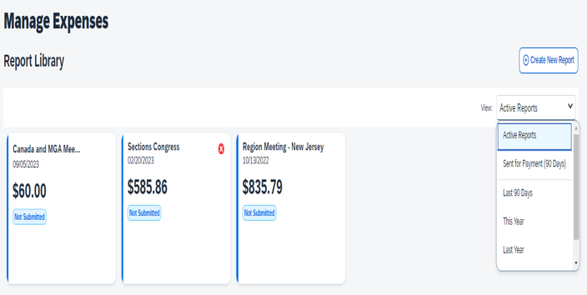
“What’s the Status of my Expense Report?” Approval Flow/Report Timeline
Step 1 – Click on Home > Expense
Step 2 – Change the “View” in Report Library
*Please note: You can only see the approval flow/report timeline after the report has been submitted

Slide 23
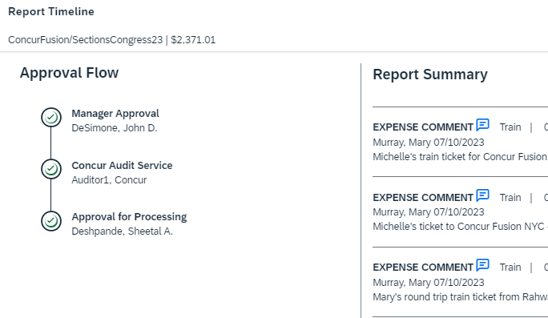
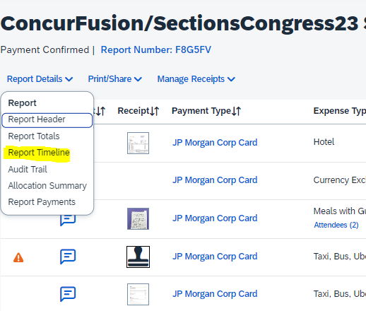
“What’s the Status of my Expense Report?” (cont.) Approval Flow/Report Timeline
Step 3: Open Report, Click on Report Details > Report Timeline
Step 4: Review Report Timeline to see Status
*Please note: You can only see the approval flow/report timeline after the report has been submitted

Slide 24
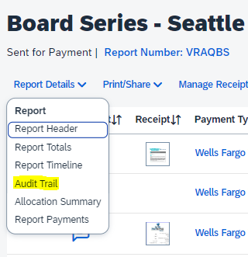
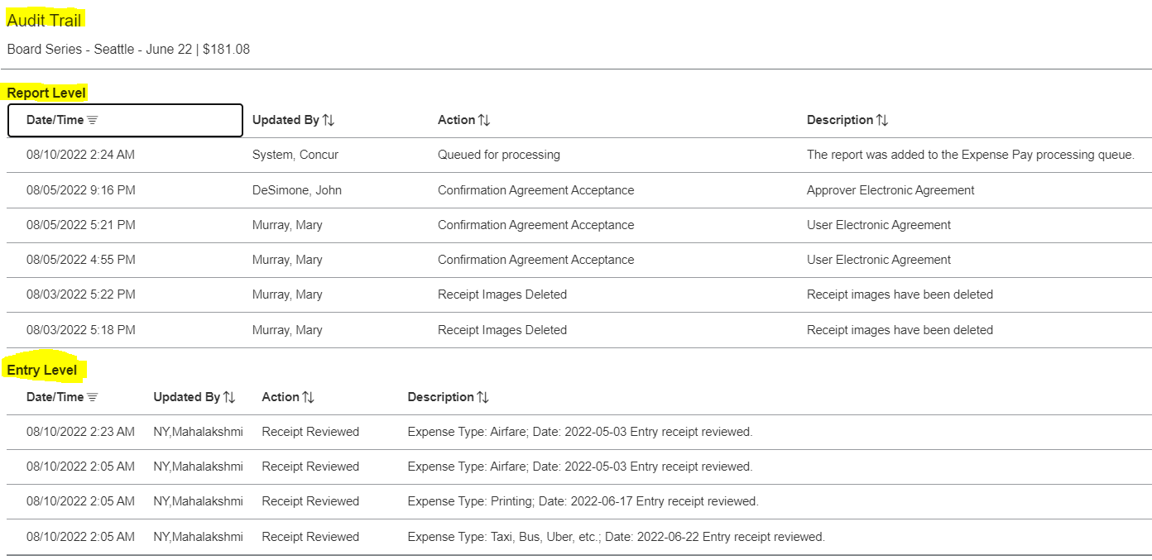
Audit Trail
Step 1 - How to Navigate
Step 2 – Click on Audit Trail
*Please note: You can only see the audit trail after the report has been submitted

Slide 25
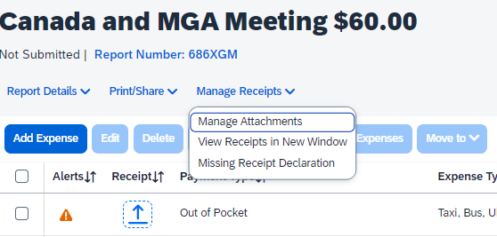
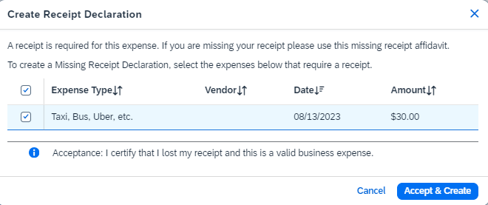
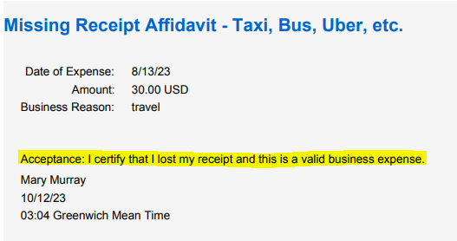
Missing Receipt Declaration
Step 1 - How to Navigate
Step 2 - Select Transaction
Step 3 - Final Confirmation

Slide 26
Combine Expense Reports using MOVE command
How to “Move” an expense line to another expense report
Please check the expense line(s) that you would like to move
Click the blue “Move to” box
Select the report that you would like to move the expense(s) to: New Report, Sections Congress or Region Meeting – New Jersey

