Slide 1
REGION 3 EDUCATION ACTIVITIES
Damith Wickramanayake
Southeastcon
March 21-24, 2024

Slide 2
Region 3 Education Activities
The Educational Activities Coordinator s
member of Section Support Committee
Serve as the Region 3 Representative to the EAB Section Educational Outreach Committee.
Responsibility includes:
To Encourage Sections to support STEM education efforts
2024: Plan: Information Sessions - Work Collaboratively with
R3 STEM Coordinator – Melody Richardson
Professional Activities Committee
Students –
Region 3 - Best Practice Webinar

Slide 3
IEEE Educational Activities Structure
IEEE Educational Activities Board (EAB)
Nominations & Appointments Committee (N&A)
Awards and Recognition Committee (ARC)
University Resources Committee (URC)
Continuing Education Committee (CEC)
Pre-University Education Coordinating Committee (PECC)
Sectional Education Outreach Committee (SEOC)
IEEE Eta Kappa Nu Board of Governors
(IEEE-HKN)
Faculty Resources Committee (FRC)
Credentialing Program Committee (CPC)
SEOC Scope
The SEOC will have the lead responsibility within EAB for building and maintaining strong working relationships with IEEE Regions, Sections, and Chapters.
Committee on Engineering Accreditation Activities (CEAA)
Educational Products Editorial Committee (EPEC)
Committee on Engineering Technology Accreditation Activities (CETAA)
Engineering Projects in Community Service Committee in IEEE (EPICS)
Notes:
Our Educational Volunteer Committee Structures are designed to support that lifespan of engineering activities.
We have dedicated committees to Pre-University, University, and Continuing Education Activities.
IEEE-Eta Kappa Nu was a separate organization that merged with IEEE over a decade ago, and they have their own Board of Governors and their own President who has a seat on the Educational Activities Board.
Also, as with most major boards of IEEE, Educational Activities also has committees dedicated to our Awards and Recognition and Nomination and Appointments processes.
Finally, we have a unique committee within Educational Activities who is focused on organizing the programs the local level within IEEE Regions. The Section Education Outreach Committee is made up of the 10 Education Chairs of each of the IEEE Regions. Those Region Education Outreach Coordination positions are designed to promote and expand awareness, and engage volunteers in our programs at the local level.

Slide 4
Educational Activities Priorities for 2024
1.
5.
9.
2.
Continuing Education Products including
10.
6.
11.
3.
7.
12.
EAB Awards Program
4.
8.
13.
President’s Scholarship
IEEE Proprietary

Slide 5
EAB – PROGRAMMES & FUNDING OPPORTUNITIES
STEM Grant Program - designed to spur STEM outreach & innovation
Provides funding to IEEE volunteers to develop new STEM programs or enhance existing programs.
Online portal for continuing education products from many organizational units and Societies across IEEE.
Representing Regions 5, 7, 8, 9, 10 and 28 Sections
Empowers students to work with local service organizations to apply technical knowledge to implement solutions for a community’s unique challenges.
FUNDINNG: Up to 10,000 USD - Deadline: May , 2024

Slide 6
AWARDS
Recognize and honor major contributions to engineering and technical education.
Award nominations are accepted 1 January each year.
The annual deadline is the first Monday after 30 April of that year.
REGION 3 AWARDS

Slide 7
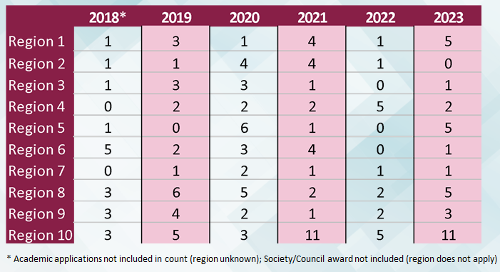

Slide 8
THANK YOU
Q & A
Contact:
Damith Wickramanayake:
damithwick@ieee.org

