Slide 1
Atlanta Section
Section Chair Report
Lightning Round

Slide 2
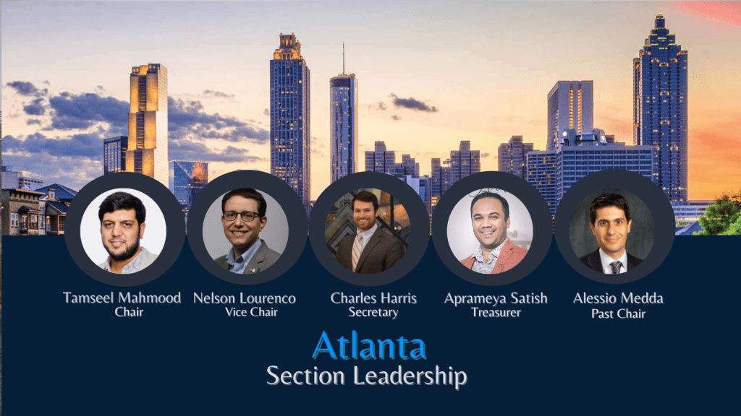
IEEE Atlanta
We have been busy…
Hope you had a great SoutheastCon 2024!

Slide 3
Atlanta Section Report
Goals:
Milestones
Increase Engagement
Diverse Options to benefit members
Ease of finding information
Effective communication
Membership increment by at least 1%
Higher number of events compared to 2023 count
Mini conferences, workshops, mentorship opportunities
Obstacles and Opportunities:
Social media presence
More dedicated volunteers
Centralized administration – Collabratec use
Industry engagement and partnership
IEEE SoutheastCon 2024, Atlanta, GA

