Slide 1
IEEE Region 3 Member Communications Committee

Slide 2
New Initiatives and Best Practices
Andrew Seely, MCC Chair 29 March 2025

Slide 3
Member Communications
The MCC facilitates communication between the Region, Sections, Chapters, and individual members.
MCC’s lines of effort in 2025:
Monthly Member E-Notice
Quarterly Region Newsletter
Region Web Site
Social Media
Collabratec
Metrics and Measures
Fellows Coordination

Slide 4
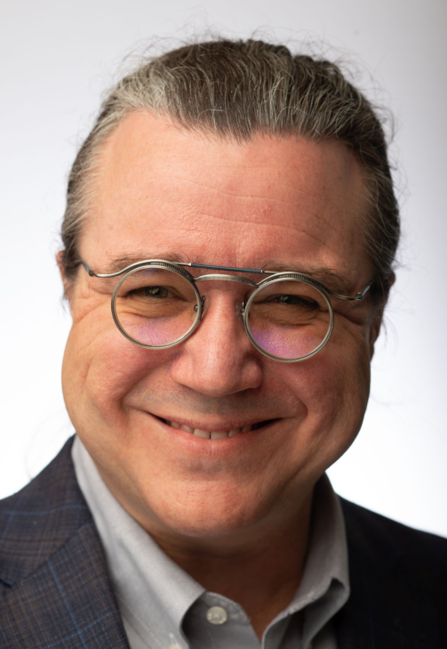
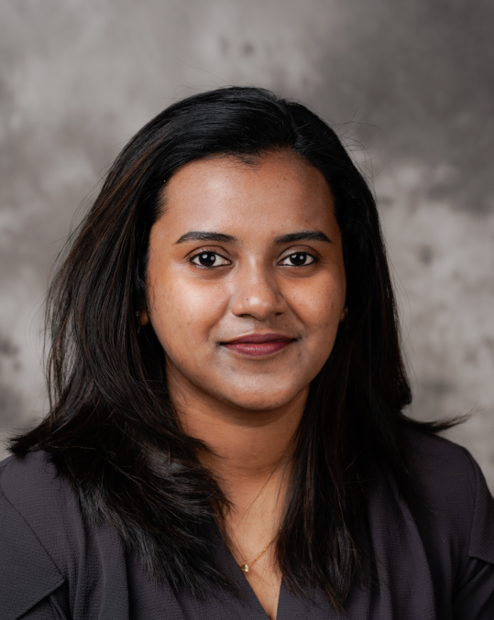
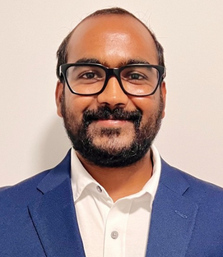
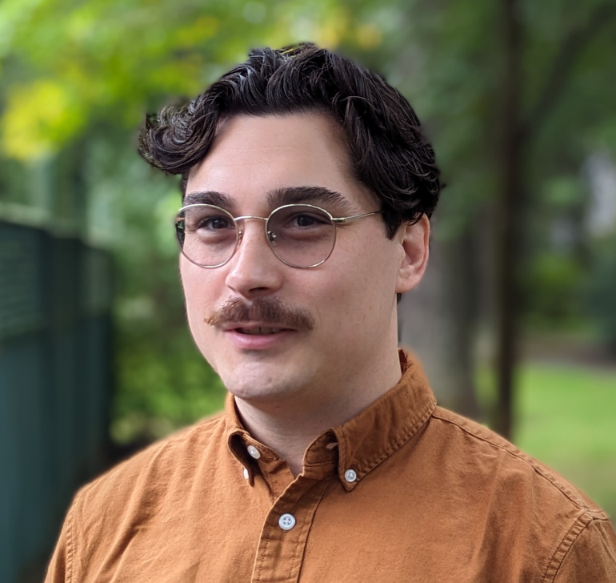
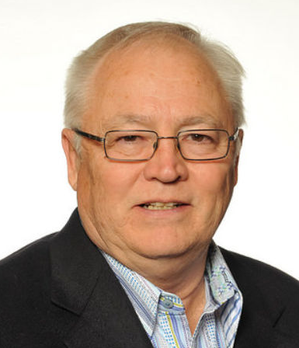
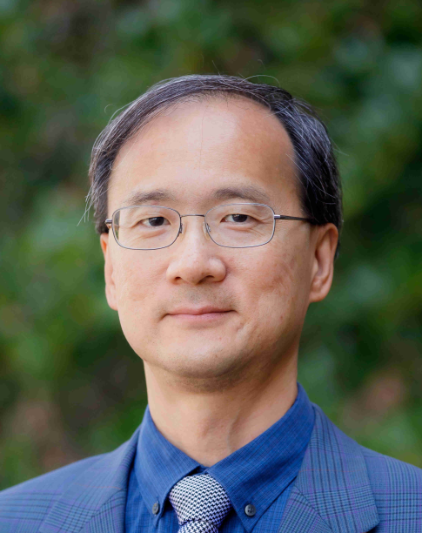
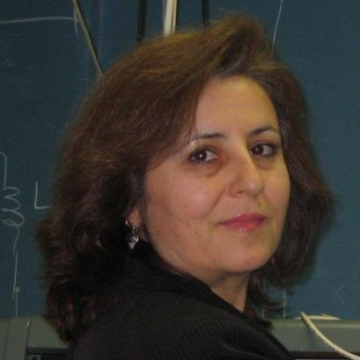
Team MCC
Chair: Andy Seely
Newsletter Editor: Bill LaBelle
Assistant Editor: Evelyn Licona
Webmaster: Lucas Sweet
Collabratec: Naresh Erukulla
Social Media Coordinator: Megha Ben
Social Media Team:
Angel Pinnock
Ahmed Elsayed
Susan Goodwin
Sree Ranjani Rajendran
Metrics and KPIs: Brian Page
Member Retention (SSC liaison): Patrick Kung
Fellows Coordinator: Hulya Kirkici
MCC Mentor: Sonya Dillard
To communicate effectively, MCC needs to meet the members where they are, not expect them to come find us!

Slide 5
Volunteers are Key to Communication
Member Communication relies on channels:
Web
Email
Persistent chat
Social media
Webinars
In-person events
Communication channels need management:
Any communication channel withers without continual maintenance
Assigning a new volunteer a limited responsibility helps to grow new leadership
Engage your volunteers, give them a sense of value

Slide 6
Need Help Finding Volunteers?
Build your volunteer cadre:
Define some volunteer roles
What it is, Why it matters
What is expected, Level of Effort, for how long
Pull your section membership from OU Analytics
Reach out to people in small groups, ask them if they would be interested in a volunteer role
If you get more volunteers than you need, always find a way to use them anyway
Don’t get discouraged, keep trying! One volunteer at a time.
Celebrate and reward
Announce new people to your section via email, web, social
Give out letters of appreciation (they’re $Free!)
Andy’s Secret Weapon …
Just Ask Someone

Slide 7
Initiatives in 2025: Web Modernization
Your section’s web site is likely the first place many people go to find contact information, details about events, and take a first step to volunteering
A defunct web page discourages engagement of members
Region 3 is working with each section to capture your current web page, current webmaster, and link back from the R3 homepage.
Recommendation: Assign a volunteer as your section’s webmaster and ask them to report monthly. Ensure your web information is up to date with R3 webmaster. Ask for help from R3 to get started.

Slide 8
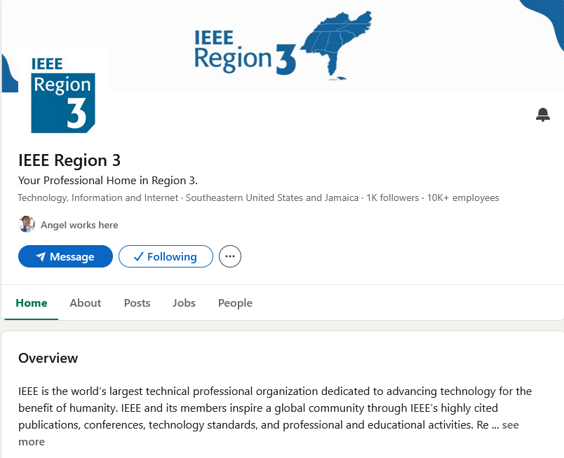
Initiatives in 2025: Social Media
Social media is where many of our members are, we have to go to them
Linked In 1180 followers
XTwitter 579 followers
Instagram 125 followers
Facebook in progress
Youtube in progress
Recommendation: Assign a volunteer as your section’s Linked-In Coordinator, establish a section page, invite your members to follow it, and make a plan to post something weekly. Region 3 Linked-In page will help promote you.

Slide 9
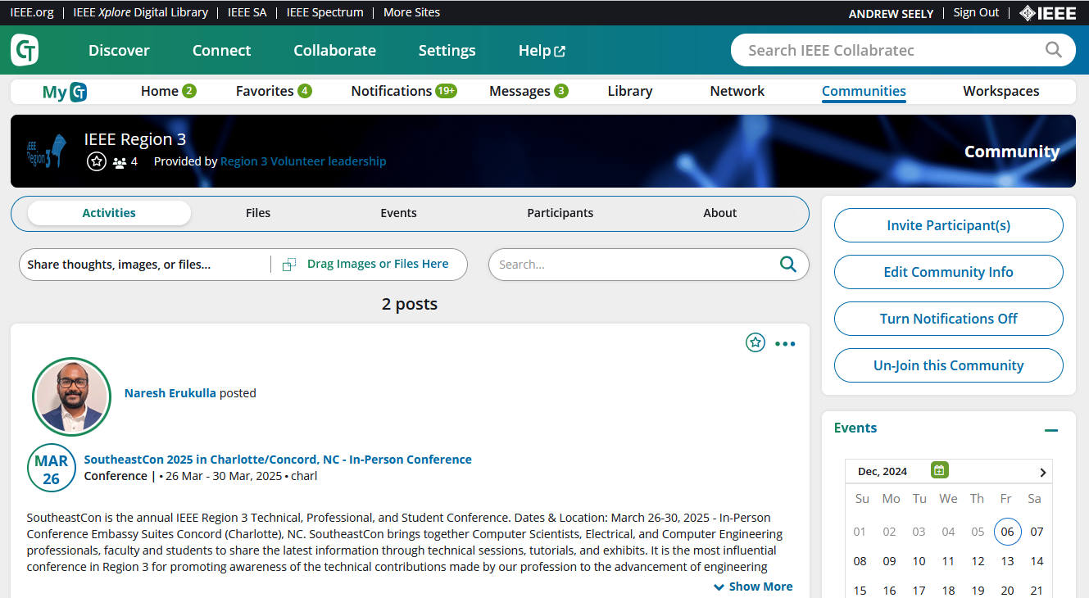
Initiatives in 2025: Collabratec
Region 3 launched a Collabratec Community in 2024
Provides a collaborative platform for member communication
Provides an enduring repository for section artifacts
Help is available from Region 3
Recommendation: Assign a volunteer as your section’s Collabratec Coordinator, establish a section workspace, invite your members to join it, and USE it to support your monthly EXCOM meetings. Region 3 Collabratec will help you get set up.

Slide 10
A parting word
Building up your volunteers isn’t fast or easy.
Take it one volunteer role, one volunteer at a time.
Remember that you’re not just getting someone to do your web page, you’re developing a future section leader.
One volunteer at a time. 1V@T

Slide 11
Thank you
Andrew Seely, Andrew.seely@ieee.org

