Slide 1
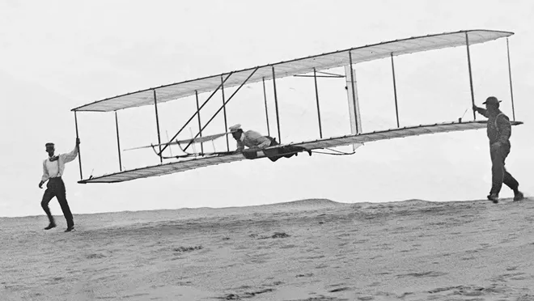

Navigating the Career Jungle:
Unleashing Your Potential in Today's Work Landscape
A few Tips to Manage Professional Development & Career Security
Bala Prasanna
IEEE Region 1 Director (2024-25)
bprasanna@ieee.org
28 March 2025
IEEE R3 – SouthEastCon-2025

Slide 2
From Recent HR articles -
Lack of Soft Skills: Recent grads are falling short in areas like communication, collaboration, critical thinking, and adaptability
Employers are firing Gen Z grads within six months due to deficiencies in communication, teamwork, and problem-solving skills
83% of employers find it challenging to work with employees who lack these essential skills.
Could this be your wake-up call?

Slide 3
Great things are not done by impulse,
but by a series of small things brought together. Vincent Van Gogh
Life consists not in holding good cards
but in playing those you hold well. Josh Billings
This time, like all times, is a very good one,
if we but know what to do with it. Ralph Waldo Emerson
Our problems are many,
but our capacity to solve them is limitless. Ronald Reagan
Change is gradual, you should aim for progress, not perfection. Mayim Bialik

Slide 4
For the lack of a nail, the shoe was lost.
For the lack of a shoe, the horse was lost.
For the lack of the horse, the message was lost.
For the lack of the message, the battle was lost.
For the lack of the battle, the war was lost.
For the lack of the war, the kingdom was lost.
All for the lack of a horseshoe nail.
Something your grandmother may have taught you

Slide 5
Tomorrow Will Be Nothing Like Today
from a billboard at JFK Airport

Slide 6
We Are All Alone In This Together
    Graham Lindsay
Career Security through Career Growth
- Learning and Practicing Soft Skills as an important path
Driving Your Own Behavior Around Values of Importance to You
Being Relevant in Workplace
- Personal management System
- training
- relation management
- creating track record
- Stay Disciplined
- Resilient
Take Yourself Further

Slide 7
If I have seen
f a r t h e r,
it is by standing on the shoulders of giants.
Isaac Newton

Slide 8
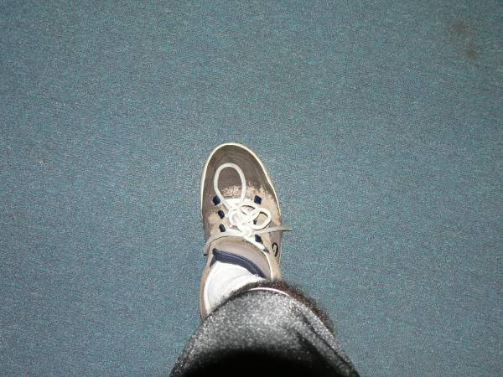
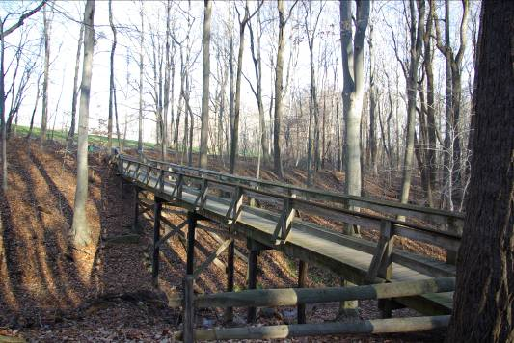
take a step…
…there’ll be a bridge

Slide 9
Once you’re in low Earth orbit (LEO), you’re halfway to anywhere.
Robert Heinlein
Science Fiction Writer
This is due to the mechanics of space launch, where accelerating into LEO is a large portion of your journey.
Storing mass in LEO is a way to make trips beyond LEO easier.

Slide 10
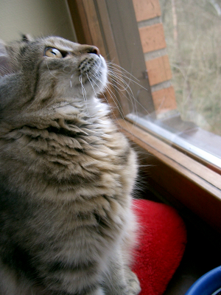

how people perceive you
is under
your control

Slide 11
Life Management Skills For Success
Career Planning
Balancing work & personal:
leveling the scale
Networking
Interpersonal Skills
Leadership
Volunteering

Slide 12
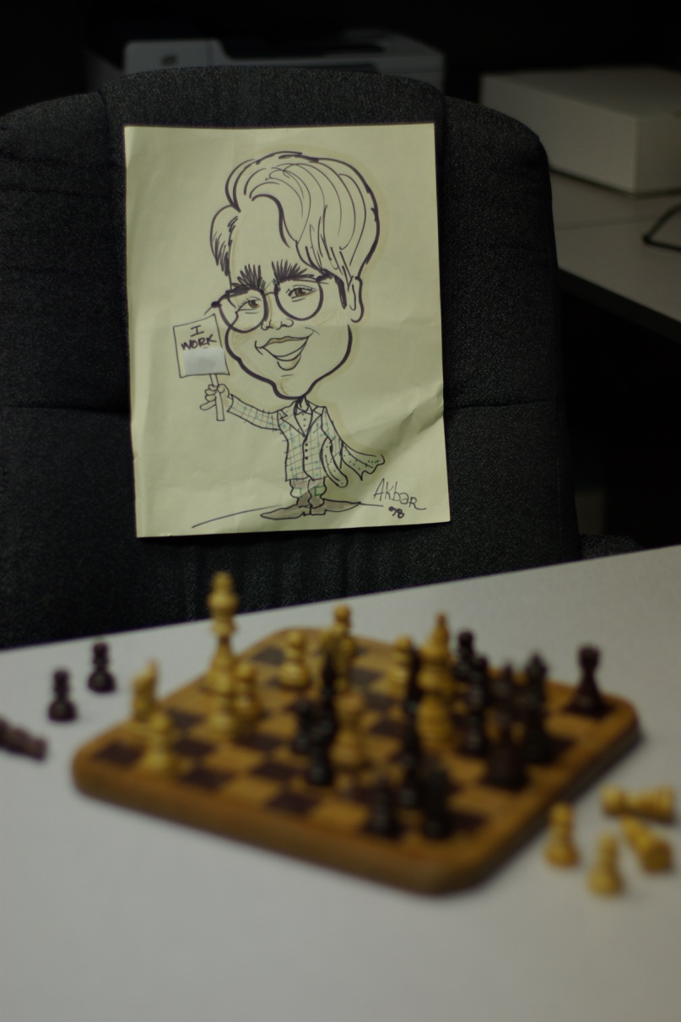
grasp the
big picture
Players
Rules of the Game
Unwritten Rules
What is the Big Idea?
Business Control Practices
Outside the Box
Annual Productivity measures
Performance assessment
Strategy and Tactics
Legal & Ethical
  Intent counts in ethics
roll with the punches…
Notes:
trategy

Slide 13
Failing to Plan is Simply Planning to Fail
Health, Family, Vacation, Hobbies/Stress Relief
Deadlines, Workload, Overtime, Training
Work Career Plan - Technical, Management
Work Your Balance Muscles
Head with Heart
Money & Meaning
Top of the Mountain & Journey
Friendly & Firm
To ignore or deny this balance is setting yourself up for disappointment & dis-ease
You must always be training for the next level up if you wish to advance.
. Be willing to experiment with behavior modification
. Train a back-up
. Do not procrastinate – a true stress buster!
. Gain control – Think Time & Think Place

Slide 14


Good posture, Neat appearance
Positive non-verbal communication
Eye contact, Confident handshake
Be positive and energetic
What you say and how you say it
Establish how you want to be treated
Talk Up
Never go to a meeting unprepared
Ask Questions, Ask Good Questions, Ask Better Questions
If you don’t manage your relationship with your manager and peers, you will not have resources to get your job done.

Slide 15
NETWORKING
where?
with whom?
why?
what will I be able
to contribute?
when?
gain?
If you help others, they’ll be more likely to help you
Follow up with leads; acknowledge sources
Thank contacts
Do what you promised to do
Keep your antenna up
dig your well before you are thirsty
Is your NET-working for you?

Slide 16

Leadership is not about position; it’s about doing.
Live & work with paradoxes
Push the frontiers rather than follow
Promote innovation
Influence and guide
Act as catalysts
Champion causes
Have that invisible something that attracts followers
Articulate a vision and make it happen
Focus on customers
Anticipate the future
Stick your neck out
Focus on the real work, not the mundane
Deal with ambiguities - can you rationalize fuzzy data
Be transcendent
Own higher levels of confidence

Slide 17


Conflict Holds Creative Potential
win/win: conflict can be healthy when it brings out new ideas & relationships
win/lose: distrust, anger, withdrawal
conflict is unavoidable & common
negotiation is the primary key to resolving it
conflict & negotiation are central parts of organizational life
don’t let conflicts/differences harden into resentment, hate, or anger

Slide 18
Handling Conflict Productively
Competing: assert your position w/o opposing view points
Avoiding: stall, ignore, sense of timing
Collaborating: fully satisfying both sides (relationship is important)
Accommodating: forgoing (your) concerns (selfless)
Compromising: negotiating, finding middle ground
do not overuse anyone
Link to IEEE HKN Career Conversations-Workplace Conflict
https://youtu.be/-PCdoggl2bk?si=htT4F9qBazKGn2Xj

Slide 19
Office Politics
You always have to play politics.
But remember, there is good politics &
there is bad politics.
Managing your boss
Managing your peers: relations with coworkers are often trickier than managers
Who are your angels?
Hustle & Harmonize
Nobody wins unless everybody wins
Don’t just ask for opinions; change them
Everyone expects to be paid back
Success can create opposition
Don’t ignore the aftermath of success

Slide 20
what is your brand?
When you have Joe’s word, you can take it to the bank.
No matter when I go and what question I have, Mary has given me satisfactory answers all the time on this project.
When you see my name on a technical document, it comes with
a 100% guarantee - no equivocation!
Russ’s thought process, judgment & communication at the right time
has never let me down.
When you assign testing to Kumar, good as gold.
Wow, you make a great teacher/mentor/debugger ..!
When in doubt, I always count on Dawn for my answers
You cannot be all things to everybody. Understand your strengths & create a positive branding of you.

Slide 21
Don’t sweat the small stuff…
Avoid weatherproofing
Choose your battles wisely
Praise & blame are all the same
Do one thing at a time
Just for fun, agree with criticism directed towards you (& watch it go away)
Surrender to the fact that life isn’t fair
Look for the extraordinary in the ordinary
Give up on the idea that more is better
… and it’s all small stuff

Slide 22
Now, the big stuff…
Manage for Results
Differentiate & understand Headlines vs. Trendlines
Don’t burn your bridges
Learn to prioritize
“And then more” – Overachieve on expectations
Milk a cow; don’t milk a duck
Time Management - front loading & multi-tasking
Time, Relationship, Career, Anger Management
Money, Money, Money
-Power of Compounding - Save $ .. Did you know ..?
- good credit(student loan, buying a house, …)
& bad credit (car, furniture, …)
Member of a professional society
Quality of life for you and people around you
Disillusionment at work -
  too much idealism gets in the way of progress;
  be philosophical in approach
… if you screw up, go back & ask:
What can I do REGAIN your confidence in me?
… and it is big stuff…

Slide 23
… and some more
Personality amplifiers (bring back that smile on your face)
Managing “self”
    Time, Relationship, Career, Anger
    Wide angle view of the profession
    Read your boss’s mind
Have your elevator speech ever ready (not more than 45 seconds)
Monkey on the back (mine vs. yours)
Is sloppiness in speech caused by ignorance or apathy? I don't know and I don't care. William Safire

Slide 24
… and some more
Speaking to your Boss
This just isn’t possible
- always speak in terms of what can be done
I can’t stand working with ….
- reflects poorly on you, do not make this your boss’s problem
But I emailed you about that last week
- alerting by an email does not absolve you of your responsibility
It is not my fault
- whiny 8-year old, or take charge professional?
But we have always done it this way
- Don’t kill new ideas with negativity

Slide 25
… and some more
Be passionate about deadlines
Be a maintenance-free employee
E-mail etiquette
  Not a private communication between sender/receiver
  Reply-only-sender vs. reply-all
    What court are you playing?
  Writing/expressive skills
  Promptness in response
Be a Professional!
Separate your personal attititudes from professional expectations
Consider PE or PMP training
As a professional, have the stamina of a marathoner, not a sprinter

Slide 26
It’s all about choosing
how to
spend time
friends
how you interpret
criticism/feedback
how you feel
to nurture peer
& boss relationships
to equip yourself with
occupational armor –
training, networking
assignments
so make the right choices.
Think of Simon Cowell (American Idol) & Dr. House (House). Would you have them on your side?

Slide 27
Responsible Students
Set goals, stay focused on the future
Plan their time:
  Use a calendar to keep all events, due dates in plain sight
Study everyday:
  Do it steadily
Take notes:
  Teachers almost always highlight what is important
Keep their commitments to themselves and others
Get ready ahead of time:
  Being late or early is not something that simply happens;
  it is a choice you make!

Slide 28
Got Emotional Hygiene ??
We need to be clear which emotions are harmful and which are helpful; then cultivate those that are conducive to peace of mind. Often, due to a lack of knowledge, we accept anger and hatred as natural parts of our minds. This is an example of ignorance being the source of our problems. To reduce our destructive emotions we strengthen the positive ones; such emotional hygiene can contribute to a healthier society.
- Dalai Lama

Slide 29
Q: “At Auschwitz, tell me, where was God?”
A: “Where was man?”
- from Sophie’s Choice
You have a role to play in this world - a reason for being here. But it is up to you to find your part and direct your future.
You alone determine your destiny through your own efforts. Accept this responsibility - not just for yourself, but for us all. You have the power to change your life and the lives of others as well.
Don’t back away from the exercise of this power or wait for some one else to act. Of course you can get what you want, but part of what you want should be to help others along the way.
The good life is not a passive existence where you live and let live. It is one of involvement where you live and help live.
Whatever you do will be insignificant, but it is very important that you do it. Mahatma Gandhi

Slide 30
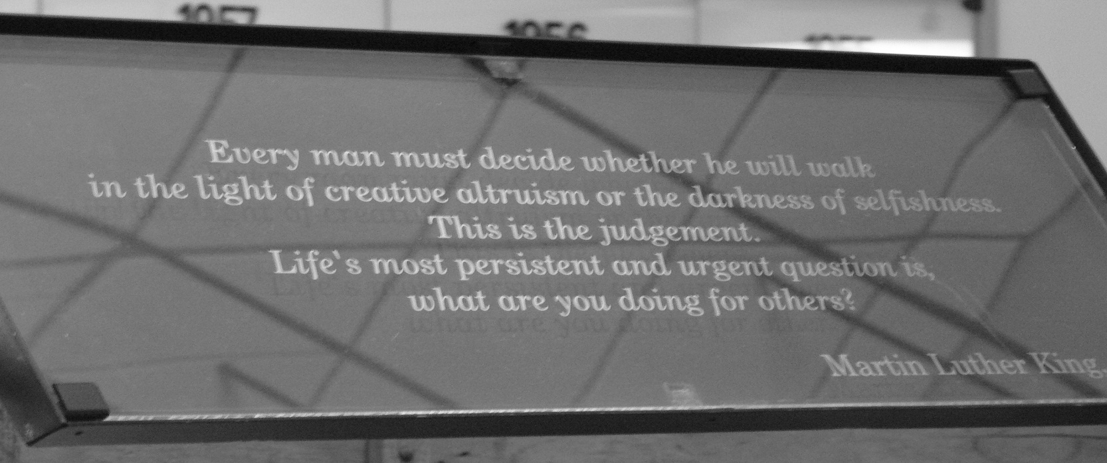
Being a volunteer

