Slide 1
Section Vitality & Succession Planning
Theresa Brunasso, Region 3 Past Director

Slide 2
Agenda
What are we talking about?
The Importance of Succession Planning
Overview of Volunteer Engagement
Why Don’t People Volunteer?
The #1 Secret
The Eight Do’s and Don’ts of Volunteer Recruitment
Next Steps
The Care and Feeding of Volunteers
Q&A

Slide 3
The Importance of Succession Planning
You want to retire someday…
Ensures the future of your Section.
Identifies qualified future leaders.
Creates structure for training and development.
Disaster-proofs your Section.
Provides additional help for your Section.
Gives you the opportunity to move on to new positions.

Slide 4
Help Wanted!

Slide 5
Finding and Engaging Volunteers
Do these problems sound familiar?
Are you struggling with finding volunteers to fill officer and committee positions?
Do you find that some of your volunteers don’t follow through with their commitments?
Do you find that other volunteers start out strong, and then just fade away…?
We’re going to review the Do’s and Don’ts of getting more people involved – more people ENGAGED.
You are busy too! We’ll learn to optimize time and energy spent on the recruitment efforts so it has maximum effect.

Slide 6
Why Don’t People Volunteer?
They have their reasons…
They have other work, volunteer, and family commitments.
They think others are better qualified.
They don’t know what volunteer opportunities are out there.
They don’t know or appreciate the value of volunteering.
They think it will take all of their time.
They aren’t interested.
They see the existing volunteers burn out.
Nobody asked them.

Slide 7
#1 Way to get a volunteer?
This is not a trick question
Notes:
Ask Charles if he’s willing to come up and help me with my presentation, then next slide

Slide 8
#1 Way to get a volunteer?
This is not a trick question
Ask Them!
Notes:
Ask Charles if he’s willing to come up and help me with my presentation, then next slide

Slide 9
#1. Announcements Do NOT Bring in Volunteers
Posting for volunteers is not recruiting
An announcement at your event is not recruiting
Most people will never volunteer when they see an announcement.
People want to be asked
SO ASK !!!

Slide 10
Example: Atlanta Section Call for Volunteers
The Atlanta Section is soliciting your recommendations for the following Executive Officer positions in 2020:
Atlanta Section Chair
Atlanta Section Vice Chair
Atlanta Section Secretary
Atlanta Section Treasurer
The terms of office shall be for one year starting on January 1, 2020. An individual must be of Member grade or higher or a Graduate Student Member to be eligible to hold elected office. Any member eligible to vote in the Atlanta Section elections may nominate an individual for office, and nominating yourself for an office is strongly encouraged. Any individual nominated for office should be willing to serve for the full year; we therefore recommend discussing the nomination with the individual prior to submission. The duties for each position are defined in the MGA Operations Manual, which may be found at the IEEE website, but a brief summary is also included below.
We got no responses!

Slide 11
Example: A Personalized Email Request
It’s all about your volunteer
We've opened up nominations for 2020 Atlanta Officers, and I wonder if you are interested in serving as Vice Chair next year. Wyman is running for chair, and the current treasurer and secretary are running to fill their positions again, so you would have an experienced team to work with. You've done an outstanding job as the SPSS Chapter Chair, and I know that you would be a great Vice Chair and Chair. Wyman, Kristin and I would be happy to answer any questions you have about the position, So let me know if you are interested and available.
As always, thanks for all you do for IEEE.
He said, Yes!

Slide 12
The Essential Components of the Request
Use them all
Explained why he would be good for the job
Let him know that he would have people supporting him.
Let him know that we would answer his questions.
Thanked him for all the work he’s already done for IEEE.

Slide 13
#2 – DO it as a TEAM
This should not be a one person show
Recruiting alone is one of the widest and deepest traps. To meet the demands of looking for volunteers, often one person runs around asking the same people to do a different job.
Partner with other volunteers on the current committees to brainstorm possible people.
Let others reach out to their contacts.

Slide 14
#3 – Do NOT take “Engagement” literally!
You don’t plan the wedding on a first date!
Don’t “propose” a long-term commitment
Instead, ask for a “date”
We often recruit as if we are asking for a life-time commitment!
Recruit for short-term project teams or tasks – not a lifetime commitment
Many people are afraid of getting tied into a job and never getting out of it.
Notes:
Do you want to run a conference next year, organizing everything? Second – ask for a small task such serving as publicity chair where we have a written description and resources.

Slide 15
The growing micro-volunteer phenomenon
Don’t ask for too much
The following tasks are defined for supporting activities for volunteers who may be interested in helping for a short period of time, but are not ready for a long-term commitment.
Types of tasks:
Technical (e.g. program review/edits, preparing flyers, IT support)
Managerial (e.g. securing venue, reserving A/V, ordering catering)
Labor (e.g. moving tables, suggesting and/or transporting a speaker)
Clearly outlines the time line of the volunteer position

Slide 16
#4 DO Use Events!
Don’t ask for a commitment—ask for help for an event.
Try the “event method” of recruiting
Use your events to
Awaken passion.
Test out the relationship
Identify strengths and weaknesses of the volunteer.
Make use of the Cookbook!
https://r3.ieee.org/volunteer-tools/region-3-tools-for-sections-processes-steps-for-organizing-activities/

Slide 17
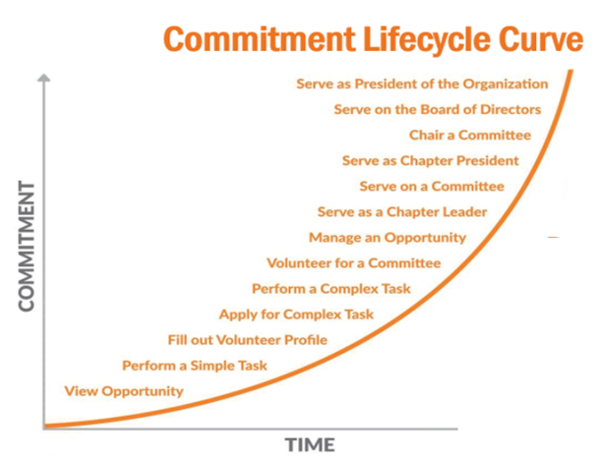
Commitment Lifecycle
Volunteer Career
Short-term projects provide excellent “first dates”— they’re how you find your long-term volunteers.
Gives people the opportunity to “try on” the role as a volunteer to see how it fits.
Short-term volunteers have the opportunity to become enthusiastic and work closely with a passionate leader.

Slide 18
#5 “No” doesn’t mean “Never”
It’s not you. It’s them
When we get the courage to recruit someone and then they say, "no" we often give up.
Timing is important. Sometimes “no" means "not now."
Don’t be afraid to ask again in the future.
Sometimes “no” means “not this role.”
Probe to find out what the person likes to do and consider another position
Learn when to stop asking.
Some will come back later.
Notes:
Skit – 10 excuses / 1 Month Later – NO /1 Month Later – NO /1 Month Later – YES . Ask Charles about doin something for the Section, perhaps Awards chair.

Slide 19
#6 DO Be People Driven!
It’s all about the volunteer.
Is this person a good match?
The "Butt In the Chair" method focuses on your needs, not the volunteer’s interests. Most people volunteer based on their interests, not your needs.
Often volunteers see themselves taking on a particular position or conducting specific tasks, based on their interests.
If we simply place volunteers where there is an empty position, the outcome will overwhelmingly be volunteers that quit.

Slide 20
Being People Driven
When looking for volunteers
Think “position.”
What positions need to be filled to accomplish our mission?
Think “role.”
What do I want the team members to do?
Think “people.”
Which people can fill those positions?

Slide 21
#7 – Do NOT Just Put Butts in Chairs
You’re trying to build a relationship
It’s easy to fall into the trap of following the “Butt in the Chair” syndrome.
We are in desperate need of a volunteer and need them quickly, we plead our case to everyone and at the last minute we get someone to be a "Butt In the Chair.“
Most times a chair is better empty than filled with the wrong person who does nothing. Complacency is contagious!

Slide 22
#8 Recruit by Duties and Responsibilities
Let them know what they’re getting into
Individuals are looking at the title of the position as if it was an employment opportunity.
Provide as much detail as possible so the volunteer knows what they are signing up for. The description should include:
Position Title
Responsible to
Mentors who can give guidence
Volunteers who can help
Time requirements for position
Key objective
List of Key Work Areas
Under each of the Work Areas, list subcategories of duties
Notes:
Let them know that the position description will be reviewed with them at the end of the year, and updated as needed.

Slide 23
Next Steps
You can do this!
Actively ask potential volunteers (individuals) to participate
Work as a committee, talk to other committees
Emphasize short term positions and projects
Maintain pool of contacts and know what they would be interested in
Be flexible with committee structures and avoid appointing a person just to occupy a position
Regularly review what positions are needed in your Section

Slide 24
Care and Feeding of Volunteers
Show them that you care
Offer varied duties
Give them freedom to make the position their own
Micromanagement is not appreciated!
Lookout for Burnout
Help them find their replacement
Recognize and reward
Awards
Pins
Certificates
Write-ups
Thank-you notes

Slide 25
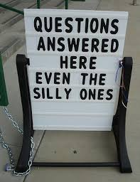

Slide 26
Thank you!
Theresa Brunasso
theresa.brunasso@ieee.org

