Slide 1
vTools and Information Management March 28, 2025
Eugene Khusid, Sr. Program Manager, Information Management, MGA

Slide 2
IEEE Member and Geographic Activities Board Committees 2025
MGA VP
MGA Secretary
MGA Staff
Vice Chair
Member
Development
Vice Chair
Geographic
Unit Operations
Vice Chair
Information Management
MGA Past Chair
MGA VP-Elect
MGA Treasurer
Member
Engagement and Life Cycle Committee
Geographic Unit Operations Support Committee
IT Coordination and Oversight
Committee
Strategic Planning
Nominations and Appointments
Operations Manual Compliance
Operations Committee
Admission and Advancement (IEEE)
Chapter Operations Support
vTools
Awards and Recognition
Finance
Member Benefits Portfolio Advisory
Life Members
(IEEE)
Potentials Editorial
Membership Recruitment and Recovery
Sections Congress
Student
Activities
Training
Women in Engineering (IEEE)
Young Professionals
(IEEE)

Slide 3
ITCO
Charter - MGA Operations Manual
IT COORDINATION AND OVERSIGHT COMMITTEE
GENERAL: The MGA Information Technology Coordination and Oversight (ITCO) Committee shall report to the MGA Board through the Vice Chair – Information Management.
SCOPE: The Committee shall be responsible for collecting IT requirements for MGA and coordinating/advocating their design, development, deployment, training, and usage.
FUNCTIONS:
Provide leadership, coordination, and oversight for automation projects to support membership and the geographic unit structure.
Provide oversight for enterprise solutions such as Entity Web Hosting.
Consult on business rules

Slide 4
vTools
Charter - MGA Operations Manual
VTOOLS COMMITTEE
GENERAL: The MGA vTools Committee shall report to the MGA Board through the MGA IT Coordination and Oversight Committee (ITCO).
SCOPE: The Committee shall work with the MGA ITCO and MGA Geographic Unit Operations Support (GUOS) Committee to develop solutions to assist geographic unit volunteers, develop and deliver training modules for developed solutions, and migrate solutions to normal IEEE IT operations. Additionally, it shall provide technical support to all MGA committees as requested.
FUNCTIONS:
Develop solutions compatible with the standard IEEE IT operations and support model for member and volunteer needs. Develop and provide training and advocacy for developed solutions. Work closely with Region Information Management Coordinators (IMCs) to deploy the solutions and the training

Slide 5
vTools portfolio is under volunteer leadership
Chris Gunning
MGA Vice Chair – Information Management & ITCO Committee Chair
Cinnati Loi
vTools Committee Chair

Slide 6
ITCO and vTools Committee Members

Slide 7
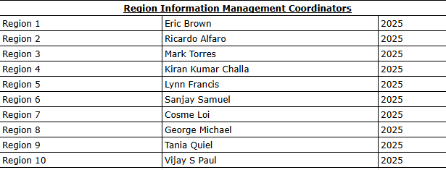
Region Information Management Coordinators

Slide 8
vTools

Slide 9
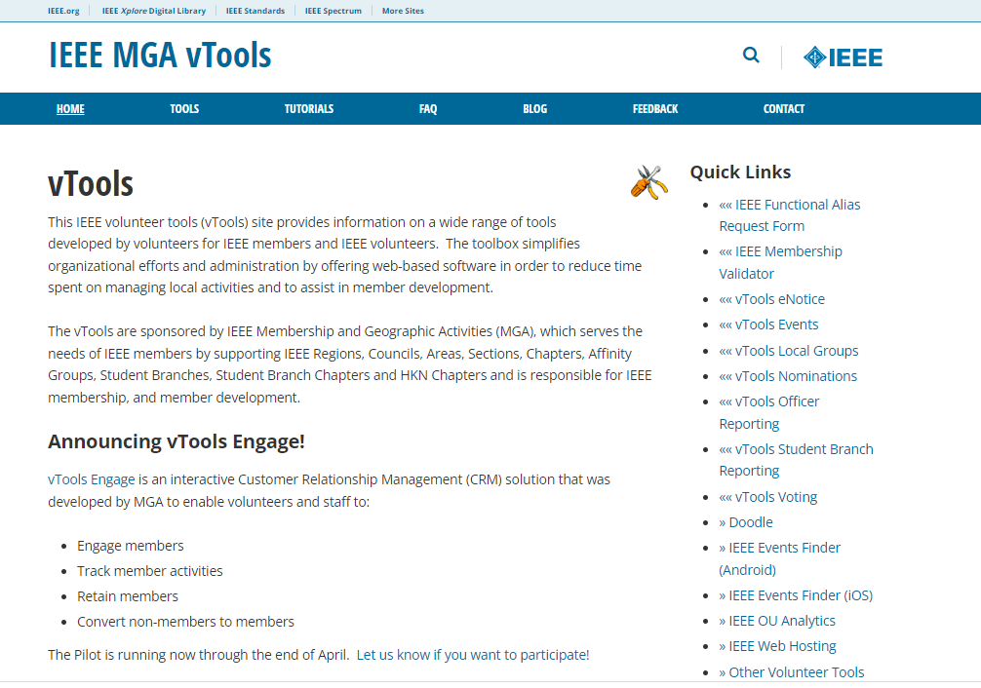
vTools Portal - vtools.ieee.org

Slide 10
Who can access vTools
Automatic access is granted for the following:
Region Executive Committee Members
Region-level Representatives (eg. Students, YP, WIE)
Region Directors
Section, Chapter, Affinity Group Executive Committee Members
Chair, Vice Chair, Secretary, Treasurer
Newsletter Editors*
Webmasters*
Membership Development (MD) Chair
SAMIEEE Recipient
Council Chairs
Student Branch and HKN Executive Committee Members
Includes Advisor, Counselor
vTools Coordinator*
eNotice Coordinator - access limited to eNotice only
To report officers in order to have access to vTools, use vTools.Officer Reporting
* does not require active IEEE membership

Slide 11
10 vTools applications we’ll overview today
Engage
eNotice
Events
Local Groups
Nominations
Officer Reporting
Student Branch Reporting
Voting
WebInABox
Xtreme Registration

Slide 12
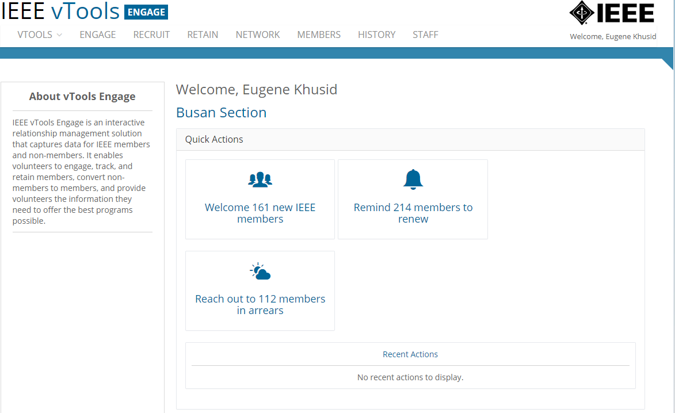
1. vTools Engage
https://engage.vtools.ieee.org
An interactive Customer Relationship Management system (CRM) that was developed by MGA to enable volunteers:
Engage members
Track member activities
Retain members
Convert non-members to members
Available for Region, Section, and Chapter use

Slide 13
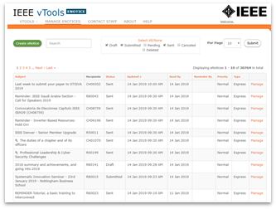
2. eNotice
https://enotice.vtools.ieee.org
Enabled email distribution of newsletters, meeting notices, social events and IEEE conference materials.
Source of email address is IEEE Membership database
Volunteers email their members about local events
Supports - Regions, Councils, Sections, Chapters, Affinity Groups,
Student Branches, Societies
Honors member communication preferences
Features
Express delivery within two (2) hours
Create eNotice content using Event information
Send email reminders to event attendees (registered and attended guests
Supports Attachments (i.e. speaker notes, flyers)
Supports Personalization (First Name, Last Name, Section Name, Email Address,
Grade, Membership Status)
Customization of eNotice ‘From’ and ‘Reply-to’
Preview of Draft and Express versions
Footer includes
Target OU’s URL (if available)
Option to manage their communication preferences
Send Test eNotice - eNotice sent to volunteer

Slide 14
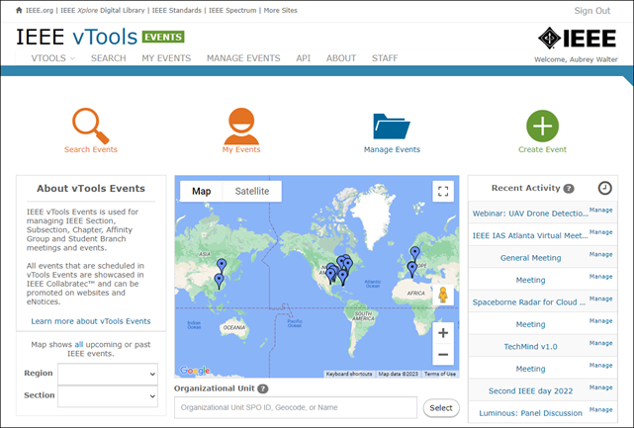
3. Events
https://events.vtools.ieee.org
Used to create and manage local events. Officers can create meeting announcements by entering all relevant meeting information in one central place. Each event is accessible at the vTools Events website and are automatically exported to various sites - IEEE Collabratec and the IEEE App.
Registration, with or without payment
Credit Card payments for R1-R7 with deposits to Concentration Banking (supports R8-R10 in USD)*
@Event - on-site check in provides quick one click ‘sign in’ for attendees
Event-eNotice Integration
Create eNotice from Event information
Send email reminders to event attendees (registered and attended guests) for a single event (@Event)
Feeds (RSS, HTML, XML) -Collabratec, IEEE mobile app, Section site
Promote – Twitter, Facebook, LinkedIn
Report meetings to IEEE headquarters (L31)
File Report option - one click to submit one report for all HOSTs
Reports submitted into Annual Section Rebate vTools application

Slide 15
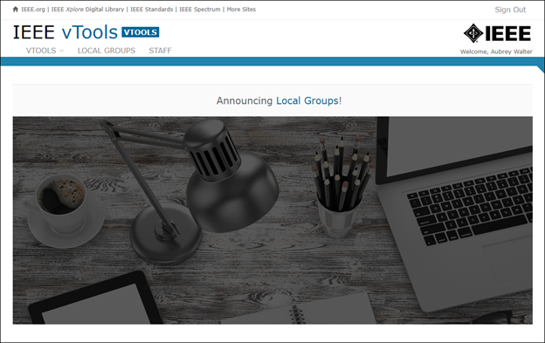
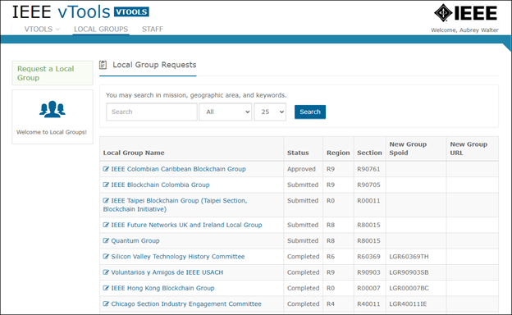
4. Local Groups
https://vtools.vtools.ieee.org
A Local Group is a new IEEE Organizational Unit that is a sub-unit of a Section, focused on a specified local interest
A Local Group shall comprise a minimum of two (2) IEEE members, one of whom must be an IEEE voting member, and both of whom must be members of the geographic unit involved
Local Groups require approval by the Section Chair
Both IEEE members and non-members may be participants of the Local Group

Slide 16
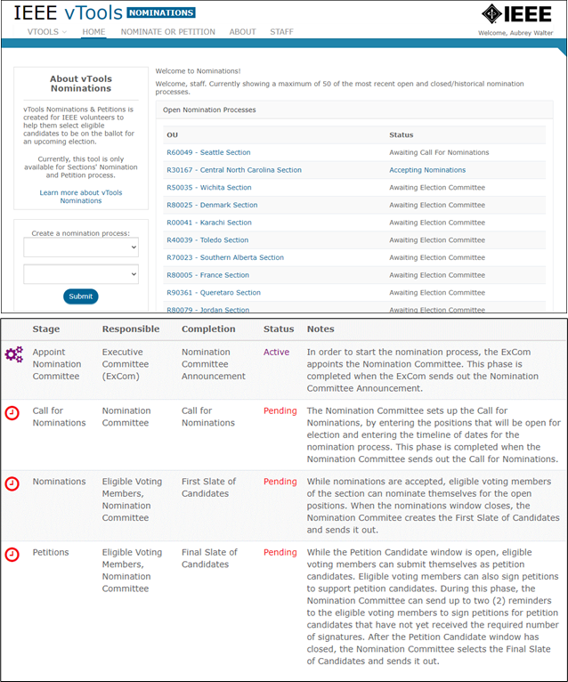
5. Nominations
https://nominations.vtools.ieee.org/home
Enables Section volunteers to manage the nomination/petition process
Step by step, easy to follow
Section Officers Appoint Nominating Committee
Nominating Committee
Establishes timing
Sends call for nominations
Prepares 1st slate of candidates
Reviews petition candidates
Send out final slate of candidates
Built-in validations
Built-in email function and editable templates
Integration with vTools Voting

Slide 17
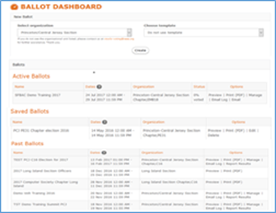
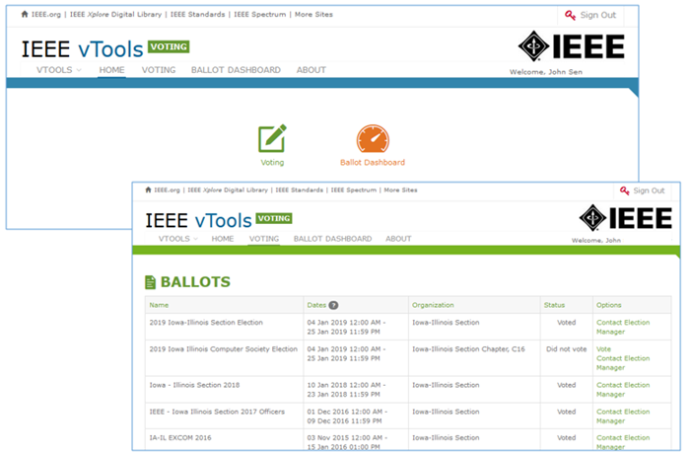
6. Voting
https://voting.vtools.ieee.org
Create ballots for local geo unit elections for:
Regions, Geographic Councils, Sections, Subsections, Chapters, Affinity Groups, Student Branches, Student Branch Chapters, Student Branch Affinity Groups Technical Committees
Features
Dashboards - Active, Draft, Past
Ballot/Motion*
Creation of multiple positions with multiple candidates
Auto-load voter list of eligible members for Organization holding election
Preview online ballot as DRAFT
Ballots and Motions now include explicit option to abstain
PDF /Print versions of ballot available
Once election is open,
Organizer emails voters directly from tool
Once election has closed
Review election results
Members sign in with IEEE Account for secure access to online ballot
Integration with vTools Officer Reporting
*Please note that this is different from the general IEEE elections.

Slide 18
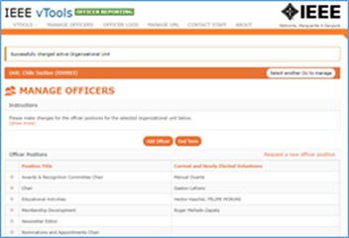
7. Officer Reporting
https://officers.vtools.ieee.org
An online officer reporting tool that enables authorized volunteers to make modifications to the officer roster for a given region, council, section or chapter. The tool provides automatic validation and updates the central IEEE database.
Online officer reporting
Supports: Regions, Councils, Sections, Subsections, Chapters, Affinity Groups, Student Branches, IEEE Eta Kappa Nu
Instantaneously updates the IEEE Membership database when submitted by authorized volunteers
Officers have automatic access once report saved
Updates OU Analytics and the IEEE organizational roster (overnight)
Features
View organizational roster
Automatic validation of
Valid Member Grade, Resides in OU
Add and/or End term of an officer
View Officer Logs of organizational roster changes
Update Organizational Unit URL (website)

Slide 19
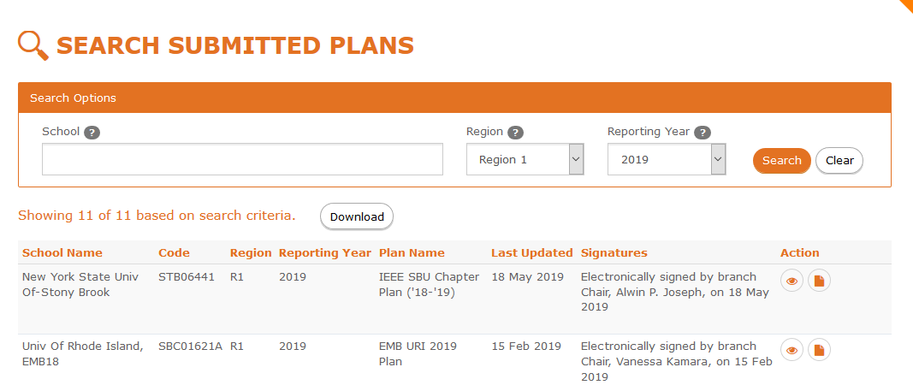
8. Student Branch Reporting
https://sbr.vtools.ieee.org
Student Branch Officers submit plans for upcoming year
Features
Student officers (Branch Chair, Counselor, Section Chair, Region Student Representative) provide approval of submitted plans
Plan details (i.e. Branch Operations / Function, Goals, Activities planned)
Search submitted plans, download PDF versions of a plan

Slide 20
9. WebInABox
https://webinabox.vtools.ieee.org
Basic web site “WebInABox” with wizard-like interface for creation
No webmaster skills required
Enables a common look and feel compliant with IEEE web presence guidelines
Integrates with Events - includes upcoming and past events
Data driven with auto updates from central IEEE database
Provides Officer Roster
Provides file storage
Supports Sections, Chapters, Affinity Groups and Student Branches
Not meant to compete with or replace complex content management systems such as WordPress

Slide 21
10. Xtreme
https://xtreme.vtools.ieee.org
IEEEXtreme is an annual global challenge in which teams of IEEE Student members—advised and proctored by an IEEE member, and often supported by an IEEE Student Branch—compete in a 24-hour time span against each other to solve a set of programming problems
vTools provides registration process for teams
Team information provided to competition platform host /vendor
Features
Member eligibility - Student and Graduate Student Members
Proctor Registration
Proctor Validation
Email confirmations to team admins, proctor and team members

Slide 22
OU Analytics

Slide 23
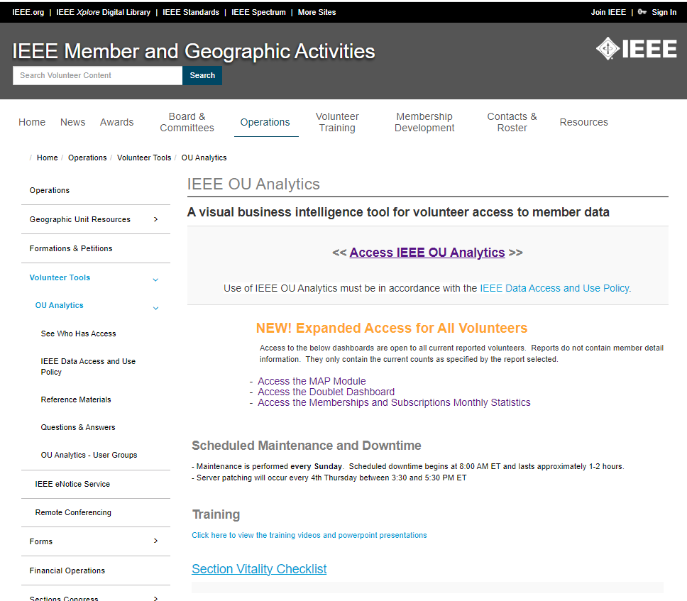
IEEE OU Analytics is …
A visual business intelligence tool which provides volunteer access to member data
http://www.ieee.org/oua

Slide 24
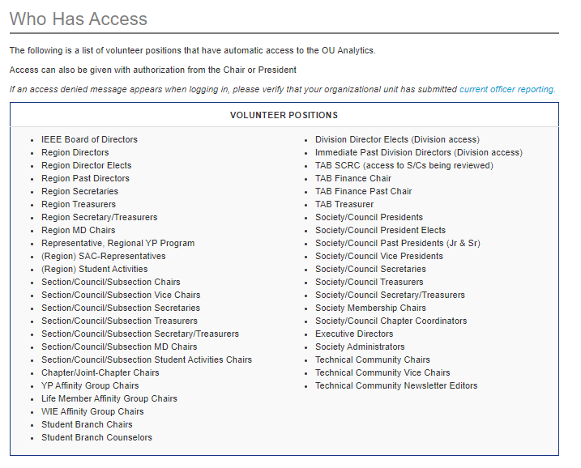
Who Can Access IEEE OU Analytics?
Notes:
www

Slide 25
What data is available?
Data is limited to your Organizational Unit
Region - All members and affiliates who live in the Region
Section - All members and affiliates who live in the Section
Subsection - All members and affiliates who live in a Subsection
Example: Montgomery Subsection of the Alabama Section
Chapter/Joint Chapter/Affinity Groups - All members and affiliates who live in the Section(s) and are a member of the associated Society
Student Branches - All student members attending the school of the Student Branch
Student Branch Chapters/Student Branch Affinity Groups – All student members attending the school of the Student Branch and belonging to the associated Society
Data includes:
Contact information
Grade and Grade History
School, HKN
Memberships – IEEE, Society, Affinity
Subscriptions
Volunteer Positions, including history
And much more

Slide 26
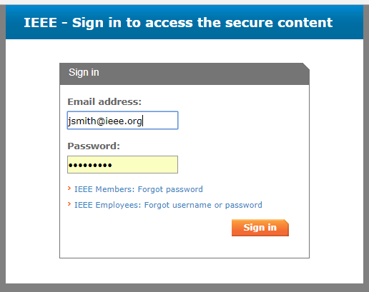
IEEE OU Analytics
Click “Access IEEE OU Analytics”
Use of IEEE OU Analytics must be in accordance with the IEEE Data Access and Use Policy.
Sign in with your IEEE Web Account Username and Password

Slide 27
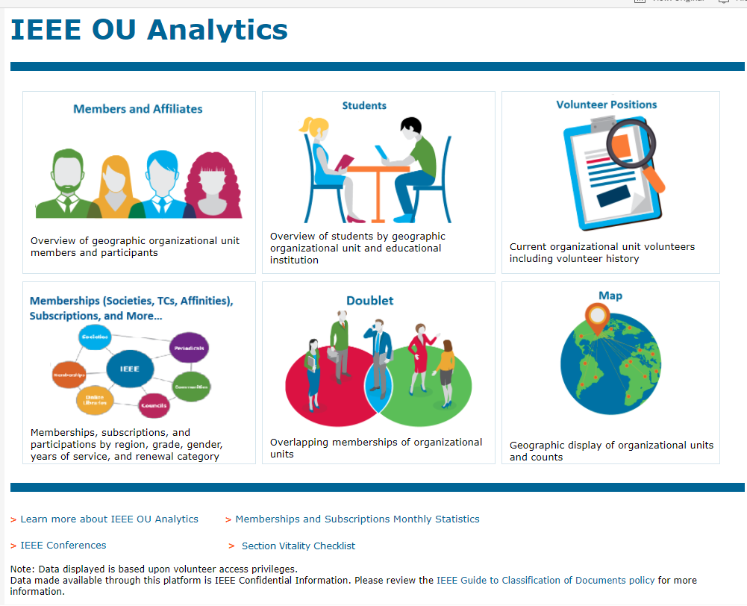
Landing Page
Six Modules
Members and Affiliates
Memberships
Students
Doublet
Volunteer Positions
Map

Slide 28
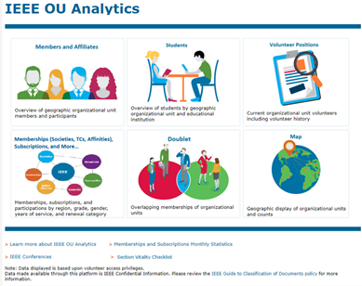
Members and Affiliates
Dashboard
Count By Region and Grade
Count by Gender (pie)
Count by Technology Focus
Count by Grade and Gender
Geographic Counts - by City / State / Province / Country/Grade
Employer Information
Member Activity
Detail

Slide 29
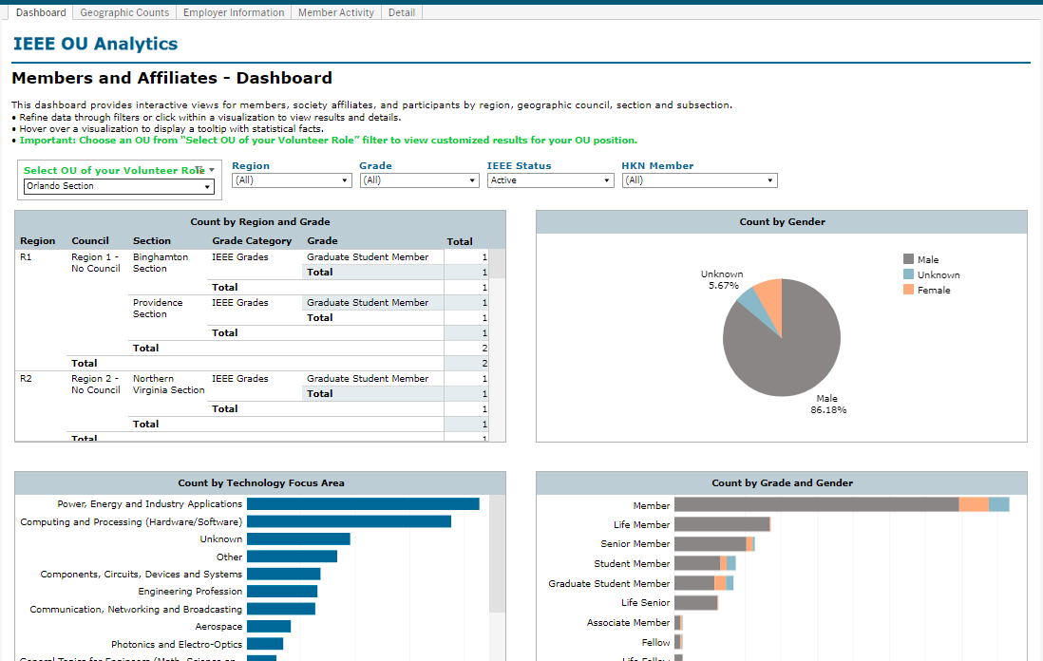
Includes Students that go to school in the Orlando Section

Slide 30
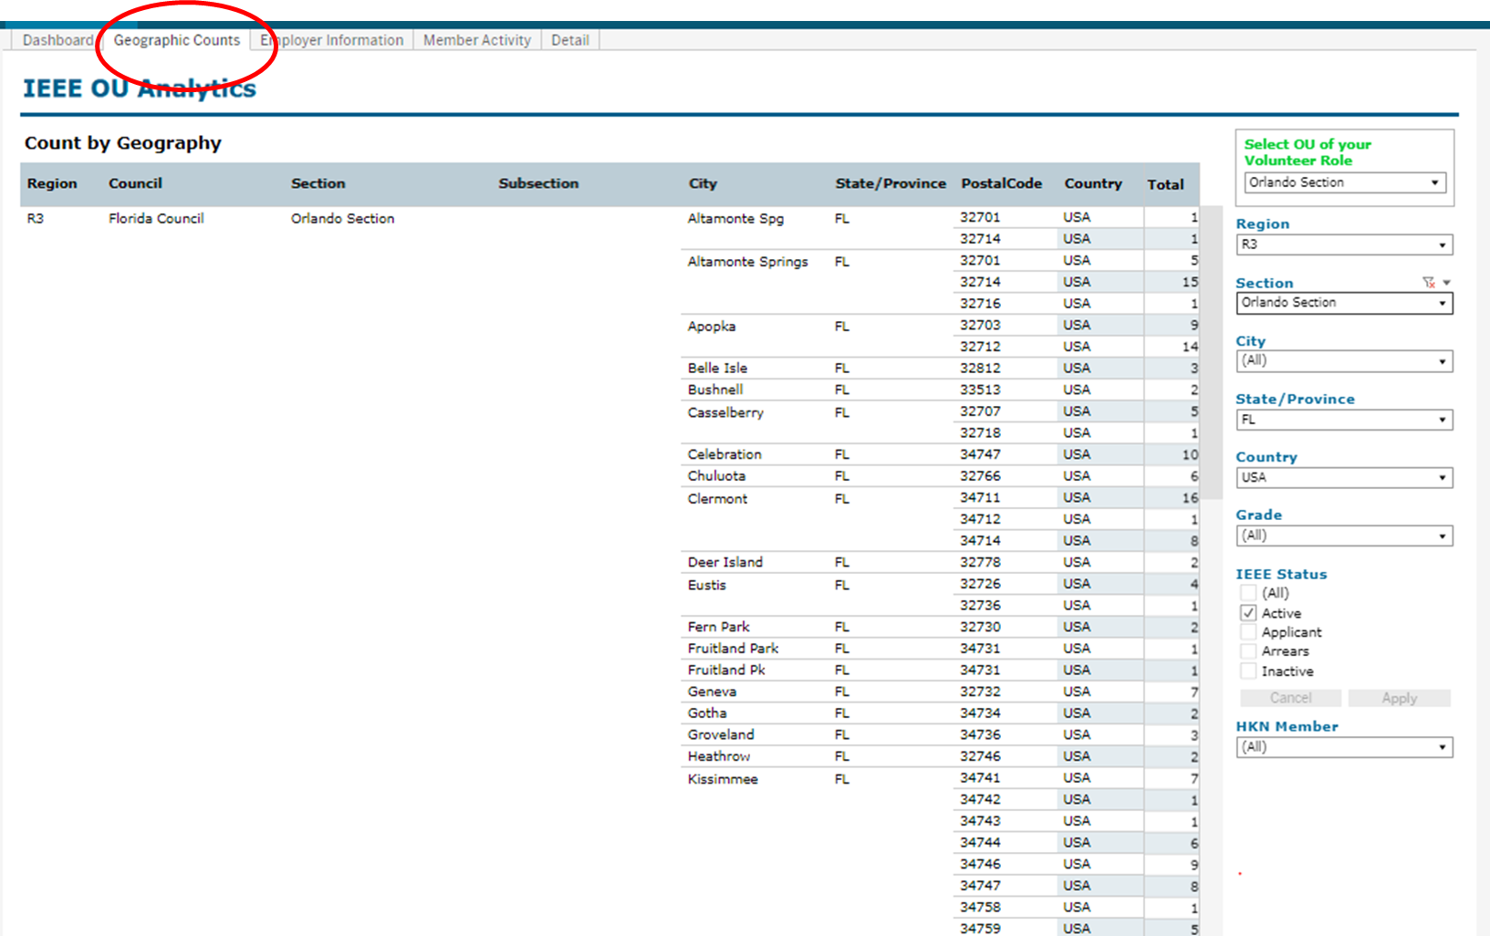

Slide 31
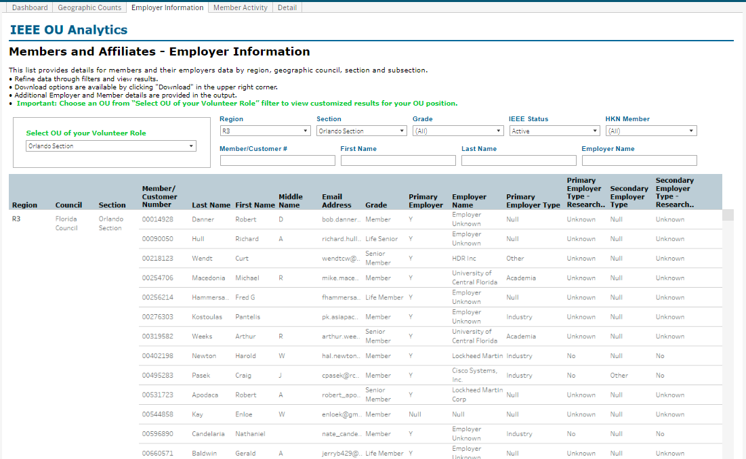

Slide 32
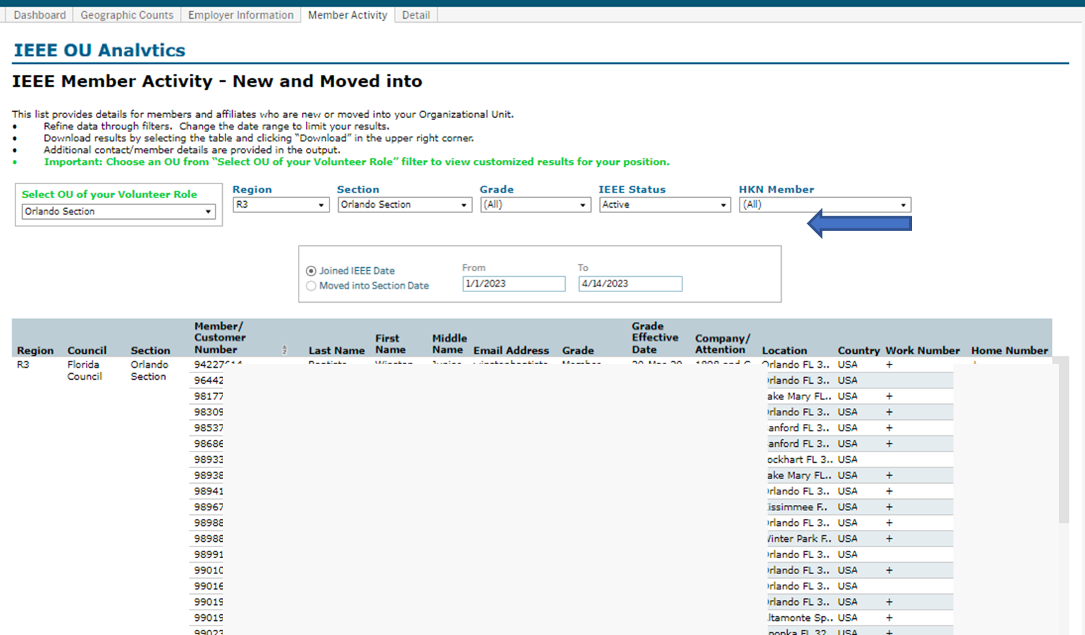

Slide 33
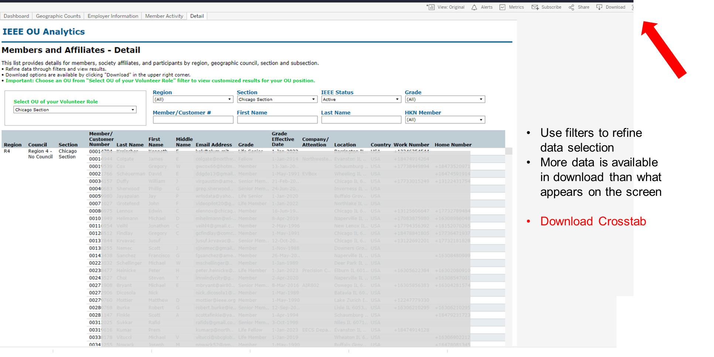

Slide 34
Memberships
(Societies, TCs, Affinities) Subscriptions, and More
Product Dashboard
Summary
Count by Grade (pie)
Count by Gender (pie)
Count by Grade and Years of Service
Product Summary by Region by Grade
Renewal Category Dashboard
Renewal Summary by Region by Grade
Detail

Slide 35
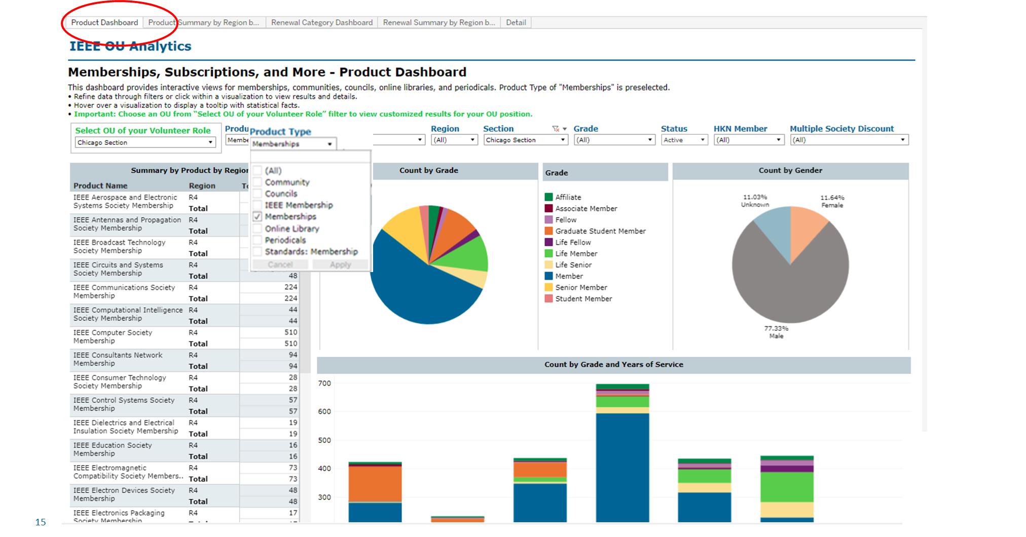

Slide 36
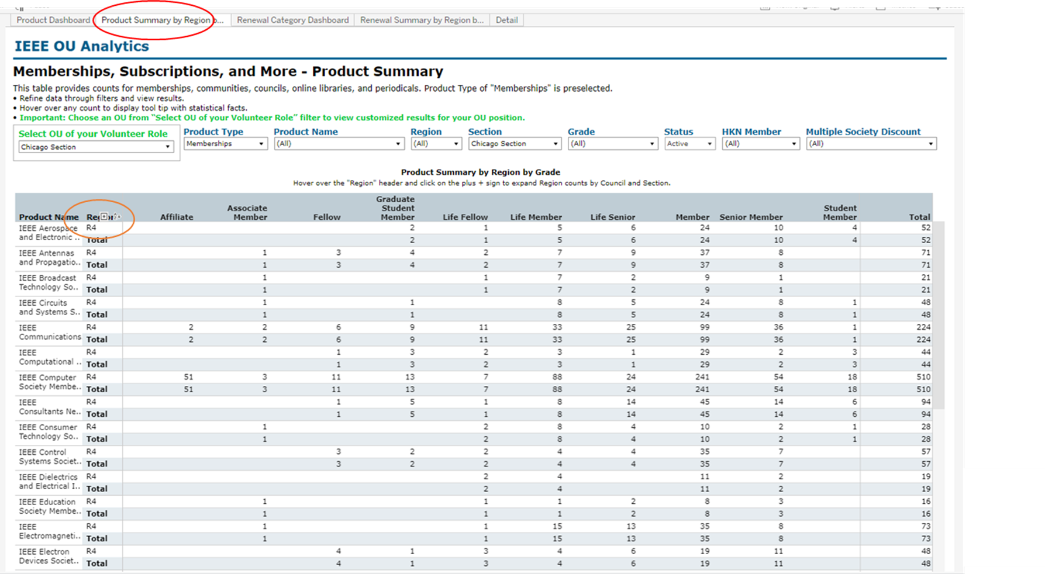

Slide 37
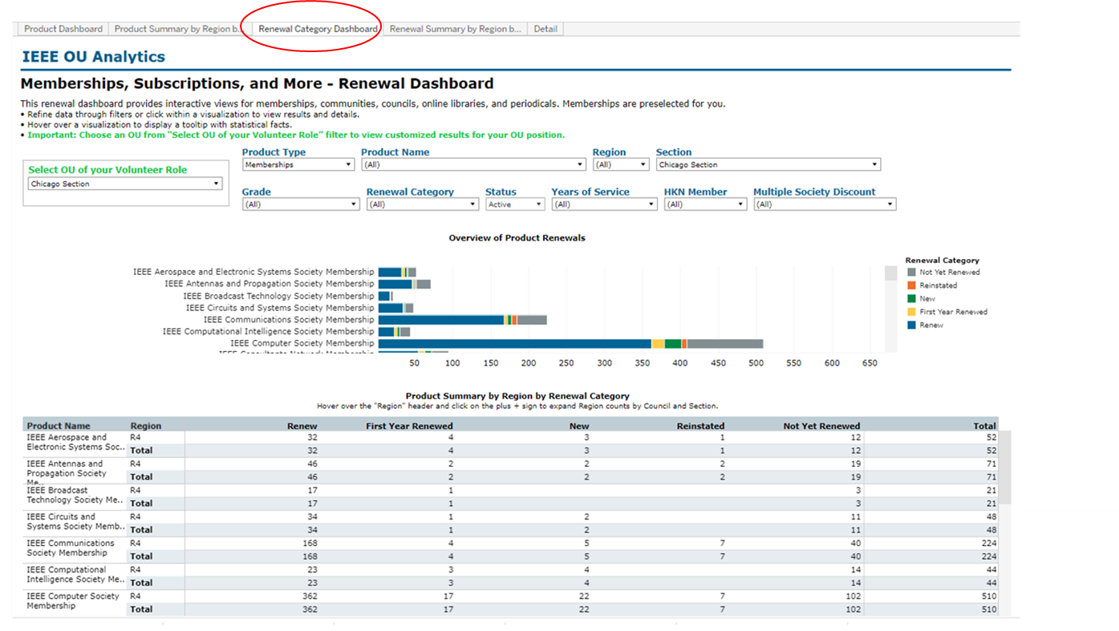

Slide 38
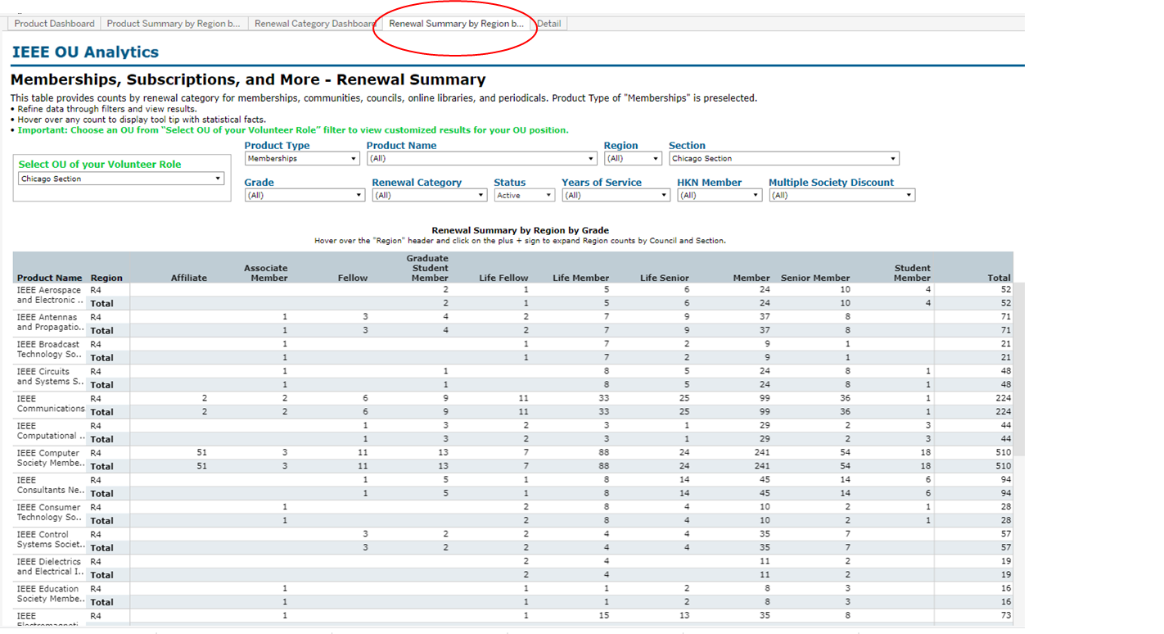

Slide 39
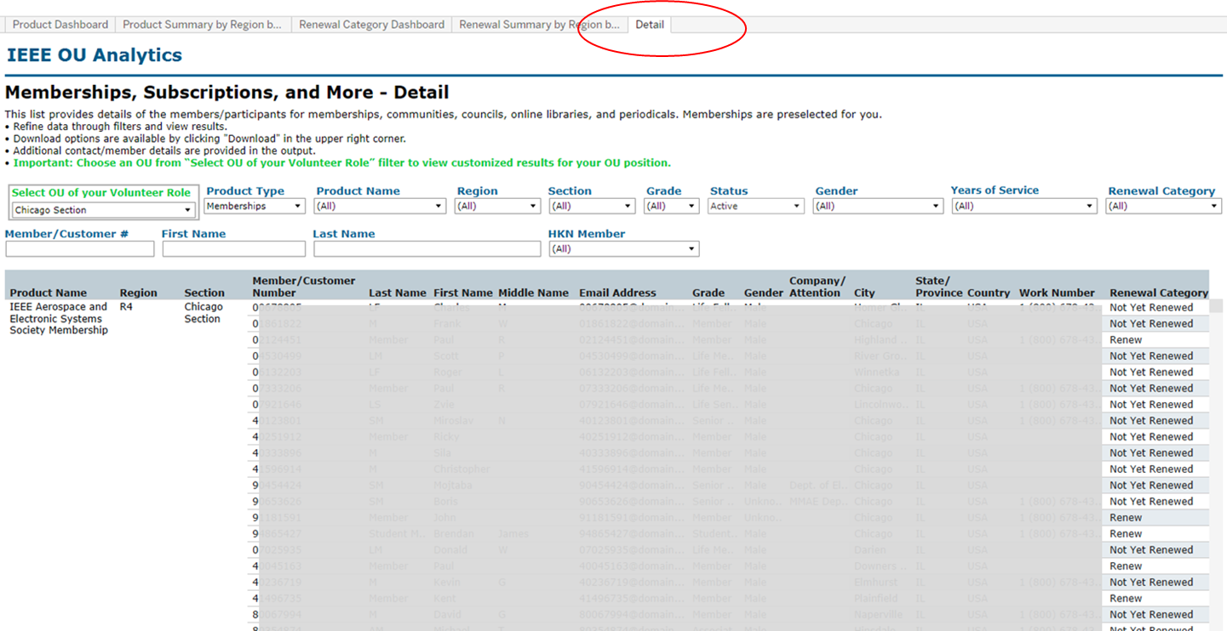

Slide 40
Dashboard
Student Count by Section and School
Student Count by Gender
Student Count by Grade
Student Count by Field of Study
Detail
Select OU
Where they live (primary address)
Where they go to School

Slide 41
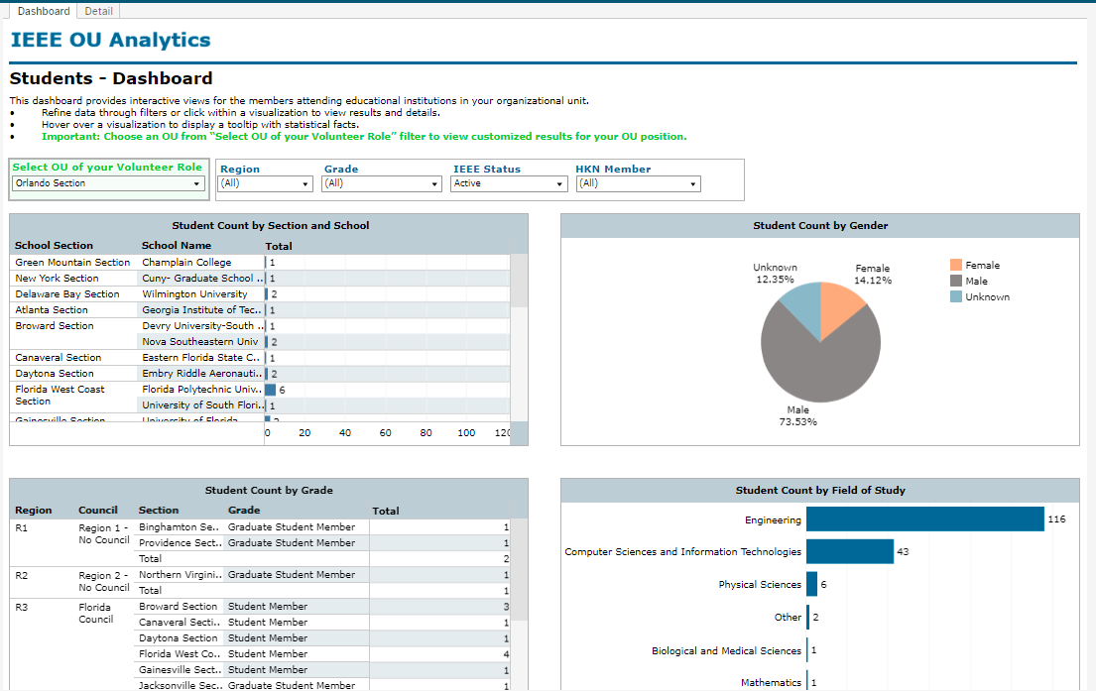
Attending Students

Slide 42
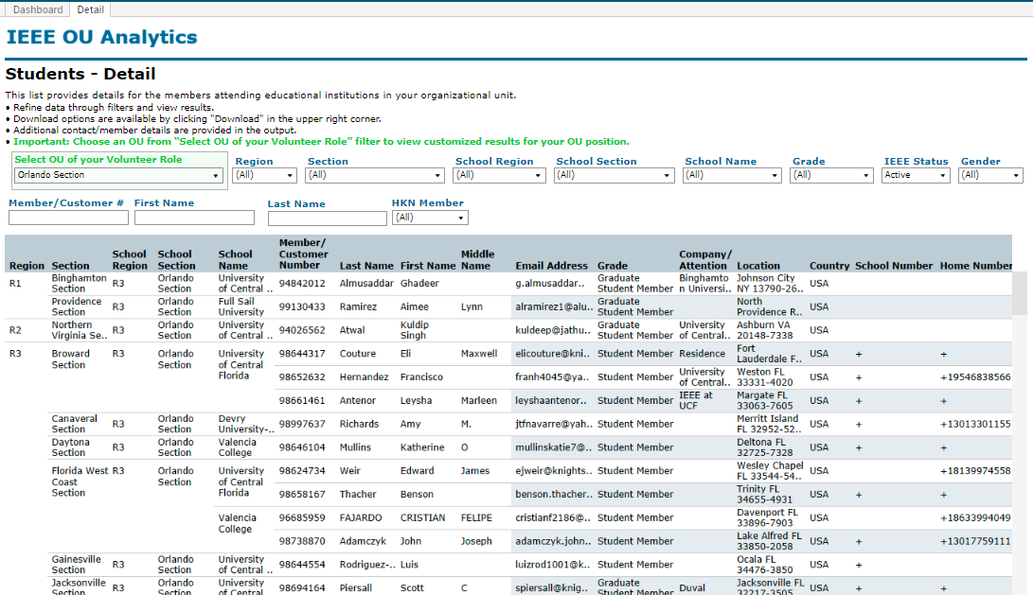

Slide 43
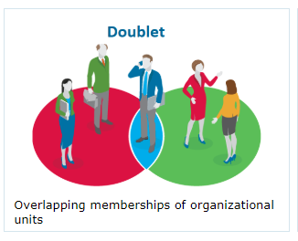
Doublet
Members with this society membership also have this membership

Slide 44
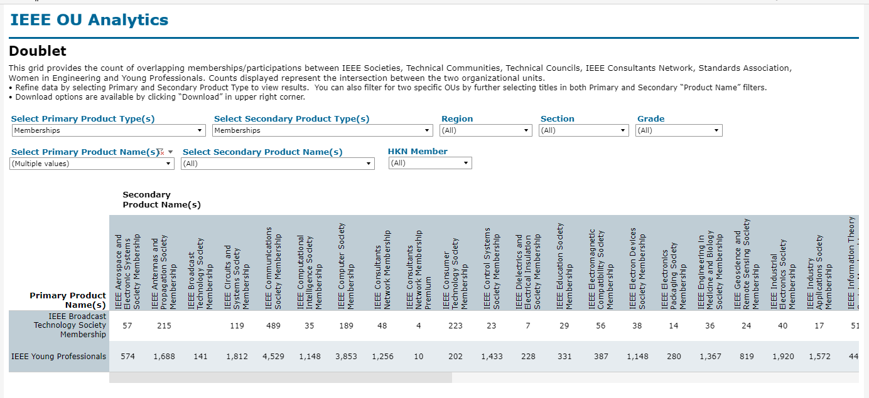

Slide 45
Volunteer Positions
Volunteer Positions in Related
Volunteer History

Slide 46
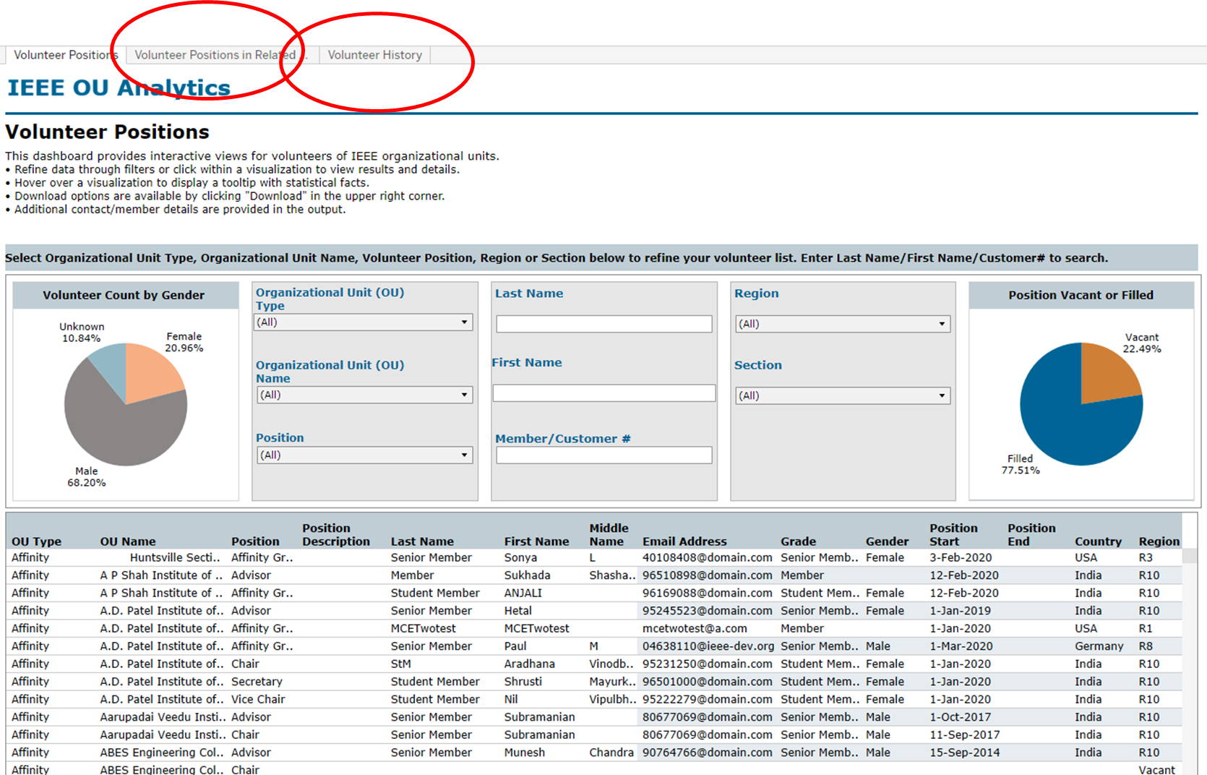

Slide 47
MAP
Region Summary
IEEE/Society Membership Summary
Chapter Summary
Member Count by Chapter
Potential Chapters
Affinity Group Summary
Student Branch Summary
Potential Student Branches

Slide 48
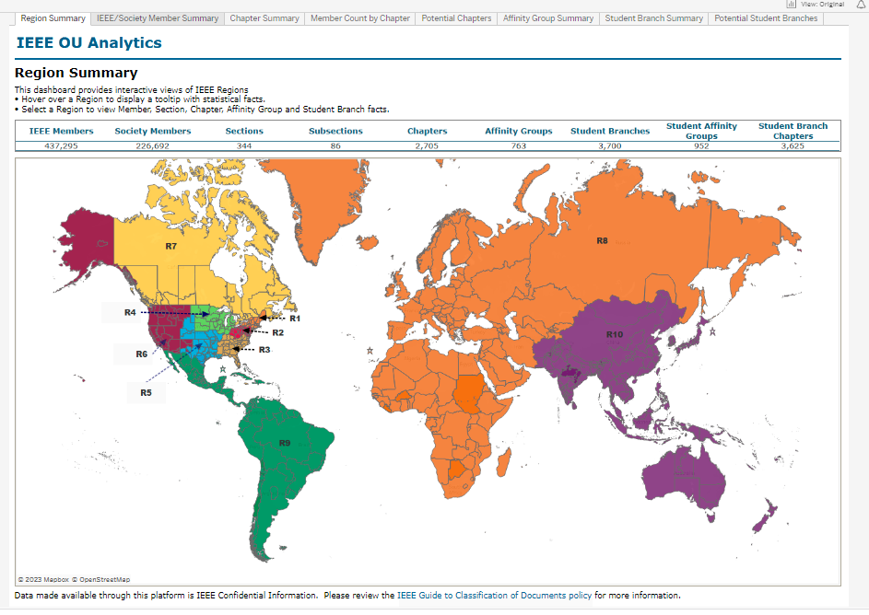

Slide 49
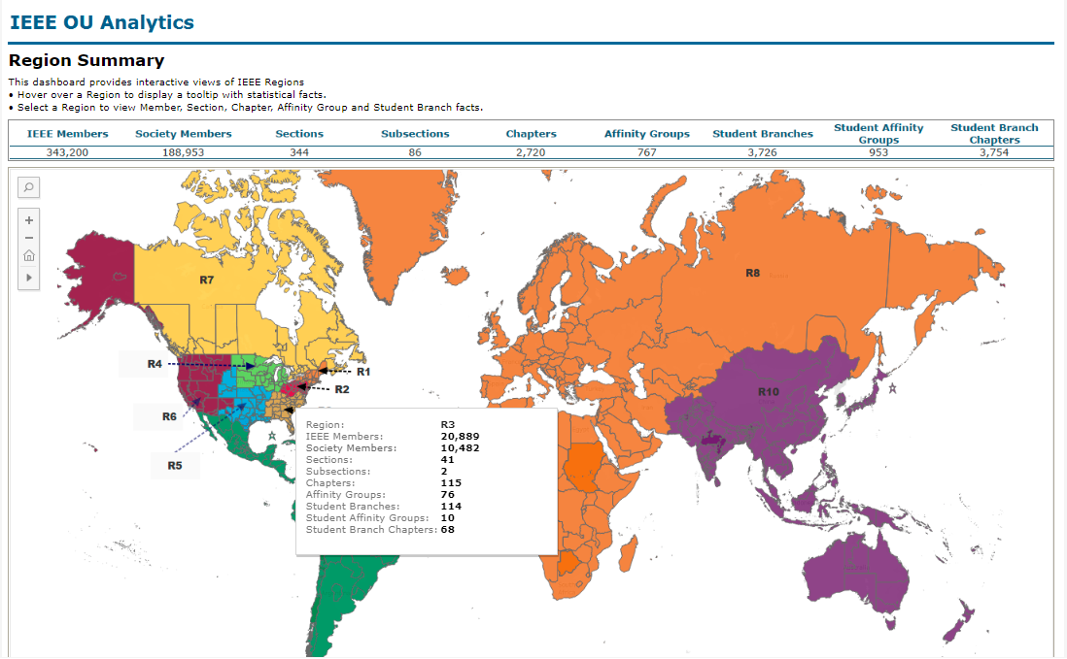

Slide 50
IEEE OU Analytics
ouanalytics@ieee.org
Staff in Member and Geographic Activities and Technical Activities

Slide 51
Questions, comments, requests
mga-im@ieee.org

