Slide 1
Hosting a Conference In Your Section
Joe Juisai
Chair, Region 3 Conference Committee
28 March 2025

Slide 2
Agenda
Why host conferences?
Running a local conference
Sponsoring a society conference
Hosting IEEE Region 3 SoutheastCon

Slide 3
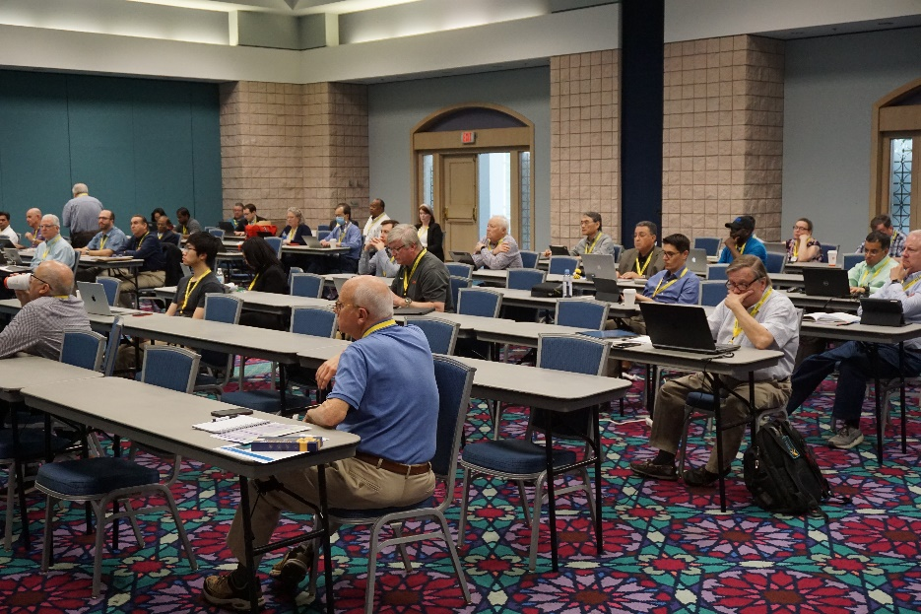
Why host conferences?
Engage your membership base
Network with others in the field
Experience in planning events
Reap benefits of conference surpluses

Slide 4
Running a local conference
Consider running a conference in your Section to engage members
Orlando Section Example
  Hold a Section Conference at local colleges in the fall in conjunction with the 10 Orlando Society Chapters and 3 Affinity Groups
    2019, 2025 – UCF
    2023, 2024 – Valencia
  The Section handles the logistics (location, food, registration, etc.)
  The Society Chapters and Affinity Groups bring a speaker
  Student Branch members help at the registration table and guiding attendees to the right rooms
  Society Chapters and Affinity Groups get one technical meeting credit towards their annual activity requirement
  Collect a fee to cover food or subsidize students

Slide 5
Sample Agenda and Logistics Needs

Slide 6
Local Conference Planning
These cannot be planned in two weeks and be successful
Minimum 6 months of lead time
  Find a venue – Universities are great
  Commitment from Society Chapters to participate
  Society Chapters identifying speakers
  Finding a keynote speaker (if required)
  Collecting fees
  Ordering food
  And more ….
The Region is working on a cookbook to help with planning
We have an objective to complete 5 local conferences
at the Region level (1 for each Area)
Reach out to us for assistance and advice

Slide 7
Sponsoring a Society conference
Societies may want financial assistance to bring a conference to a Section
  In return, the Section receives a portion of the conference surplus
Example: IEEE International Workshop on Antenna Technology
  March 2025
  Held at Hilton Cocoa Beach Oceanfront (Canaveral Section)
  Financially sponsored by Orlando Section
  Orlando Section members sit on the IWAT conference committee to ensure that the conference finances are in order
Build experience on the behind-the-scenes work of hosting conferences

Slide 8
Hosting IEEE Region 3 SoutheastCon
Three tracks
  IEEE Region 3 business meetings (88 participants)
  Technical paper presentations (260 papers in 2025)
  Student Competitions (473 students registered)
3-4 days in spring
  We are here in Concord, NC for the 54th edition SoutheastCon (1972) and the 62nd annual conference (1964)
  We are heading to Huntsville, AL on March 13-15, 2026, for IEEE SoutheastCon 2026
3-year planning cycle from proposal to conference closure
  Proposal and budget to IEEE Region 3 Conference Committee
  Approval by Region 3 Committee (at SoutheastCon N-3(2))
  Hardware rules and announcement at SoutheastCon N-1
  Planning leading up to the event

Slide 9
IEEE SoutheastCon Logistics
800+ room nights (peak at 275 rooms per night)
15,000 square foot hardware competition room
Banquet ballroom for 700+ guests
15-20 meeting rooms (papers, student programs, Region 3 meeting)
  1 – 100-person meeting room for Region 3 main sessions
  Up to 4 – 40-person meeting rooms for Region 3 breakouts
  Student Program
    3 – 30-person meeting rooms
    Up to 2 – 60-person meeting rooms
  Technical Programs
    Up to 6 30-person meeting rooms for paper presentations
    Additional meeting rooms for tutorials, workshop and demonstrations

Slide 10
IEEE SoutheastCon Finances
Seed Funding
  The OU (Section or collection of Sections) is expected to provide $5,000 in seed funding to the conference
  Region 3 will match $5,000 in seed funding
Expect to spend $215,000 to $275,000
  Major cost is food and beverage at the hotel
Income at $250,000+
Surplus and Deficit
  Surplus split 50:50 with region
    2024 surplus was over $135,000
    Per Region 3 policy and the memorandum of understanding with the section, Region 3 covers losses

Slide 11
IEEE SoutheastCon Award Process
Candidate OUs submit a proposal and budget
Conference Committee has proposal templates and guidance documents for Candidate OUs to complete proposals
Submitted to Conference Committee – July 31, 2025
Reviewed and present to Conference Committee – August 2025
Discussed at Conference Committee – September 8, 2025
Discussed at Finance Committee – September 9, 2025
Discussed at Region 3 ExCom – September 25, 2025
Approved at Region 3 Committee – March 15, 2026

Slide 12
IEEE SoutheastCon Award Timeline
MAR 25 | APR 25 | MAY 25 | JUN 25 | JUL 25 | AUG 25 | SEP 25 | OCT 25 | NOV 25 | DEC 25 | JAN 26 | FEB 26 | MAR 26 | APR 26
Proposal Dues
Site Visits
Oral Presentations
Committee Discussions and Endorsements
Region 3 ExCom Endorsement
Region 3 Committee Approval
Today

Slide 13
IEEE SoutheastCon Next Steps
Interested in hosting IEEE Region 3 SoutheastCon
  Region 3 plans on awarding the next 2 SoutheastCons in 2025
  2028 and 2029 are still up for grabs – conference committee discussion in September 2025
  Formally award 2028 and 2029 in Huntsville
Contact Information
  Joe Juisai
  Joe.Juisai@IEEE.org
  +1 (415) 260-1980

