Slide 1
Tools For Sections: Tools You Can Use!
Section Vitality & the Elections Process
Theresa Brunasso, Past Director

Slide 2
Agenda
Why have Section, Chapter & Affinity Group elections?
Election Requirements
  Election Committee
  Schedule
  Candidates
  Tools

Slide 3
Why Elections?
Elections are required by the MGA Operations Manual
  https://mga.ieee.org/board-committees/operations-manual
    Section 9.13 Geographic Unit Elections
  Section Officers, Paragraph 9.5 F 7a: “All officers shall be elected by Section members of Graduate Student Member, Member, Senior Member, and Fellow grade. Elections for all officers shall take place every one or two years, in accordance with the term of office as defined by the Section.”
  Chapter Officers, Paragraph 9.7 D 5b “All officers shall be elected by Chapter members of Graduate Student Member, Member, Senior Member, and Fellow grade. Elections for all officers shall take place every one or two years, in accordance with the term of office as defined by the parent geographical unit that assumes responsibility for the Chapter management”
  Affinity Group Officers, Paragraph 9.10 D 6a: “All officers shall be elected by Affinity Group members of Graduate Student Member, Member, Senior Member, and Fellow grade. Elections for all officers shall take place every one or two years, in accordance with the term of office as defined by the Section.”

Slide 4
Why Elections? (continued)
Section, Chapter and Affinity Group Officers have term limits!
  The consecutive period of service in any one office shall normally not exceed four years.
  All officers shall not serve in any one position, in any single organizational unit, more than six years in total.
  Exceptions to this rule require approval by the Region Director who will annually report such exceptions to the MGA Board.
Members have the right to choose their officers
Electing new officers guards against volunteer burn out
Electing new officers brings new volunteers and ideas to your organization
MGA is using vTools data to share all election and officer terms with Area Chairs and Region Directors.

Slide 5
Election Committee Composition
Approved by the Geographic Unit ExCom
Composition:
  Minimum of three Voting Members
    Chair
    vTools Lead
    Member
  No more than one members can be a current officer
    Typically outgoing chair
  Chair of the Elections Committee cannot be a current officer

Slide 6
Election Committee Responsibilities
Ensures a fair and transparent election
Distributes a call for nominations to all active members of the Geographic Unit
  • Candidate and voter eligibility date (30 June) and criteria
  • Election dates
  • Positions with descriptions being solicited
  • Election committee contact information
  • Instructions on how to self-nominate or nominate others
  • Petition dates
Actively solicits volunteers to run for office
Prepares a recommended slate of candidates for approval by the ExCom
No single candidate slate shall proceed without Region Director approval.
Reviews any petition candidates

Slide 7
Election Schedule

Slide 8
Candidate Requirements
IEEE member in good standing as of June 30th
  Must provide IEEE member number to Election Committee
Eligible Member grades:
  Graduate Student Member
  Member
  Senior Member
  Fellow
For ballot:
  Photo
  Biography
  Candidate statement

Slide 9
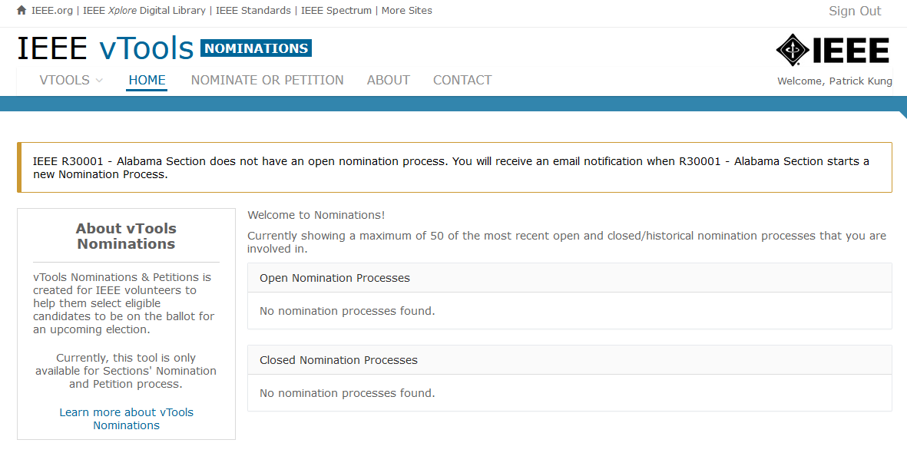
Election Tools
All voting in Geographic Unit elections should be electronic via secret ballot within vTools
http://nominations.vtools.ieee.org/ to access vTools nominations (Sections only)

Slide 10
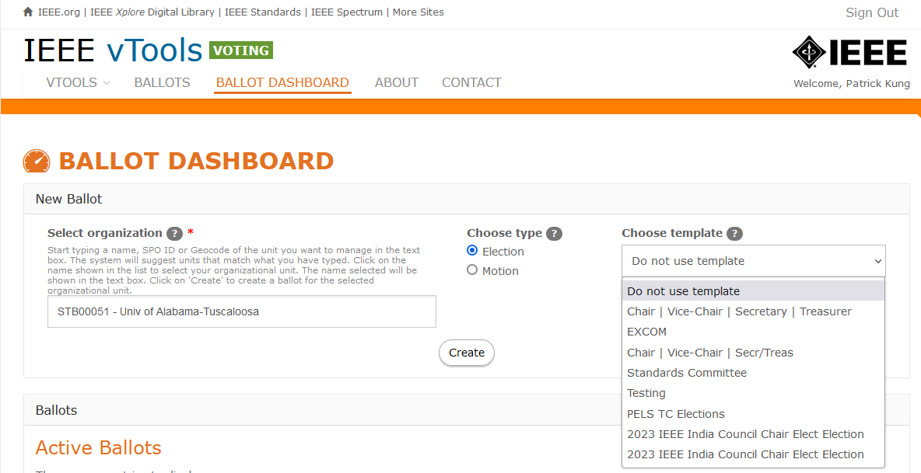
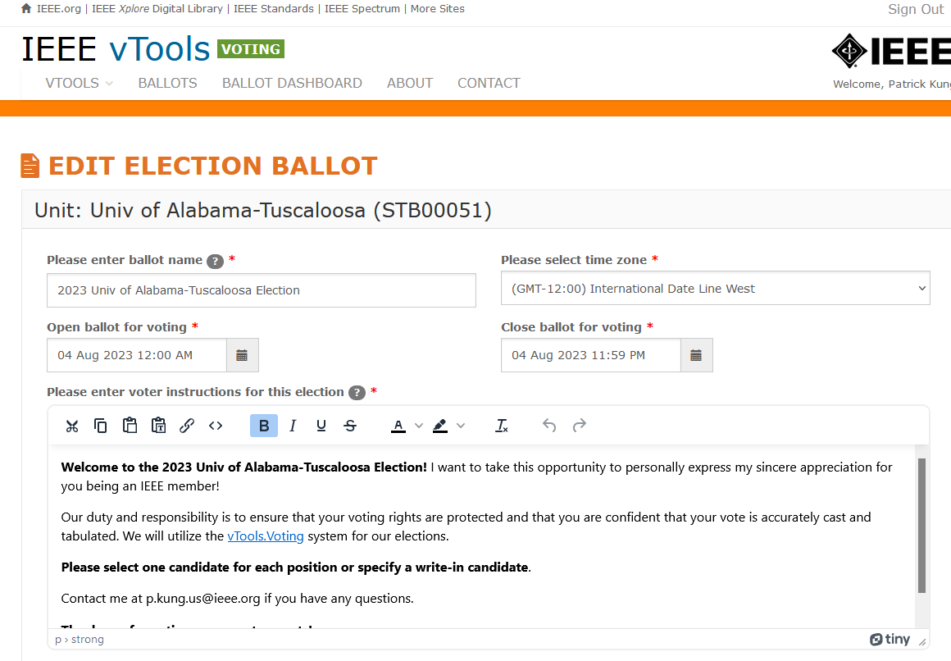
vTools Ballot Creation
https://voting.vtools.ieee.org/tego_/ballot_admin/index to create a ballot

Slide 11
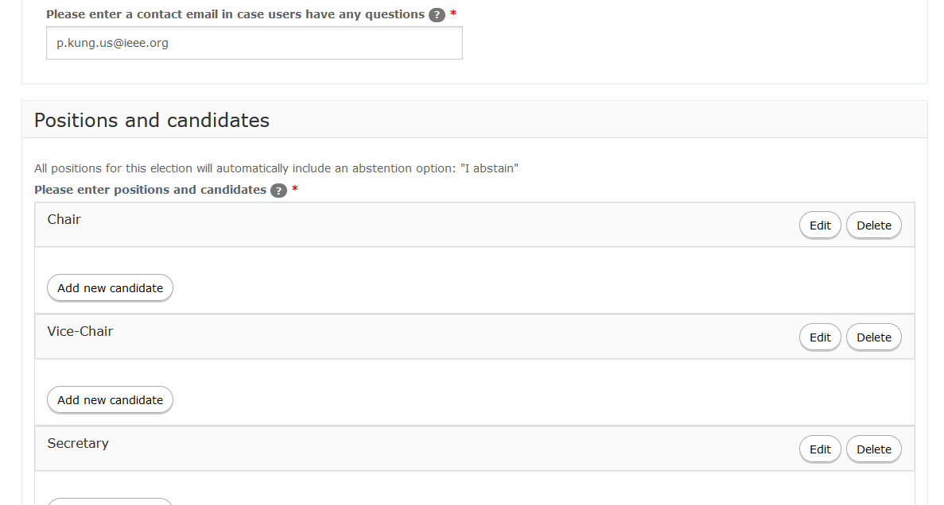
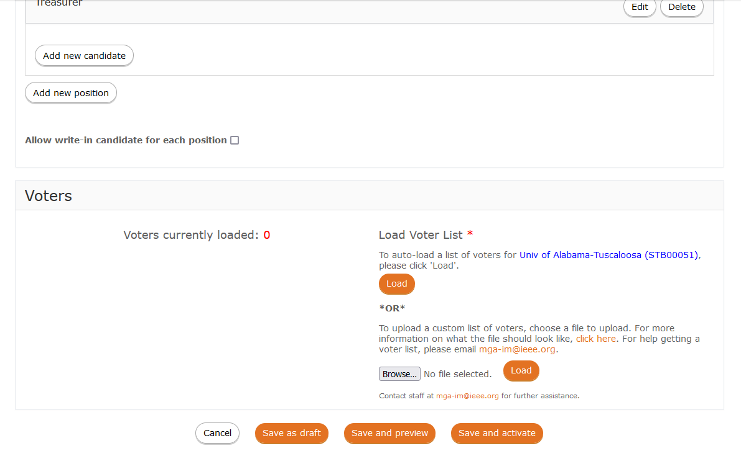
vTools Ballot Creation (continued)
Bio, statement, photo

Slide 12
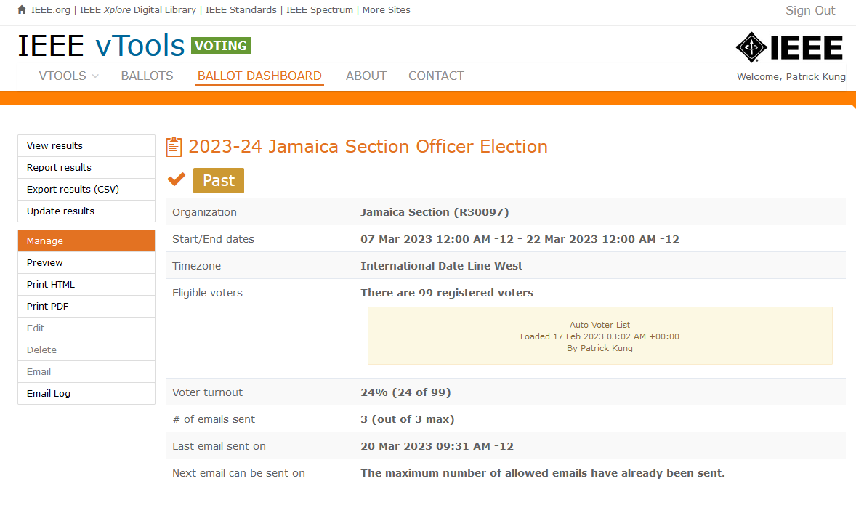
vTools Election Management

Slide 13
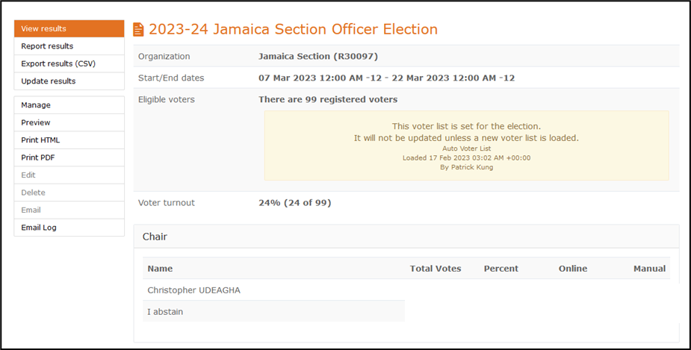
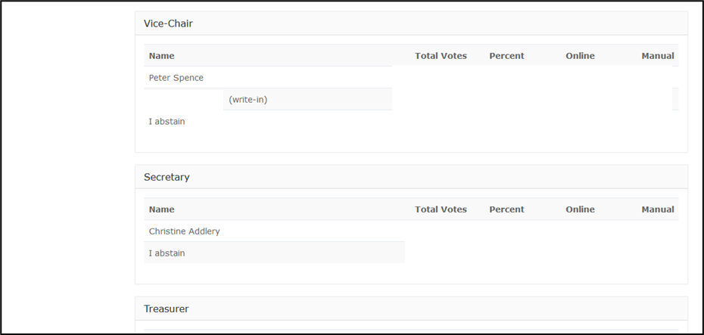
vTools Election Results

Slide 14
Summary
We appreciate your years of service, but elections are required
There are many more volunteer opportunities at the Region, MGA and IEEE level!
vTools makes it easy to hold elections
Your Area Chairs are available to help
Your Area Chairs, Director-Elect and Director will know if you don’t hold your required elections.

Slide 15
Thank you for all you do for IEEE!
Any questions?
theresa.brunasso@ieee.org

