Slide 1
IEEE LIFE MEMBERS REGION 3
(Friday March 28, 2025)
March 28-30, 2025
1 of 22

Slide 2
Table of Contents
IEEE Life Members, Region 3
History of Life Members - Life Members Committee (SLIDE-3)
IEEE Foundation and Life Member Fund (SLIDE-4)
Life Members and Life Members Committee (SLIDE-5)
LMC Region Funding (SLIDE-6)
LMC Grant Funding (SLIDE-7, SLIDE-8 )
LMC Fellowships, Medal and Paper Prize (SLIDE-9)
Life Members Engagement (SLIDE-10)
LMC Awards Activity (SLIDE-11)
2024 LMAG Activities (SLIDES-12 & 13) / Three Photos
Region 3 LMAG Present & Future Outlook (SLIDES -14, -15, -16, -17 & -18)
Examples of Life Member Engagements via LMAG (SLIDES -19 & -20)
Summary (SLIDE-21)
Q&A / END (SLIDE-22)
2 of 22

Slide 3
History of IEEE Life Members – Life Member Committee
May 13, 1884: American Institute of Electrical Engineers (AIEE) Founded in New York (Composed mostly of Engineers, Academia, Service providers, Equipment suppliers of Telegraphy / Telephony / Electrical Technology and Power)
1889: At the inception of AIEE in 1884 there were discussions on having Life Membership. AIEE selected the first Life Members in 1889 from the founding members.
May 13, 1912: Institute of Radio Engineers (IRE) Founded in New York (composition included American / International Wireless Engineers, Academia, Equipment manufacturers and Practitioners).
January 1, 1963: AIEE and IRE merged to form Institute of Electrical and Electronic Engineers (IEEE). Life Member fund (LMF) along with Life Member Committee (LMC) was created.
3 of 22

Slide 4
IEEE Foundation and Life Member Fund
February 1, 1973: IEEE Foundation was formed as IEEE’s philanthropic partner.
IEEE Foundation provides banking / investment services to LMC and for LMF .
LMC Submits an annual budget to the IEEE Foundation.
LMC activities and functions are financed thru Life Members Fund (LMF).
4 of 22

Slide 5
IEEE Life Members and Life Members Committee
1945 – 2025 (80-year period): IEEE Life Membership grown from 1045 to over 39,400.
LMC invests in our life members by providing local, social, technical, and humanitarian activities that:
Keep LMs active in the IEEE community
Encourage life-long learning with events / resources
Mentor students / young professionals with outreach and grant initiatives
Support fellowships and awards programs
Honor our legacy by capturing the life history of our Life Members
Life Members Affinity Groups (LMAGs): LMAG programs are supported by LMC at Local and Section levels.
5 of 22

Slide 6
LMC Region Funding
E01: Support Student Region Events per Region (2k)
E20a: LM Affinity Group Activities per Region (5k)
E30-2: Group Mentoring Initiative per Region (0.5k) SAC, YP, WIE, LM
6 of 22

Slide 7
LMC Grants Funding
E02: Grant Support Student activities per Region (1k)
E03: WISE Program (Selection Completed for 2025)
E04: Education STEM outreach (0.5k)
E05: EPICS program per Region (0.5k)
E06: Human / Philanthropy Joint Efforts (0.5k)
E07: MOVE related projects (10k max)
E08: Global Museum projects (10k max) HC
E09: YP (5k)

Slide 8
LMC Grants Funding (continued)
E10: IEEE Honor Society –HKN (5k)
E11: WIE / International Leadership Conference (3k)
E12: Rising Star Conference (3k)
E19: LM Oral Histories (2k) HC
E30-1: Miscellaneous projects per Region (1k)

Slide 9
LMC Fellowships, Electrotechnology History Prize, Medal
E13: LM History Fellowship for 1-year full-time graduate work or post-doctoral research in the history of electrical science and technology at a recognized university – (29k max). Candidates with (undergraduate degree in engineering, sciences, or humanities are eligible for the fellowship) HC
E14: LM Graduate Study Fellowship in Electrical Engineering to support 1st year graduate students for Masters or to pursue PhD (2-year recurring fellowship) selection by EAB. (22k Max)
E15: James Mulligen Educational Medal: to recognize An IEEE member in the teaching profession for contributions to the vitality, imagination, and leadership of the members of the engineering profession. (7.5k max) – Medal, certificate and honorarium – EAB
E16: LM Bernard Finn IEEE History Prize: Administered by Society for the History of Technology (SHOT) for best paper in the history of electrotechnology – power, electronics, telecommunications and computer science (2k max including $1000/- for travel to receive honor.

Slide 10
Life Members Engagement
Life Members are encouraged to get involved in activities that:
Excite students about STEM.
Empower young professionals to pursue careers in IEEE’S fields of interest.
Engage LMs in Group Mentoring Initiatives of SAC, YP & WIE.
Preserve Legacy that IEEE members help create.
Participate in fund raising for LMF, Publish LM Newsletter, Maintain LM Website.
Recognize peers for their accomplishments.
Encourage life members and retirees to stay active in IEEE.
Lead or participate in Life Members Affinity Group events.
Assist or be part of awards & recognition and nomination committees at the local areas in the region.

Slide 11
LMC Awards Activity
Region LMAG Achievement Awards - One LMAG selected from nominations for each Region annually – Award Prize of $500 to Section CB account and Certificate of Recognition presented through Region Director / Area Chair at an event decided by the region.
Region Life Member Individual Service Award - One Life Member selected from nominations for each Region annually - Certificate of Recognition presented through Region Director / Area Chair at an event decided by region.
Global LMAG Achievement Award - Global winner selected from Regional winners. Award Prize of $2000 to the LMAG payable through the Section CB account and Certificate of Recognition presented at a global event decided by LMC with consent of the winning LMAG; Travel expenses paid according to IEEE Foundation policy.
Global Life Member Individual Service Award - Global winner selected from Regional winners. Plaque of recognition presented at a global event decided by LMC with consent of the winning LM; Travel expenses paid according to IEEE Foundation policy.
Nominator should submit 2025 LMC Awards Nomination Form by April 15, 2025, to the R3 LM Coordinator. LMC Nomination Forms and Instructions are in Life Members’ website, or you may contact R3 LM Coordinator to locate.

Slide 12
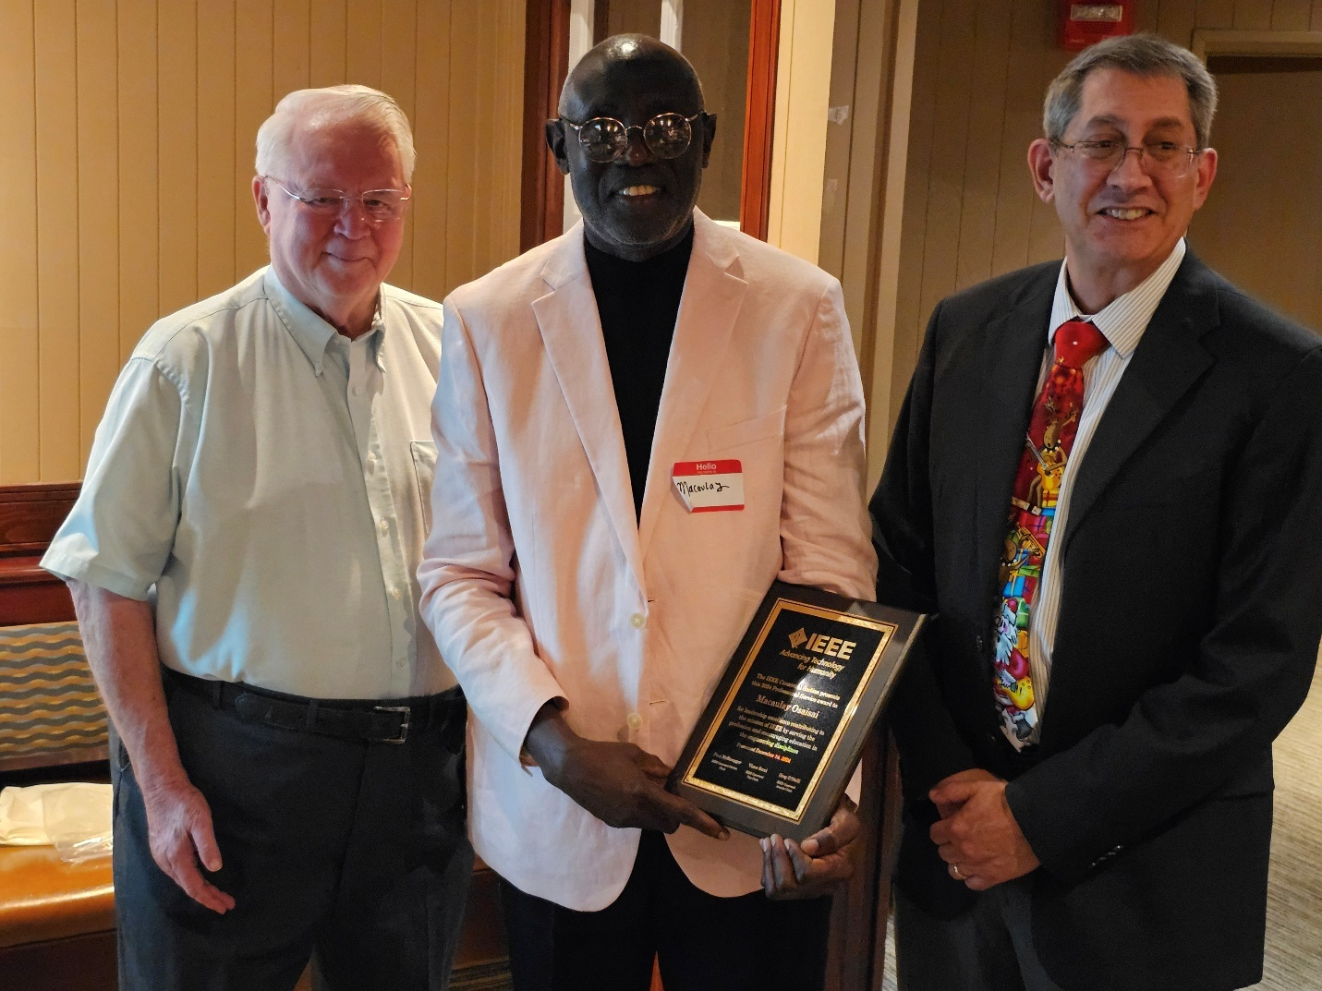
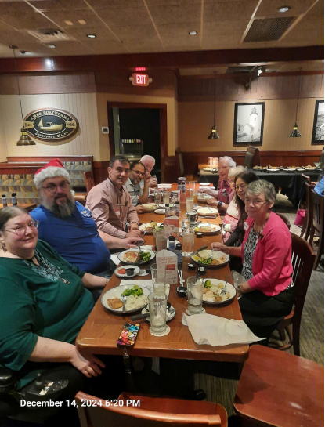
2024 LMAG Activities – Joint Section Event
(L to R): Greg O’Neill (Award Chair), Macaulay Osaisai (Award Recipient), Paul Nyffenegger (Section Chair)
December 14, 2024: R3 Canaveral (FL) LMAG Hosts Activities to Engage and recognize Life Members in a joint Section and AESS / COMSOC Chapter social event at Merritt Island Red Lobster.
IEEE Professional Service award to outgoing LMAG Chair Macaulay Osaisai for leadership excellence in Engineering profession in Canaveral (FL) Section

Slide 13
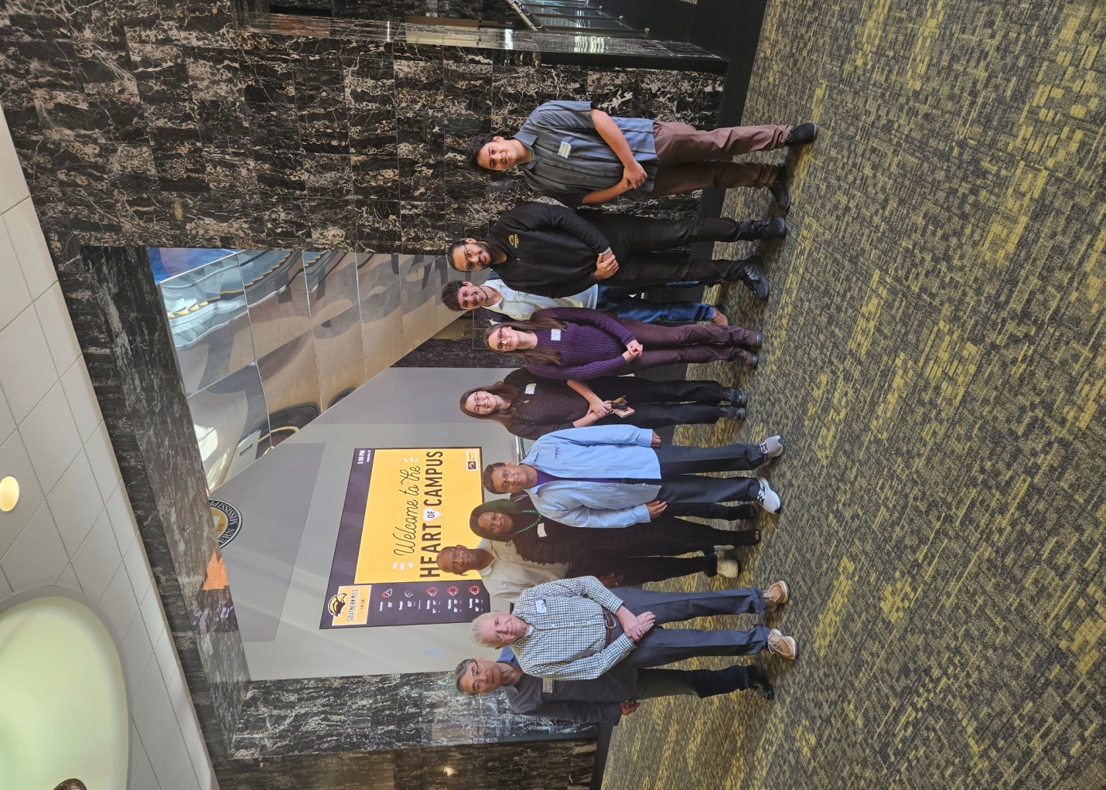
2024 LMAG Activities – Joint Section Event (Cont’d)
The Mississippi LMAG & IEEE MS Section organized a full day training event for the section volunteers on 28 Sep 2024 at the University of Southern Mississippi (USM)
All the units of the MS Section; EXCOM, LMAG, YP, WIE, and all student branches (MSU, JSU, USM, and MS College) were represented for the meeting.
L to R: Andrew Sung, George Sidders, Winnfort Myles, Ujunwa Mbachu, Rajeev Agrawal, Elizabeth Phillips, Margaret Brune

Slide 14
Region 3 LMAG Present & Future Outlook
Active Life member population grew from 1045 in 1945 to more than 39,400 in 2025.
With 344 Sections and 10 regions the worldwide, LMAG numbers reached 189 in 2025.
Region 3 currently has 28 Sections with LMAGs with 4008 life members affiliated.
Region 3 has 13 Sections (>6 LM for each Section) with the potential to petition to form a new LMAG.

Slide 15
Region 3 LMAG Present & Future Outlook (Cont’d)
Sections with unaffiliated LMs, No. of LMs / Members
R30004 (Central Virginia, Area 1), 158 / 521
R30002 (Richmond, VA, Area 1), 147 / 736
R30743 (Central TN, Area 4), 130 / 722
R30521 (Gainesville, FL, Area 5), 94 / 393
R30016 (Virginia Mountain, Area 1), 86 / 435
R30711 (Chattanooga, TN, Area 4), 66 / 244
R30061 (Savannah, GA, Area 2), 56 / 90
R30733 (Memphis, TN, Area 4), 50 / 303
R30167 (Central NC, Area 1), 48 / 243
R30381 (Central Savannah River, SC, Area 2), 36 / 145
R30041 (Mobile, AL, Area 5), 32 / 142
R30015 (Evansville-Owensboro, IN, Area 4), 29 / 137
R30791 (Tri-Cities, TN, Area 4), 19 / 73
Area Chairs: A1 (James Imanian); A2 (Alessio Medda); A3 (Raul Ortega); A4 (Paul Kuban);
A5 (Rajeev Agrawal)

Slide 16
Region 3 LMAG Present & Future Outlook (Cont’d)
Benefit Forming LMAG
Section gets yearly rebates if the LMAG is in good-standing.
LMAG event expenses supported by LMC per IEEE Foundation Policy.
LMAG can engage LMs effectively for supporting Sections and LMs remain active in the Section programs.
LMs and LMAGs in the region qualifies for awards nomination.
Activities of interest to life members are supported at local level.
Existing LMAGs should have at least two events identified per year in v-Tools events list and six events per year to be in good standing.

Slide 17
Region 3 LMAG Present & Future Outlook (Cont’d)
Examples of Additional Funding Support provided in 2024 via LMAG or LMC in Region 3 Sections
Atlanta (GA) LMAG Activity: $200
Broward (FL) LMAG Activity: $200
Canaveral (FL) LMAG Activity: $800
Melbourne (FL) LMAG Activity: $1400
Mississippi LMAG Activity: $400
Tallahassee (FL) LMAG Activity: $700
R3, Regional Hardware Competition Prize: $1500
R3 Charlotte NC (HKN Leadership Conference): $5000
Support of MOVE for relief in NC after Hurricane Helene: $20,000

Slide 18
Region 3 LMAG Present & Future Outlook (Cont’d)
Region Officers, MGA and the LMC encourage these 13 Sections to organize LMAG petitions and start LMAGs for full LM affiliation and LM engagement in Region 3.
Contact your Regional LM Coordinator by email at jmkulang@gmail.com or by phone at (214)912-8536 to obtain the MGA petition link and walkthrough the simple petition process.

Slide 19
Examples of Life Member Engagements via LMAG
Technical lecture
Joint activities with parent Section and other groups
Visit museum or site of technical interest
Social gatherings and luncheons
Become a participating mentor
Assist in new officer orientation sessions
Hosting past / current volunteers
Assist in forming student branches , chapters, affinity groups

Slide 20
Examples of Life Member Engagements via LMAG (Cont’d)
Assist local school districts (pre-university)
Support career days
Science fair judging
Assist local student branches
Resource for early career knowhow
Resource for soft skills
Student paper contests judging
Resource for Senior Member elevations
Source for Fellow nominations.

Slide 21
Summary
The IEEE Life Member Committee (LMC) and Life Member Fund represents / supports over 39,400 Life Members worldwide.
The LMC funds many projects of interest to Life Members.
The LMC supports 189 Life Member Affinity Groups (LMAG) worldwide and 28 LMAG in Region 3. 28 LMAGs should post in the vTools events at least 2-events to keep the LMAG alive to receive rebates from MGA and have at least 6-events to receive bonus rebates from MGA. 6-events and above will qualify for self-nomination for potential LMC awards
Life Members are encouraged to network with Life Members socially, through technical presentations and tours, be involved with STEM activities and technology history projects. LMs / LMAGs should lead Group mentoring initiatives with Students, Student Activities Coordinator, YP and WIE to accomplish strategic goals of IEEE.
Region 3 officers, MGA and the LMC encourage the remaining 13 sections in Region 3 to consider forming an LMAG with their Life Membership.

Slide 22
IEEE Life Members, Region 3
Q&A??
Closing Note:
The 2025 IEEE Life Members Evolution Conference will be held from June 11 to 13 at the Joyce Cummings Center at Tufts University in Medford, Massachusetts (Boston).
The 2025 IEEE Life Members Evolution Conference speakers will cater to a wide audience, ensuring a rich and engaging experience for all—and an exceptional opportunity to connect with industry leaders, gain valuable insights, and expand your network. Visit lifemembersconference.ieee.org to learn more.
End of Presentation

