Slide 1
Why You Should Join the MOVEment!
Theresa Brunasso, Region 3 Past Director

Slide 2
Agenda
IEEE-USA MOVE Overview
2024 Disaster Responses
2024 STEM Outreach Events
How to support IEEE-USA MOVE

Slide 3
What is MOVE?
MOVE: Mobile Outreach using Volunteer Engagement:
  Emergency relief program assisting victims of natural disasters with communications, lighting, and power solutions.
Three truck across the USA
  MOVE-1 Based in Texas
  MOVE-2 Based in North Carolina
  MOVE-3 Based in California
When not supporting disaster victims, used for STEM Outreach
  Started by Region 3 under leadership of President-Elect Mary Ellen Randall
  Run by volunteers
  Funded by donations
  Supported by IEEE-USA staff

Slide 4
MOVE Trucks
MOVE 1
MOVE 2
MOVE 3
Added Last Year!

Slide 5
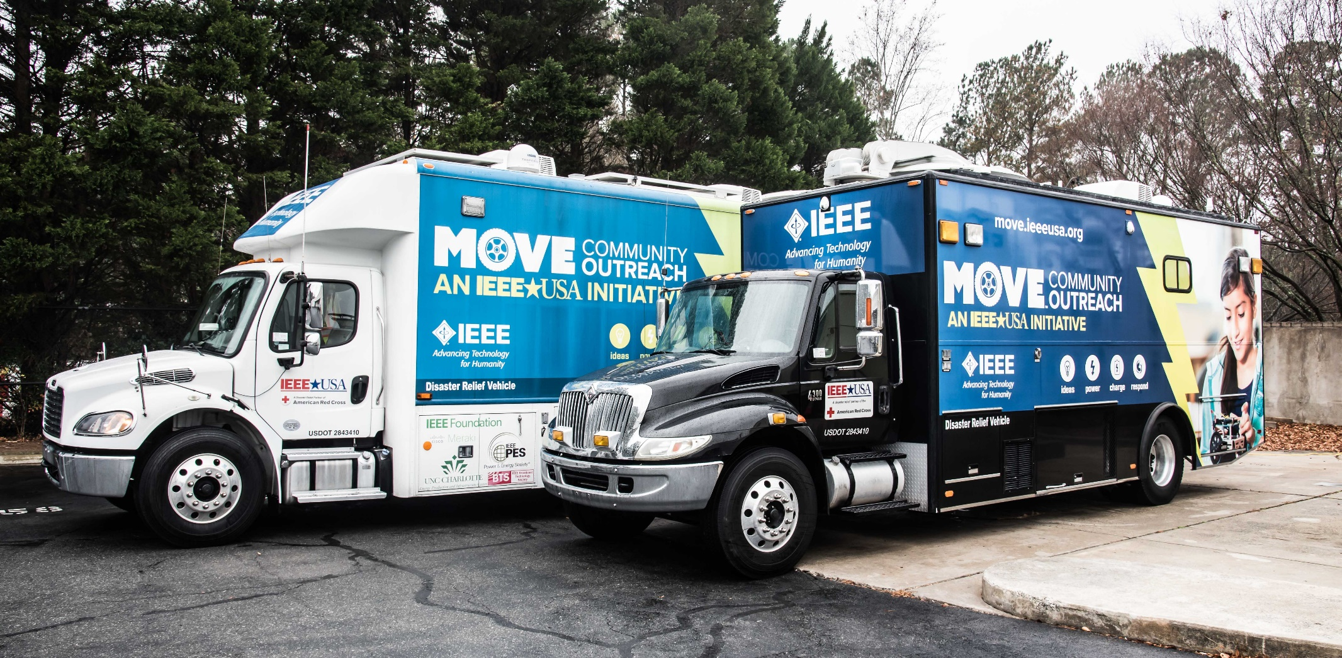
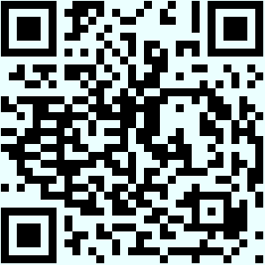
IEEE-USA MOVE Overview: Truck Virtual Tour
Take a virtual tour of the MOVE truck to see the power, communications, networking and battery charging equipment inside the truck. Then go outside the truck and see the solar panels and other equipment mounted on the roof of the truck.

Slide 6
IEEE-USA MOVE Overview: Capabilities
Provide Power for the Red Cross Shelters and Disaster Response Operations
Provide Internet and Network Access to the Red Cross Shelters and other Disaster Response Operations for email, messages, IP telephone, Videoconferencing, etc.
Recharging Battery Packs to power cell phones
Transport Capabilities to remote locations impacted by the disaster
Provide Lighting

Slide 7
IEEE-USA MOVE Overview:
Disasters Supported Over the Years
Responded to 40 disasters since March 2016
  Hurricanes
  Tornados
  Fires
  Floods
Across a dozen states:
  AL, AZ, FL, KY, LA, MO, MS, NC, NM, SC, TN, WV

Slide 8
2024 Disaster Response
Jun 2024, Ruidoso Fires, NM
  MOVE-1, 13 days
Jul 2024, Hurricane Beryl, TX
  MOVE-1, 9 days
Sep 2024, Hurricane Helene, NC
  MOVE-1, 14 days
  MOVE-2, 35 days
October 2024, Hurricane Milton, FL
  MOVE-3, 31 days

Slide 9
Gratitude from Red Cross Leadership
From: McGrath, Chris Director, DST Operations
Sent: Thursday, November 7, 2024 3:39 PM
Subject: Thank you, IEEE!
Dear IEEE MOVE Team,
I want to sincerely thank you for your partnership, commitment, and dedication over the past few months. Your quick deployments and commitment have helped countless communities during some of their most challenging times.
The IEEE team’s expertise and ability to quickly provide support and connectivity during large-scale disaster responses have been a tremendous asset to the American Red Cross and those in need. Recent responses in New Mexico, the Carolinas, and Florida, especially in response to Hurricanes Helene and Milton, has been especially meaningful. Arriving in Asheville as some of the first responders on scene, bringing not only your technical skills but also a positive, helpful attitude that made a significant impact to all those around. While in Asheville the IEEE team provided immediate and vital support to the DRO Command Center as well as the WNC AG Center to support clients.
In addition, I’d like to highlight the effort it took to mobilize MOVE-3 from California to Florida on very short notice. While en route to multiple sites, the teams picked up critical DST equipment from the LFC or other staging areas, ensuring that all the necessary tools were available to support the communities in need. This effort truly reflects the dedication and commitment of the IEEE MOVE team, no matter the distance or scope.
The kindness, resilience, and eagerness to help that each of you demonstrated made a real difference to our team and those affected by the natural disasters. Your hard work and dedication to communities across the country truly reflect the spirit of service and support.
Thank you for everything you’ve done. Unfortunately, I couldn’t meet any of you in person this season, but I sincerely hope we’ll have the opportunity to do so in the future so I can personally thank you all.
We are incredibly grateful to have the entire IEEE team as a vital partner in our shared mission to help people recover and rebuild.
With deepest appreciation,

Slide 10
2024 Public Visibility & STEM Events
34 Events, Including
  Atlanta Science Festival
  NWS/OK members
  IEEE Greentech Conference
  RARSfest
  Region 5 Meeting
  Eclipse Event
  University of North Texas, Dallas, Denton & Arlington
  Life Members Conference
  Texas A&M Safety Talk
  IEEE World Forum on Public Safety Technology
  NC DoT
  Regions 1 & 2 Combined meeting
  International Microwave Symposium

Slide 11
MOVE is going Global
  Caribbean
India Council
Team under the American Red Cross Agreement
Team has Modular MOVE Equipment
Supported Two Major Disasters
Working to acquire a small MOVE Vehicle
Team has been training and supporting industry and STEM event

Slide 12
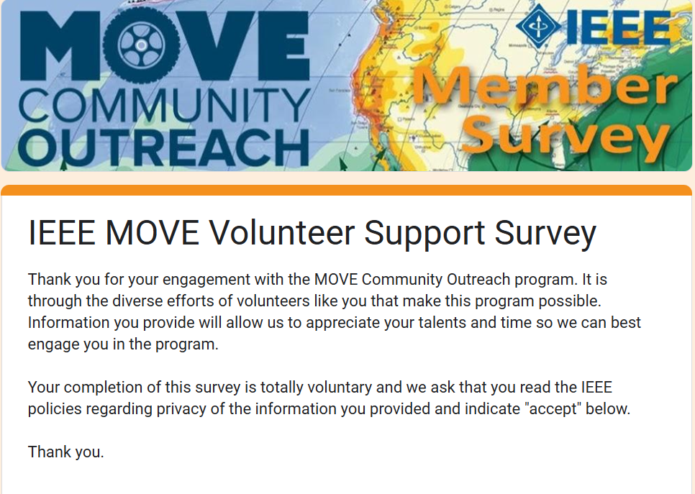
How to support IEEE-USA MOVE
Volunteer: https://bit.ly/MOVE-SIGNUP

Slide 13
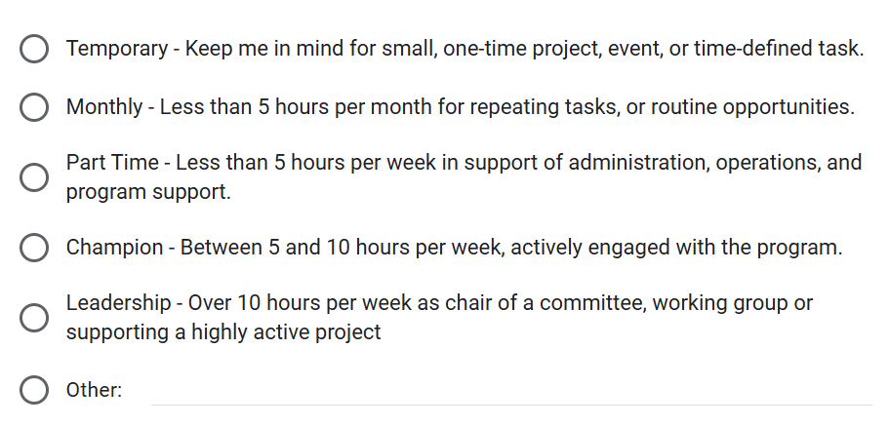
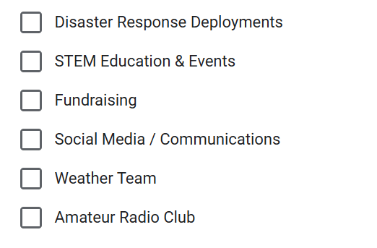
Join the MOVEment!
It does NOT have to be a big commitment
Interest
Time Available

Slide 14

Support us with your donations!
You don’t have to wait until Giving Tuesday!
Donate today through the IEEE Foundation
Make a personal tax-deductible donation to MOVE. ieeefoundation.org/move

Slide 15
IEEE-USA Sponsorship Levels
With your help, we can keep our trucks maintained, fueled, and ready for the next disaster.

Slide 16














Thanks to our Volunteers & Supporters
IEEE Volunteers
IEEE Alabama Section
IEEE Eastern NC Section

