Slide 1
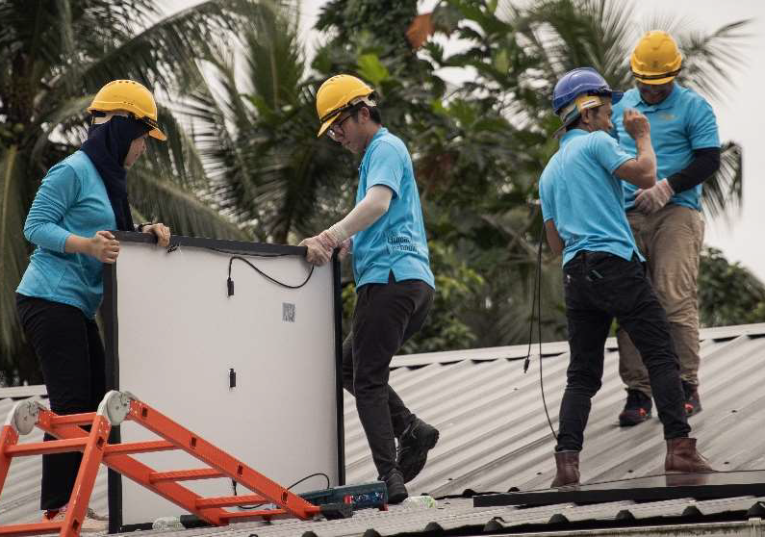

Introduction to IEEE Humanitarian Technologies

Slide 2
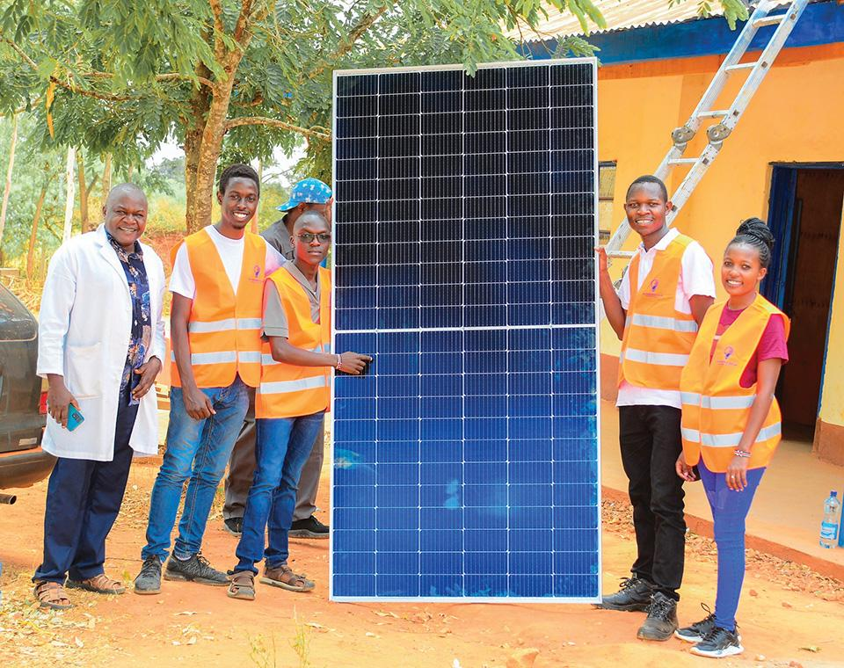
Agenda
Presenter Introduction
Introduction to IEEE Humanitarian Technologies
IEEE HT Consortium Programs
  All About IEEE MOVE
  All About IEEE SIGHT
  All About IEEE Tech4Good

Slide 3
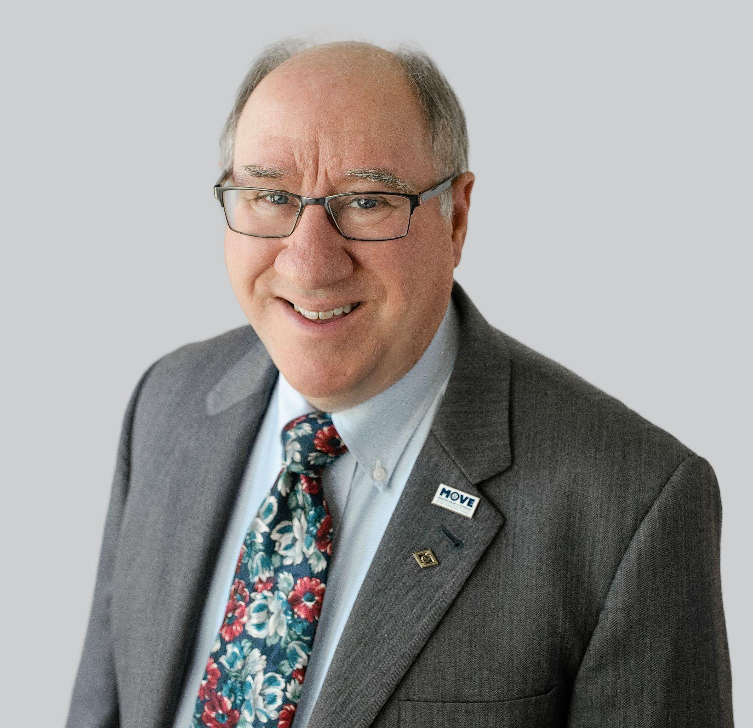
Speaker Introduction: 2025 HTB Chair, Grayson Randall
IEEE Senior Member
HTB Chair since 01 January 2025
IEEE MOVE Operations lead in the United States.
  Responsible for the IEEE MOVE trucks and associated equipment that is deployed to natural disaster sites in the United States to support emergency communications.
Served on the IEEE Future Directions Committee
Active in IEEE Region 3
Professional background in digital communications, robotics, public safety, and emergency response.

Slide 4


Slide 5
Who We Are
We are IEEE’s Tech for Social Impact Hub
IEEE Humanitarian Technologies is a consortium of current and new programs and initiatives - supported by a global network of volunteers and technical professionals - working together to apply technology to solve the world's most pressing problems.

Slide 6
Our Focus
We focus on a specific type of humanitarian work:
“Tech for Good” or “Technology for Social Impact.”
Which makes sense as we're powered by the
world's largest engineering network.

Slide 7
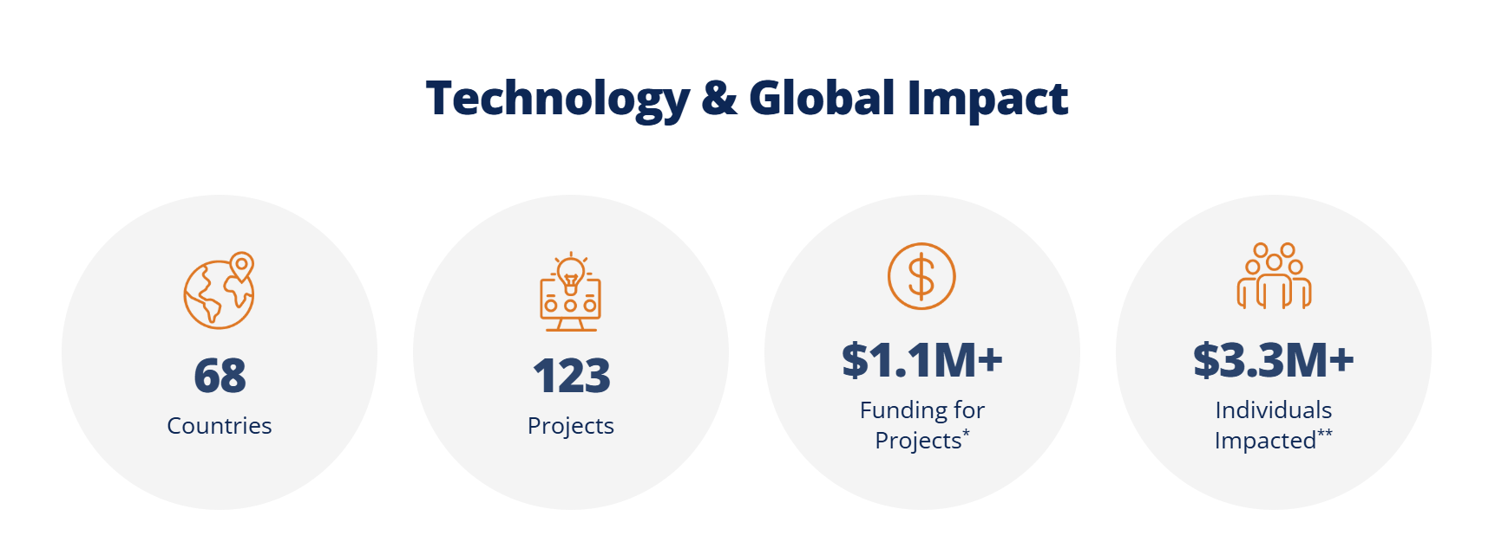
Our Impact
Numbers represent data from January – October 2024.
* The amount of funding awarded in grants or awards to project-type implementations.
** The number of individuals impacted is an estimate that includes projections from some programs.

Slide 8
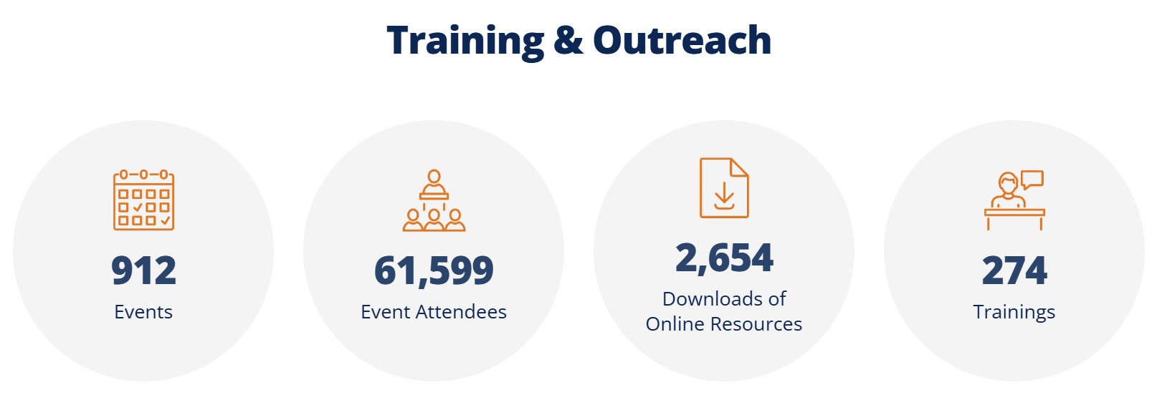
Our Impact
Numbers represent data from January – October 2024.

Slide 9
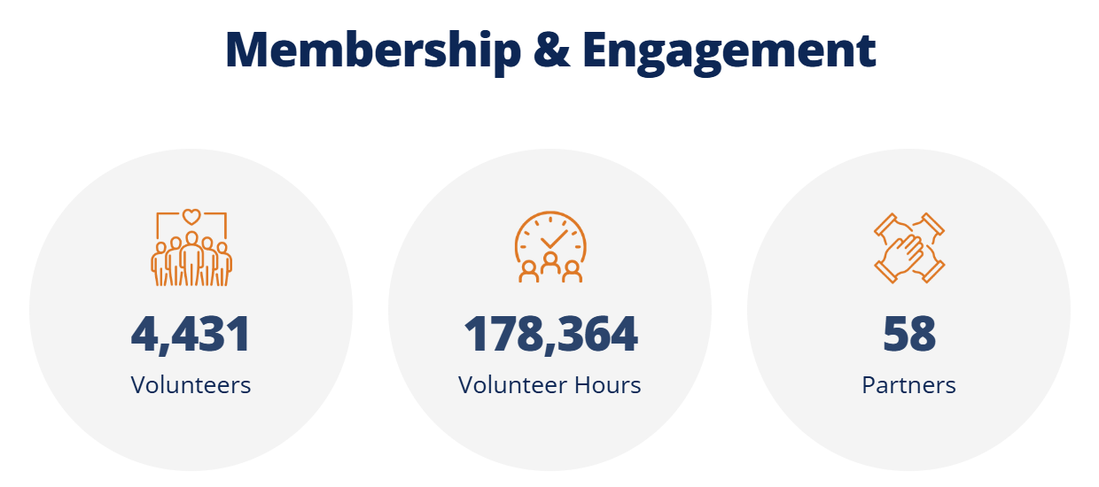
Our Impact
Numbers represent data from January – October 2024.

Slide 10
IEEE HT Consortium Programs

Slide 11







IEEE Humanitarian Technologies
IEEE HT provides a “home” to all IEEE Humanitarian Tech program and initiatives through support with:
  Impact infrastructure and expertise in humanitarian technology to track the impact of our programs and initiatives, moving towards a data-driven approach from design to final outcomes/outputs.
  Outreach and joint marketing to standardize messaging, clearly differentiate offerings, establish cohesive outreach strategies for the programs, attract and retain volunteers, and more.
  Partnerships platform to develop, deploy, or expand programs that advance technology to achieve social and environmental impact locally.

Slide 12





HT Consortium
HT Programs

Slide 13
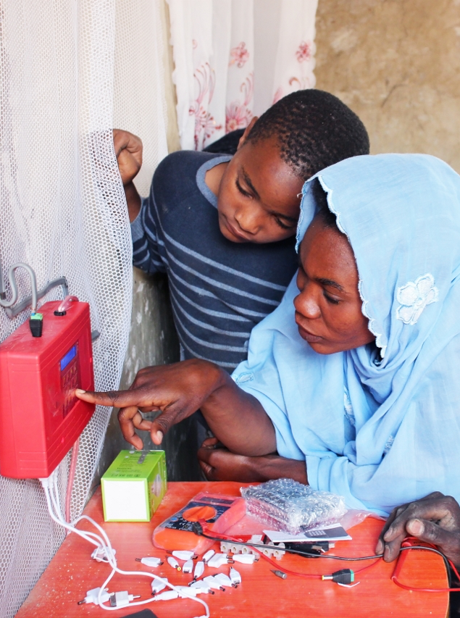

Empower a Billion Lives
Description: A global competition to develop sustainable and scalable solutions to energy poverty.
Mission: promote and incentivize solutions to energy access across the globe through community, conversation and competition.
Opportunities: Small and medium enterprises (SMEs) apply for funding for clean and affordable energy solutions. IEEE volunteers can compete or participate in application reviews.
empowerabillionlives.org

Slide 14
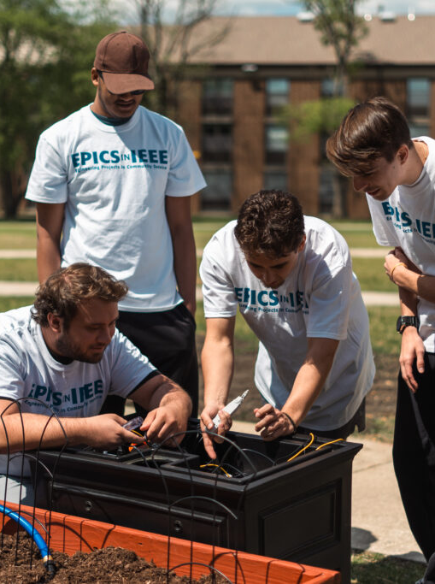

EPICS in IEEE
Description: To support student-led humanitarian technology projects.
Mission: Empower university students to work along with technical professionals and communities around the world to enhance their practical engineering skills and knowledge through service-learning experiences.
Opportunities: University-level student teams design and implement impactful projects for communities around the world. IEEE volunteers review applications, provide feedback, and mentor teams.
epics.ieee.org

Slide 15


IEEE REACH
Description: To preserve the history of IEEE technologies and to advocate and build STEM capacity across the world.
Mission: provide teachers and students with educational resources that explore the relationship between technology and engineering history and the complex relationships they have with society, politics, economics, and culture.
Opportunities: IEEE volunteers can help by disseminating the educational content.
reach.ieee.org

Slide 16
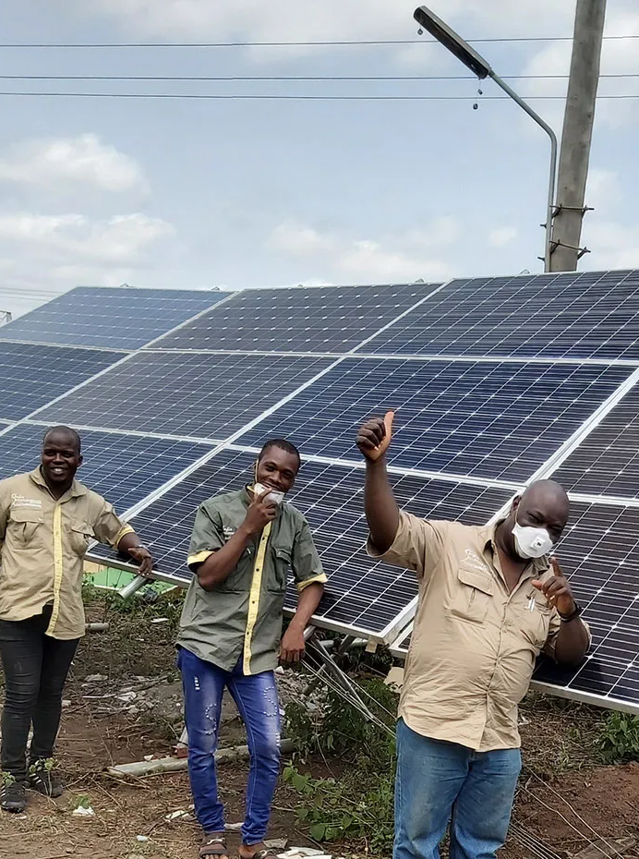

IEEE Smart Village
Description: To fund solutions that integrate sustainable electricity, education, and entrepreneurship to empower disadvantaged communities.
Mission: IEEE Smart Village integrates sustainable electricity, education, and entrepreneurial solutions to empower off-grid communities.
Opportunities: IEEE volunteers can apply for funding to scale their solutions. Volunteers also contribute to regional working groups to review applications and mentor projects.
smartvillage.ieee.org

Slide 17
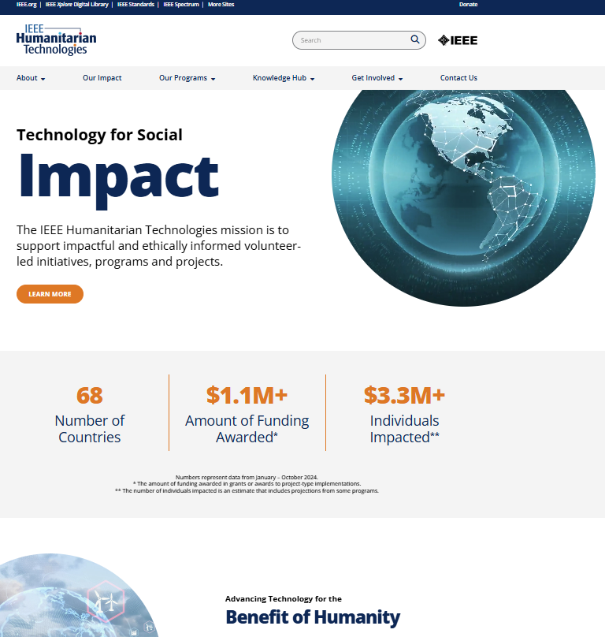
For more information, visit ieeeht.org

Slide 18

All About IEEE SIGHT

Slide 19
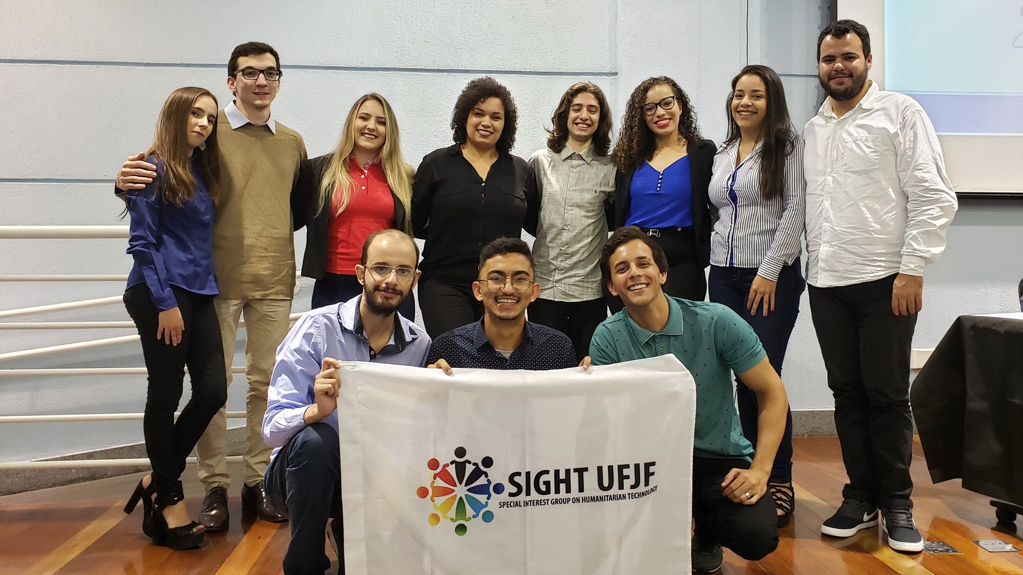
IEEE SIGHT
Description: A global community of 67,000+ engineers and technologists interested in contributing to sustainable development in their community.
Mission: To foster a global network of volunteers partnering with local communities and organizations to leverage technology for sustainable development.
Opportunities: IEEE members can join SIGHT Groups to participate in impactful projects locally, expand their professional network, and learn best practices for humanitarian technology implementation.
sight.ieee.org

Slide 20

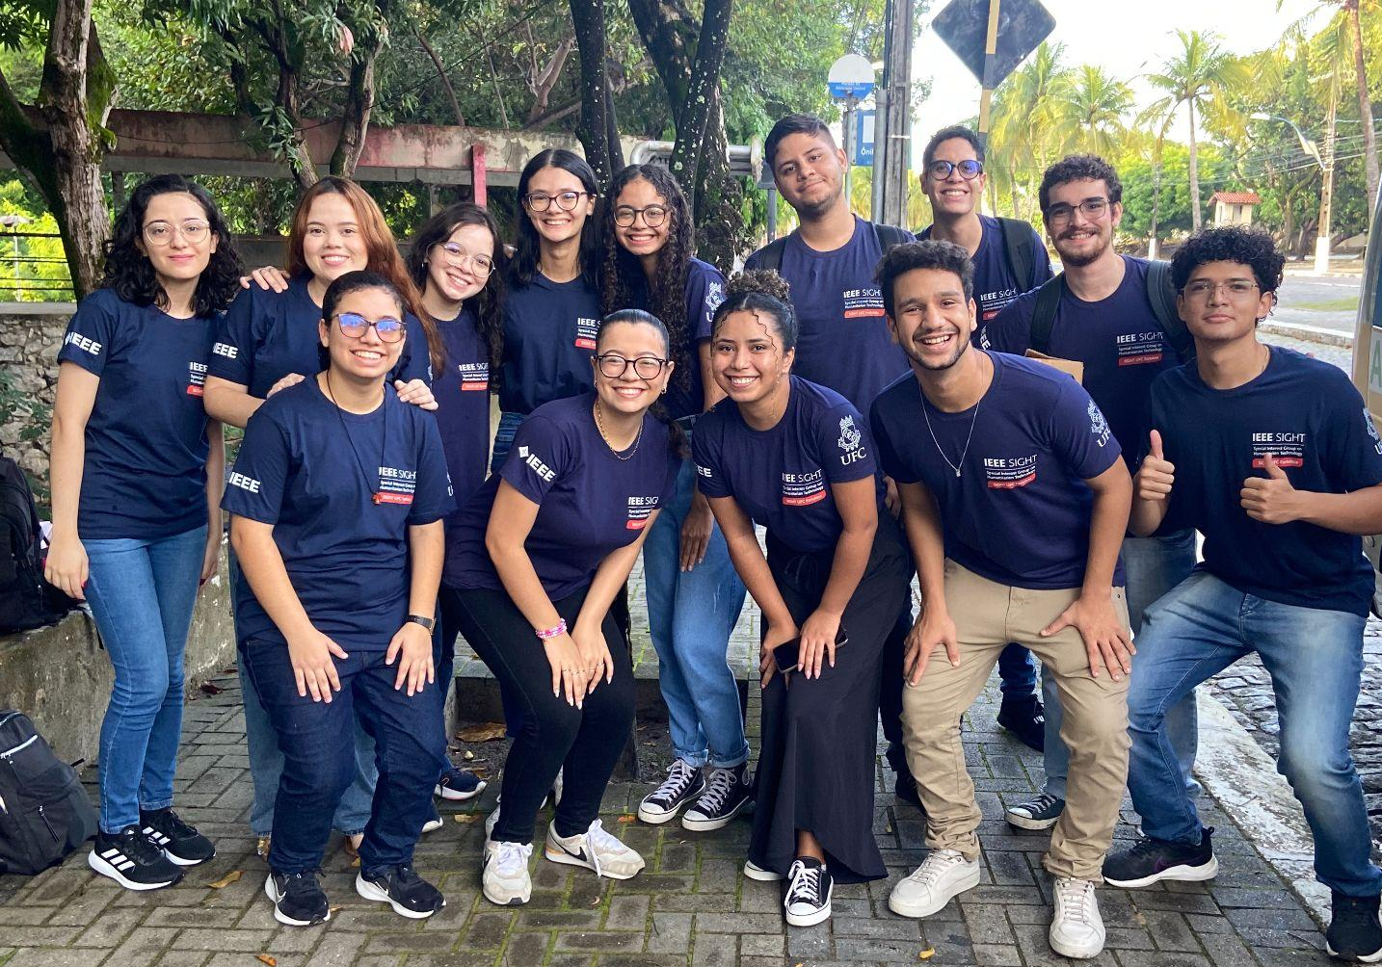
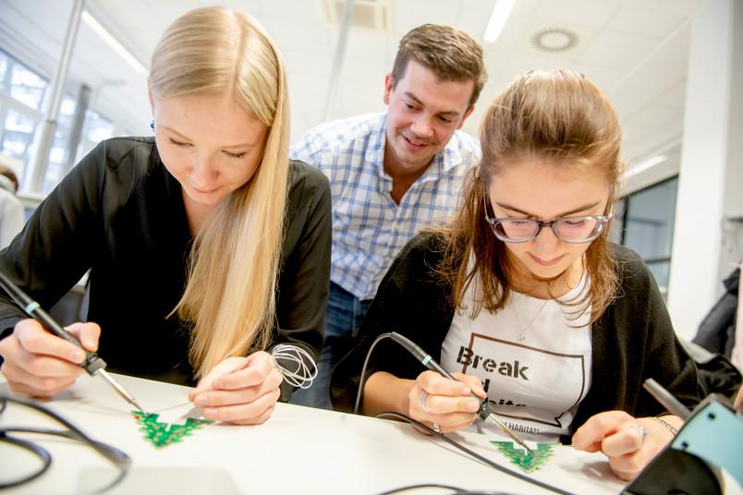
IEEE SIGHT At a Glance
69,529 individual members in 130 countries
270 SIGHT Groups in 50+ countries
1267 activities with 82,000+ attendees in 2024

Slide 21
IEEE SIGHT Benefits
Membership is free and open to all who want to engage in sustainable development.
Members receive the monthly Humanitarian Technologies newsletter, as well as special announcements.
SIGHT Groups can participate in targeted funding opportunities
  Tech4Good project grants.
  Humanitarian technology-related event sponsorship.
  Funding opportunities from other members of the IEEE HT consortium.
Networking opportunities with other SIGHT members with similar interests.
SIGHT provides US$250 in seed funding to new SIGHT Groups, and US$200 to existing Groups, consisting of at least 6 IEEE members.

Slide 22
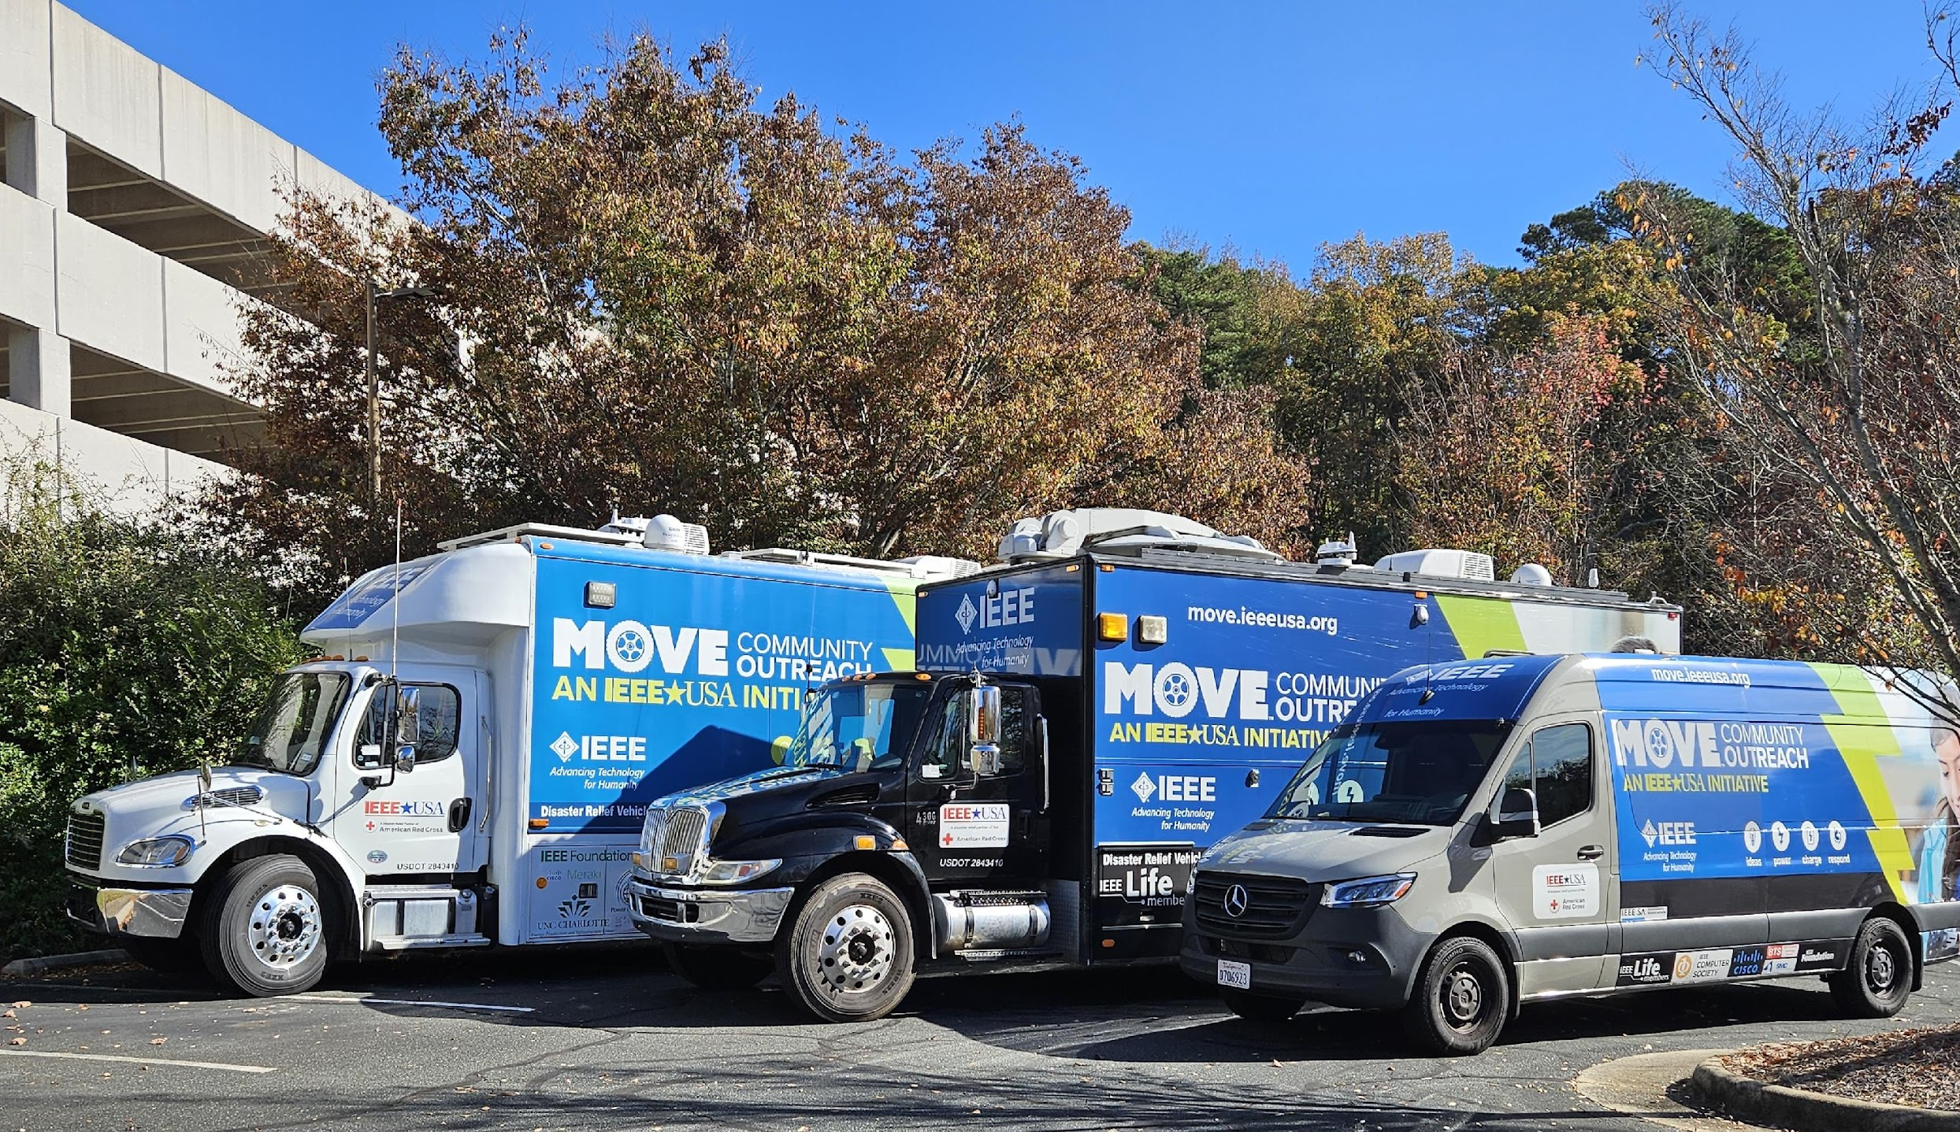
All About IEEE MOVE

Slide 23
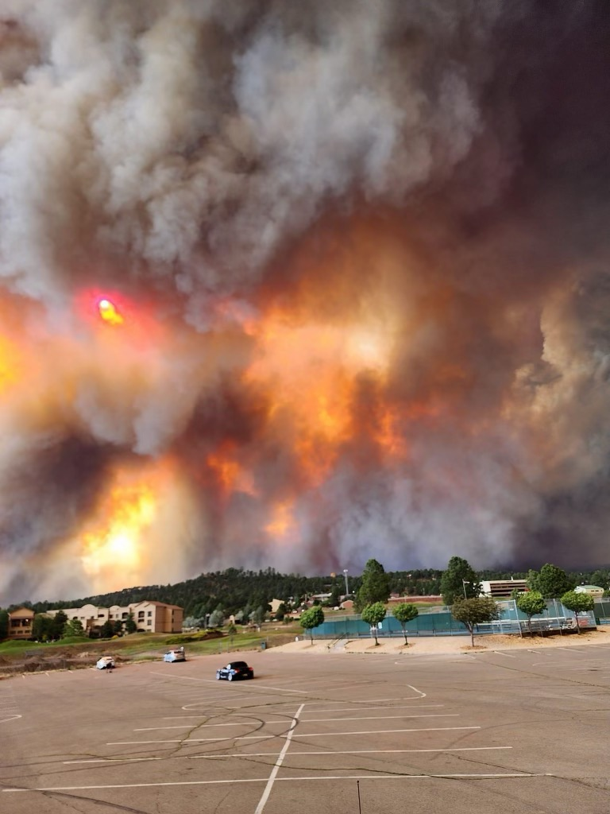
Program Overview: IEEE MOVE (Disaster Response + STEM Education)
MOVE (Mobile Outreach using Volunteer Engagement)
Global disaster relief and outreach emergency response program committed to assisting natural disaster relief workers with short-term communications and power solutions.
When not deployed for emergency response, the MOVE Global assets are employed by volunteers to conduct community outreach and facilitate learning opportunities for students and the general public in the areas of Science, Technology, Engineering, and Math (STEM).
  Includes topics such as disaster preparedness and readiness.

Slide 24
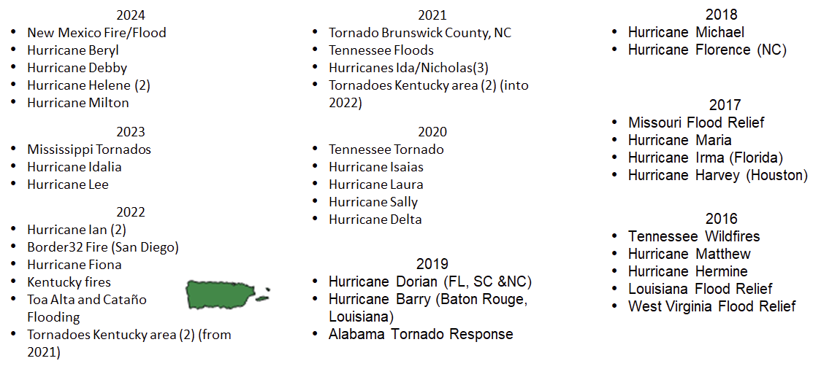
41 MOVE Disaster Relief Deployments

Slide 25
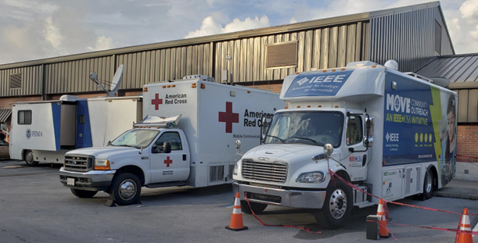
MOVE Truck and Volunteers
Deployment Capabilities
Provide power for the Red Cross Shelters and Disaster Response Operations
Provide internet and Network Access to the Red Cross Shelters and Disaster Response Operations for email, messages, IP telephone, videoconferencing, etc.
Recharging battery packs to power cell phones
Transport capabilities to remote locations impacted by the disaster

Slide 26

IEEE >> Advancing Technology for Humanity
MOVE Community Outreach
Emergency Relief Program assisting victims of natural disasters with short-term communications and power solutions.
STEM Outreach
Public Visibility
IEEE Member Engagement
Run by Volunteers
Funded by Donations

Slide 27


Slide 28
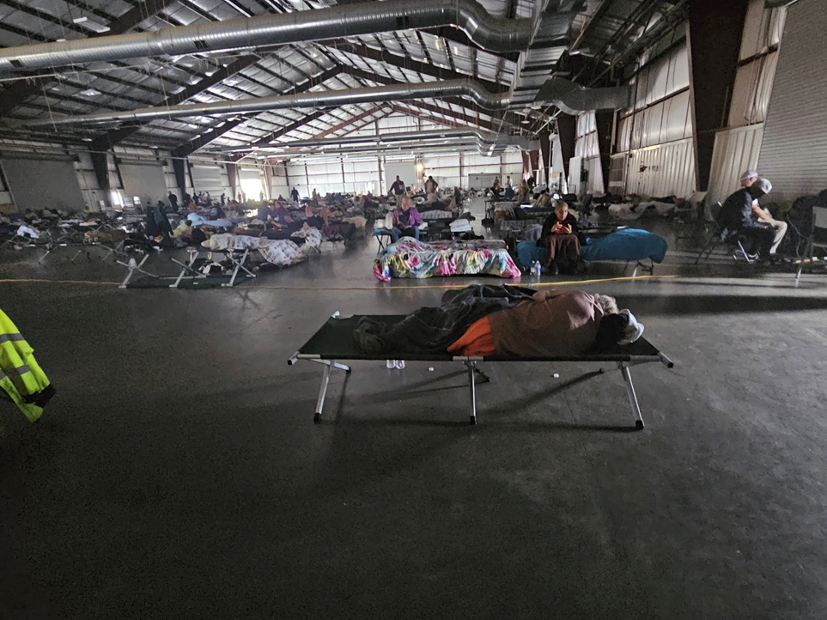

Slide 29
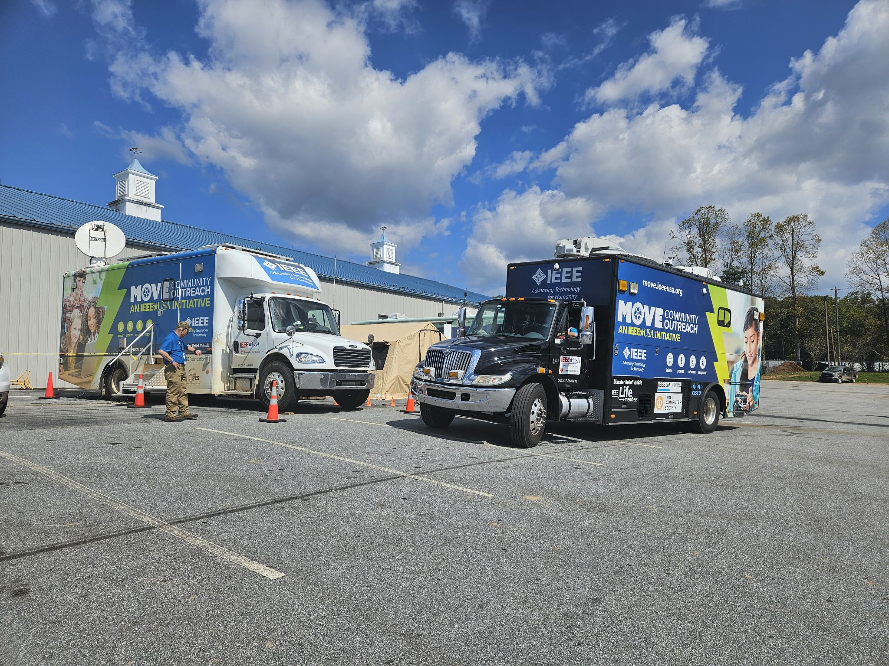

Slide 30
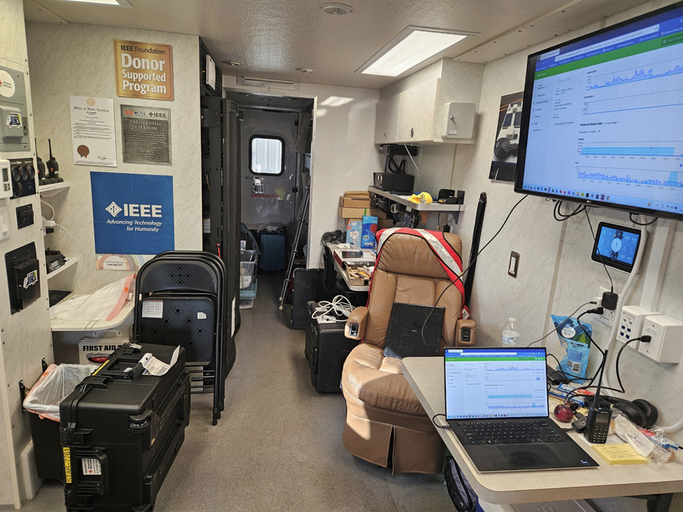
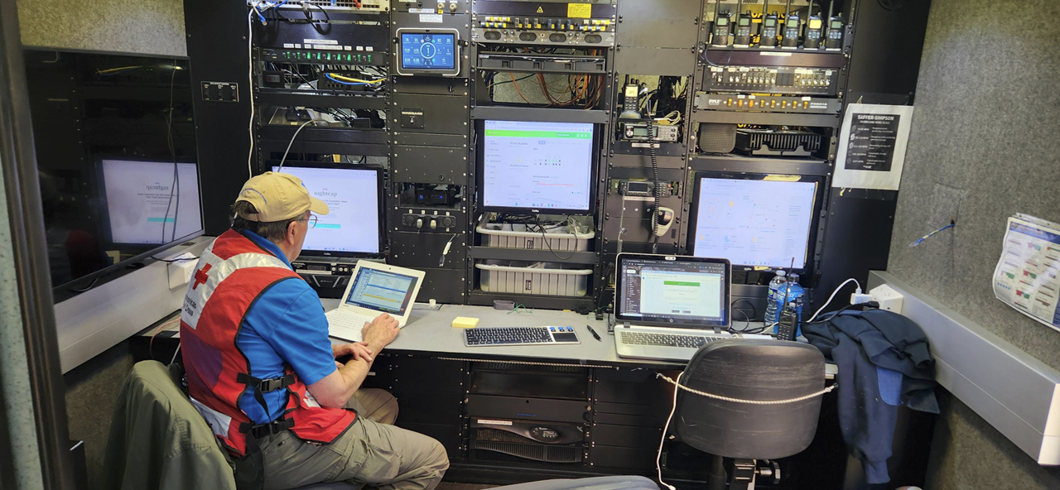
MOVE Trucks

Slide 31
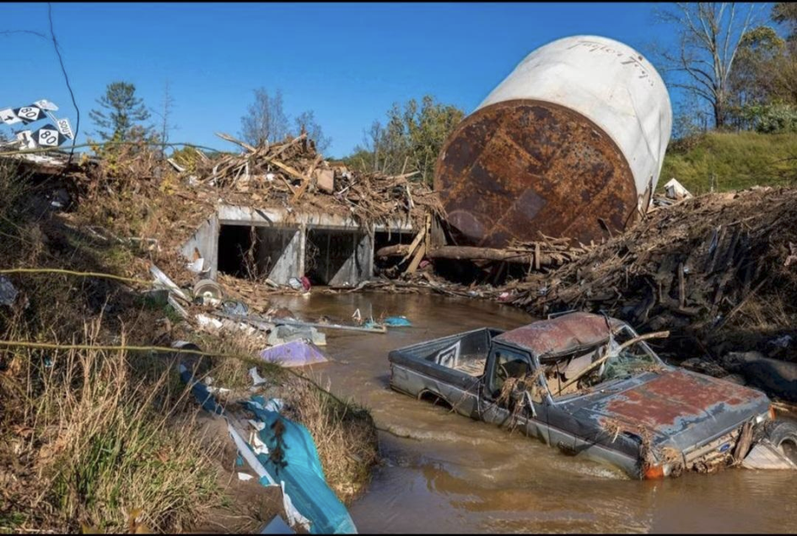
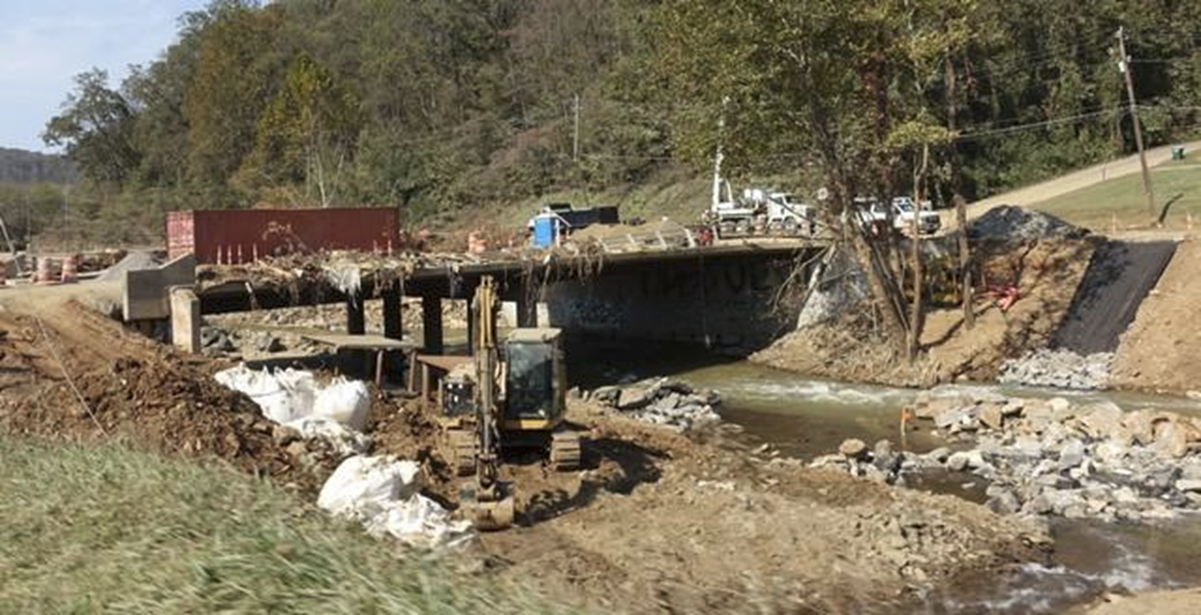
Hurricane Helene in North Carolina

Slide 32
All About IEEE Tech4Good

Slide 33
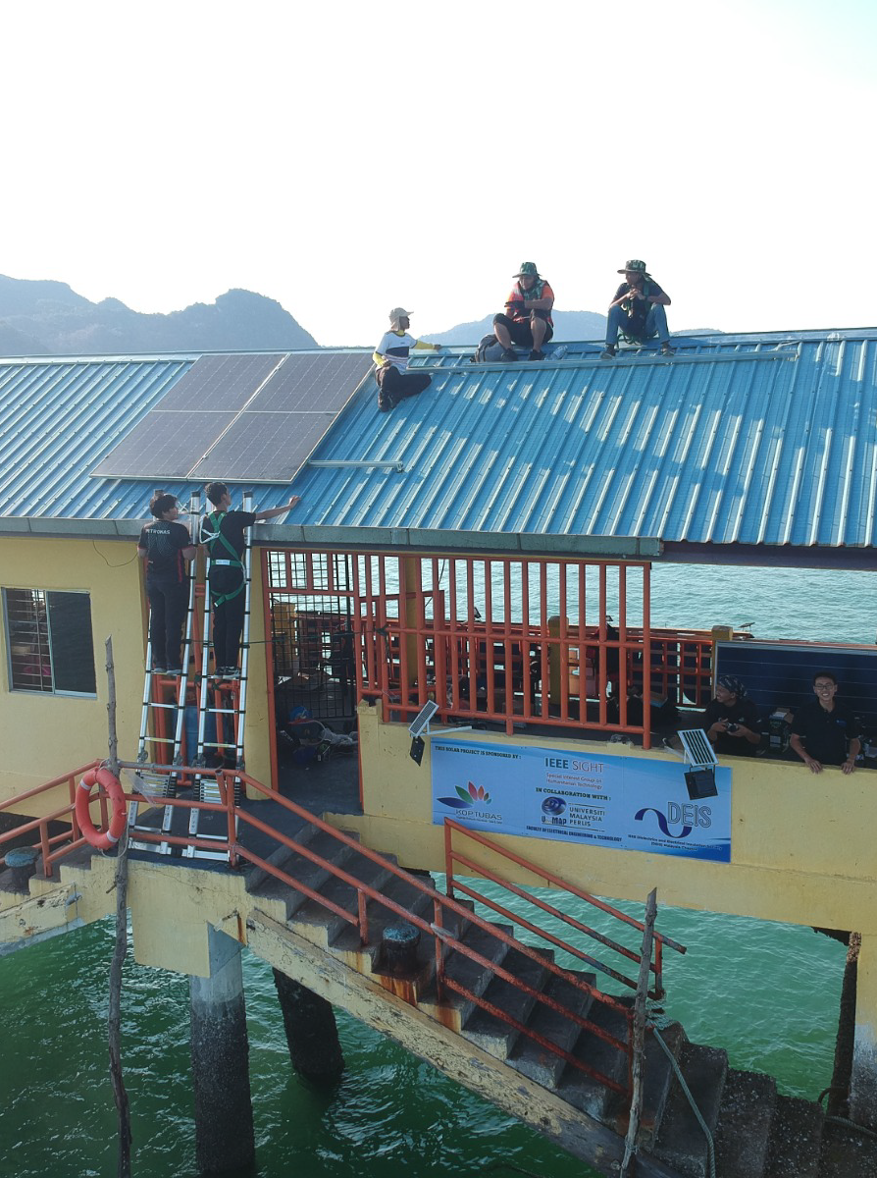

IEEE Tech4Good
Description: Funding opportunities to support grassroots technological projects, led by IEEE members, that address local challenges related to sustainable development.
Mission: Create new opportunities to partner and leverage the strength of the IEEE network and expertise to solve global challenges and foster technology for social good.
Opportunities: IEEE members can apply for Tech4Good funding to implement a project that addresses a challenge in the local communities where they live. The starting point is always the needs of the community determined together with local organizations and leaders. Teams ensure that their solution contributes to one of the UN Sustainable Development Goals.
htb.ieee.org/funding-opportunities/tech4good/

Slide 34
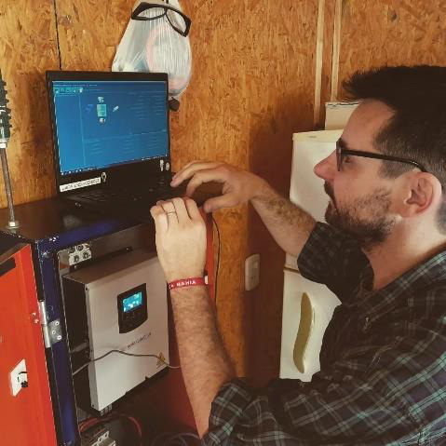
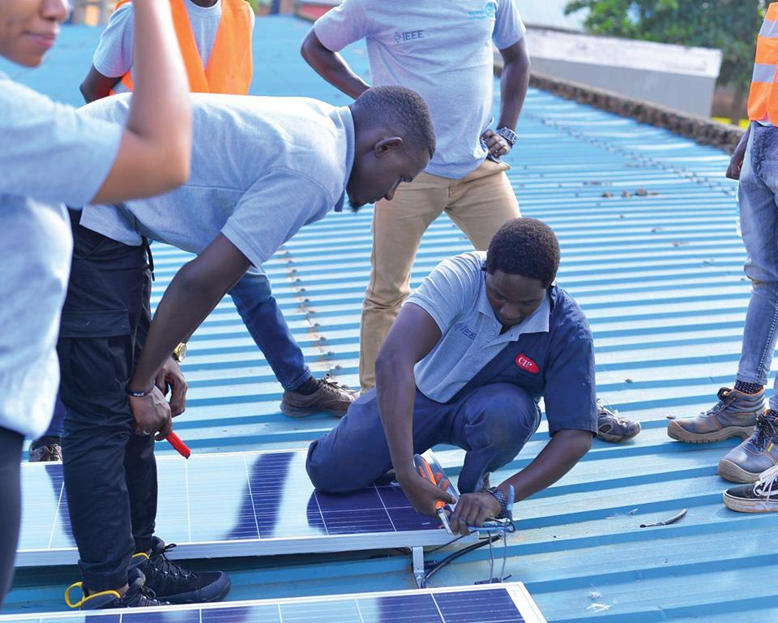
Tech4Good Project Description & Requirements
Funding amount: up to US$10,000 per project
Project timeline: 6 months
Primary applicant has to be an IEEE Member; team should be connected to a local IEEE entity (most frequently Sections or Student Branches)
Projects must:
  Address one or more of the UN Sustainable Development Goals (SDGs).
  Work with a partner community entity to identify and address a need through the development, customization, or deployment of technology.
  Consider environmental, cultural, socio-economic, and infrastructural issues that could affect the project’s impact.

Slide 35
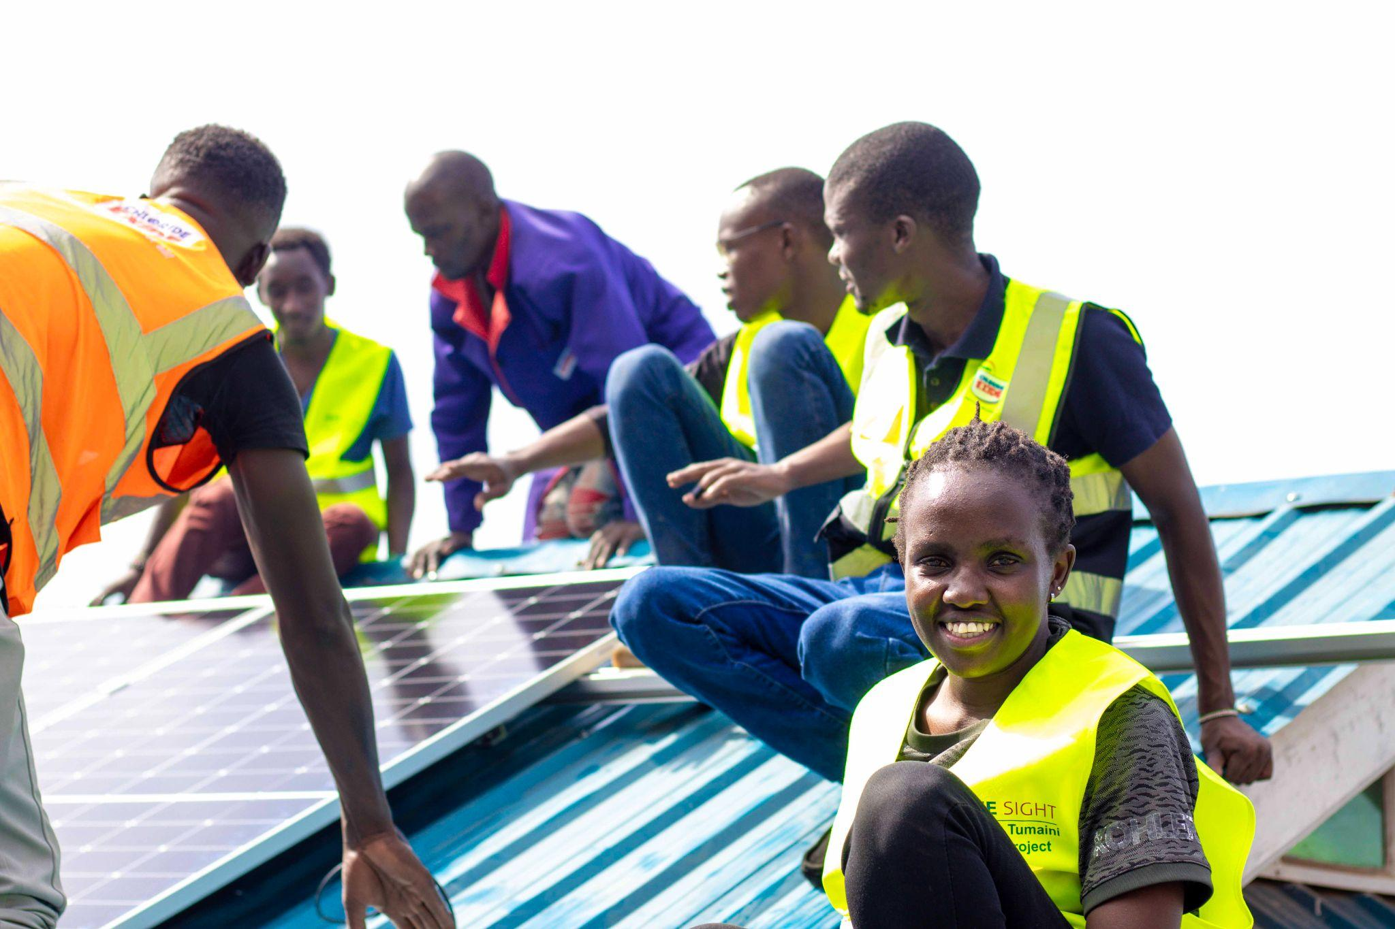
Tech4Good 2024 Highlights
355 applications were submitted to the five 2024 Calls for Proposals
77 Applications approved
  Fifteen countries
  Three IEEE Regions
  137,592 estimated beneficiaries
US$597,546 in grants awarded
1,267 volunteers involved
  Approximately 42% identify as female

Slide 36
Ways to Get Involved with IEEE HT

Slide 37
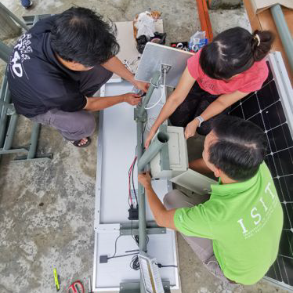
Funding and Engagement Opportunities
2025 Tech4Good Call for Proposals - Now open for all active IEEE members through 31 March
  Volunteer reviewers always welcome!
2025 Internet for All Call for Proposals (offered to IEEE ComSoc members) - likely opening in April
EPICS in IEEE Call for Proposals open through 01 May
HTB Event Sponsorship for related events, tracks, sessions
Start a new SIGHT group
Take the interactive, free courses on IEEE ILN - Humanitarian Technology and Sustainable Development at IEEE
Sign up for the HT newsletter to get up-to-date information from consortium programs including Tech4Good, EPICS, ISV, and more

Slide 38
Contact:
htb-office@ieee.org

Slide 39

Thank you!

