Slide 1
YP/WiE Forum: Project Driven Service
Sunny Bellary, YP Regional Coordinator
Ebonee A. Walker, Ph.D., WiE Regional Coordinator

Slide 2
Welcome & Introductions
Name
Section
Affinity Group
Job Title & Affiliation

Slide 3
Affinity Group Updates
What have you done?
What are you planning?
What are your concerns/challenges?

Slide 4
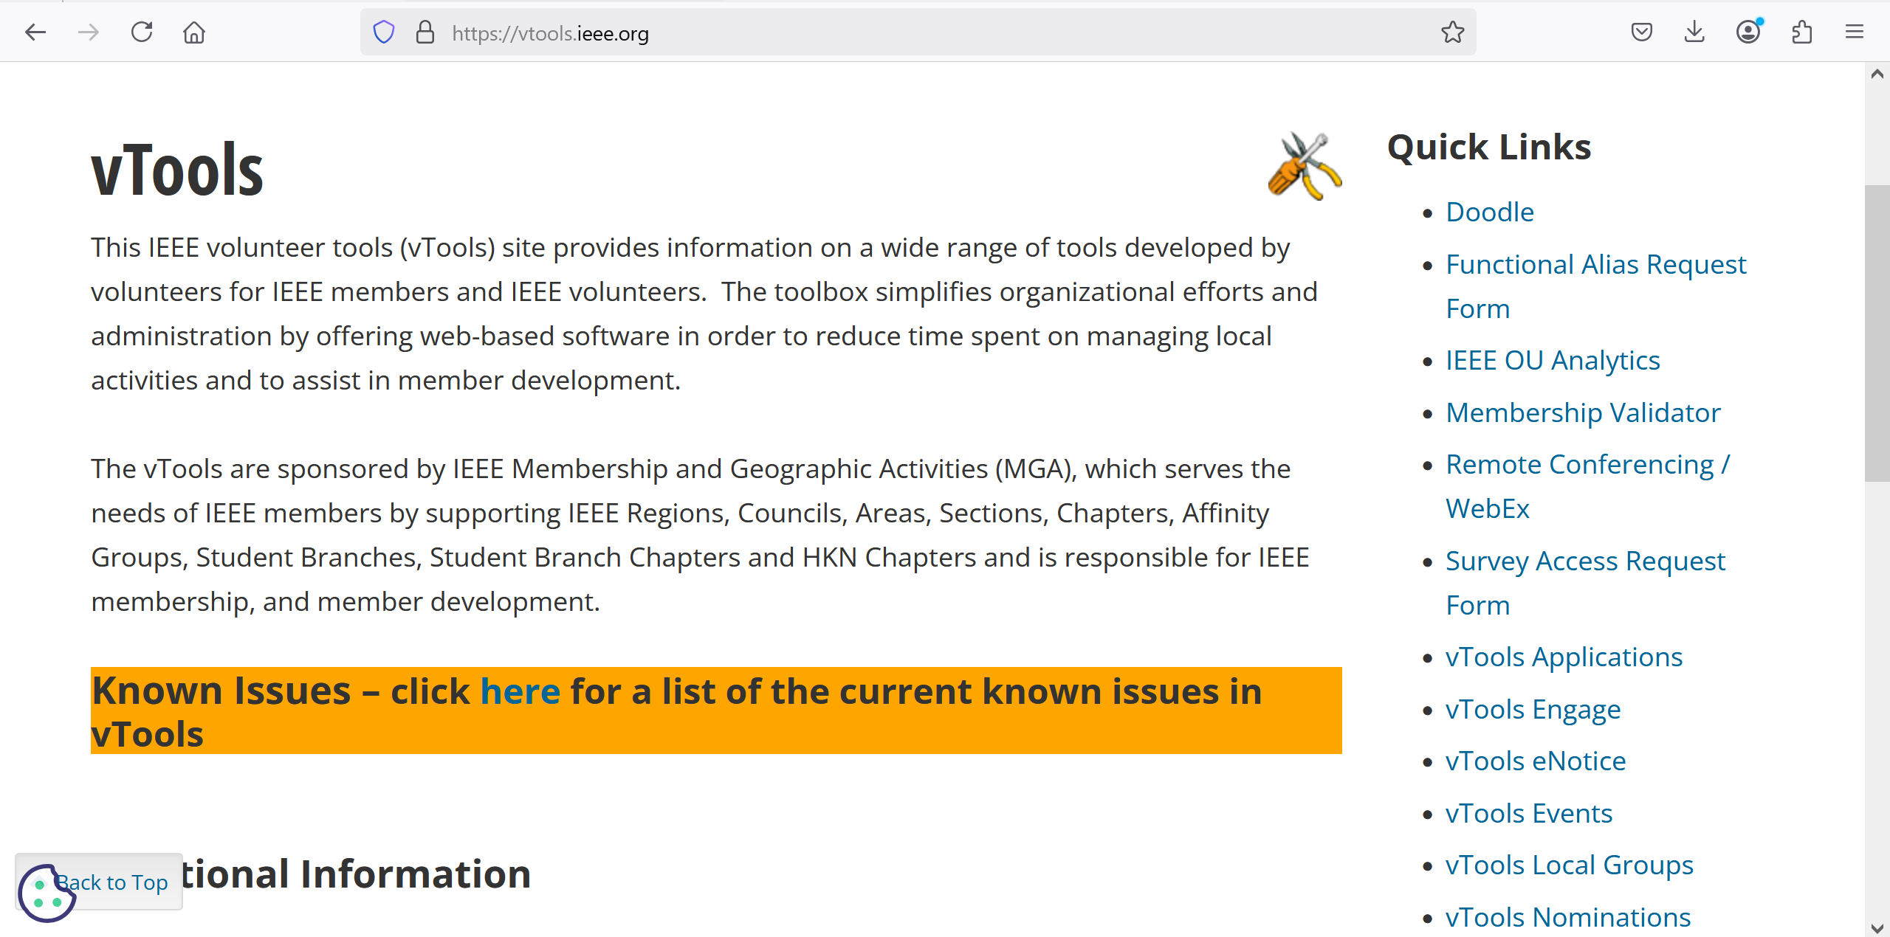
Resources for the AG
https://vtools.ieee.org/

Slide 5
Closing Remarks

