Slide 1
State of IEEE Industry Engagement
Jessica Bian, Chair of IEEE Industry Engagement Committee (IEC)
Jim Ramirez, Senior Manager, IEEE Corporate Development
Region 3 Meeting, March 28, 2025

Slide 2
Industry Professionals’ Needs – Unmet
Technicians (Engineering Affiliates)
Applications, Support, & Maintenance
IEEE best known today
Solutions & Deployment
Tools & Product Developers
Standards
Core
Underserved
R&D - Innovation
Researchers & Academics
Technology Maturity
Notes:
The biggest group of industry members are those most closely aligned with academia, that is, those in Research or R&D. We’re largely missing those industry technology professionals who make up the bulk of those in our fields, particularly those in solutions & deployment and those in applications, support, & maintenance.
While we don’t have precise numbers for those in the field for each of these categories (because they were developed by IEC),
Note: the recent All-societies Research Project* has data on this question specifically, which shows that. For that question, looking at the members in industry who responded to the survey, more than half were in either R&D (47%) or Research and Academics (6%). The rest were relatively evenly spread across the other categories.
The question in the member database on whether they spend 50% or more of their time on Research also suggests that a high percentage of our members are in these first two categories – with close to 40% saying they spend 50% or more of their time on Research.
* The All Societies Research Project is a survey that has been done every four years the past 12 years and includes samples from every society.

Slide 3
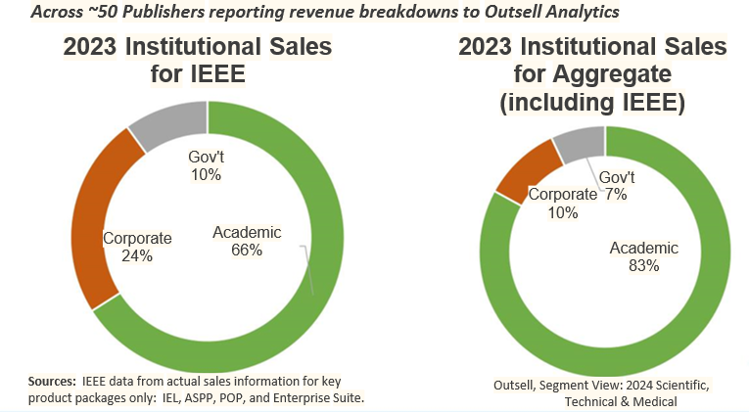
IEEE Corporate Engagement Is STRONG in Publication Sales
Corporate revenue from IEEE Xplore sales is ~$66M (end of 2024)
This represents 23% of our overall business at IEEE - Much higher % than for many others
Notes:
Moving forward beyond the beta would require significant effort to get authors or editorial boards in place to review and approve articles.

Slide 4
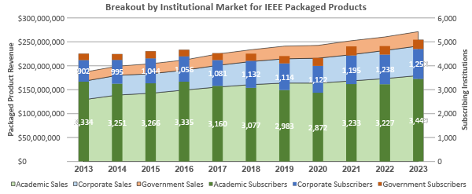
Packaged Products to Corporate Market Increasing
Today's corporations continue to deliver new patented technologies at an ever-increasing pace, and IEEE is by far the most-cited publisher in new patents.
Notes:
But while industry membership has been decreasing, packaged sales to the corporate market has been increasingly strong over the last decade.
This slide includes sales of products comprised of IEEE documents, including IEL, ASPP and POP, and Enterprise. Enterprise is a product designed for the corporate market. And this chart does not include two products that are generating good revenue from the Corporate Market:
eBooks, not included on this slide, are selling well to corporate accounts in North America because the content is practical and applied. In 2023, eBooks sales drove $670K in sales form 67 corporate subscribers globally, up from $369K from 45 corporate subscribers in 2019, an 82% increase.
And IEEE DiscoveryPoint, also not included on this slide, will generate in addition nearly three quarters of a million in recognized revenue in 2024.
Source:
Product Sales – MSD 2023 year-end data

Slide 5
Corporate Engagement in Conferences, Membership, and Other Areas?
Engage companies - IEEE Premier Corporate Program
One IEEE - One-Stop VIP Services (Platinum, Gold and Silver)
Xplore Subscription discount, employee IEEE membership discount
Access to talents, local Sections/Chapters
Society/Council Resource Centers
Event Sponsorship, Standards development, and more
Boeing, Lockheed Martin, OPPO
TMEIC, Shemar in 2024
Ongoing discussion with Samsung and others
Notes:
Moving forward beyond the beta would require significant effort to get authors or editorial boards in place to review and approve articles.

Slide 6
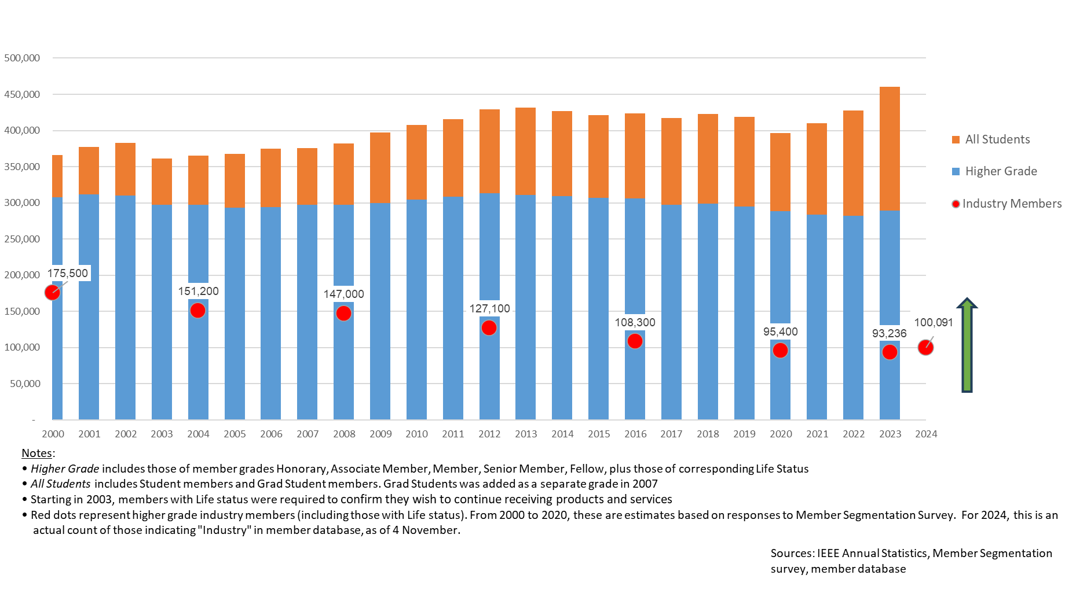
IEEE Individual Membership – Overall and Industry, 2000 to 2024
Notes:
Has been a steady decline in Industry members over the past 20 years, but we did have a modest increase in 2024\ – but see two slides later -- on Corporate MSD sales

Slide 7
IEEE Goals
IEEE Industry Engagement Committee
7

Slide 8
Percent of Members in Industry & Percent with no data
Region Name | No Employer Type Data | Total HG Membership | Total Known Employer Type | Percent Unknown | Percent Industry | Percent Academia
Region 1 | 2,522 | 15,543 | 13,021 | 16% | 63% | 21%
Region 2 | 2,278 | 14,023 | 11,745 | 16% | 53% | 20%
Region 3 | 2,513 | 16,572 | 14,059 | 15% | 57% | 22%
Region 4 | 1,612 | 11,112 | 9,500 | 15% | 62% | 24%
Region 5 | 2,163 | 16,142 | 13,979 | 13% | 67% | 16%
Region 6 | 3,970 | 30,758 | 26,788 | 13% | 70% | 12%
Region 7 | 1,532 | 9,909 | 8,377 | 15% | 55% | 29%
Region 8 | 8,442 | 52,423 | 43,981 | 16% | 32% | 55%
Region 9 | 2,165 | 9,905 | 7,740 | 22% | 29% | 54%
Region 10 | 16,257 | 89,448 | 73,191 | 18% | 22% | 67%
All | 43,454 | 265,835 | 222,381 | 16% | 42% | 43%
Notes:
We’ve developed systems to share industry member statistics with OU industry liaisons on a regular basis. This slide shows Region level data, but we are also delivering Section and Society data.

Slide 9
Percent of Members Eligible for Senior Member
Region Name | Total Members (all Grades) | Total Potential Endorsers (SM, F, LS, LF) | Pct Current SM | Total AM, M, LM | Potential Senior Members | Pct Potential SM of total membership | Pct of AM, M, LM who are Potential SM
Region 1 | 25,680 | 4,802 | 14.7% | 16,538 | 12,398 | 48.3% | 75.0%
Region 2 | 21,967 | 4,221 | 16.3% | 14,431 | 11,068 | 50.4% | 76.7%
Region 3 | 27,033 | 5,655 | 18.4% | 15,855 | 10,903 | 40.3% | 68.8%
Region 4 | 17,621 | 3,265 | 15.5% | 10,676 | 7,721 | 43.8% | 72.3%
Region 5 | 24,483 | 4,499 | 16.4% | 15,406 | 10,603 | 43.3% | 68.8%
Region 6 | 45,476 | 9,134 | 16.7% | 30,097 | 21,534 | 47.4% | 71.5%
Region 7 | 14,854 | 2,610 | 15.0% | 8,737 | 5,970 | 40.2% | 68.3%
Region 8 | 92,627 | 13,216 | 12.6% | 40,883 | 23,497 | 25.4% | 57.5%
Region 9 | 24,405 | 2,148 | 8.6% | 7,911 | 3,569 | 14.6% | 45.1%
Region 10 | 213,029 | 19,315 | 8.3% | 70,939 | 31,362 | 14.7% | 44.2%
All | 507,175 | 68,865 | 11.9% | 231,473 | 138,625 | 27.3% | 59.9%
Notes:
We’ve developedsystems to share industry member statistics with OU industry liaisons on a regular basis. This slide shows Region level data,but we are also delivering Section and Society data.

Slide 10
2025-2030 IEEE Strategic Goals Directly Related to Industry Activities
Provide opportunities for technology-related interdisciplinary collaboration, research, and knowledge sharing across industry, academia, and government
Industry Content Platform - transform research papers to industry application content, expected to be ready by 2026
Create new industry conferences for product development community
Thursday, April 10 2025, 11am, ET, webinar
Empower technology professionals in their careers through ongoing education, mentoring, networking, and lifelong engagement
Engage individual industry members
Elevate/value individual industry members
Senior and Fellow grades
Create industry content
Create conferences for industry
e.g., AI World Technology Summit (WTS)
Value
Individual Members
(SM, FM)
Conferences
WTS
Publications
Industry Content
Notes:
Moving forward beyond the beta would require significant effort to get authors or editorial boards in place to review and approve articles.

Slide 11
Industry Member Engagement Strategy - ‘Seen, Heard, Valued’
Engagement - A meaningful contact or connection
Has your Section had any meaningful contact/connection with each of your industry members?
Meaningful - Seen, Heard, Valued; not one-way flow, not just sending eNotices/emails
‘Seen’ - Lead your Section to reduce Unknown Employer Type from 22% to 5% by May 31, 2025
Region 3 has 15% Unknown (2,513 Members) as of Feb 1, 2025
Instructions and Data at the Industry Engagement Resources webpage
‘Valued’ - Lead your Section to nominate 90% of eligible industry members for Senior Members IMMEDIATELY
- Region 3 has 10,903 (68%) eligible Members as of Feb 1, 2025
Notes:
Moving forward beyond the beta would require significant effort to get authors or editorial boards in place to review and approve articles.

Slide 12
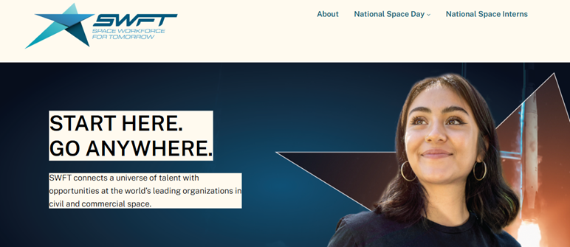
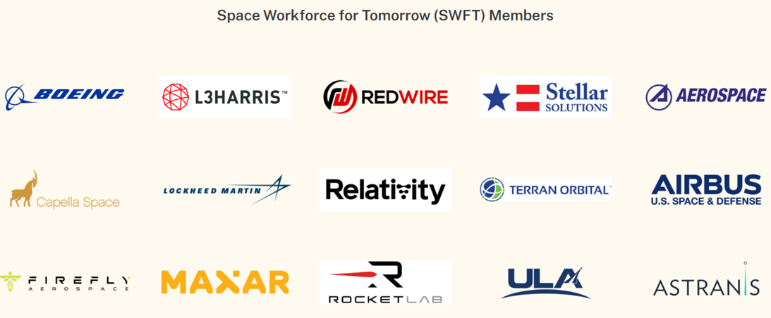
Industry Member Engagement Strategy - ‘Seen, Heard, Valued’ (cont’d)
‘Heard’ - Lead your Region/Section to run virtual internship/job fairs for students and YPs
Use vFairs platform, and invite companies to participate with internship/job openings
The aerospace industry offered 3,000+ summer internships each year.
Notes:
Moving forward beyond the beta would require significant effort to get authors or editorial boards in place to review and approve articles.

Slide 13
2025 and Beyond
Working with TAB TCOES (Committee on Technical Community Outreach, Engagement and Society Membership)
Distinguished Member Recognition framework and virtual career fairs
Working with MGA Admission & Advancement Committee to accelerate Senior Member elevation
Provide personalized industry member lifelong engagement
Personalization at Scale with AI tools
ICP - Industry Content Platform
ICGC - IEEE Career Guidance Counselor
Personalized emails
Career relevant conference invites
13
Notes:
Much of the work that’s been highlighted in this presentation will continue in 2025, along with some other projects aimed at adding value to technology professionals in industry.

Slide 14
Questions & Input

