Slide 1
IEEE President-Elect Address
Mary Ellen Randall, 2025 IEEE President-Elect, IEEE Fellow
Joint Virtual Region 3 & 5 Annual Meeting
29 March 2025

Slide 2
My Pledge to Our Members
Institute innovative products and services to ensure our mutually successful future.
Engage stakeholders (members, partners, and communities) to unite on a comprehensive vision.
Expand technology advancement and adoption throughout the world.
Execute with excellence, ethics, and financial responsibility.
Lead by example with enthusiasm and integrity.

Slide 3
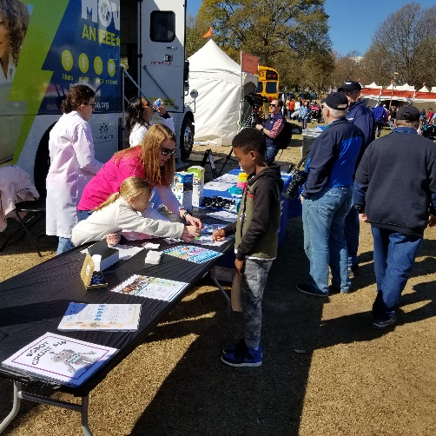
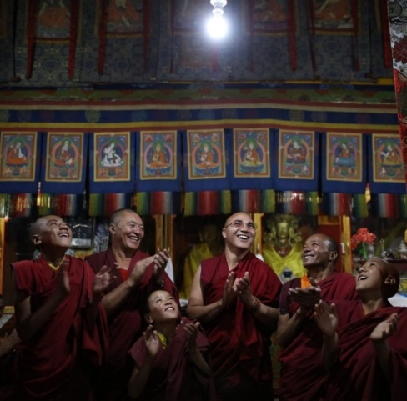
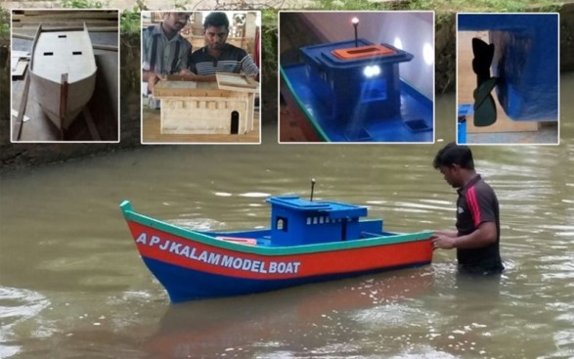
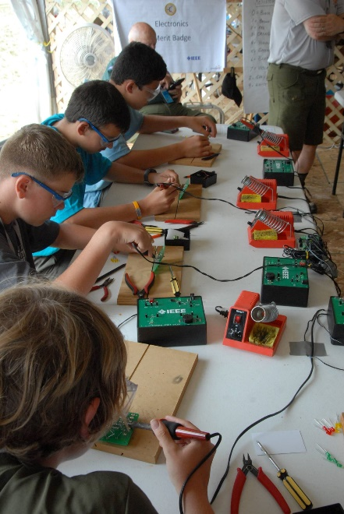
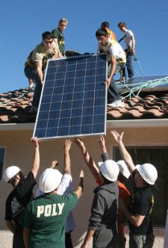
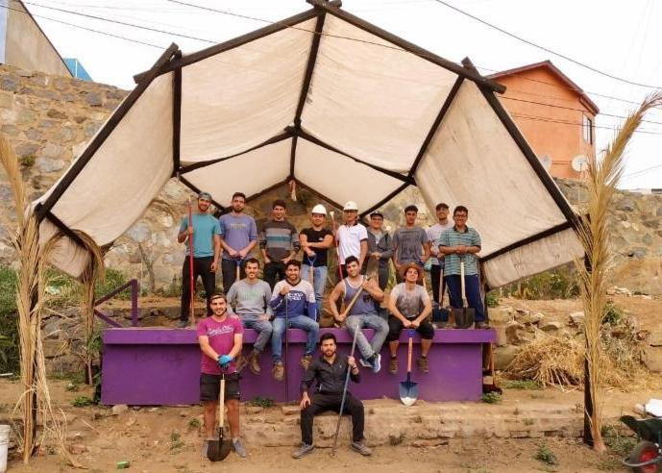
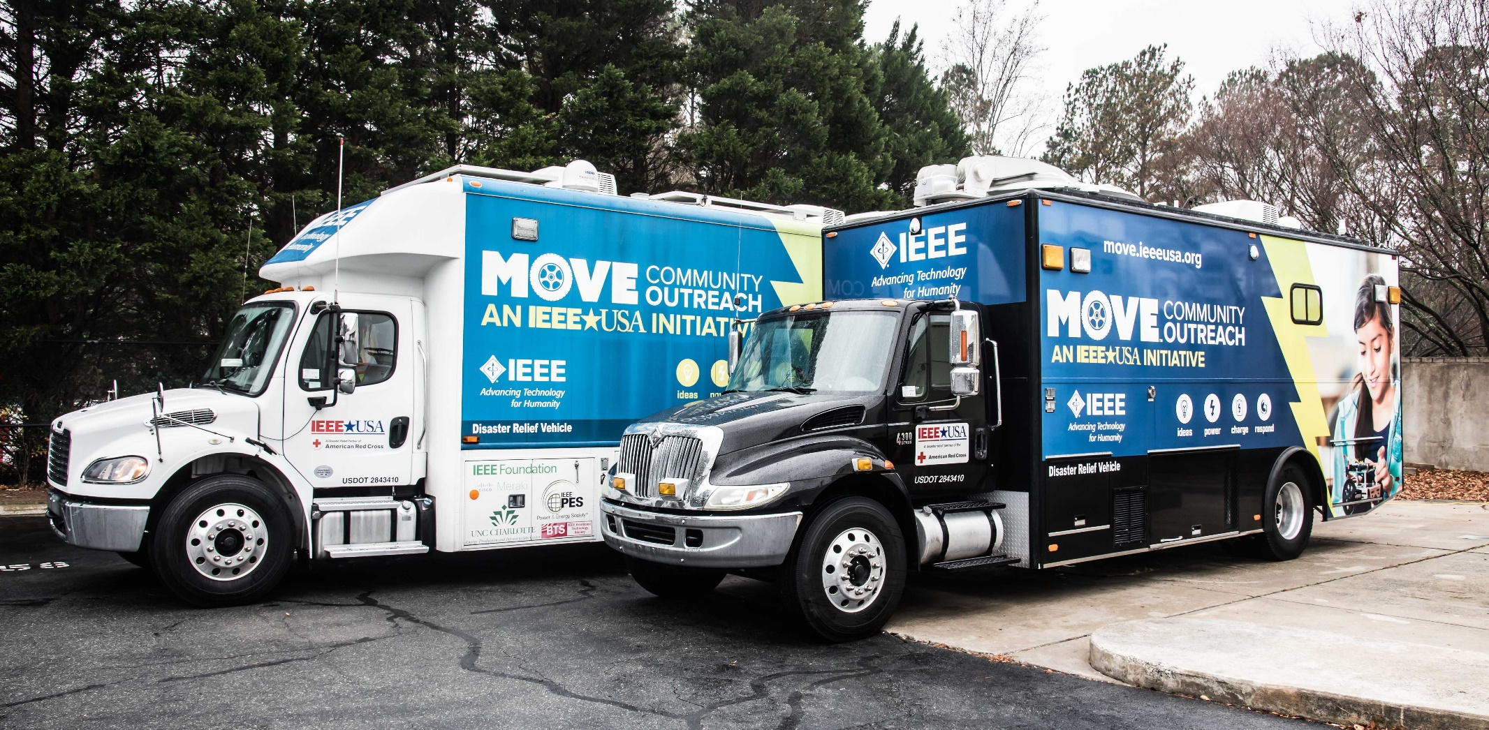
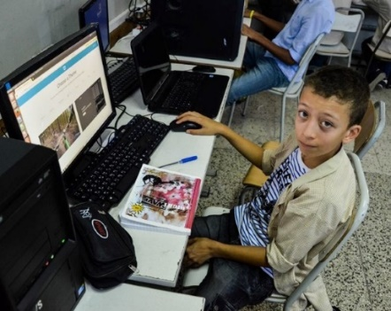
IEEE is Committed to Advancing Public Imperative Activities
Social good activities that are directed at the general public.
They are generally related to the promotion of the public’s understanding and appreciation of our fields of interest and/or positioning our technical expertise in ways to benefit humanity.
Typically, these activities are not expected to create a financial surplus.

Slide 4
Why do Public Imperative Activities Matter to IEEE?
IEEE is a Section 501(c)(3) Public Charity.
“To engage exclusively in scientific and educational activities […] for the benefit of the engineering community and the general public”
Public Imperative Activities are IEEE’s methodology to show the world our charitable impact.
Notes:
IEEE as a public charity means that the purpose of our work is to provide education, in our case for scientific purposes, and showcase our mission to the world for the benefit of humanity. These activities tied to the mission of IEEE—advancing technology for the benefit of humanity—and help us better demonstrate the great impact that IEEE and its members have on society.
You are helping bring IEEE’s role as a public charity to life every day by your activities which promote the IEEE mission.

Slide 5
Seven Guiding Principles of the Budget Redesign Process
Align Budgets with Mission, Vision, Core Values and 2025 – 2030 Strategic Organizational Goals
Invest in Diverse Innovations with a Tolerance for Failure
Invest in Brand Enhancement and Awareness
One IEEE: Transform from Independent Silos to Collaborative Stewardship
Publicize Public Charity Status and Invest Accordingly
Invest in Technological, Operational, and Talent Advancements to Sustain Relevance and Accelerate Growth
Simplify and Streamline Budgeting Processes for Greater Clarity and Ease of Use

Slide 6
“I've learned that people will forget what you said,
people will forget what you did, but
people will never forget how you made them feel.”
Maya Angelou
Author & Poet
Notes:
I’d like to close with a quote that resonates strongly with me and one that I think of often when dealing with my fellow volunteers and members.

