Slide 1
IEEE and Regions 1 & 2 – At a Glance
Bala Prasanna
Director – Region 1
March 28, 2025
Confidential Controlled Distribution

Slide 2
Region Realignment – A Board Mandate
We are all alone in this Together
IEEE is realigning its geographic regions to provide a more equitable representation across its global membership (Effective Jan 1, 2028)
consolidation of the six U.S.-based regions into five, joining together current IEEE Region 1 (Northeastern U.S.) and Region 2 (Eastern U.S.) into new Region 2
splitting of current IEEE Region 10 into two regions-Region 10 (North Asia) & Region 11 (South Asia and the Pacific)
Two zones within Region 8 as
Zone A: includes Europe and North Africa.
Zone B: comprises the Middle East and Sub-Saharan Africa
Confidential Controlled Distribution

Slide 3
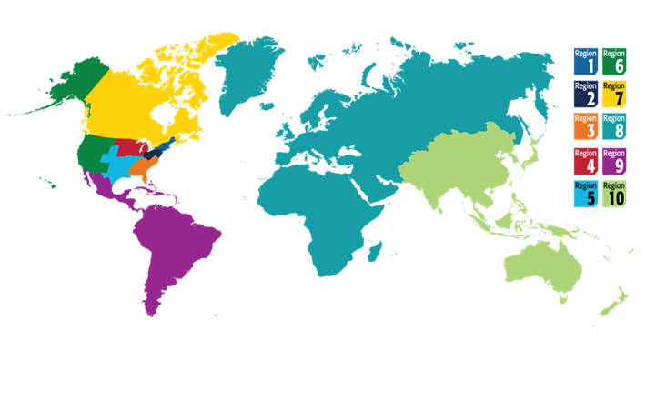
IEEE Geographic-spread of Regions
Regions 1 & 2 Merger – It’s Natural!
R1 is NorthEastern part of US
R2 is Eastern part of US
Confidential Controlled Distribution

Slide 4
Regions 1 & 2 Structurally Balanced
Same Number of Areas, almost same number of sections
IEEE Region 1 is composed of four geographical Areas in the north-eastern part of the USA and is comprised of 22 Sections including
Binghamton, Berkshire, Boston, Buffalo, Connecticut, Green Mountain, Ithaca, Long Island, Maine, Mid-Hudson, Mohawk Valley, New Hampshire, New Jersey Coast, New York, North Jersey, Princeton/Central Jersey, Providence, Rochester, Schenectady, Springfield, Syracuse, and Worcester County.
IEEE Region 2 is composed of four geographical Areas in the south-eastern part of the USA and is comprised of 20 Sections including:
Central Pennsylvania, Erie, Johnstown, Pittsburgh, West Virginia, Susquehanna, Philadelphia, Southern New Jersey, Lehigh Valley, Delaware Bay, Baltimore, Northern Virginia, Washington D.C., Akron, Cincinnati, Cleveland, Columbus, Dayton, Lima, and Youngstown
Confidential Controlled Distribution

Slide 5
Region-wise Membership at-a-glance
Confidential Controlled Distribution

Slide 6
Region-wise WIE Membership
Regions 1 , 2 and 3 comparable, shall we say!?
Confidential Controlled Distribution

Slide 7
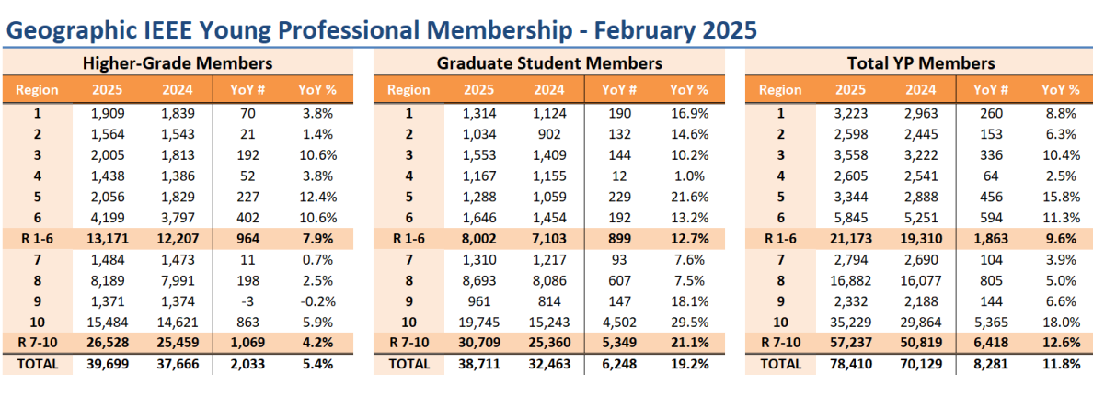
YP Membership in Regions 1, 2 and 3
Regions 8 & 10 Lead the count!
Confidential Controlled Distribution

Slide 8
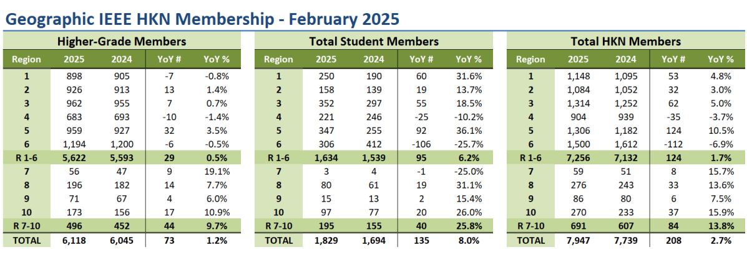
IEEE HKN Honor Society
Confidential Controlled Distribution

Slide 9
Eyes Wide Open – R1 & R2 Differentials
Coming to Terms
Challenges:
Merging two cultures,
By-laws & Ops Manual
Financials(region assessment and networth differentials) and its implication to member services,
ExCom and Board Structures,
Region Award Recognitions,
Professional and Student Activities Funding models
Organizational and Technical Meetings
History and Milestone events
Confidential Controlled Distribution

Slide 10
Eyes Wide Open – R1 & R2 Differentials
Coming to Terms
Bull by the Horn
Governance approved Election cycle including plans to seek approval of R2 director elected by R2 Director representing R1 members during first year of merger – starting 1 January 2028
Similar ExCom and Board structures prior to 2028
Region assessment, Allocationm and financial networth differentials under discussion – Assessment Increase to $8
Joint events – region leadership meetings, student activities, virtual professional activities and talks advertised and accessible to both R1 & R2 members
VICs Awards 2024 – a joint commitment
Region Award Recognitions,
Professional and Student Activities Funding models
Organizational and Technical Meetings
History and Milestone events
Confidential Controlled Distribution

Slide 11
Regions 1 & 2 Merger Full Steam Ahead
From Better Together to Perfect Together
Confidential Controlled Distribution

