Slide 1
2025 Region 6 Director Presentation for Region 3
Joseph Wei
Region 6 Director
Email: joseph.wei@ieee.org
Mobile/WhatsApp: (408) 881-4168
Discord: josephweiieeeregion6

Slide 2
2025 Region 6 Director Presentation for Region 3
Joseph Wei
Region 6 Director
Email: joseph.wei@ieee.org
Mobile/WhatsApp: (408) 881-4168
Discord: josephweiieeeregion6

Slide 3
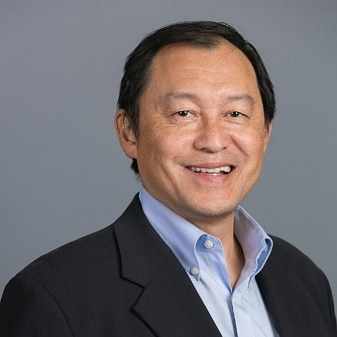
Joseph Wei | Region 6 Director
Professional Affiliation
Managing Director, Technology Ventures Group (TVG)
IEEE Society Affiliation
Computer Society
Consumer Technology Society
SFBA MEMS & Sensors Chapter
Young Professionals and WIE
Professional Experience
Co-founder, Lab360 Hardware Incubator for wearable and IoT Devices startups. Invested in a unicorn valued at >$6B.
Advisor/Mentor to Plug and Play Tech Center, Wearable Technology Conferences, Sensors Converge Conference
Founder of Intel/Linux Server Group, SGI. The first computer company that leverage Open Source Linux to accelerate its business into enterprise/HPC market.
Business/Partnership Development: Inventec. $18 Billion Taiwan ODM for servers for Cisco, Dell, Google, HP, Intel, etc.
IEEE Experience
Region 6 Director
Chair, EMBS - SFBA
Treasurer, Consumer Technology Society - SFBA Chapter
Advisor/Past Chair - SCV Section (largest Section in US)
Chair, SCV Entrepreneurship Program
Co-Chair, Sponsorships - IEEE GHTC, WIE ILC, Sensors
Fun Facts
Speaks three Chinese dialects.
Learned to snowboard 10 years ago after skiing for 35 years. Inspired by a lady who started at the age of 65.
Skilled in finding bugs in software and websites.
Personally recruited Apple co-founder, Steve Wozniak to join IEEE when he attended a Consumer Technology Chapter meeting in SCV in 2014.

Slide 4
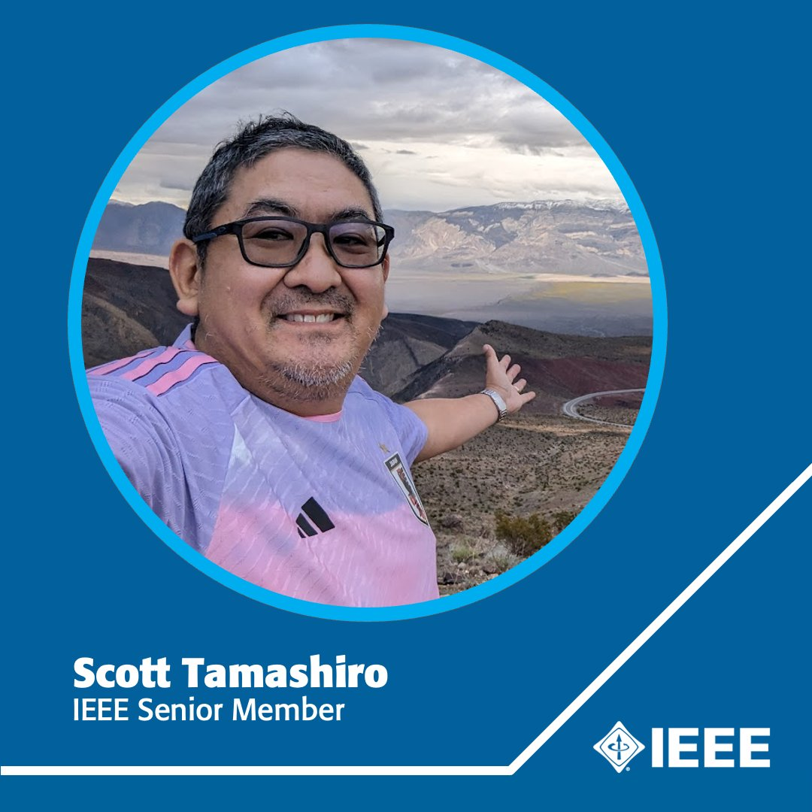
Scott Tamashiro | Region 6 Director-Elect
Professional Affiliation
Technical Staff @ Raytheon, an RTX Business
IEEE Society Affiliation
Reliability
AESS
IoT Tech Community
Professional Experience
Reliability, Maintainability, Systems Engineering, Supportability, System Safety for RTX (Raytheon)
IEEE Experience
IEEE Region 6 Secretary, Treasurer, Strategy, Conferences
IEEE MGA GUOS, A&A, N&A, ARC, MBPAC, Training, VoLT
IEEE Public Visibility, Conferences, Finance
IEEE Rising Stars Conference
IEEE GHTC, SusTech, CleanTech
IEEE-USA MAL, Secretary/Treasurer, Conferences
Fun Facts
Learned Discord and fun from my two kids
Learned empathy and emotional cues from my wife
Helped create and launch the IEEE Volunteer Leadership Training (VoLT) program
Gameday statistician for Los Angeles Galaxy professional soccer team for 30 years
Latest hunts: IEEE Milestones, national parks, magnets, Macross, K-dramas

Slide 5
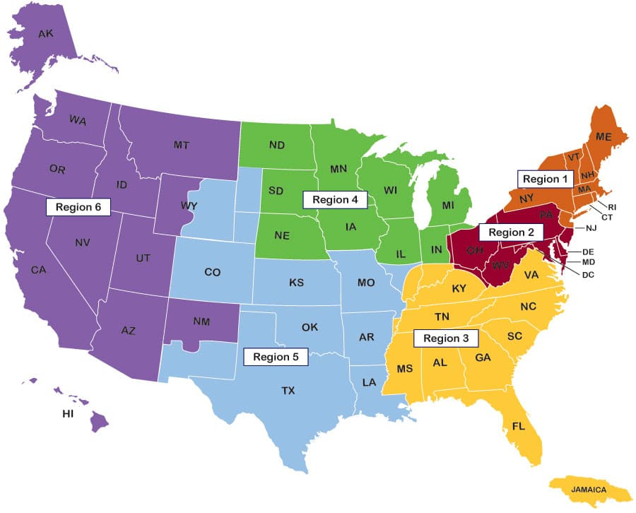
Region 6

Slide 6
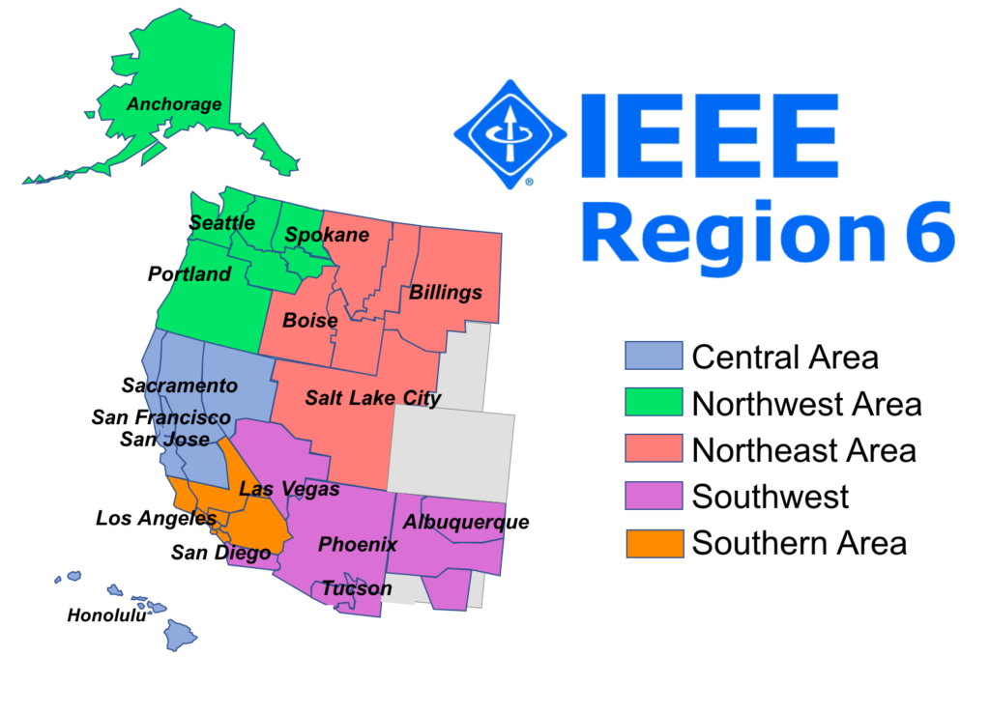
Region 6 Areas
Basic Region 6 Info:
>46,000 members (Feb)
35 Sections
88% Professional, 12% Student members
Region 6 website https://ieee-region6.org/ (to be redesigned)

Slide 7
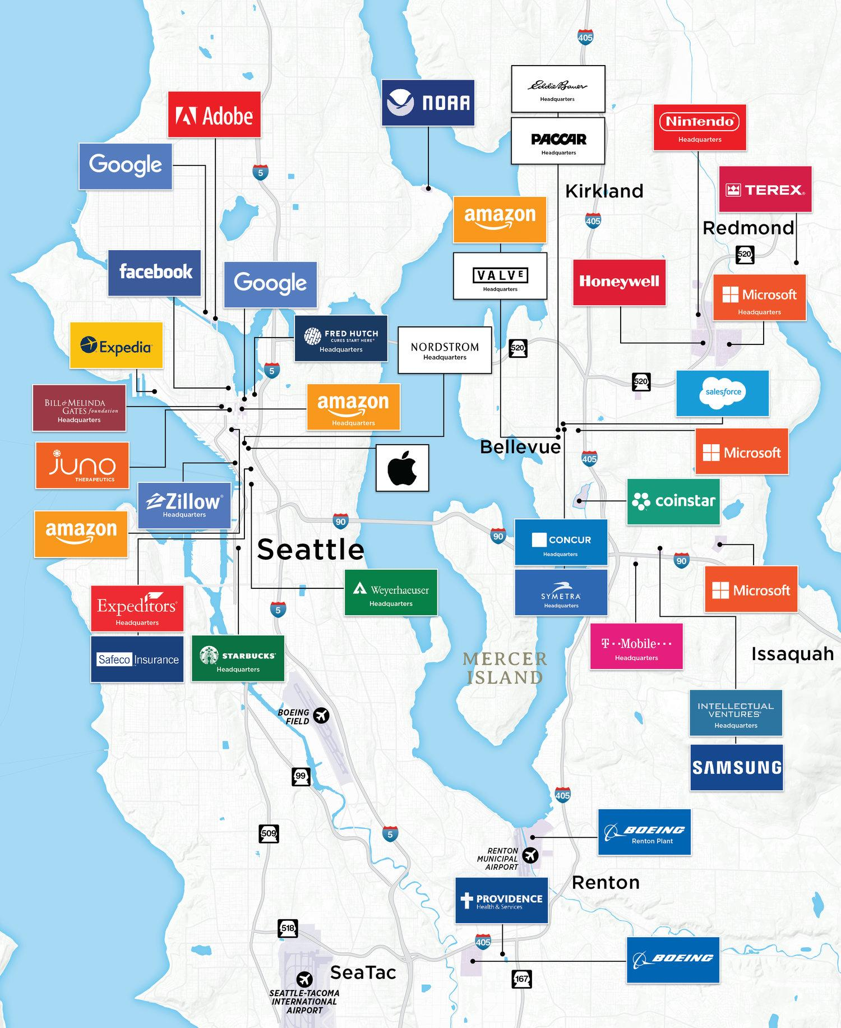
Seattle/Bellevue

Slide 8
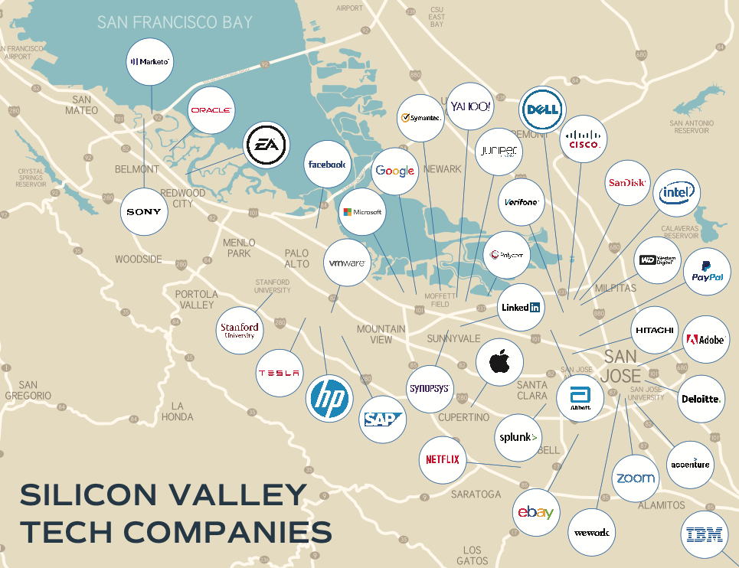
Silicon Valley

Slide 9
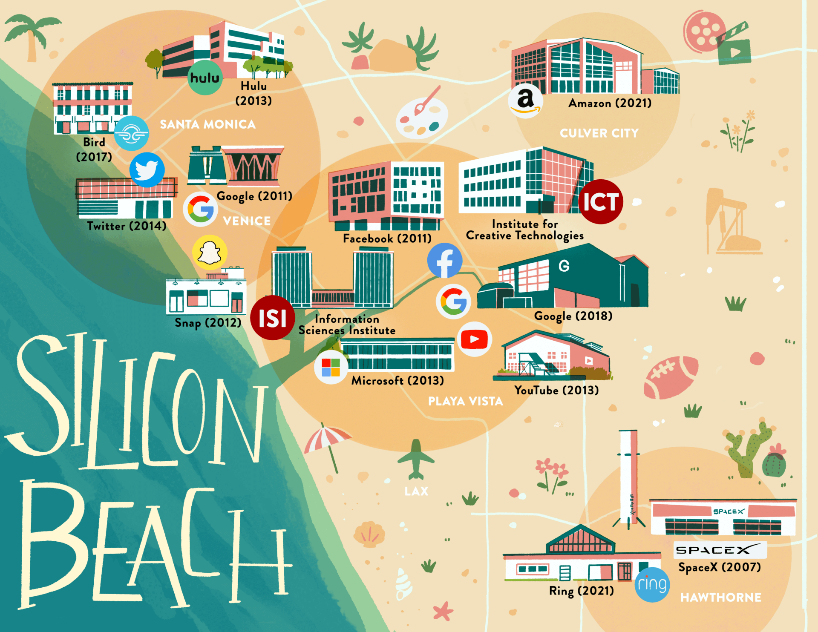
Silicon Beach
Los Angeles

Slide 10
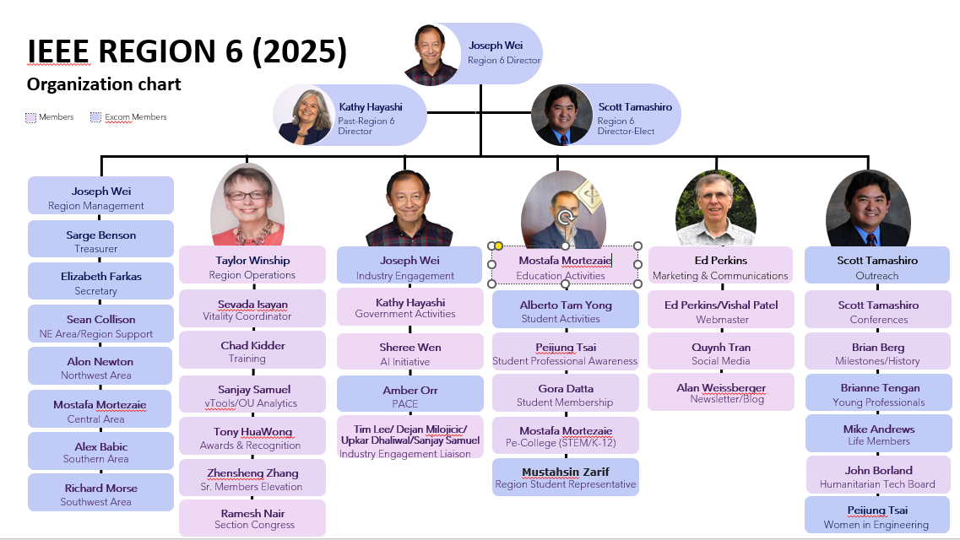

Slide 11
Region 6 Conferences (Welcome Region Partners)
https://ieee-sustech.org/
https://ieee-risingstars.org/
https://ieeeghtc.org/

Slide 12
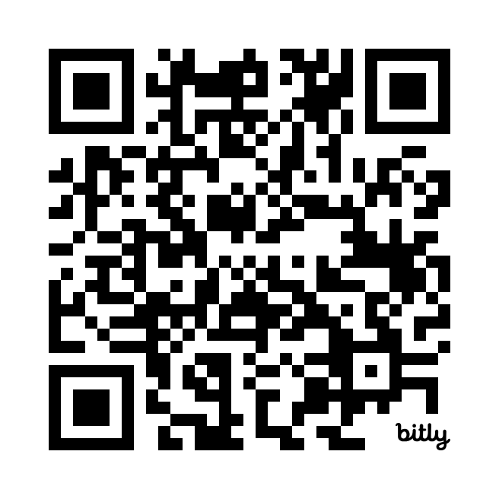
IEEE SusTech 2025 (Welcome Region Partners)
https://ieee-sustech.org/

Slide 13
EEE Global Humanitarian Technology Conference (GHTC)
https://ieeeghtc.org/

Slide 14
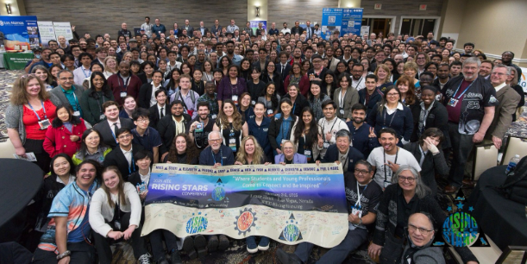
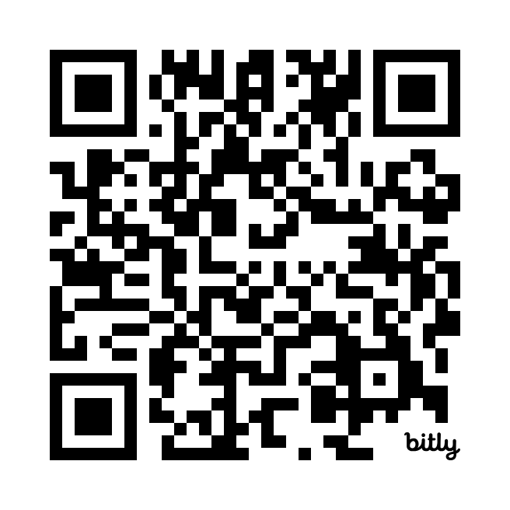
2025 IEEE Rising Stars
https://ieee-risingstars.org/

Slide 17
Questions
Contacts
joseph.wei@ieee.org
tamashiro@ieee.org

