Slide 1
Region 3 Nominations and Appointment Committee
Jill Gostin
2023 IEEE VP, MGA; 2020-2021 Director R3
Presented at SoutheastCon 2025

Slide 2
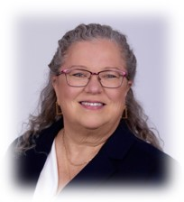
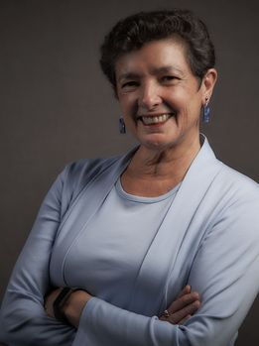
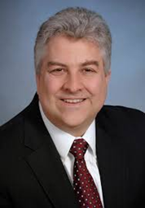
Region 3 Nominations and Appointments Committee
Jill Gostin, Chair
Theresa Brunasso
Sunny Arokia Swamy Bellary
Jim Conrad
No potential candidate for Region 3 Delegate/Director-Elect can serve on the Nominating Committee.

Slide 3
Region 3 N&A in Bylaws
R3 Bylaws Article III Section 5:
The Nominating Committee shall be charged with proposing the names of either two or three candidates for Region 3 Delegate/Director-Elect to serve for a period of two years.
All Section Chairs shall be advised of this appointment and shall be encouraged to submit suggestions for nominees to the designated Chair of the Nominating Committee.
The Committee shall consider all suggestions and report its recommended nominees to the Region 3 Executive Committee for approval.
Additional nominations may be made from the floor by the Region 3 Executive Committee provided the nominees have given permission for such nomination.
The Region 3 Committee, which has the final responsibility for nominating candidates for the ballot presented to all Institute voting members in the Region, will nominate from the slate presented by the Region 3 Executive Committee in accordance with IEEE Bylaw requirements.

Slide 4
Region 3 N&A in Operations Manual
R3 Operations Manual, Section V.5:
The Nominations and Appointments Committee (N&A) shall serve as the Nominating Committee for Director-Elect as required in the IEEE MGA Operations Manual and Region 3 Bylaws. Additionally, the committee shall solicit nominations and recommend candidates for the other Region 3 officers, committee chairs, committee members, and IEEE leadership positions.

Slide 5
Region 3 N&A in Operations Manual
Responsibilities:
Produce a list of nominees for the office of Delegate/Director-Elect for submission to the Region 3 Committee in accordance with Article III, Section 5 of the Region 3 Bylaws. Prior to submitting the list of nominees to the ExCom, the committee chair will submit the list to IEEE Annual Election Support staff (election@ieee.org) for the required vetting process (even year)
Report the approved list of nominees for Delegate/Director-Elect to the IEEE Operations Center by the required deadline (due 15 March odd year, usually submitted in fall of even year)
Nominate candidates for all Region 3 Committee Chairs and Members and provide to the Delegate/Director (as needed)
Solicit potential candidates for other IEEE Committee and Board positions (each year)

Slide 6
R3 N&A Confidentiality
Confidentiality:
All N&A meetings are held in Executive Session; all discussions and votes are confidential
The R3 ExCom reviews the recommendations of the N&A in Executive Session
All nominations are confidential
Only names of individuals actually selected for a slate or a position are announced

Slide 7
Region 3 N&A Position Recommendations
N&A recommends Volunteers to the Delegate/Dir-Elect and ExCom:
Delegate/Director-Elect slate (to ExCom)
Secretary
Treasurer
Area Chairs
Committee Chairs (Awards, Member Communications, Conference, Section Support, Operational Audit, Professional Activities, Strategic Operations and Support, Student Activities)
Committee Members that aren’t Ex Officio
Representatives to other IEEE committees and boards

Slide 8
Region 3 N&A Timeline
Even Years (focus: Director-Elect candidates):
31 March – Nominations for Dir-Elect candidates close
April – Submit all nominations to IEEE staff for review of eligibility
May/June – N&A reviews nominees and creates list of names for ExCom consideration
July/August – ExCom decides how many to include on slate (2 or 3), and selects the 2 or 3 from the N&A list of submitted names
Sept/Oct – R3 Committee meets to endorse or return the slate
Throughout the year, assist Dir with filling vacant positions, as needed
Odd Years (focus: R3 Volunteer positions for next Dir’s term):
15 March – deadline to submit slate to IEEE
Throughout the year, assist Dir with filling vacant positions, as needed
Aug-Oct – assist Dir-Elect with filling all positions for their term

Slide 9
Region 3 Structure
Treasurer*+
Director*+
Dir-Elect*+
Secretary*+
Past Dir*+
Area Chairs*+
Committee Chairs*+
Section Chairs+
Liaisons / Reps
Legend:
* - Voting ExCom
+ - Voting Region Committee
(plus 1 open Voting Region Committee position, left to Director Discretion/Selection)
Committee Members

