Slide 1
Conference Committee Report
29 March 2025

Slide 2
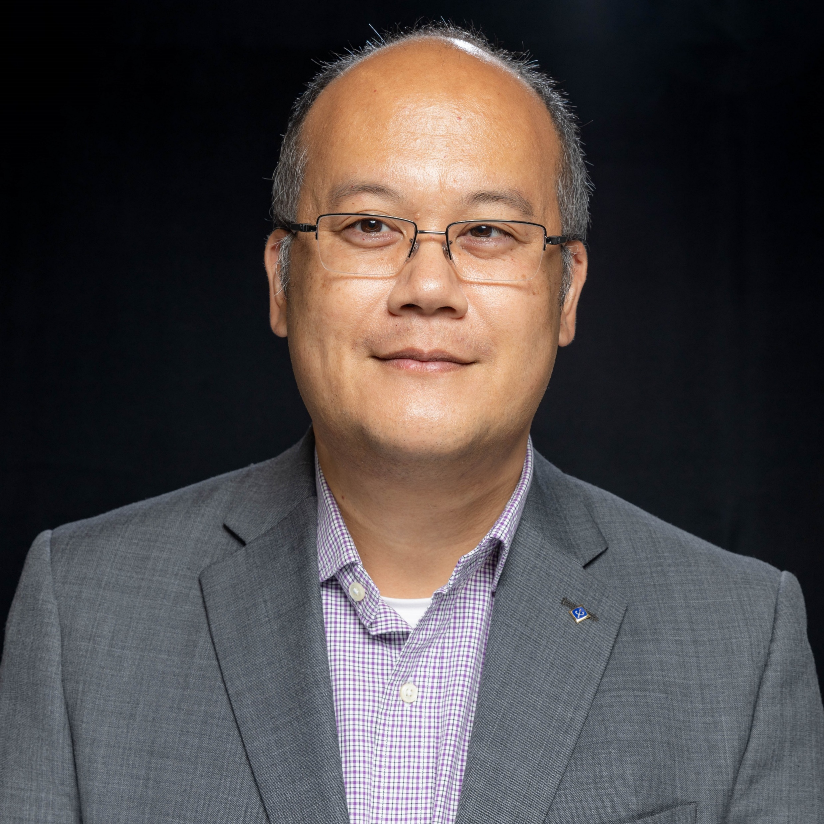



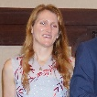



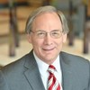

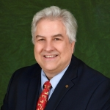



Conference Committee Members
Joe Juisai
Chair
Stephen Hopkins
Vice Chair
Sonya Dillard
Director Elect
Eric Ackerman
Past Chair
Bailey Heyman
SAC Chair
Tamseel Syed
Conference Ops. Specialist
Wyman Williams
Conference Ops.
Binesh Kumar
Industry Engagement
John McDonald
Industry Engagement
Joe Pennisi
Treasurer
Jim Conrad
Director Emeritus
Alessio Medda
2024 Chair
Charles Lord
2025 Chair
Will Goins
2026 Chair
TBD
2027 Chair

Slide 3
Conference Committee Actions
Selection of IEEE SoutheastCon 2027
Selection of IEEE CaribCon 2026
Assist of planning IEEE SoutheastCon 2025
Developed IEEE SoutheastCon Proposal Guidelines and Evaluation Criteria
Cookbook for Section-led conferences

Slide 4

Conference Committee Goals
Provide an engaging and surplus-generating SoutheastCon 2025 and other Region/Section sponsored conferences and plan for similar success in 2026-29
Lead
Progress
Conference Committee Chair Joe Juisai
Milestone | Target Completion | % Complete
Complete “Section Conference” playbook | 1Q2025 | 95%
Complete 2027 selection process | 1Q2025 | 95%
Conduct initial planning session for CaribCon 2026/2027 | 2Q2025 | Not Started
Conduct 2028/2029 evaluation process | 3Q2025 | Not Started
Assist OUs with planning and executing “Section Conferences” | 3Q2025 | Not Started
Complete 5 “Section Conferences” in Region 3 | 4Q2025 | Not Started
Detail
Complete 2027 selection process Conduct successful Concord 2025 conference
Prepare Huntsville 2026 and TBA 2027 for success
Begin planning CaribCon with Region 9
Publish initial plans for CaribCon 2026/2027 jointly with Region 9
Assist OUs interested in SoutheastCon 2028 and 2029 with proposal submission
Evaluate and endorse 2028 and 2029 proposals
Prepare “Section Conference” playbooks for R3 OUs (on behalf of Section Support)
Assist sections in planning and executing “Section Conferences”
Complete 5 “Section Conferences” in 2025
Next quarter tasks to achieve goals
Prepare endorsement package for FinCom and ExCom
Complete Section Conference playbook
Announce SoutheastCon 2027 location selection
Risks and Recommendations
Project Success - Metrics
Ability to announce 2027 location selection in January
Planning and execution of Concord 2025
Lack of engagement by Region 9 or Region 3 OUs for CaribCon
Lack of interest by OUs to host 2028 or 2029 conferences
Complete endorsements of 2027 location selection in January
Formalize selection of 2027 location at Concord 2025
Complete “Section Conference” playbook in February

Slide 5
Section-run Conferences
We put a goal to see 5 section-run conferences in 2025
We have a cookbook to be published on the R3 knowledge base with tasks and a day-of schedule
We are happy to help provide guidance to sections on how to jump start a section-run conference

Slide 6
Section Conference Cookbook

Slide 7
Section Conference Room Planner

Slide 8
IEEE CaribCon
New Region 3 and Region 9 sponsored conference
Targeting Jamaica to be the inaugural host OU in 2026
Alternate between Region 3 and Region 9
Smaller than SoutheastCon
  2 days
  Technical papers
  Panel discussions
  Student presentation competition

Slide 9
R3 Conference Award Process
Applies to IEEE CaribCon and IEEE SoutheastCon
Candidate OUs submit a proposal and budget
Conference Committee has proposal templates and guidance documents for Candidate OUs to complete proposals
Approval Process
  Submitted to Conference Committee
  Reviewed and present to Conference Committee
  Discussed and endorsed at Conference Committee
  Discussed and endorsed at Finance Committee
  Discussed and endorsed at Region 3 ExCom
  Approved at Region 3 Committee

Slide 10
IEEE SoutheastCon Award Timeline
MAR 25 | APR 25 | MAY 25 | JUN 25 | JUL 25 | AUG 25 | SEP 25 | OCT 25 | NOV 25 | DEC 25 | JAN 26 | FEB 26 | MAR 26 | APR 26
Proposal Dues
Site Visits
Oral Presentations
Committee Discussions and Endorsements
Region 3 ExCom Endorsement
Region 3 Committee Approval
Today

Slide 11
IEEE CaribCon 2028 Award Timeline
MAR 25 | APR 25 | MAY 25 | JUN 25 | JUL 25 | AUG 25 | SEP 25 | OCT 25 | NOV 25 | DEC 25 | JAN 26 | FEB 26 | MAR 26 | APR 26
Proposal Dues
Site Visits
Oral Presentations
Committee Discussions and Endorsements
Region 3 ExCom Endorsement
Region 3 Committee Approval
Today

