Slide 1
Section Support Committee
How We Can Support You!
March 29, 2025

Slide 2
Assist Sections
Stimulating interest of IEEE members
Motivating members to volunteer
Encouraging professional and technical growth of all members
Sharing best practices with other Sections
Forming Engineering Affinity Groups

Slide 3
Responsibilities
Assist in training section volunteers
Provide assistance and support to those Sections and Chapters that are having problems in meeting the requirements to remain active and viable
Assist Sections in the use of collaborative tools and other technologies that support Section and Region activities
Encourage Sections to sponsor member grade elevation programs
Encourage Sections to sponsor programs that support the interest and continued activity of Life Members
Encourage Sections to sponsor projects to facilitate the active involvement of members in IEEE activities
Initiate project experiments with one or more sections to encourage member engagement
Assist sections in developing technical programs for their members and accessing other technical activities in the Institute

Slide 4
Who Are We?
Chair – Kristin Bing
Life Member Coordinator – Jacob Kulangara
Young Professional Coordinator – Sonny Bellary
Women in Engineering Coordinator – Ebonee Walker
Senior Member Elevation Coordinators
  David Fillion (in-person, Section-based)
  Anthony Perales (virtual, Region-based)
Section Operations Specialists
  Charles Lord
  Mark Torres
Project Coordinator – LaRhonda Julien
Technical Activities Coordinator – Arup Ghosh
Membership Recruitment & Retention Coordinator – Patrick Kung
Educational Activities Coordinator – Damith Wickramamayake
Mentor – Jill Gostin

Slide 5
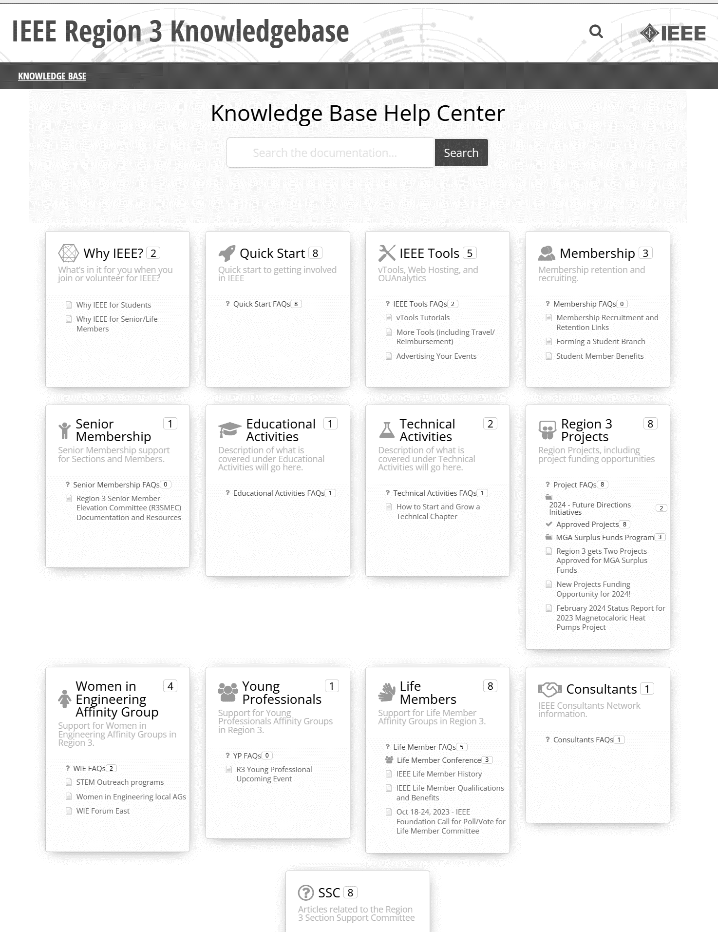
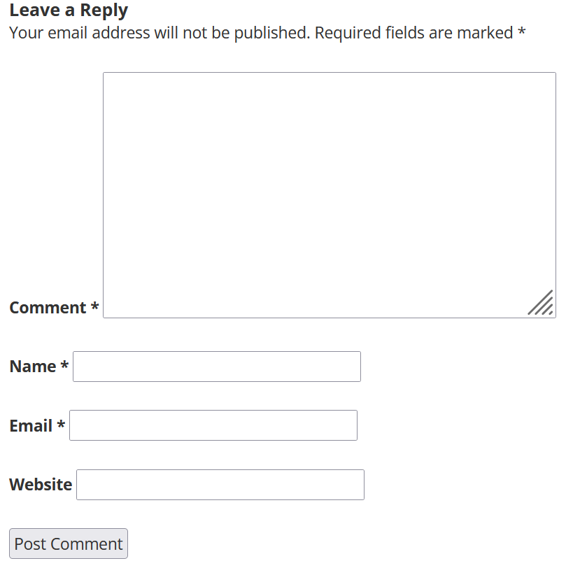
R3 Wiki Knowledgebase
https://kb.ieee.org/r3/ or navigate from the Region 3 website under Resources
Created and updated by the R3 Section Support Committee
Feedback welcome: r3-ssc@ieee.org or on wiki itself
IEEE SoutheastCon 2025 – Charlotte, NC

Slide 6
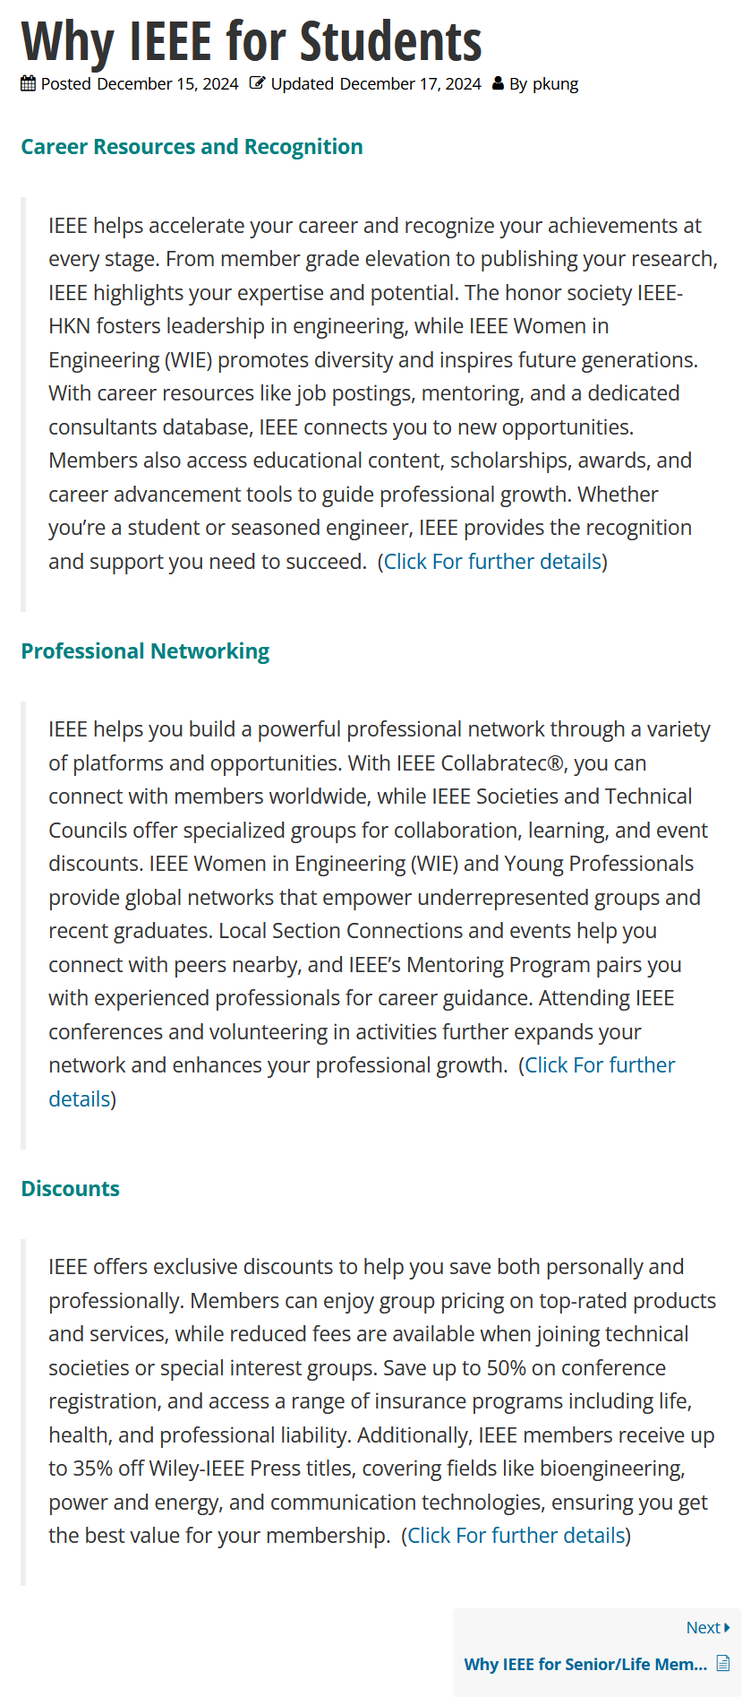
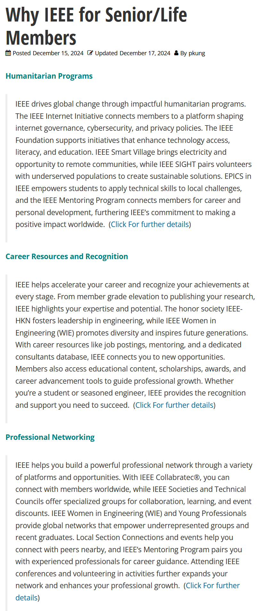
Value of IEEE
Volunteer suggestion for Knowledge Base from SoutheastCon 2024
…

Slide 7
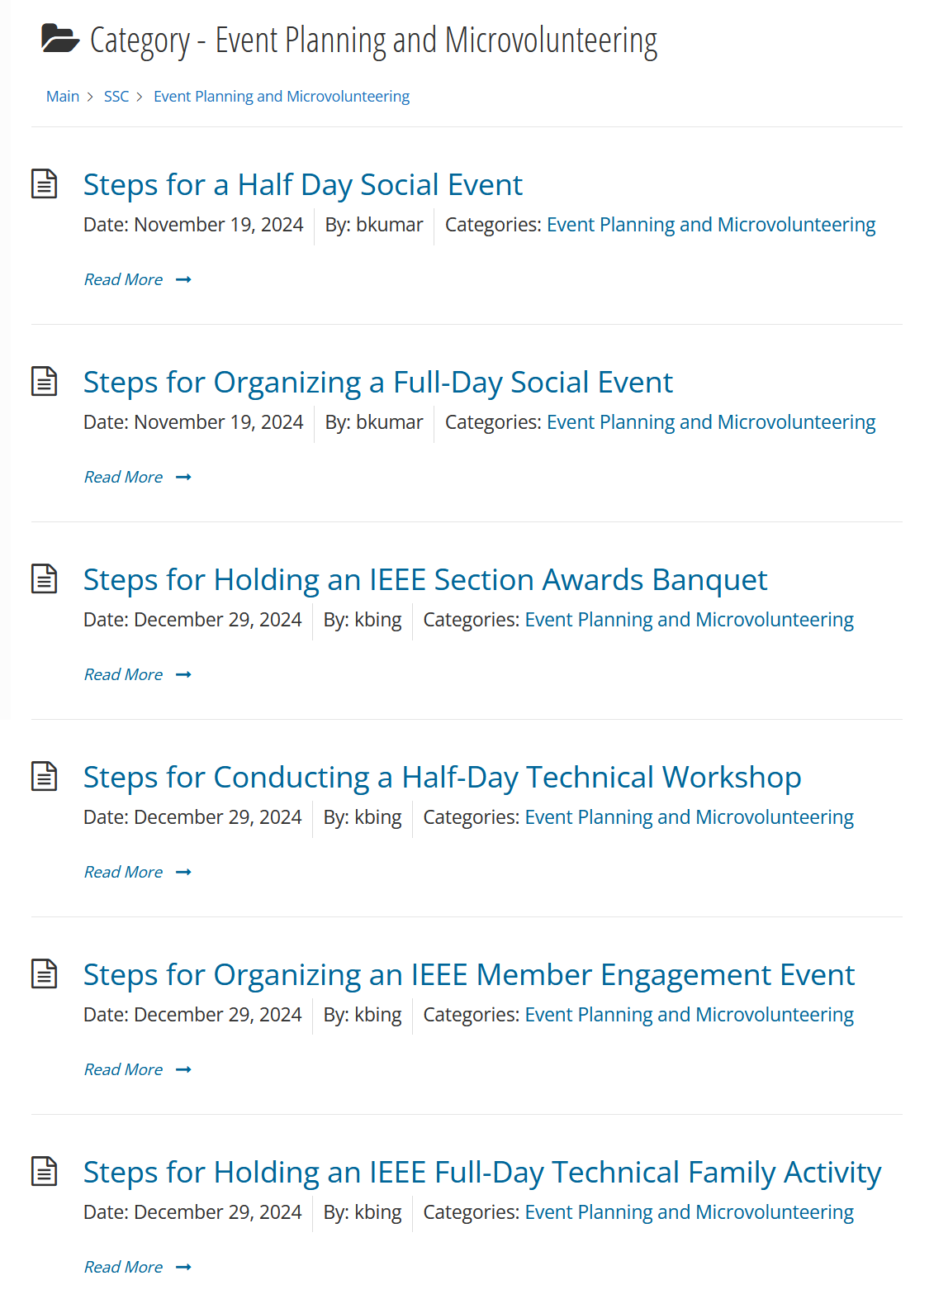
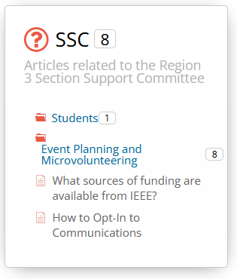
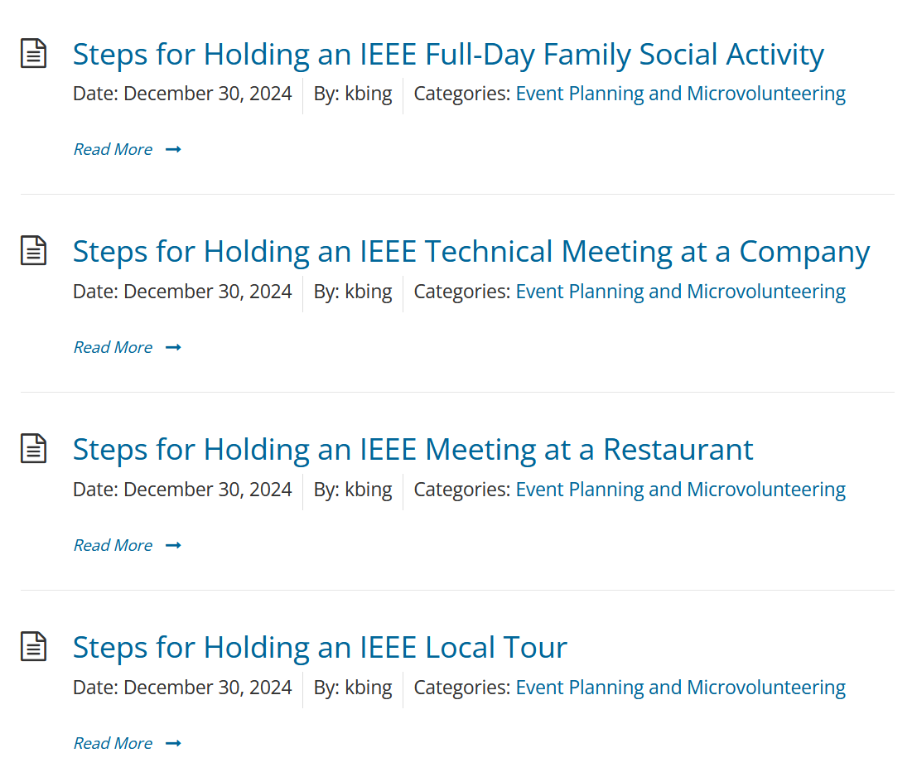
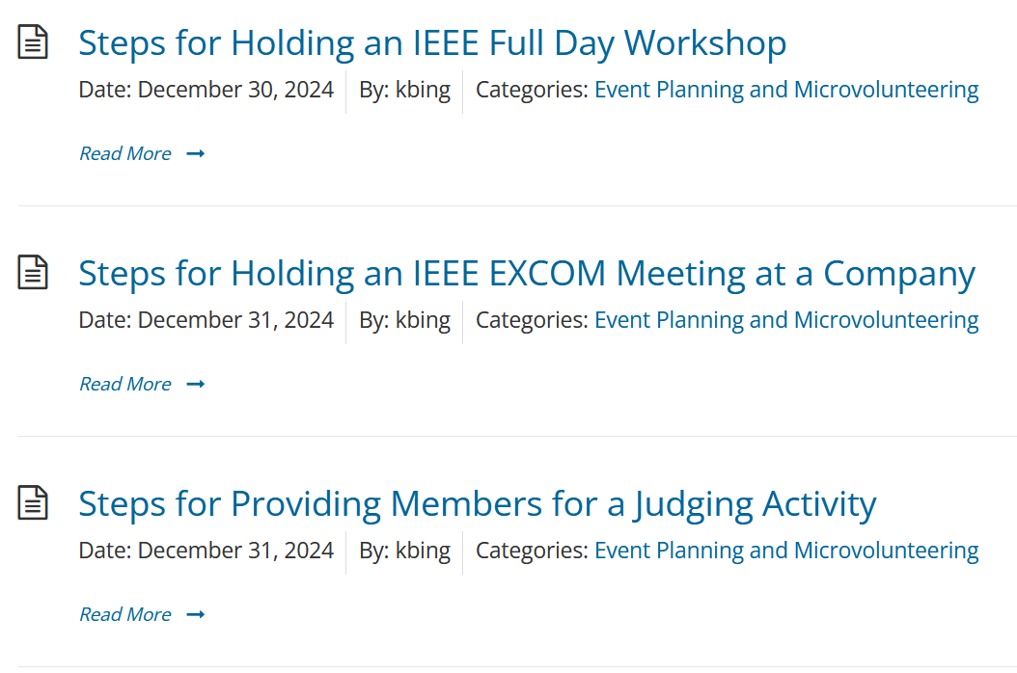
R3 Cookbook

Slide 8
Region 3 Goals Run by SSC
Goal 2: Provide all sections the training and support they need
  SSC Webinars – Section budgets and finances coming soon!
Goal 6: Develop metrics for Section engagement with Student Branches (co-run with SAC)
  Event how-to: 1 for branches with active sections already having close relations, 1 for branches with active sections but no relations, and 1 branches without an active or large section
Goal 9: Engage members through new events and (micro-) volunteering opportunities
  Organizing a Section conference
  STEM day
  Improv workshop
  Merit Badge workshop
  Humanitarian (SIGHT/HA/Smart Village)
  Networking event with another local non-IEEE society or organization
  Chapters Fair
  How It’s Made Tour
  Family Science Night
  Sr Member Roundup at local employer

Slide 9
More of SSC
Did you miss an SSC presentation or two by attending another track yesterday?
Never fear … here are some highlights …

Slide 10
Projects - Funding Opportunities
MGA Surplus
  More on this tomorrow
Engineering Projects In Community Service (EPICS)
  Provides funding, support, mentorship, and visibility for engineering projects in the following areas of community improvement: Access and abilities, Human services, Environment, Education
  $1k-$10k/project, Due May 1 and October 1 in 2025
New Initiatives Committee (NIC)
  Support potential new programs, products, or services that will provide significant benefit to IEEE members, the public, the technical community, and customers, or which could have lasting impact on IEEE or its business processes. Initiatives must be of strategic importance to IEEE
  Seed grants or larger New Initiatives, No submission deadlines
Future Directions Initiative
  Seeking longer-term cross-collaborative engagement among industry, academia, and government striving to develop and deploy various future technologies
Region 3 Projects Grant
  $1-1.5k average award
  Align with IEEE Future Directions Committee New Initiatives
  Application process begins in May

Slide 11
Senior Members – Process
Have everything ready, SM Resume, Nominator, References, and IEEE Member Numbers
Go to the application website
  https://live.runmyprocess.com/live/2215365968/appli/374985?P_mode=LIVE-
Have everything ready, SM Resume, Nominator, References, and IEEE Member Numbers
Complete the nomination – last step enter your references members numbers under References Tab
“Meet” with your references

Slide 12
Life Members
Benefit Forming LMAG
  Section gets yearly rebates if the LMAG is in good-standing.
  LMAG event expenses supported by LMC per IEEE Foundation Policy.
  LMAG can engage LMs effectively for supporting Sections and LMs remain active in the Section programs.
  LMs and LMAGs in the region qualifies for awards nomination.
    Region and Global LMAG Achievement Awards and Life Member Individual Service Awards
  Activities of interest to life members are supported at local level.
  Existing LMAGs should have at least two events identified per year in v-Tools events list and six events per year to be in good standing.
How LMC Gives Back
  LMC Region Funding (3 options)
  Grants (13 options)
  LMC Fellowships, Prizes, and Medals (4 options)

Slide 13
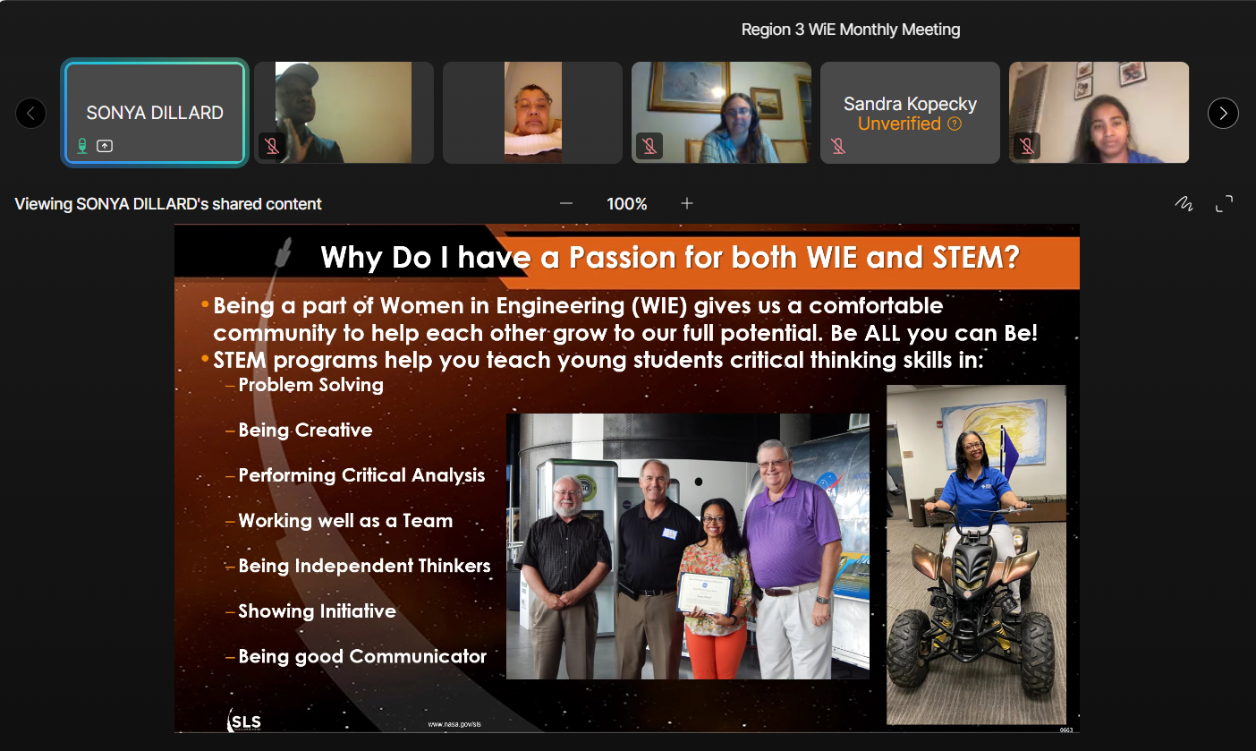
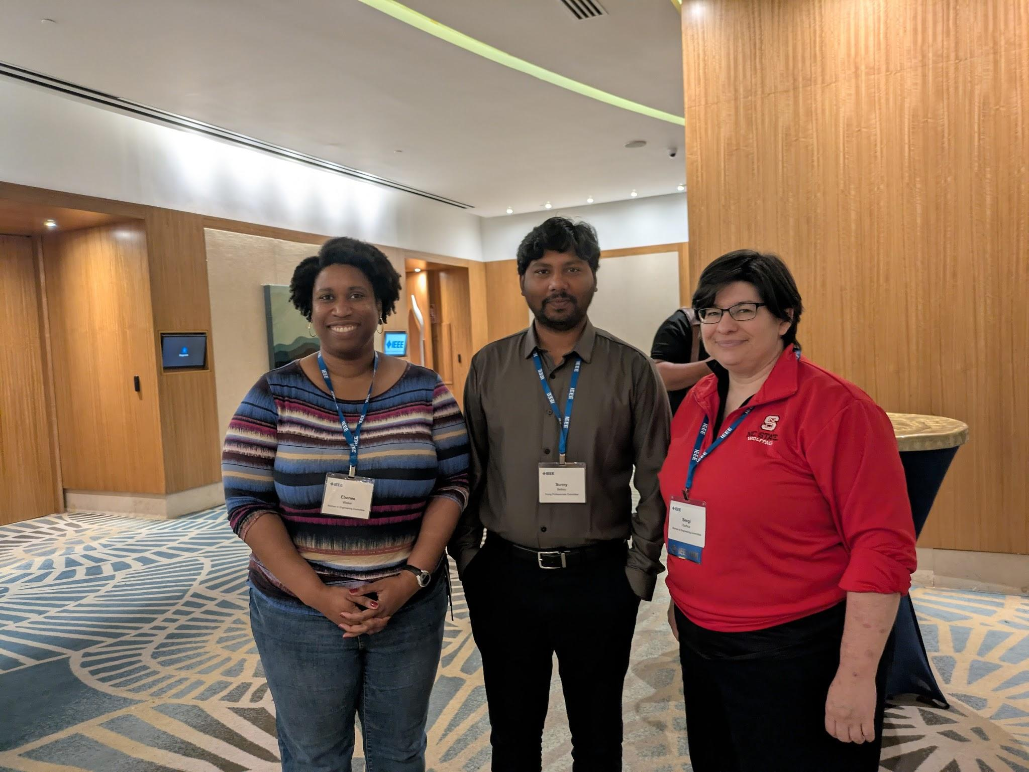
Women In Engineering
Significant Achievements
  Launching the Region-wide WiE Monthly Meetings (last Thursdays @ 6pm)
  Submitting 7 Senior Member applications for 23 March A&A Panel
  Welcoming new Jacksonville Section WiE AG
  Forming intra- & inter-Regional connections
Challenges
  Reaching all R3 WiE Members via vTools
  Forming new AGs in Sections with clusters of >10 WiE members (on Global WiE’s radar)
Support Needed
  Suggestions for virtual speakers
  Training on funding opportunities and proposal writing
  Establishment of a Region 3 WiE Flagship event

Slide 14
Thanks!

