Slide 1
Member Recruitment & Retention (MRR)
Patrick Kung
p.kung.us@ieee.org
29 March 2024

Slide 2
Project 1
Region 3 Membership & Trends

Slide 3
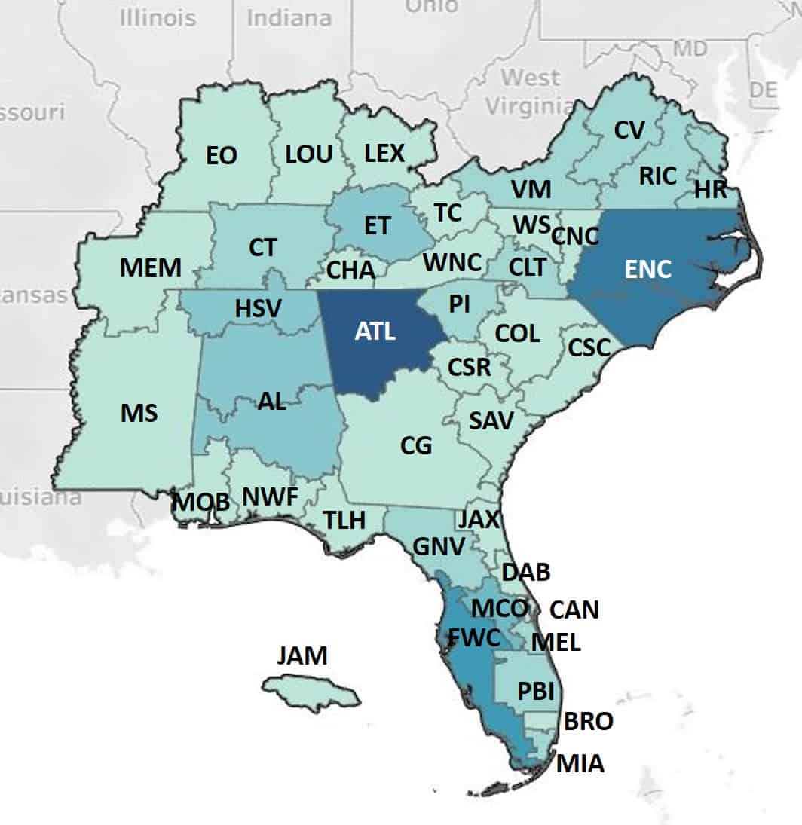
Region 3 Data
 | Mar. 2024 | Mar. 2025 | Diff
Active | 20,560 | 21,384 | +824 (+4.0%)
Arrears | 5,628 | 6,134 | +506 (+9.0%)
Inactive | 78,428 | 82,012 | +3,584 (+4.6%)

Slide 4
Active Members
Active Members | Mar. 2024 | Mar. 2025 | Diff
(M) Members | 9,040 | 9,110 | +70 (+0.8%)
(S) Senior Members | 2,850 | 3,194 | +344 (+12.1%)
(F) Fellow | 279 | 276 | -3 (-1.1%)
(L) Life Members | 4,904 | 4,893 | -11 (-0.2%)
(ST) Student Members | 3,487 | 3,911 | +424 (+12.2%)
Added Senior Members
“Replenished” Members
Added Student Members

Slide 5
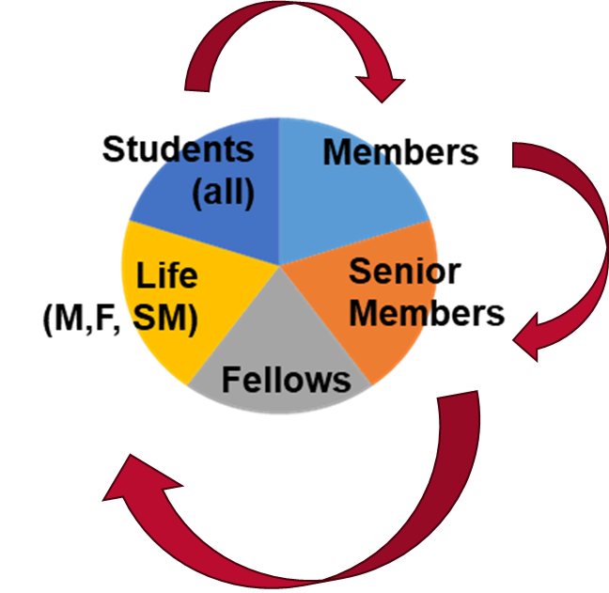
Trends per Section (3/24→3/25)

Slide 6
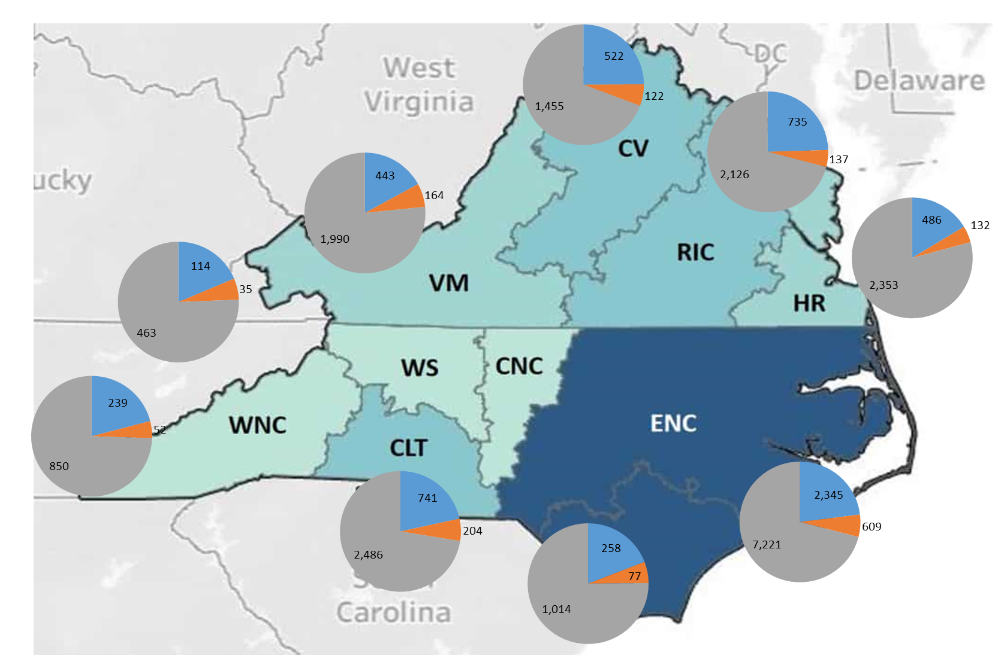
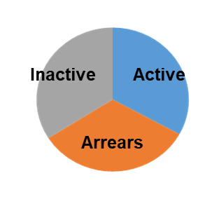
Area 1 Actives
+0.4%
+14.7%
-2.4%
+6.3%
+6.5%
+1.3%
+4.4%
+8.2%
+23.5%
+6.4%
+16.7%
+11.4%

Slide 7
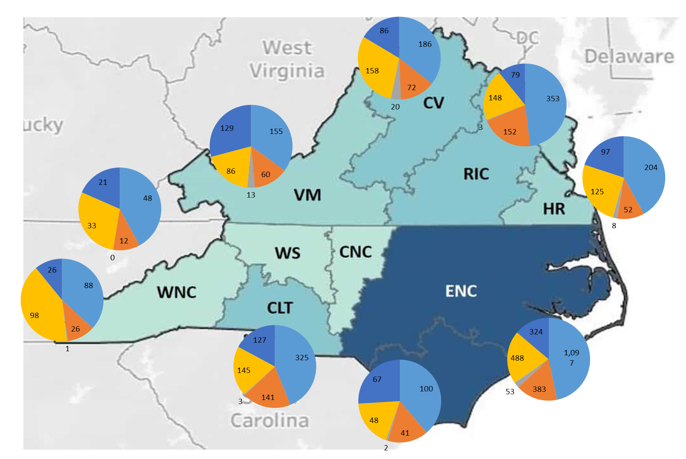
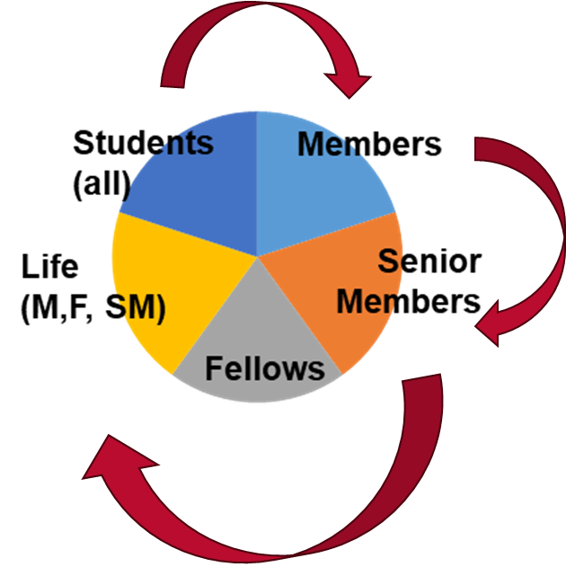
Area 1
+19.4%
+12.9%
+12.4%
-17.8%
+12.3%
+9%
+49.0%
+7.4%
+16.7%
+17.9%
+10.6%
+18.2%
+9.1%
Total
+8.2%
+39.6%
+26.1%
+15.2%
+86.1%
+22.4%
+78.5%
+11.6%

Slide 8
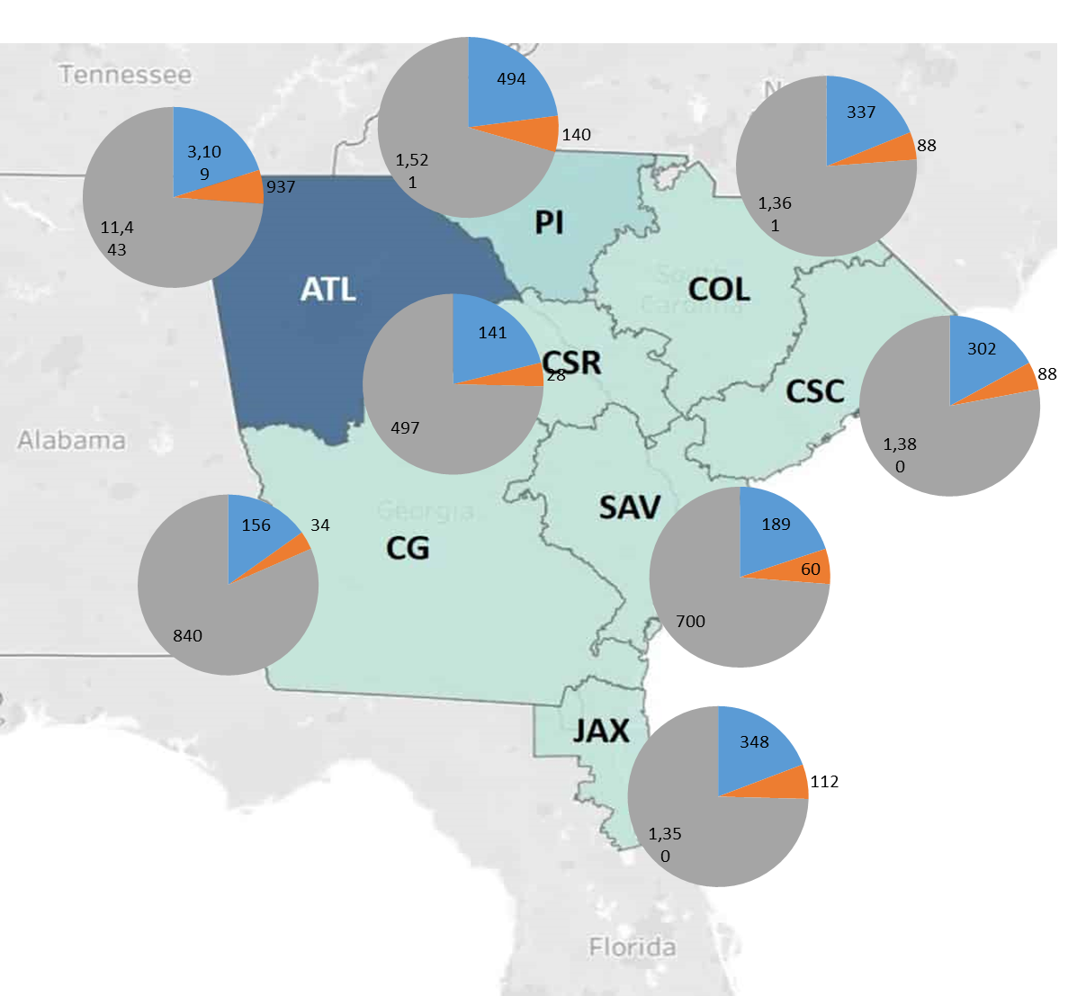
Area 2 Actives
+6.5%
+10.1%
+6.9%
+9.3%
-1.3%
+4.7%
-3.1%
+4.4%
+5.3%
-4.4%
+11.4%

Slide 9
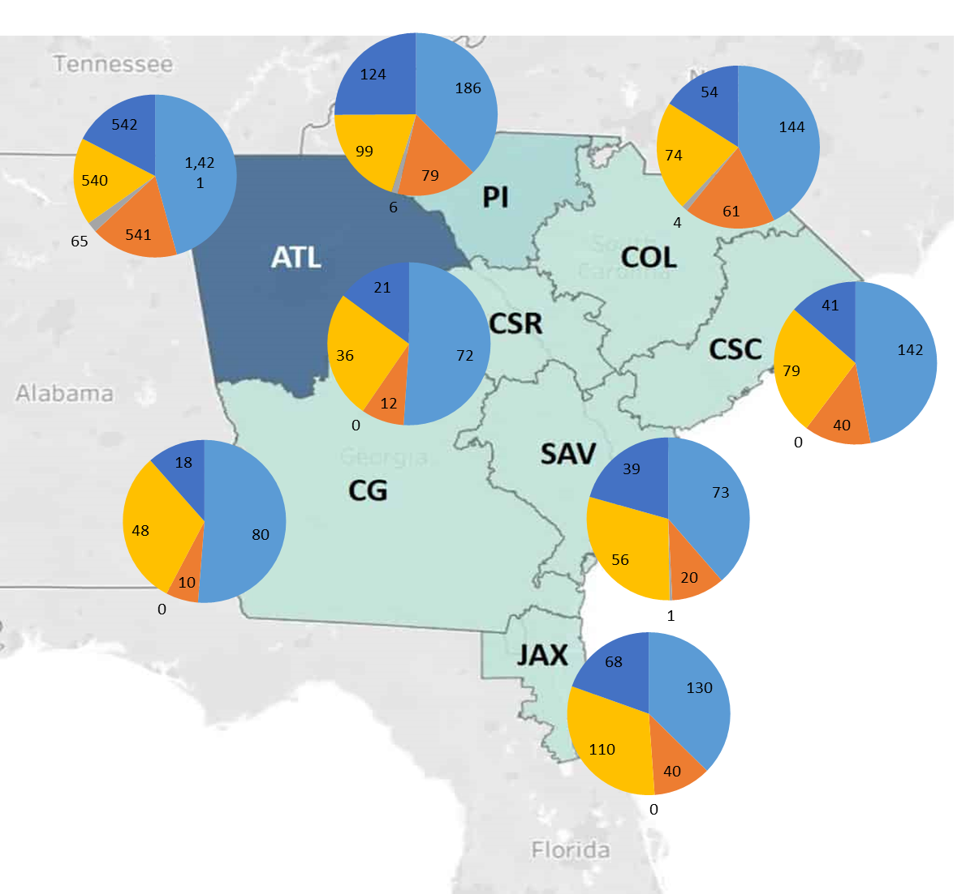
Area 2
+21.6%
+45.9%
+12.4%
+10.4%
+61.5%
+17.3%
+!3.4%
-8.9%
+38.5%
+9.1%
+7.4%
+14.3%
-13.8%
-7.7%
Total
+5.3%
+66.7%
-13.0%
-11.7%
-8.5%
+25%

Slide 10
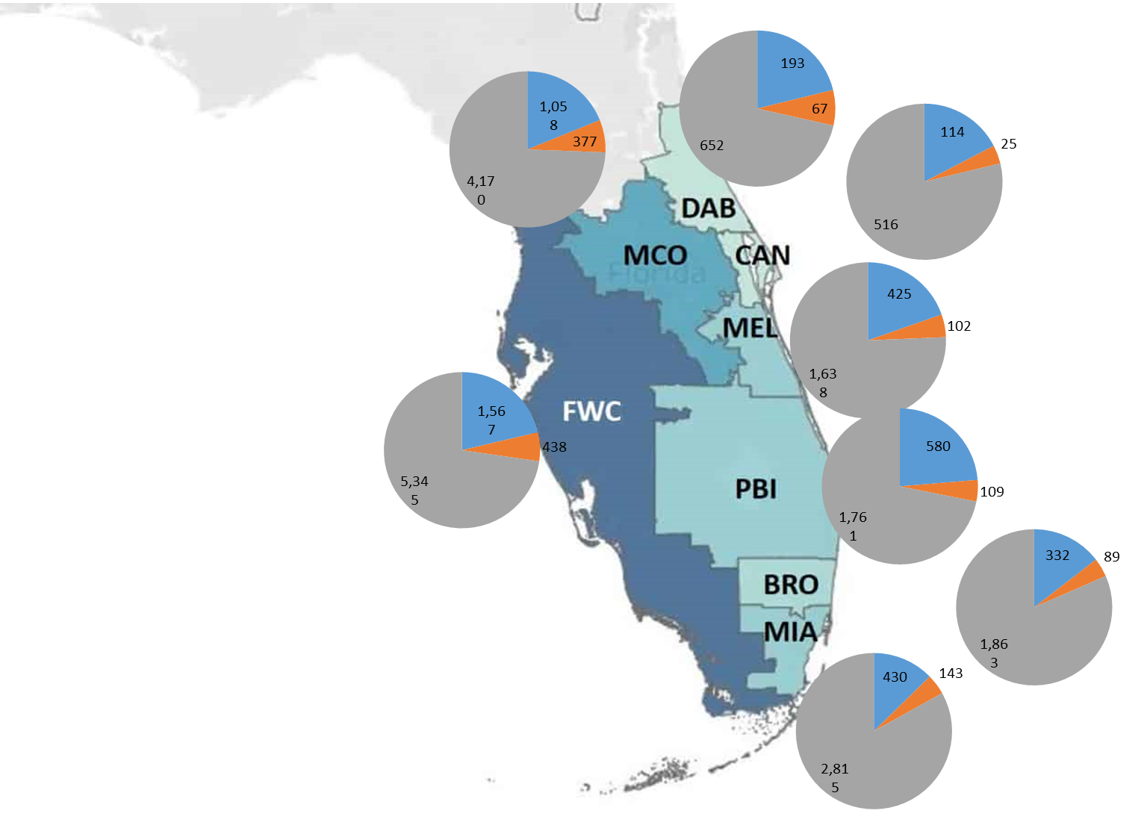
Area 3 Actives
+1.0%
+2.6%
+8.6%
-2.3%
-1.1%
+16.9%
+3.1%
+4.7%
+2.5%
+2.6%
+9.6%

Slide 11
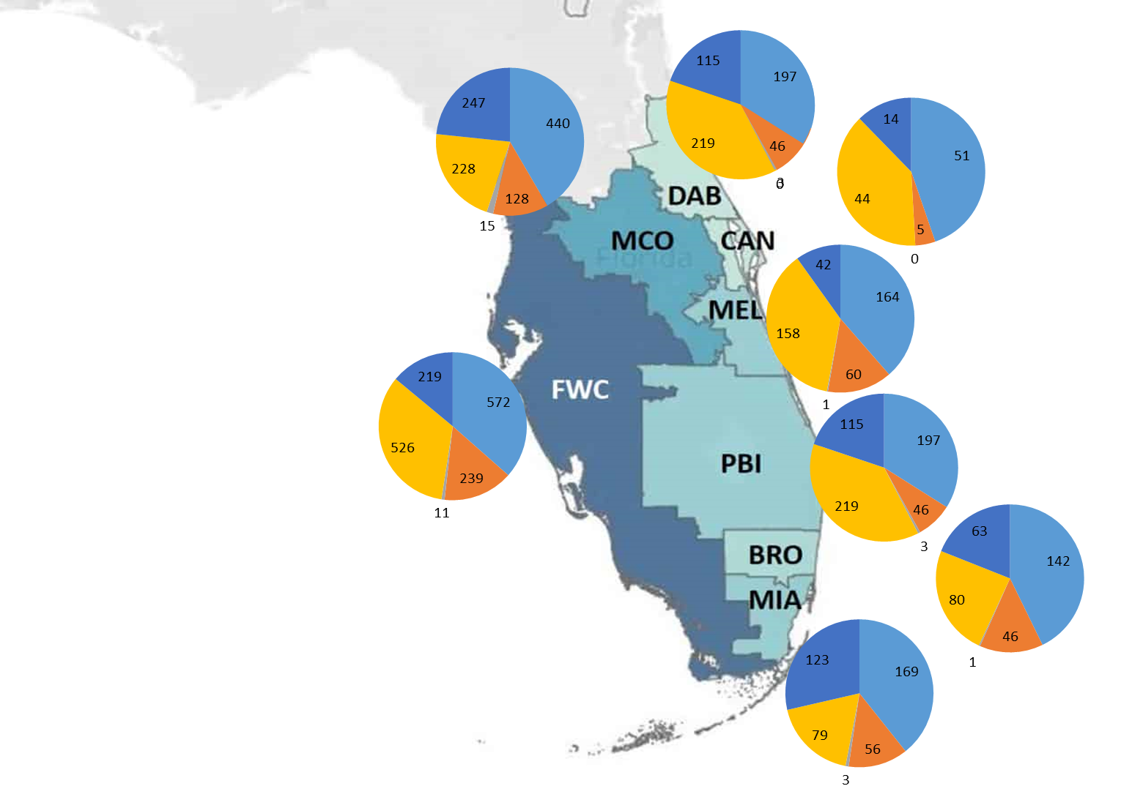
Area 3
+12.0%
-4.9%
+11.8%
+100.0%
+21.1%
+8.5%
+7.7%
+25.0%
-8.8%
-10.4%
+259.4%
+28.6%
Total
+2.5%
-5.3%
+17.9%
+17.1%
-6.6%
+31.4%
+9.8%

Slide 12
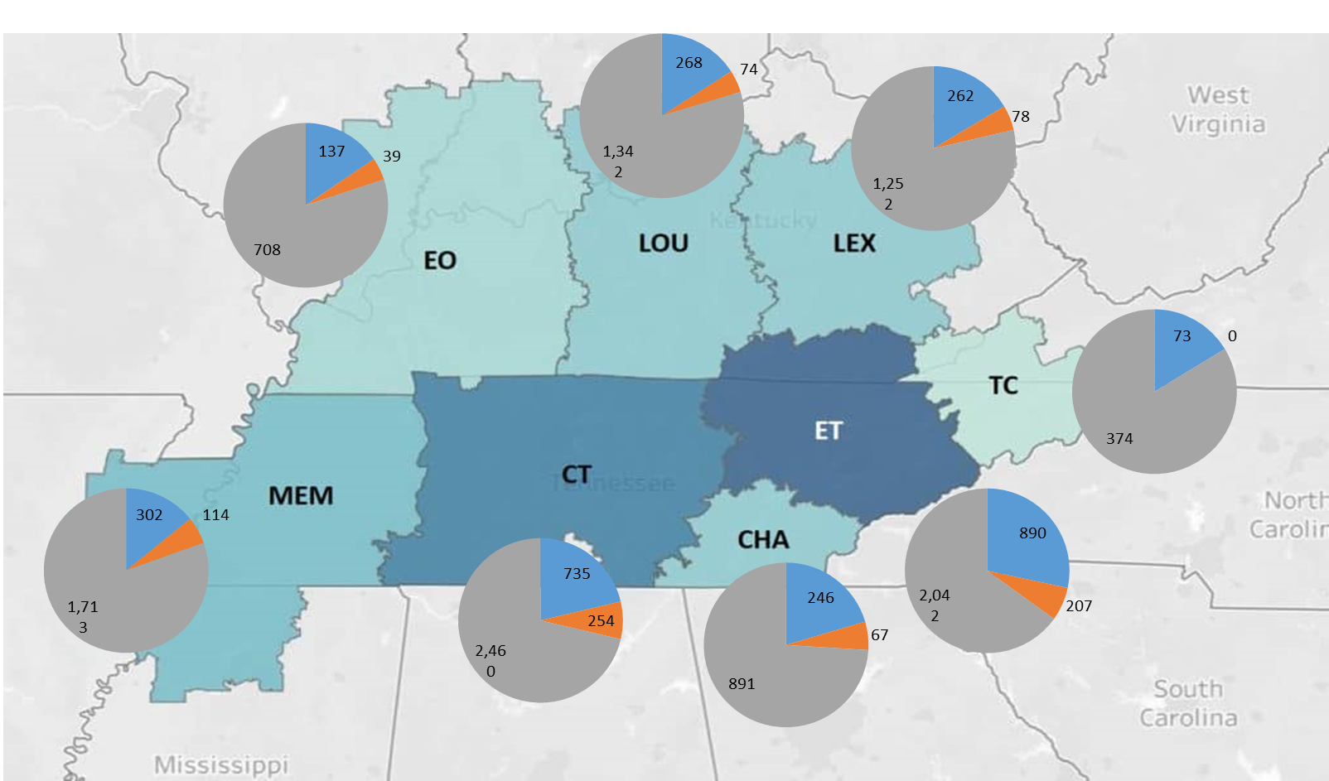
Area 4 Actives
+1.5%
-3.7%
-1.4%
-3.9%
-5.0%
+2.8%
+5.3%
+0.2%
+3.4%
-5.4%
+2.0%

Slide 13
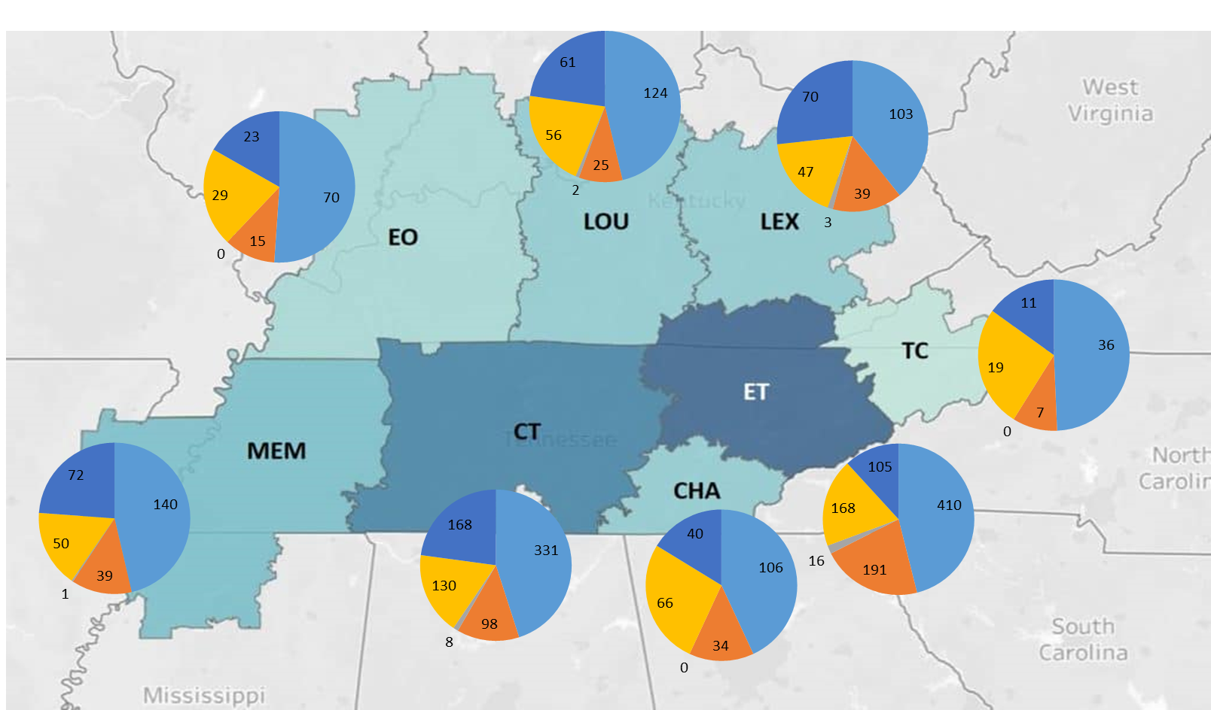
Area 4
+13.0%
-17.9%
-11.4%
+15.4%
-8.3%
-10.8%
Total
+0.2%
+5.3%
-15.9%
+11.4%
+10.4%
+8.9%

Slide 14
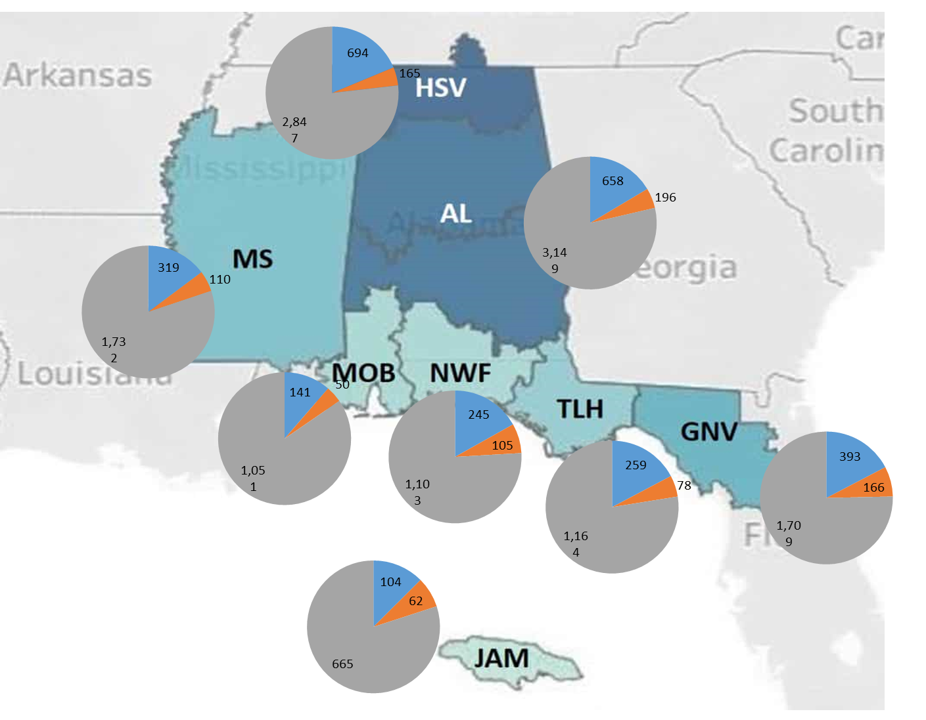
Area 5 Actives
-0.3%
+1.1%
-7.3%
-1.4%
-4.7%
+9.7%
+0.3%
+4.3%
+0.1%
+14.3%
+7.2%

Slide 15
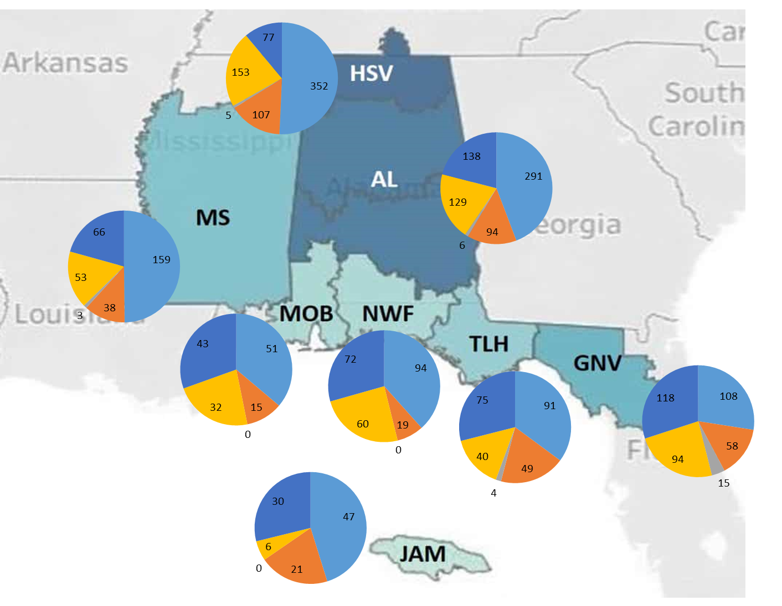
Area 5
+30.5%
-5.4%
+12.2%
-16.5%
-8.1%
-11.6%
-9.6%
+44.2%
+8.3%
Total
+0.1%
-5.0%
+42.9%
+23.4%

Slide 16
Project 2 - SSC
Why IEEE? (a Recruitment / Retention Tool)
What’s in it for you when you join or volunteer for IEEE?

Slide 17
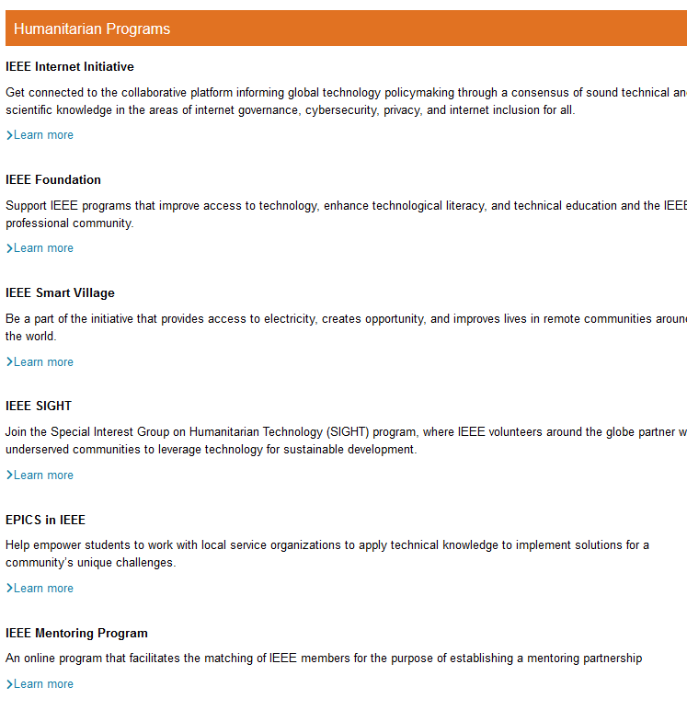
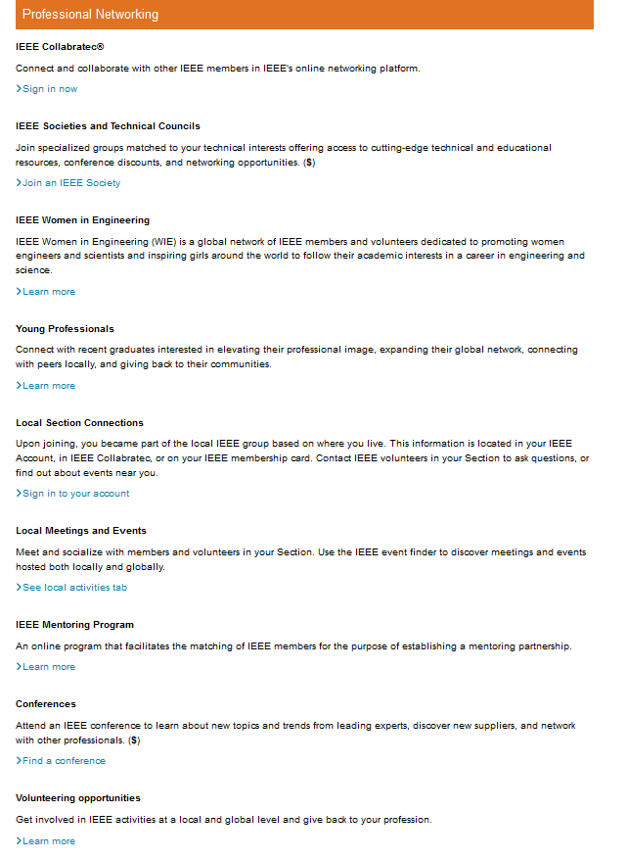
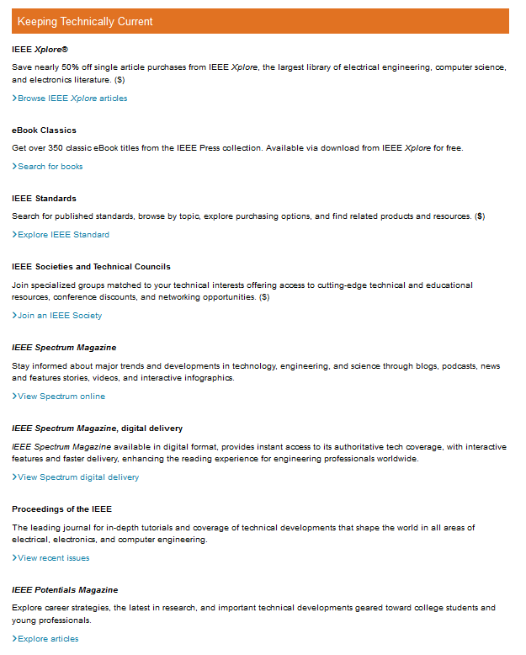
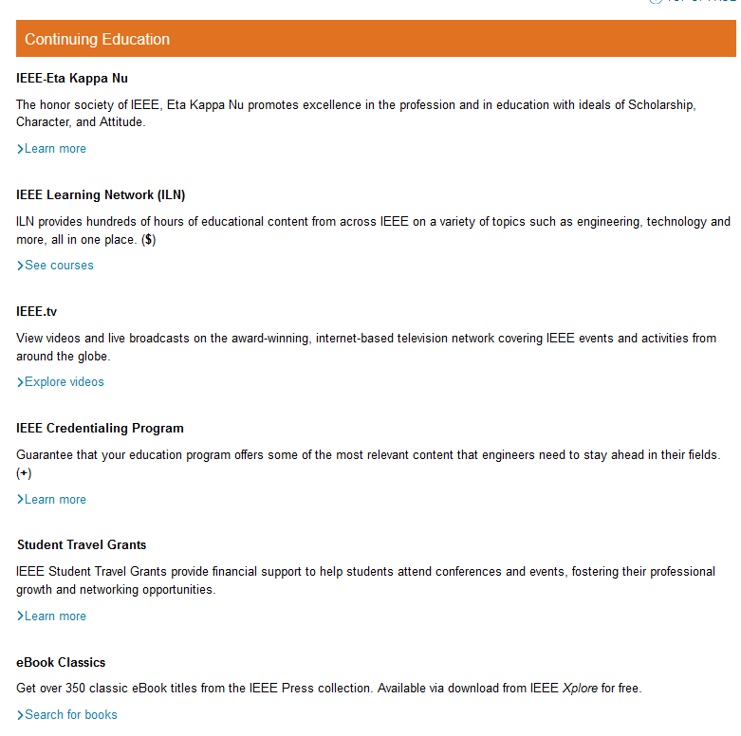
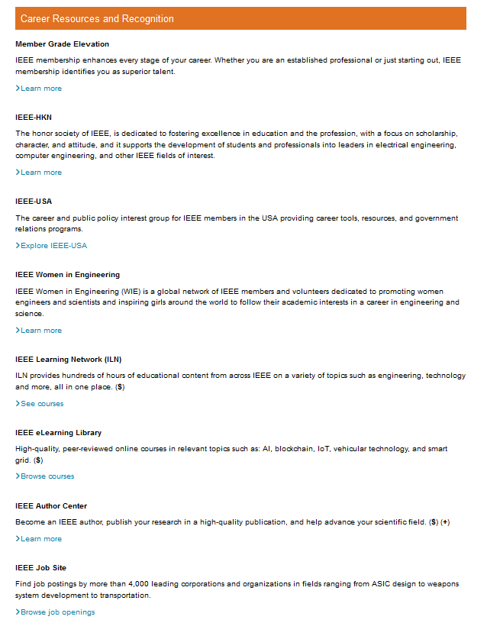
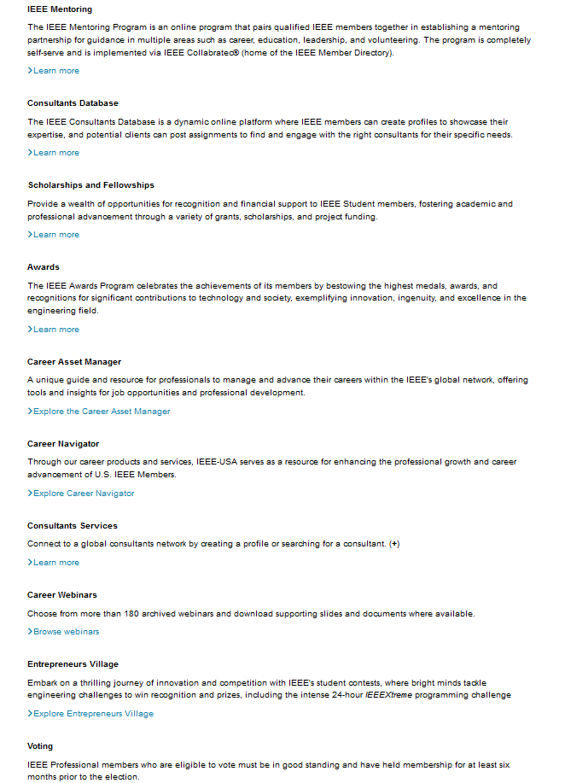
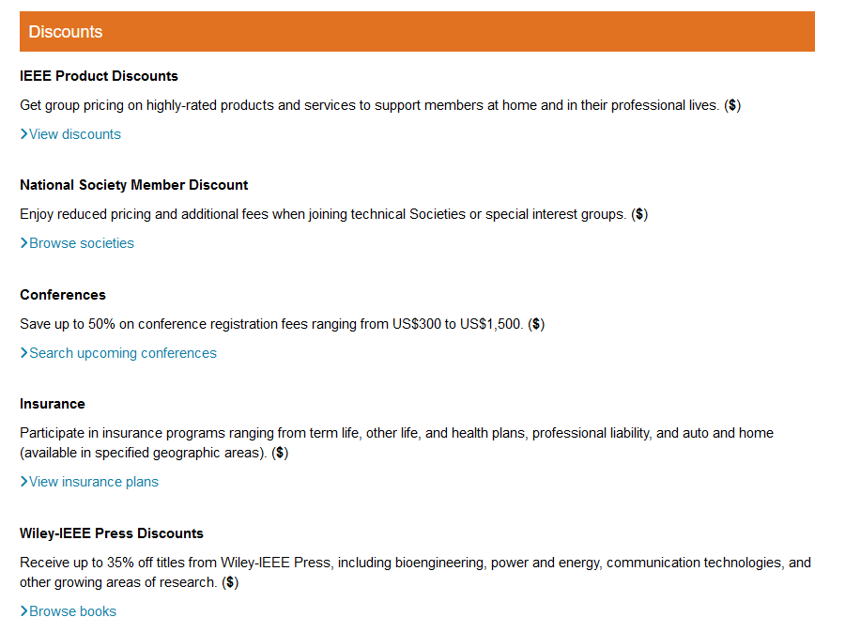
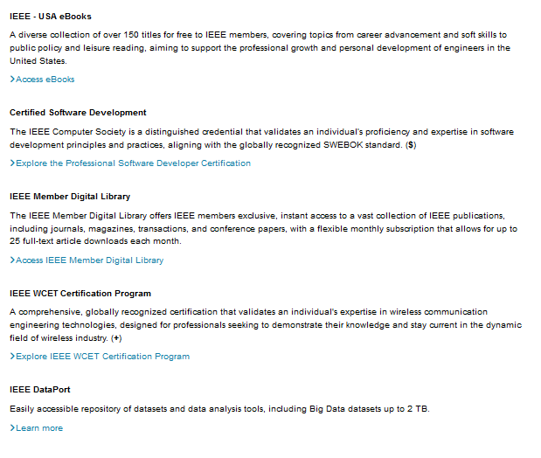
IEEE Member Benefits
https://www.ieee.org/content/ieee-org/en/membership/benefits
Comprehensive
But all TEXT, too long to read, to find something

Slide 18






Reduce to Three Basic Benefits
“Loyalty”
i.e.
personal satisfaction
“Value”
i.e.
intangible, indirect benefits
“Benefits”
i.e. tangible benefits

Slide 19
+ “Matchmaking” (MER): i.e. Not One Recipe for All
Student
Member
Life Member
Value
Loyalty
Loyalty
Value
Loyalty
Value
(Tangible) Benefits
(Tangible) Benefits
(Tangible) Benefits

Slide 20
+ “Matchmaking” (MER): i.e. Not One Recipe for All
Student
Member
Life Member
Value
Loyalty
Loyalty
Value
Loyalty
Value
(Tangible) Benefits
(Tangible) Benefits
(Tangible) Benefits

Slide 21
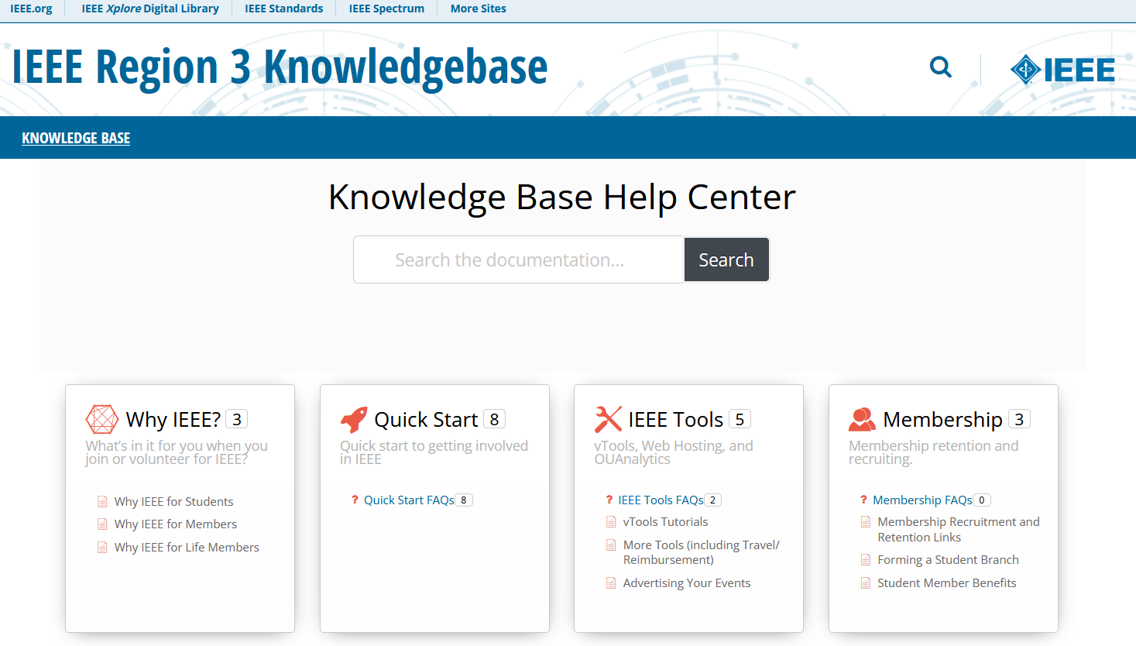
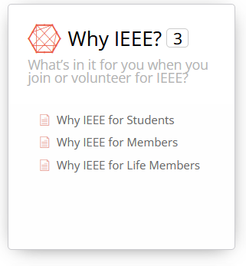
Region 3’s “Why IEEE?”
https://kb.ieee.org/r3/
Tailored to
- Students (recruit)
- Members (retain/recruit)
- Life Members (retain)

Slide 22
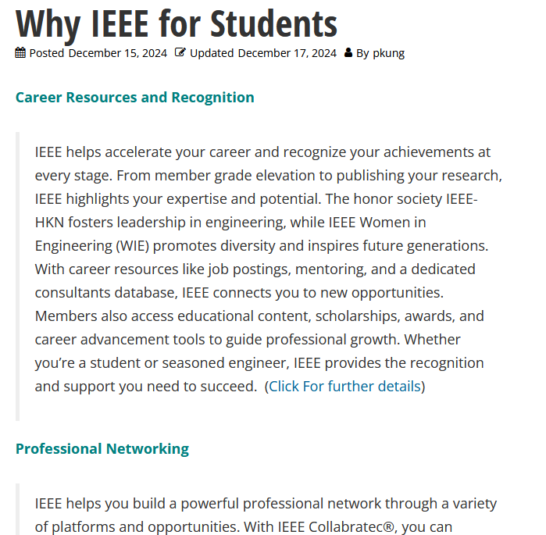
Region 3’s “Why IEEE?”
Example of shorter & tailored content

Slide 23
Project 3 - MCC
Members’ Dead/Rejected Email Addresses

Slide 24

MGA Suppressed List (Oct. ‘24)
Opportunity 1:
Why unsubscribe, why report email as spam?
→ Reach out in person.
→ Granular unsubscribe?
→ Better leverage combination of communication channels?

Slide 25
MGA Suppressed List (Oct. ‘24)
Opportunity 2: Members
→ Can Section reach out?
Roster Cleanup: Life Members
→ Wellness check?
→ If found member has passed away, MGA can’t remove but need family to request.

Slide 26
For more information: p.kung.us@ieee.org

