Slide 1
NextGen Banking Central (NGBC) and Hands-on Section Budgeting
Effective Financial Management and Reporting
Joe Pennisi, Region 3 Treasurer
March 29, 2025

Slide 2
Agenda
Overview
What’s new 2 years later – NGBC
Budgeting & Reporting
What is NGBC and how does it differ from NextGen
Short Tour of NGBC and Common Usage
Budgeting
Reporting

Slide 3
Overview
What’s new since I last spoke with you – NGBC.
IEEE contracted to develop a custom tool to address shortcomings
Will highlight what’s new and how it has improved the Treasurer’s tasks
Budgeting and Reporting tools are much more self-sufficient
Will discuss: Who, What, When, Why & How
Will demonstrate what’s new and what’s been improved

Slide 4
NGBC vs. NextGen
Still treat it like your bank portal – see what’s already occurred, not what’s coming
Some interfaces are the same some have changed
Dashboard is the same; login is the same
Account transactions and actions differ greatly
NextGen
Built on top of Coupa, existing product
Transaction tagging not officially supported
“Hundreds” of features/options
Lack of controlled hierarchical access
Manual annual financial reporting – require MGA help
Budgeting & adding categories – require MGA help
Any interim reporting is all manual
NGBC
Custom interface designed for IEEE
Transaction categorization supported online & via Excel
Only required features for Volunteer Treasurers
Hierarchical access for Sections to see subgroup accts
Ability to update transactions at any time
Self-service to generate custom categories for Section
Self-service to upload budget
Ability to generate Budget vs Actual reports on-demand (coming)

Slide 5
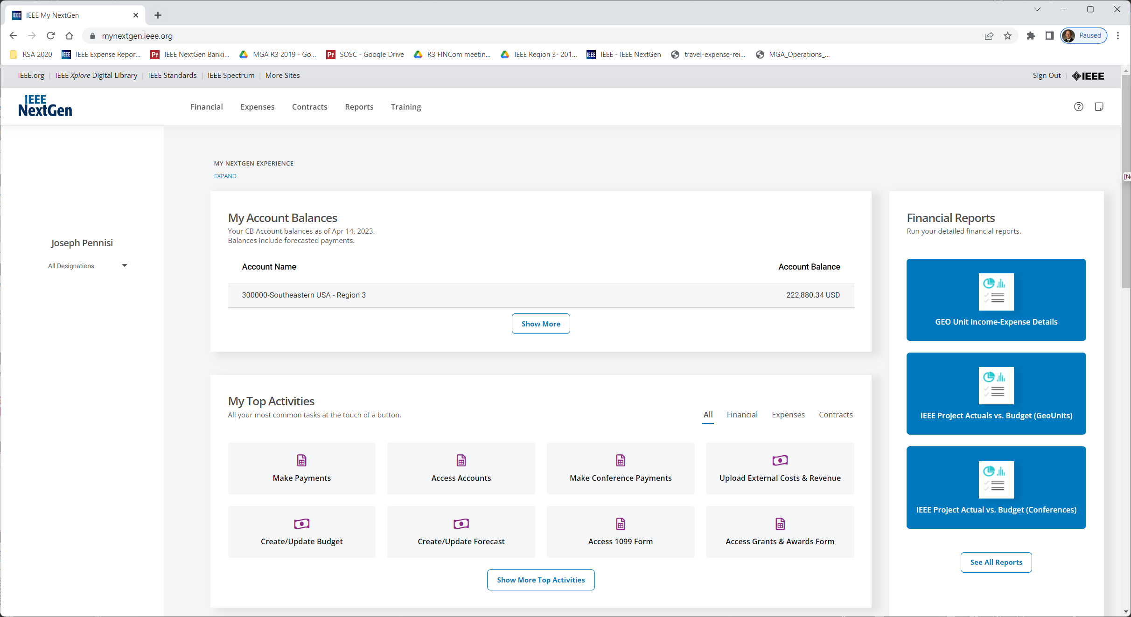
NextGen Banking Dashboard
Same
Changed
NextGen Cloud:
B vs A Reporting
https://mynextgen.ieee.org/
Quick view of account balances
NextGen Banking: Account Activities
NextGen Expenses:
(opens Concur)

Slide 6
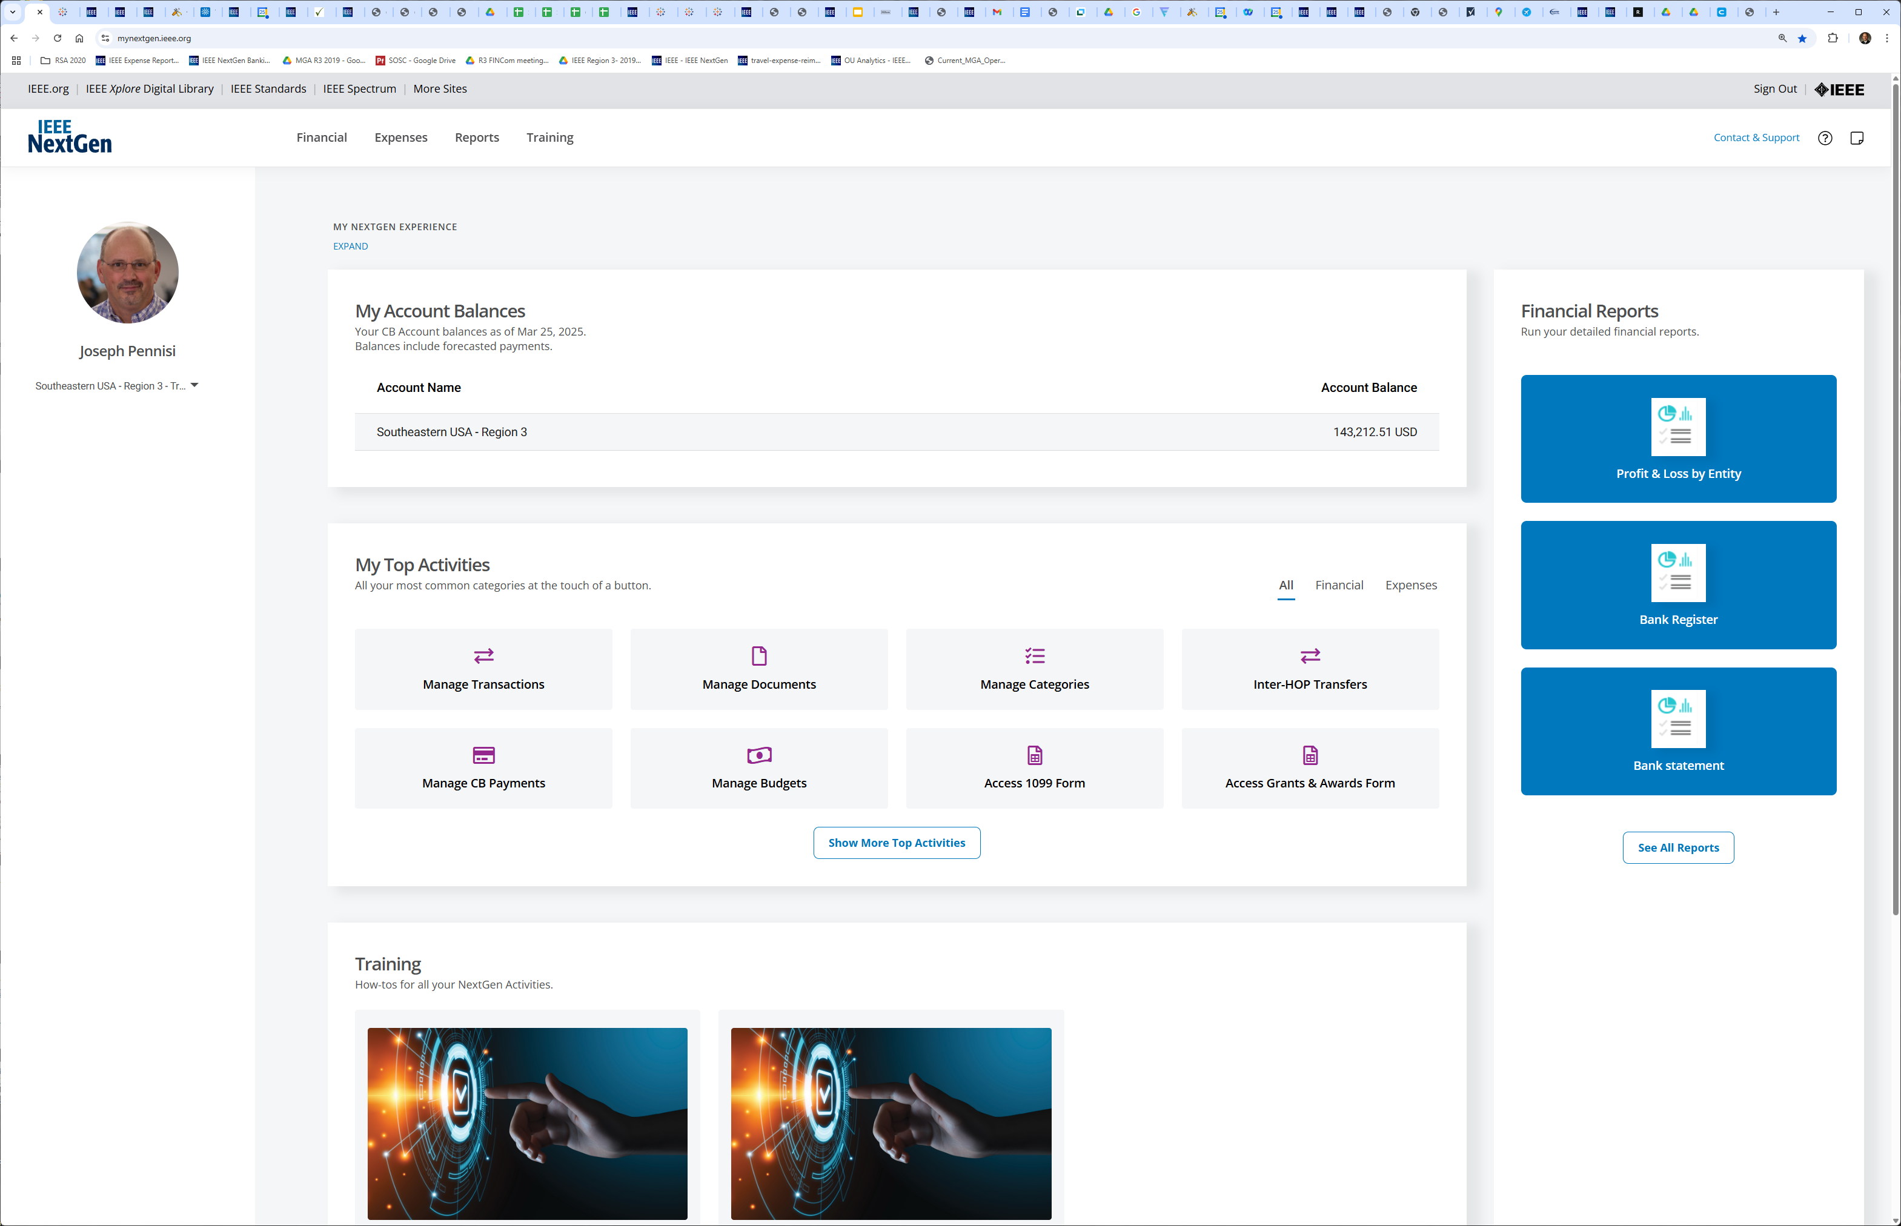
NGBC Dashboard
Same
New
NGBC Reports – opens new tabs
https://mynextgen.ieee.org/
Quick view of account balances
NGBC:
Account Activities
Shows Categories that open Concur

Slide 7
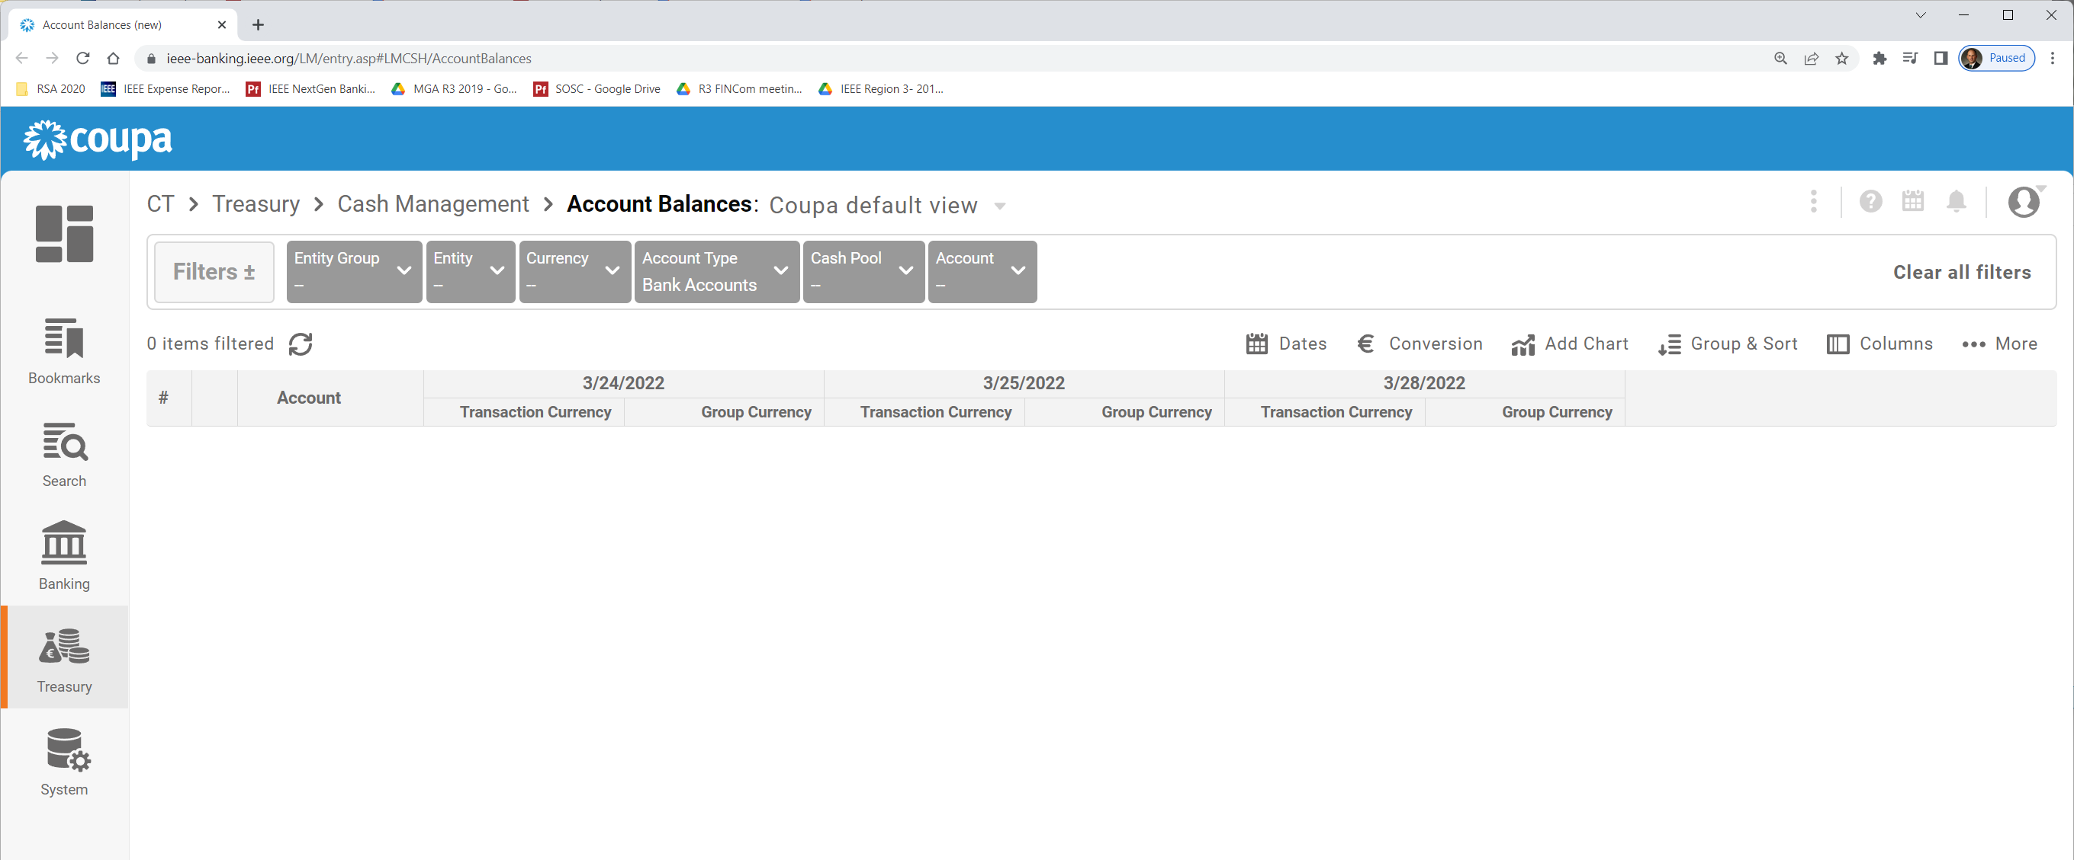
Account Balances
View all bank transactions through “Access Accounts”
Opens “coupa” dashboard to account balances
Clear out filters to see your account balances
Clear out filters to see your account balances
Change Dates here for balances on given dates

Slide 8
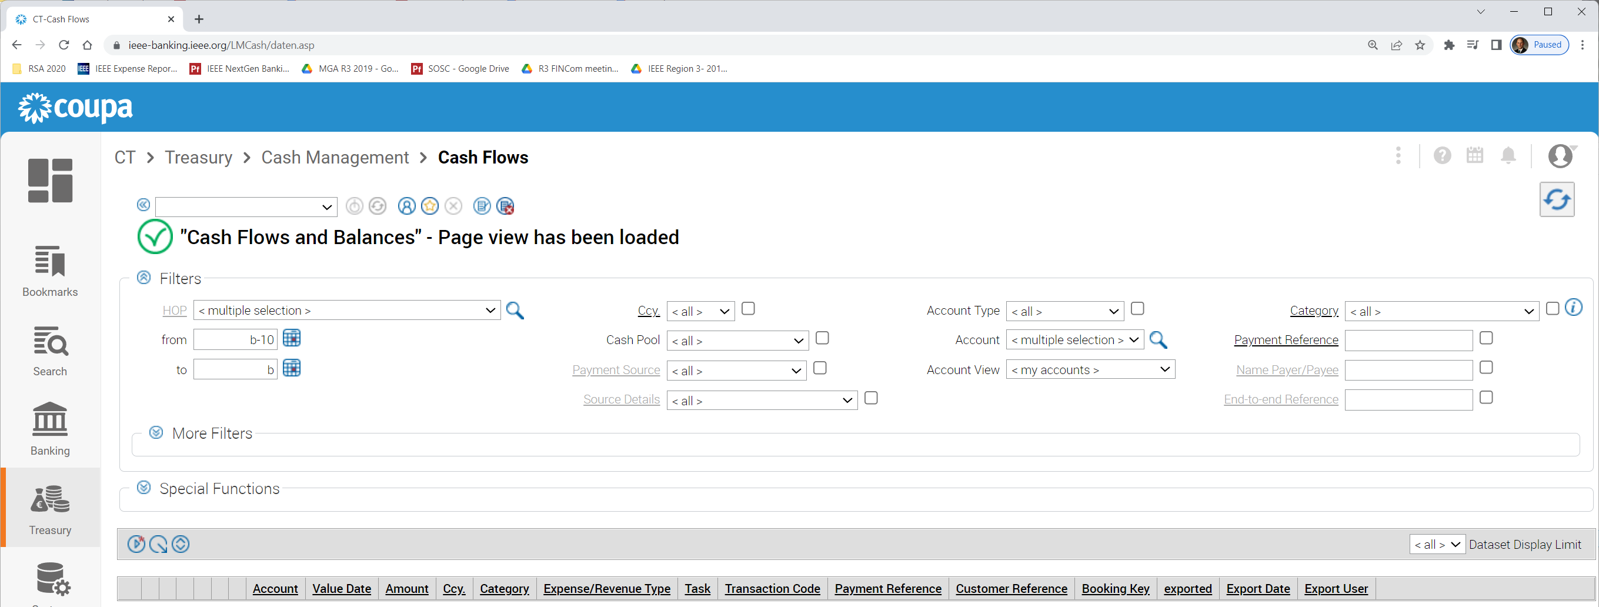
Bank Transactions
Need to set several fields before “update” to get data
Select “Cash Flows” to see all transactions
1
2
4
3
Select HOP from drop down
Select “all” for Account
Select start/end date of interest
Click “update”
Select HOP from drop down
Select “all” for Account
Select start/end date of interest
Click “update”
Select HOP from drop down
Select “all” for Account
Select start/end date of interest
Click “update”
Select HOP from drop down
Select “all” for Account
Select start/end date of interest
Click “update”
HINT: You’ll use the Update button frequently to refresh displayed data

Slide 9
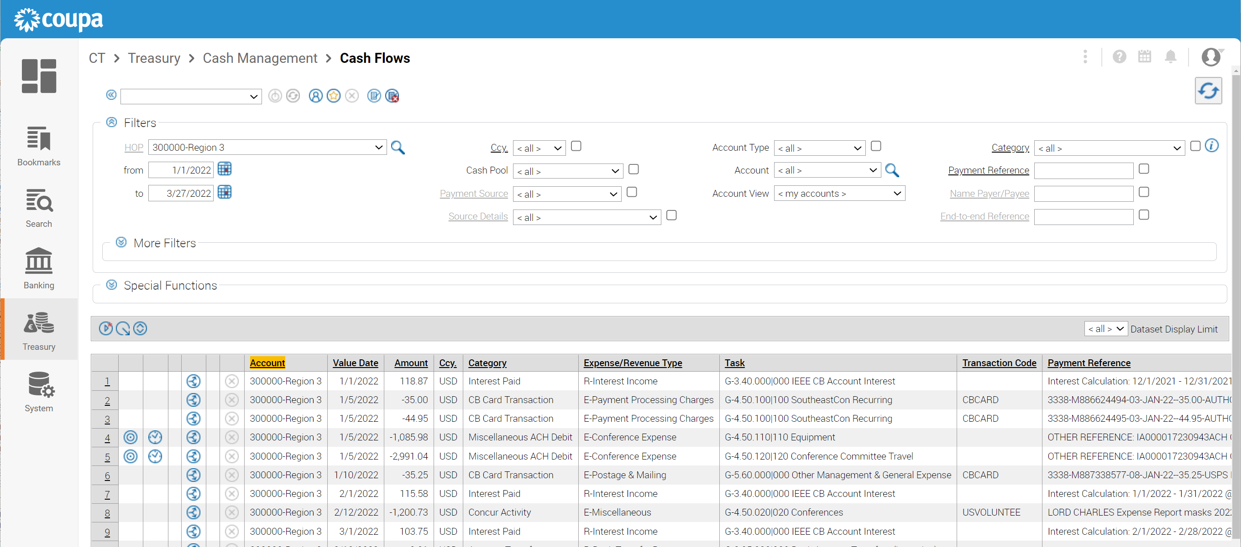
Bank Transactions
Note: Due to Current NextGen limitation that exposes more tasks to a treasurer than are valid, NextGen tagging does NOT sync with NextGen Cloud.
MGA Finance manually uploads each project from periodic Treasurer spreadsheet tagging process.
Currently a manual tagging and upload process is required to enable reports.
Treasurers CAN tag transactions as they appear in the list.
The key is tagging ONLY with tasks in your WBS list (obtained from file). This is manual, but beneficial for managing finances until tool updates provide this capability.
Transaction Tagging:
Category
Expense/Revenue Type
Task (task code)
Need to limit to GL codes in your WBS list
Export current view to spreadsheet CSV file for those inclined to work with those

Slide 10
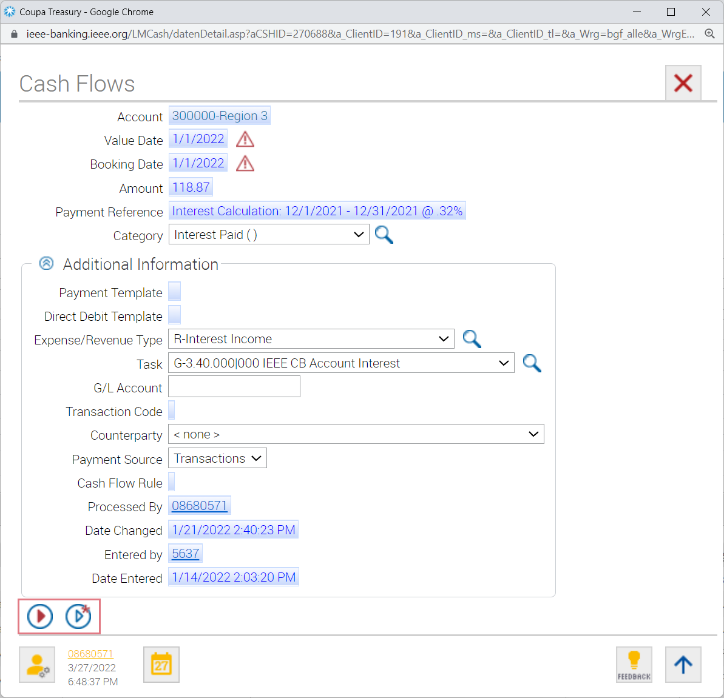
Tagging
Select number for transaction to tag
Select Type & Task from drop down
*Make sure to only use Task from budget
Click “save” when complete

Slide 11
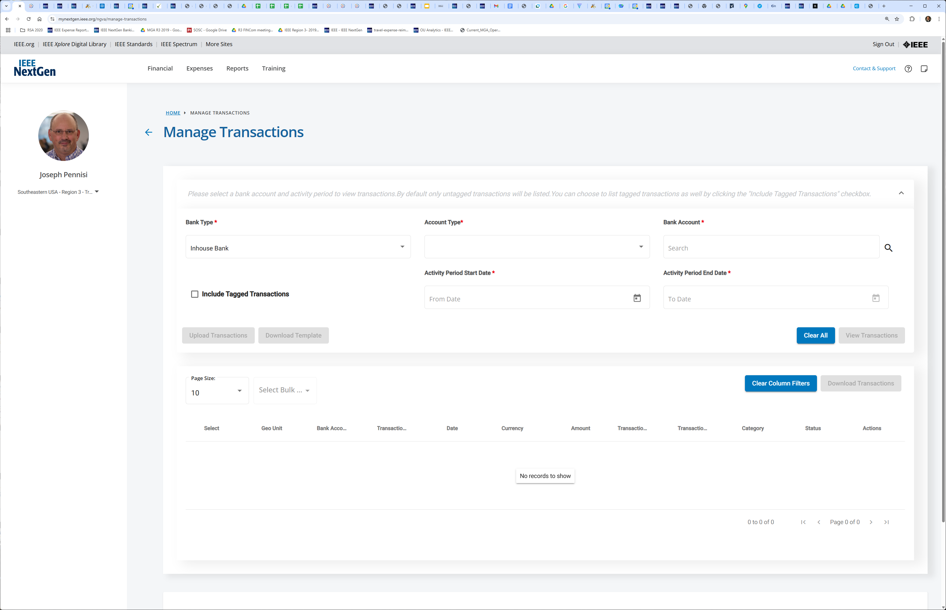
Manage Transactions
Manipulate all bank transactions through “Manage Transactions”
Select Account – if only one available, this is prefilled
Select Start/End dates of interest
Choose to see all transactions or just those uncategorized
View Transactions
Download to Excel

Slide 12
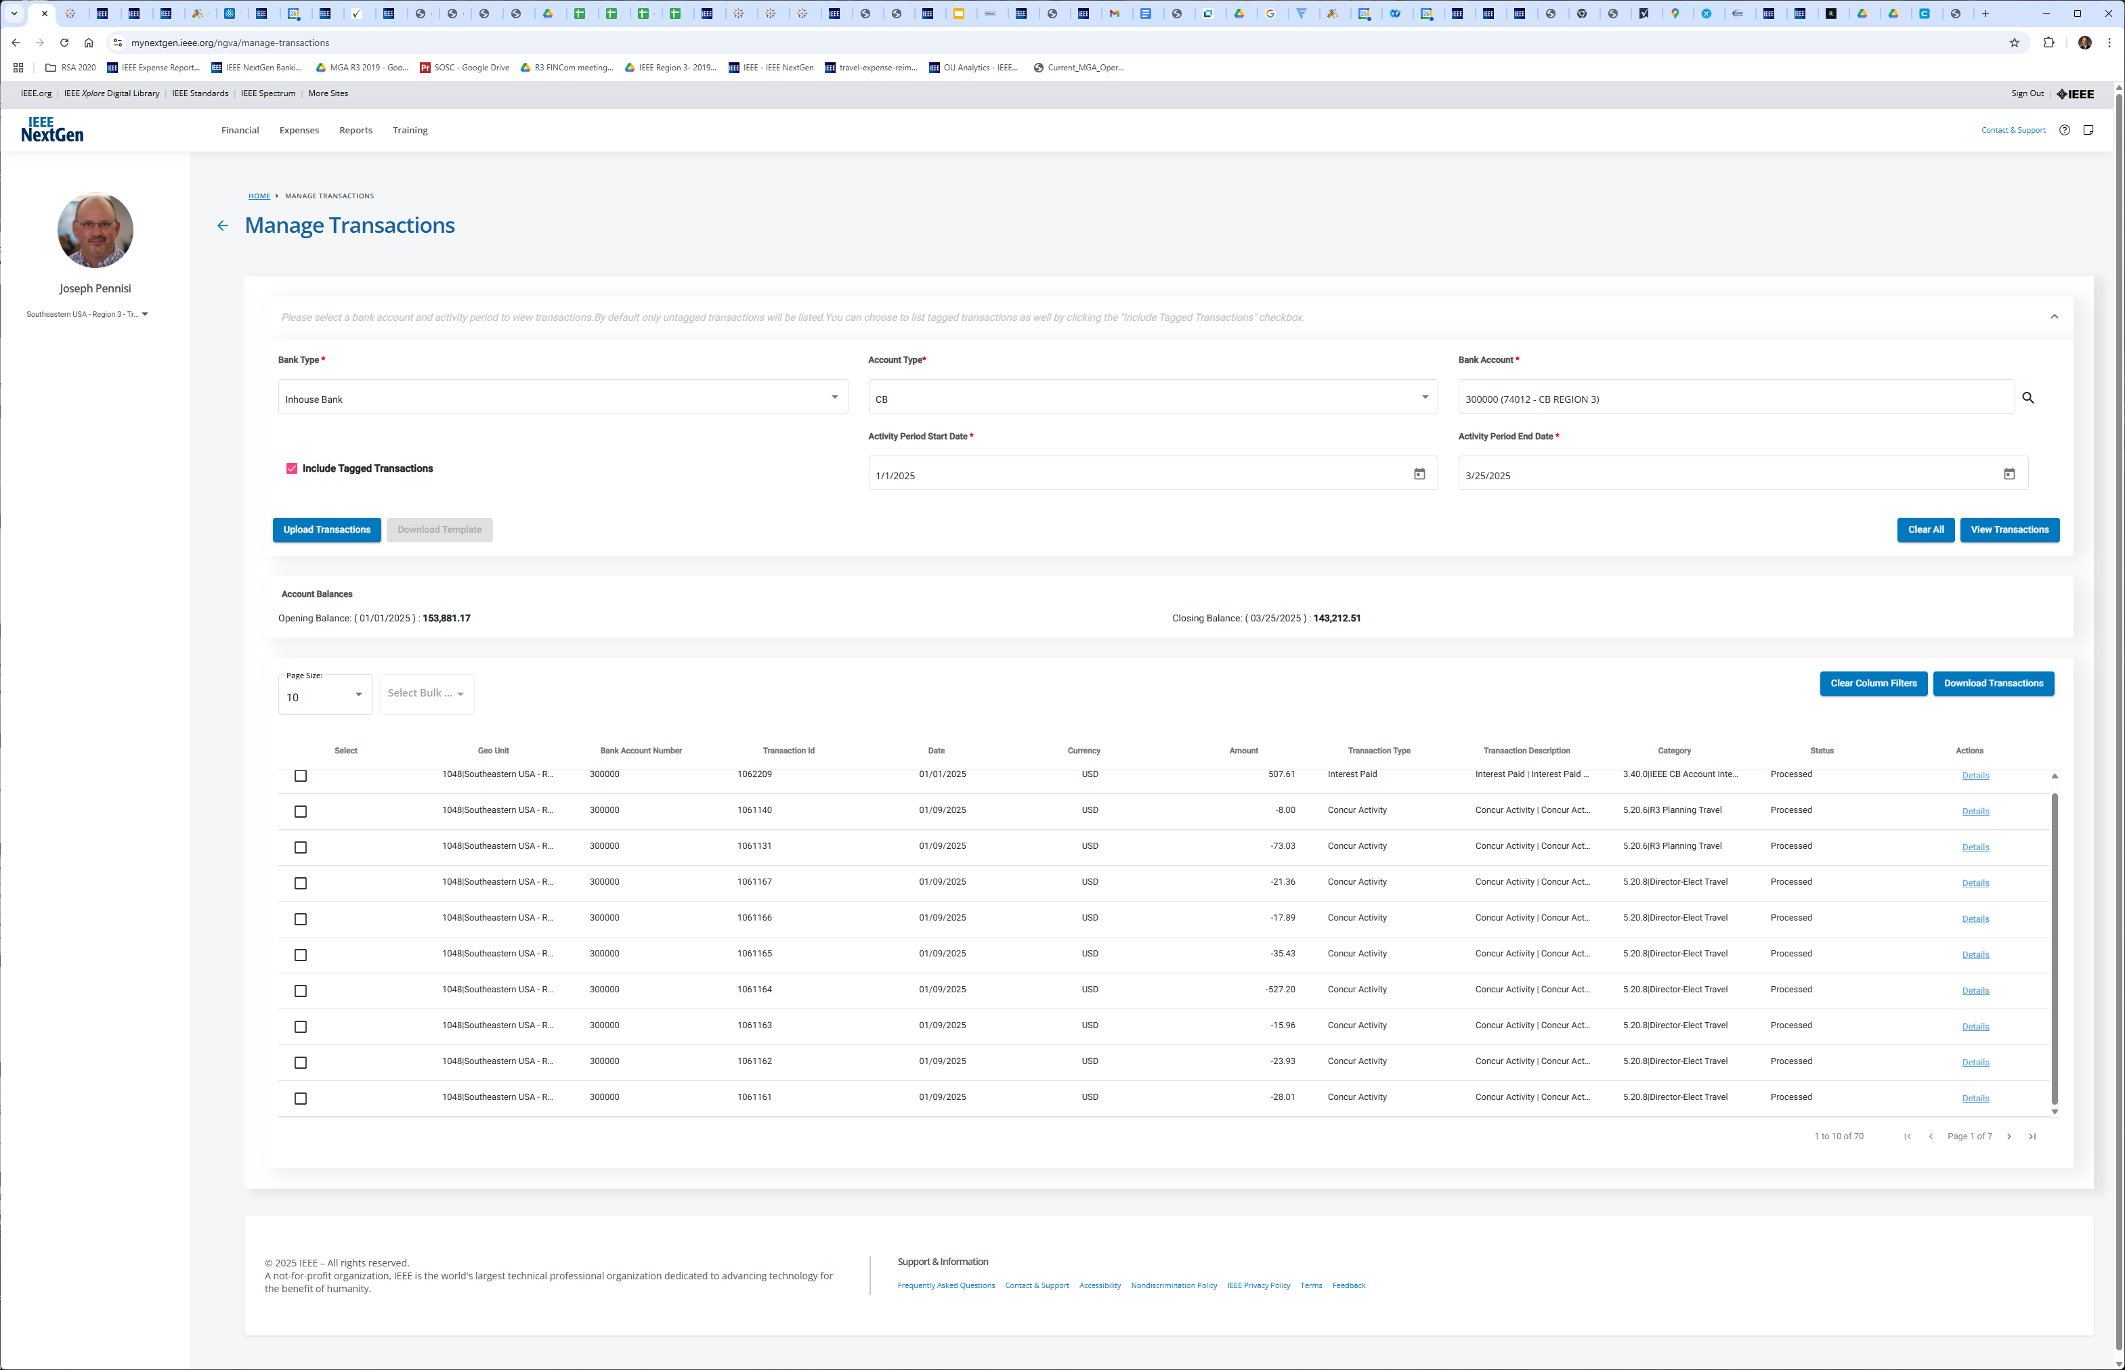
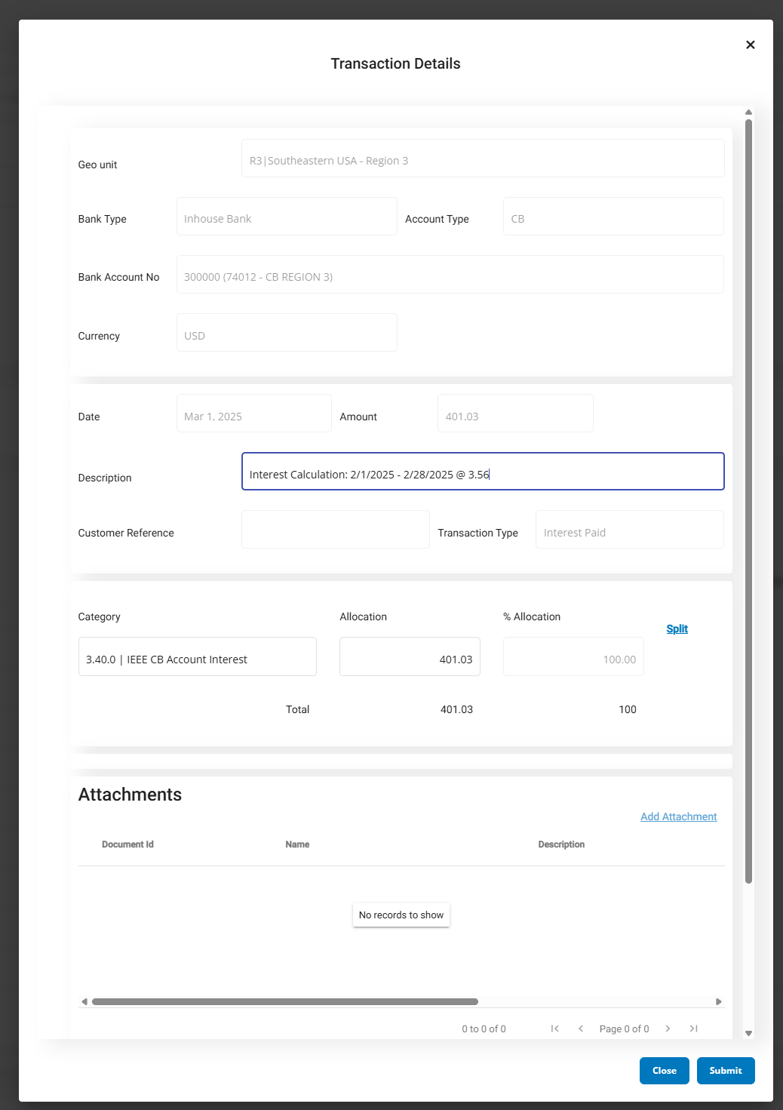
Categorize Transactions Online
Select Category
Details

Slide 13
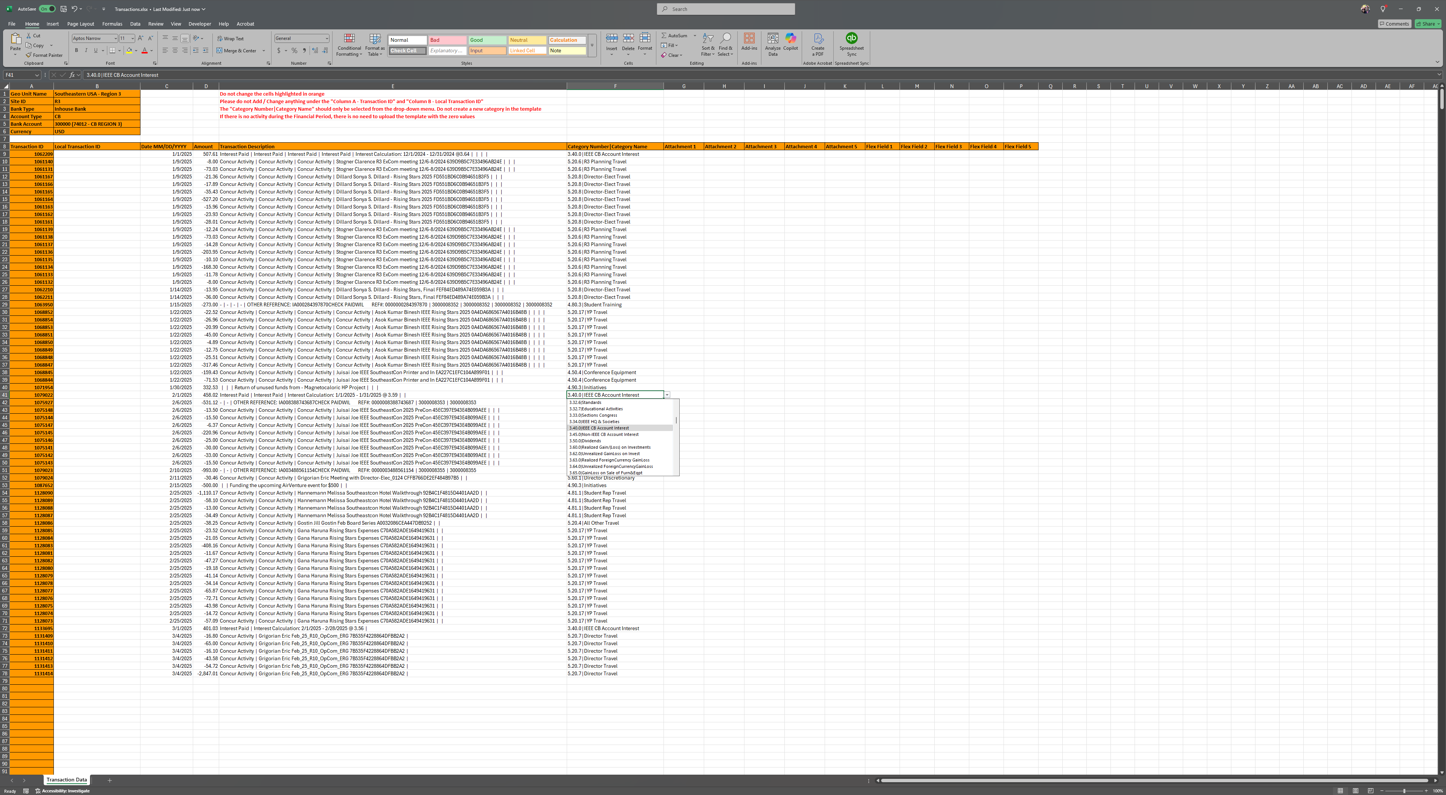
Download Transactions
Only Categories for your account are available to select – utilize all Excel features – copy/paste multiple lines

Slide 14
Upload Transactions
When complete with updates in Excel, save file and upload transactions here – changes take effect immediately

Slide 15
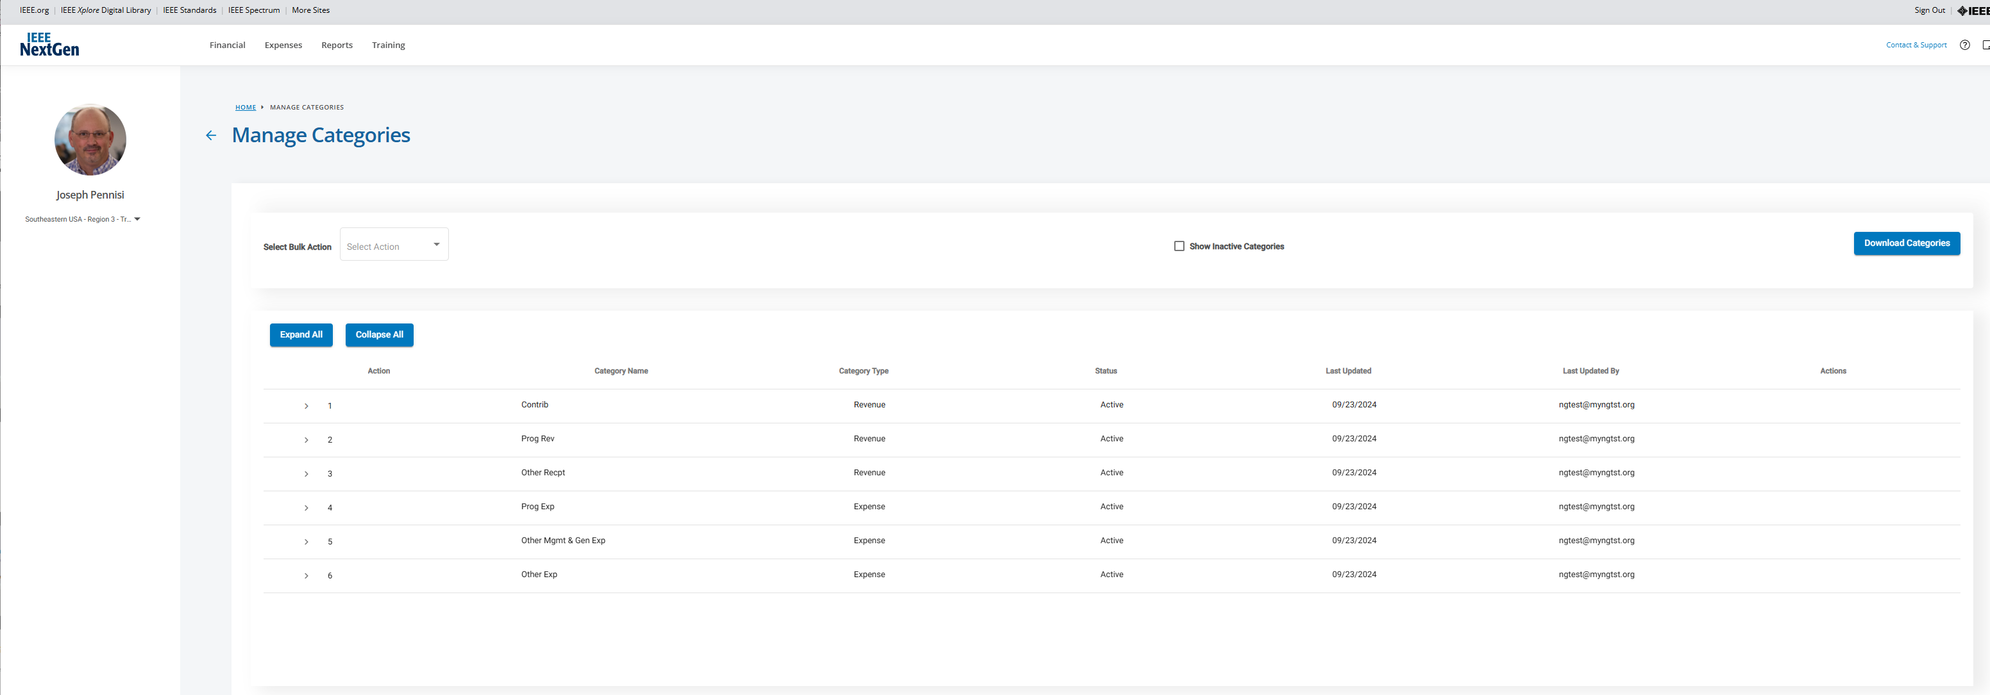
Managing Categories

Slide 16
Managing Categories

Slide 17
Adding Custom Categories

Slide 18
Adding Custom Categories

Slide 19
Adding Custom Categories
All additional travel expense categories I added – these were immediately available

Slide 20
Adding Custom Categories
You can download a full list of your available categories – this list is specifically for your geo unit (Section, Chapter, etc.)

Slide 21
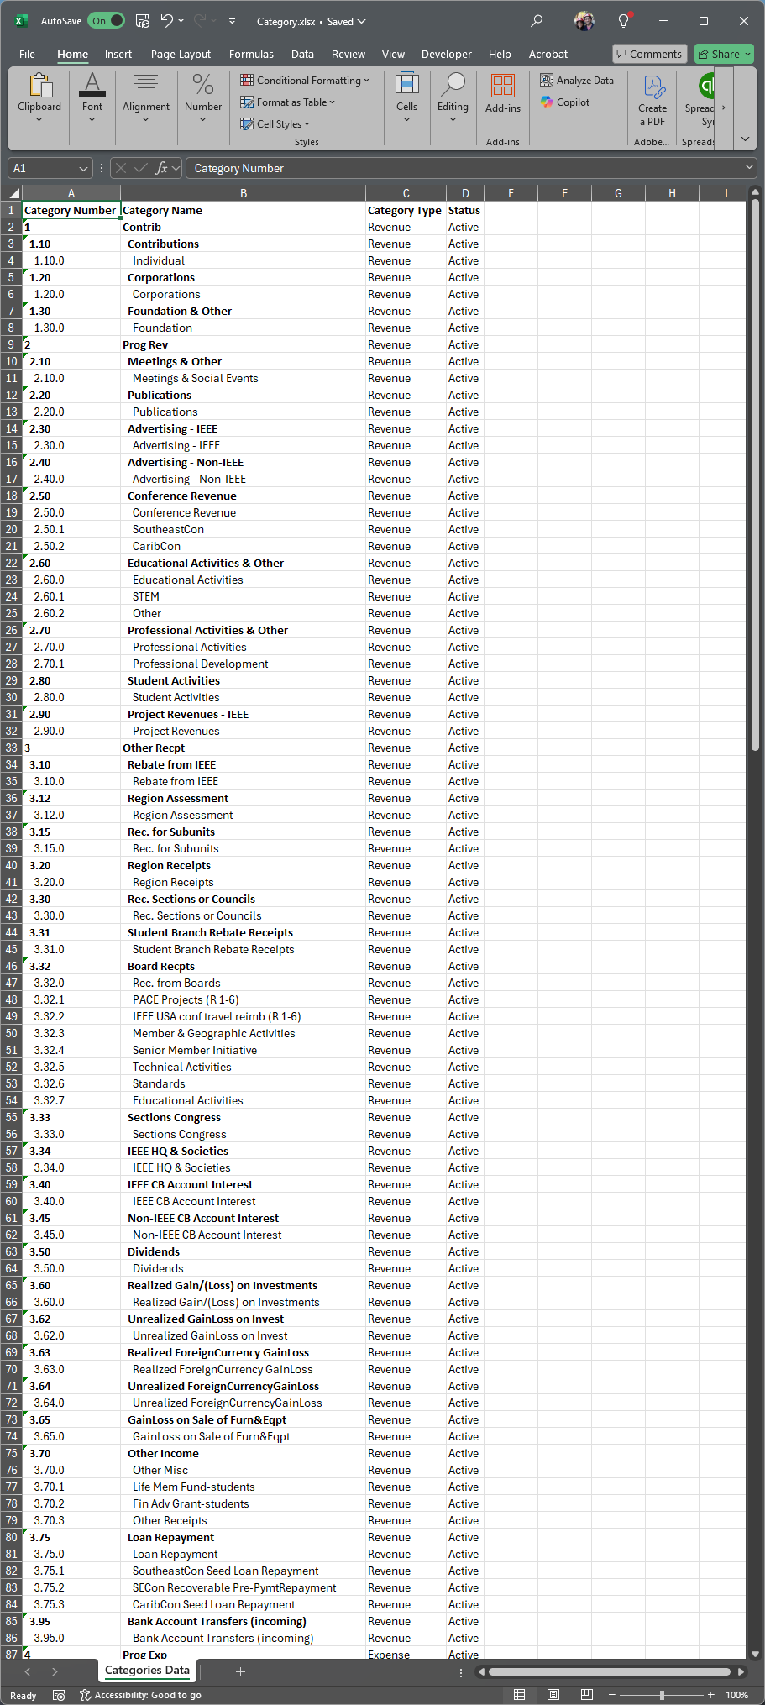
Adding Custom Categories
You can download a full list of your available categories – this list is specifically for your geo unit (Section, Chapter, etc.)

Slide 22
Inter-Hop Transfers

Slide 23
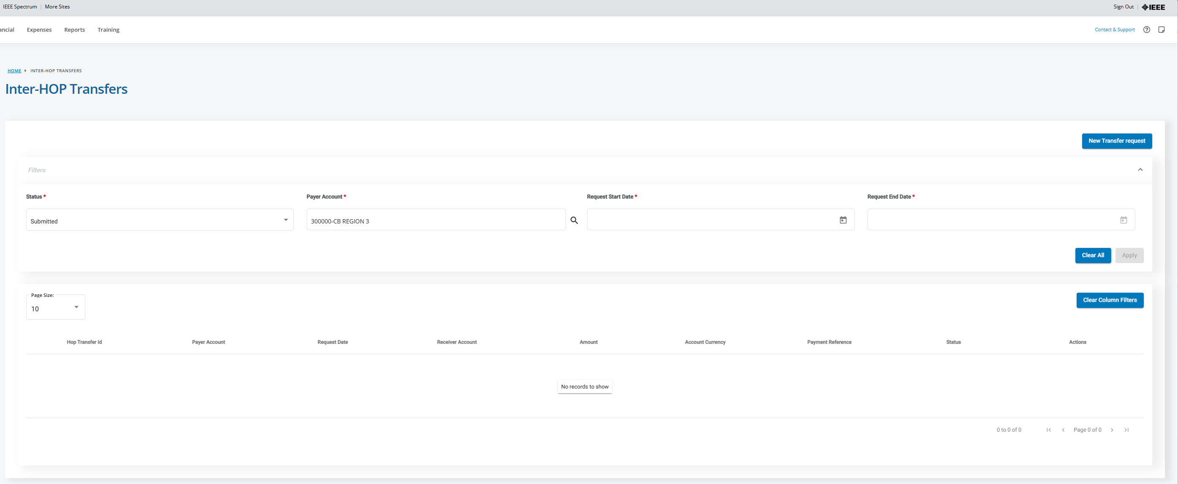
Inter-Hop Transfers
Start a new transfer

Slide 24
New Transfer
To help with auditing, this transfer request gets fulfilled by MGA Finance team.
This process introduces the concept of “Attachments” to NGBC.
To effect a transfer, the treasurer completes the form with:
Receiving HOP account
Amount
Payment Reference (text)
Category to tag transfer out
Attachment with approval
Email pdf or other doc

Slide 25
Adding Documents
You add new documents from here – or select one already updated (pdf, xls & doc, as well as others are supported)
Each document needs a name and description.
Use this for attaching any document to a transaction.

Slide 26
Budgeting 101

Slide 27
Budgeting 101
Budgets are critical to proper finance management
Who – Treasurer and ExCom
Sections, Chapters, Affinity groups, etc. all should establish budgets
What – All Income & Expenses planned for the year
Utilize historical data, but discuss strategic plans for the coming year
Why – Need a fiscal plan to manage to throughout the year
Budgets are based on best available information at the time – do not need to be “set in stone”
When – Ideally, budget should be approved before Jan 1st
View the budget as the contract your geo unit’s ExCom has approved for the unit to spend funds
An incoming ExCom can ratify the budget for thoroughness
How – Treasurer works with geo unit to develop; ExCom approves
Decide amounts for income and expense for a budget, update it in a template, upload template
ExCom

Slide 28
Budget Template
Once Template is filled out, use this to upload it into NGBC
ExCom
Download budget template with content specific to your geo unit

Slide 29
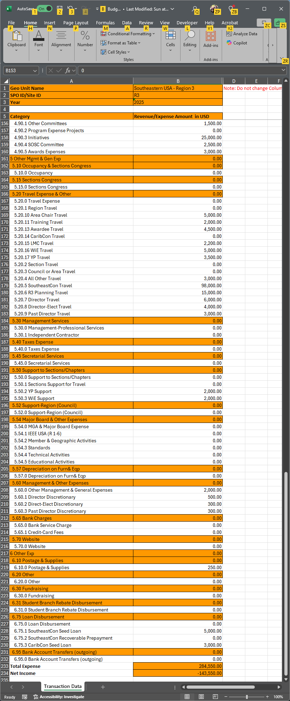
Budget Template
Region 3 2025 Budget
What mechanism you use to decide on budget amounts is up to you (note – spreadsheets work well).
Once you have decided and approved, enter that information into this template – do NOT change any lines or update orange – and then upload into NGBC.

Slide 30
Region 3 Budget Approval Process
A reminder of what I do for the Region – does not need to be elaborate – need detailed proposal and ExCom approval.

Slide 31
Reporting 101

Slide 32
Reporting
Click here to get list of all reports available
Unlike previously, these reports are now actively linked to the geo accounts and will show active data – they are therefore much more useful as part of NGBC

Slide 33
Reports
Each of these reports provides useful financial information on balances, transactions by date and by category.
Recommend utilizing the Budget vs. Actual report to communicate your geo units financial state on a regular basis (monthly or quarterly, depending on activity level)

Slide 34
Budget vs. Actual Reporting

Slide 35
Budget vs. Actual Reporting
Simulated Data
BvsA Reporting under development

Slide 36
Additional Useful Reports

Slide 37
Additional Useful Reports
Reports can be exported as:
Pictures (png)
Crosstab (xls/csv)
PDF
Powerpoint *

Slide 38
Summary
NGBC has been design from the ground up to support us
Simplified interface – only tasks relevant to IEEE geo units
Improved Self-servicing – Custom categories, online categorization, budget management
Improved Reporting – System generated Budget vs Actual and other reports with current data
Improvements greatly ease a geo unit’s budgeting and reporting
No longer require MGA Finance team to:
Generate customized categories
Upload budget templates
Be involved in categorizing transactions and uploading to NextGen
Data is available to report generation tool without intervention
Budget vs. Actual report still in progress, but should be live soon
Sections, Chapters, and Affinity Groups should now be able to:
Budget and upload into NGBC
Report to their organization with support of fully auto-generated reports from NGBC

Slide 39
NGBC & Budgeting
Questions?
Demo
(time permitting)

Slide 40
Backup

Slide 41
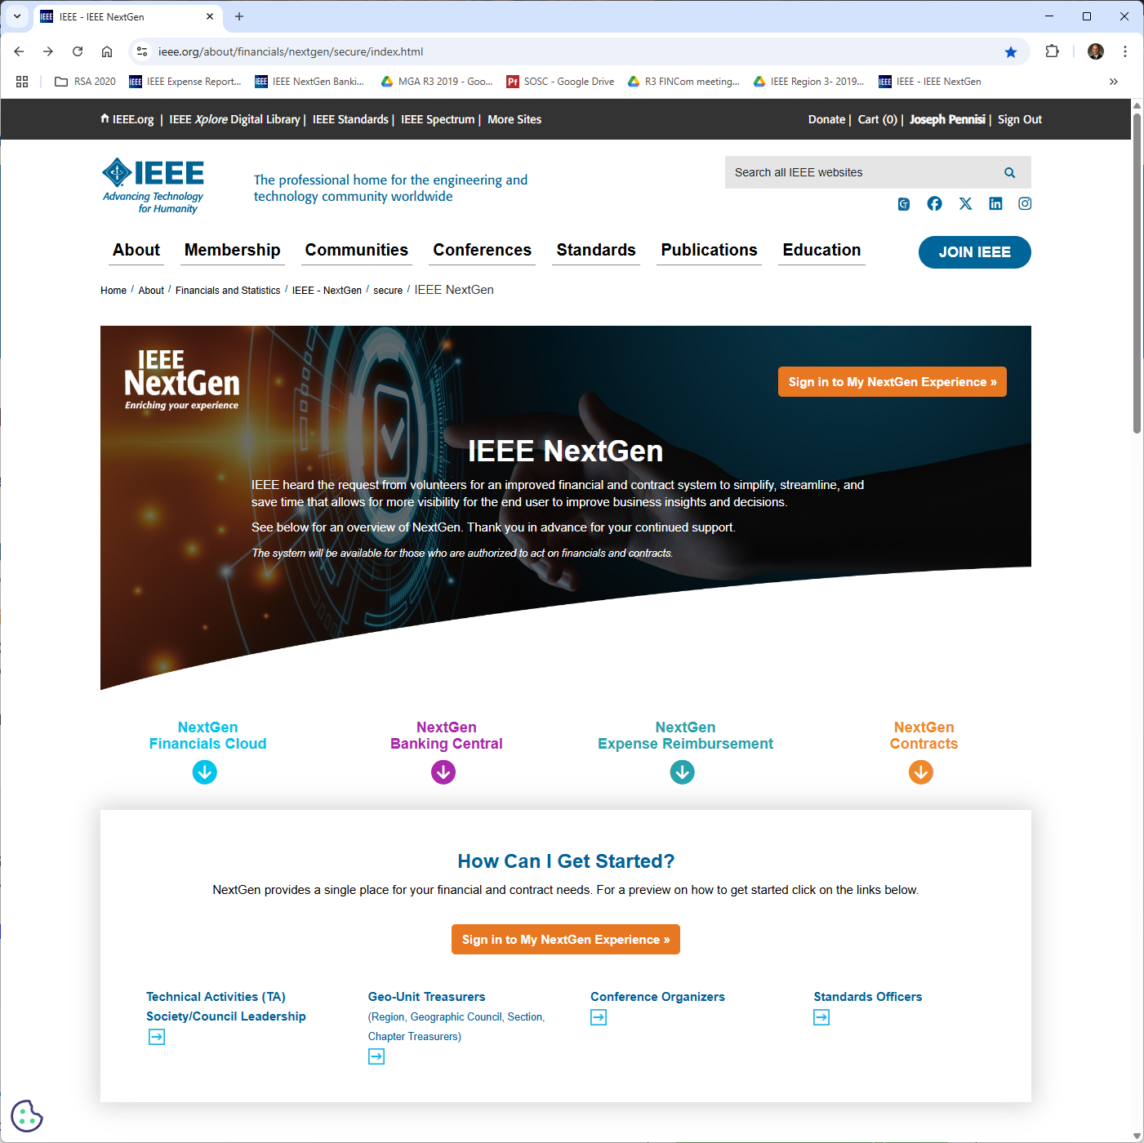
Logging in
Or go directly to NGBC via: IEEE NextGen Banking
(https://mynextgen.ieee.org)
https://www.ieee.org/nextgen

Slide 42
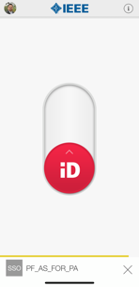
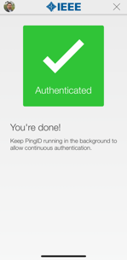
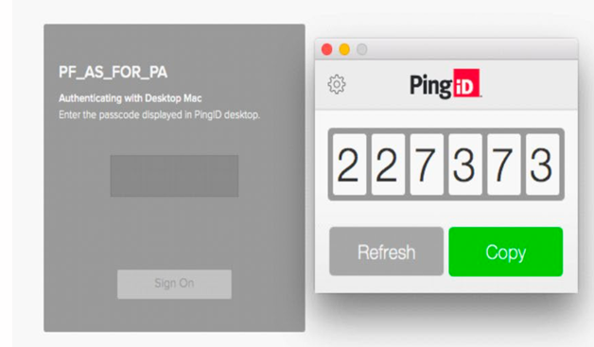
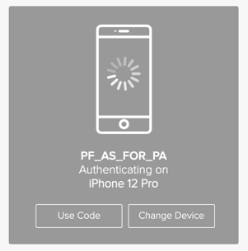
Multifactor Authentication Security - PingID
Mobile
Desktop
IEEE Proprietary

Slide 43
Thank you!
Joe Pennisi, joe.pennisi@ieee.org

