Slide 1
vTools Nominations: Full Process
Aubrey Walter, vTools Project Manager, IEEE-MGA Staff
30 March 2025

Slide 2
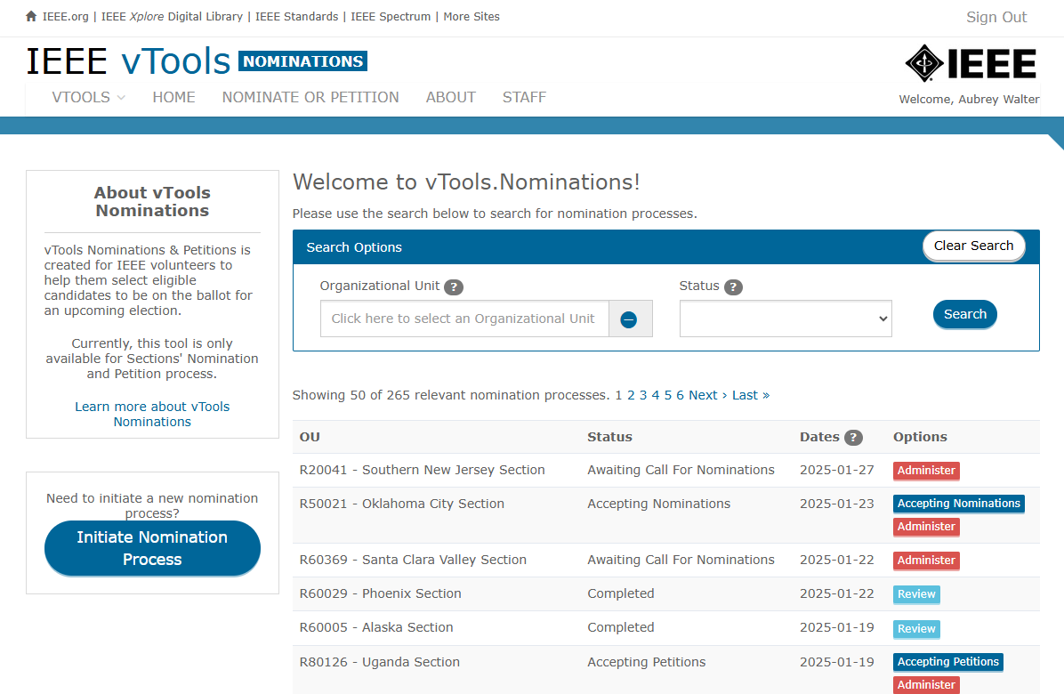
Nominations
https://nominations.vtools.ieee.org/
vTools Nominations was created for IEEE volunteers to help them select eligible candidates to be on the ballot for an upcoming election.
This tool is currently only available for Sections and Chapters Nomination and Petition processes.
Support for Chapters was added in Q1 2025.

Slide 3
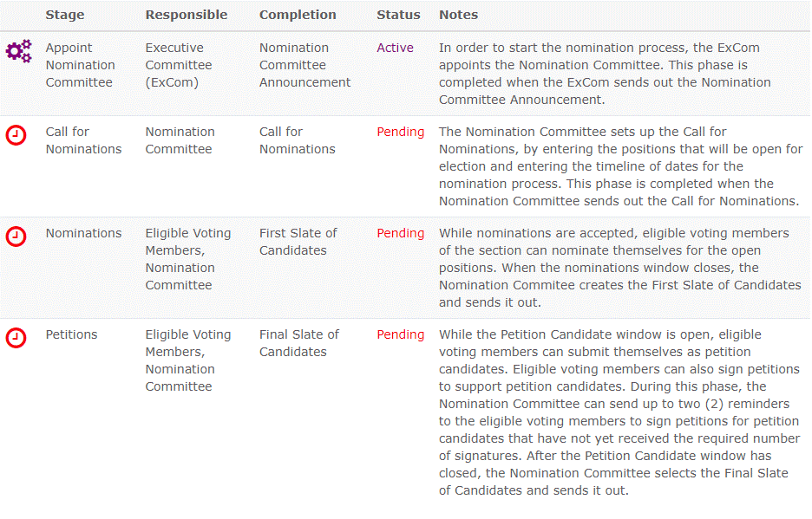
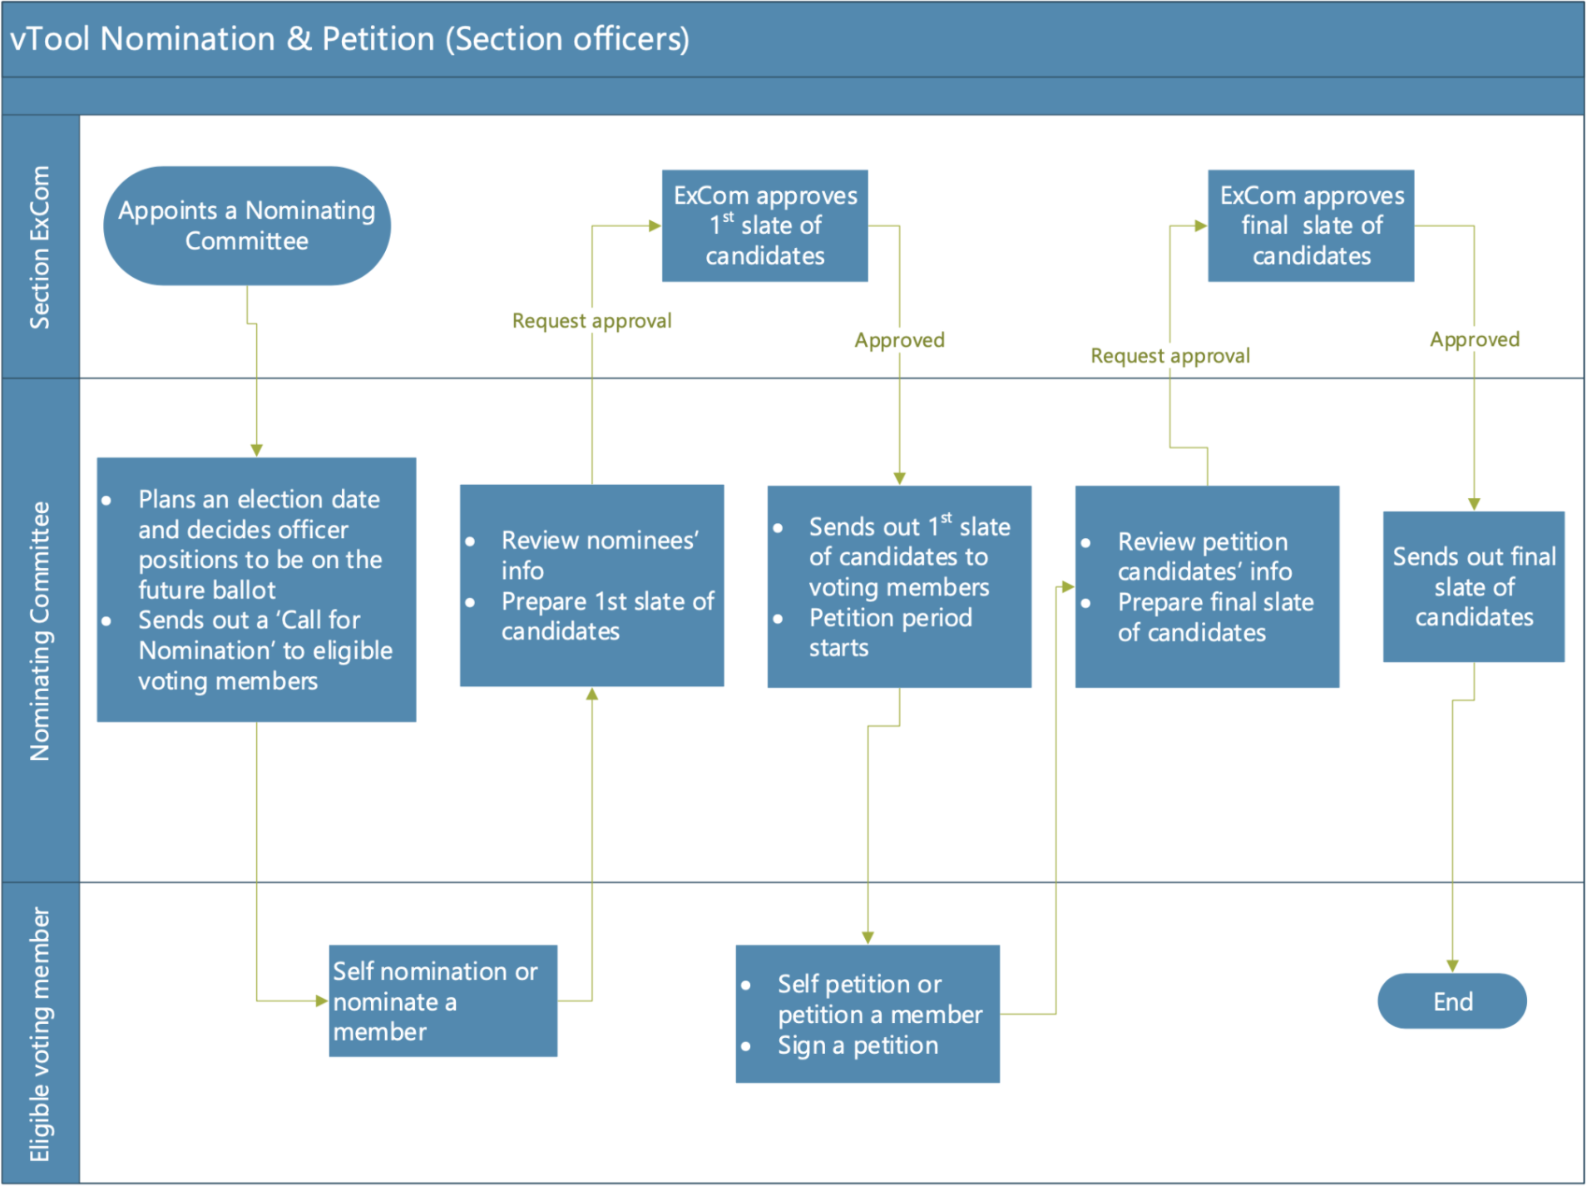
Nominations – Process Overview
These charts (which are also available in the tool) show the workflow of the steps in the process and who is responsible for each step.

Slide 4
Creating a Nominations Process

Slide 5
Begin the Process/Form Election Committee
Responsible: Section Executive Committee member(s)

Slide 6
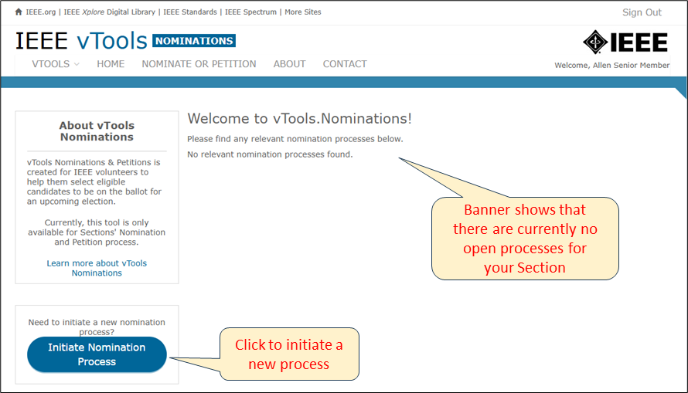
Begin the Process Responsible: Section Executive Committee member(s)
Log in to https://nominations.vtools.ieee.org with your IEEE Account.
There will be a banner at the top of the page showing that there are currently no open processes for your Section.
On the bottom left, click the button to initiate a new process for the Section.

Slide 7
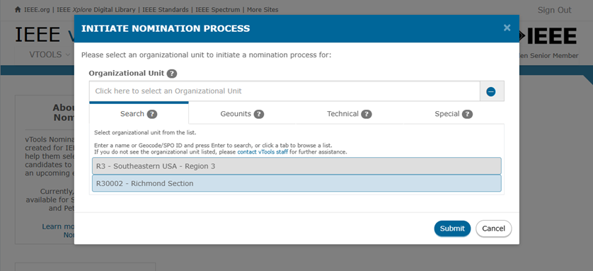
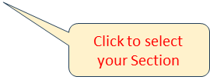
Begin the Process – Select the OU Responsible: Section Executive Committee member(s)
In the OU Picker popup box, select your Section, then click Submit.
You will be brought to the “Home Page” for the nominations process (see next slide).

Slide 8
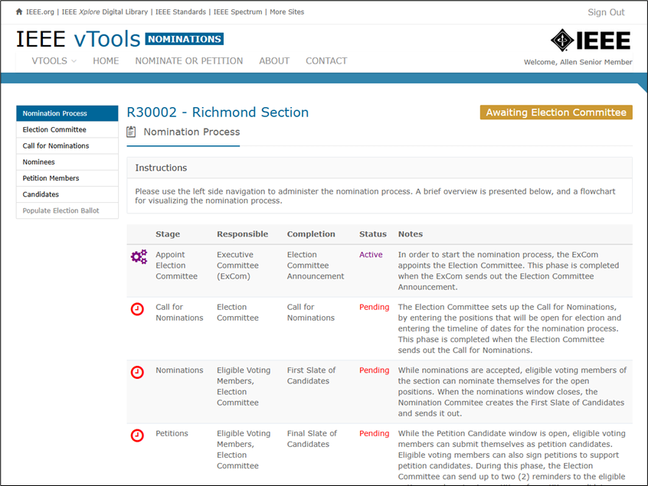
Begin the Process – Nominations Homepage Responsible: Section Executive Committee member(s)

Slide 9
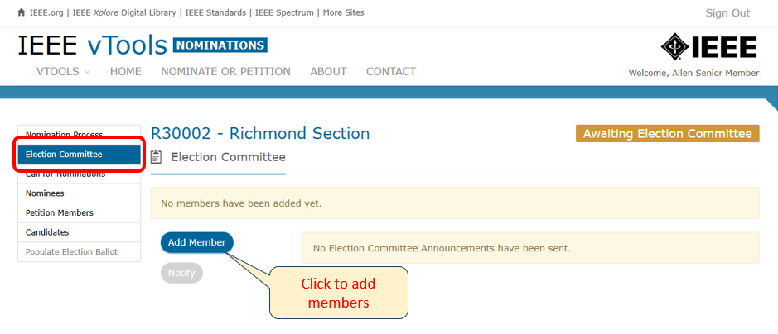
Begin the Process – Appoint the Election Committee Responsible: Section Executive Committee member(s)
The banner at the top right corner of the screen will show “Awaiting Election Committee.” In the menu on the left, click on “Election Committee.” Click “Add Member” to add members to the Election Committee:

Slide 10
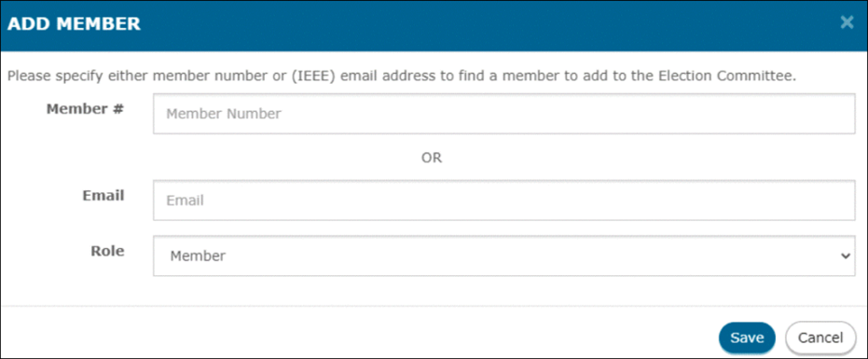
Begin the Process – Appoint the Election Committee Responsible: Section Executive Committee member(s)
Enter either the member number or email address of the members you wish to add. Here, you may also specify the Role these members will play (Member or Chair). You must specify one of the members as the “Chair.” The other members will just be “Member.” These roles can be changed later, if needed.

Slide 11
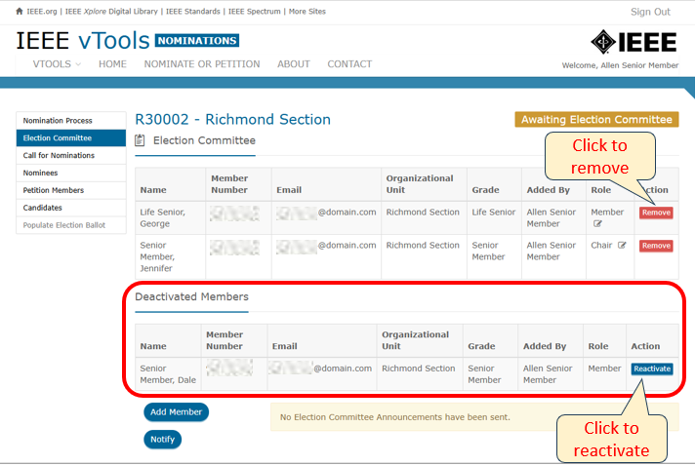
Begin the Process – Appoint the Election Committee Responsible: Section Executive Committee member(s)
After the members have been added, the page should look like this →
If you want to change the Role of any of the members, click the pencil icon next to the role and change it to either Chair or Member.
Note that there can only be one Chair, so if you select someone else to be Chair, the other person’s role will automatically switch to Member.
Here, you can also remove members. Removed members will move to the bottom of the page and show as “Deactivated Members.” You can click “Reactivate” to add them back, if needed.

Slide 12
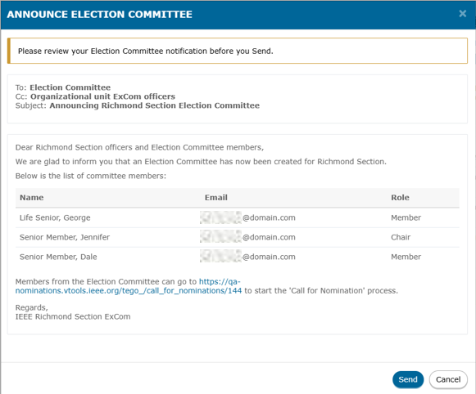
Begin the Process – Appoint the Election Committee Responsible: Section Executive Committee member(s)
Once all the members have been added, and roles have been assigned, click “Notify” at the bottom of the page to announce the Election Committee.
You will see a pop-up box like this where you can review the notification before you send.
If all looks OK, click “Send.”

Slide 13
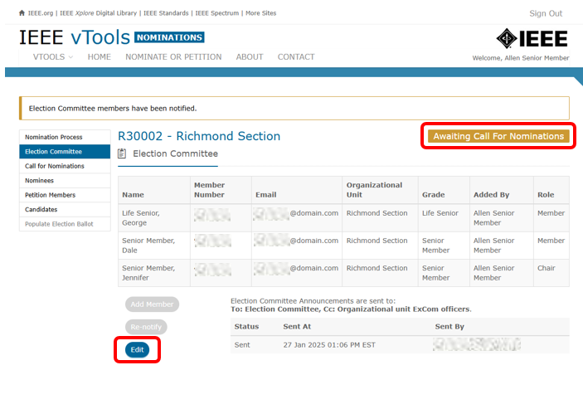
Begin the Process – Appoint the Election Committee Responsible: Section Executive Committee member(s)
At this point, the announcement has been sent, and the banner at the top of the screen will show “Awaiting Call for Nominations.”
An “Edit” button will appear on the screen, so you may edit the Election Committee further at this stage, if needed.
Note: If you click “Edit,” Election Committee Members’ access to the tool will be temporarily suspended until the Election Committee is re-notified.
If done, you can now log out of the application.

Slide 14
Call for Nominations
Responsible: Election Committee member(s)
(as appointed in the first step of the process)

Slide 15
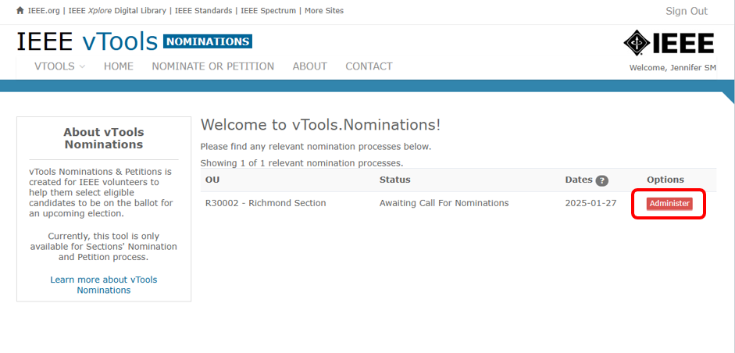
Call for Nominations Responsible: Election Committee member(s)
Log in to https://nominations.vtools.ieee.org with your IEEE Account. Next to your Section, click the red button that says “Administer.”

Slide 16
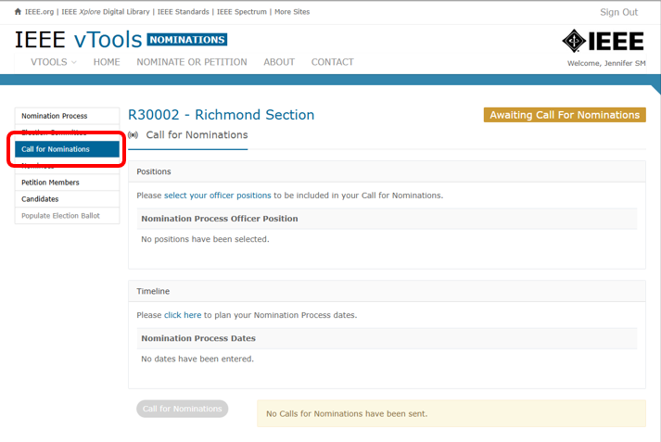
Call for Nominations Responsible: Election Committee member(s)
Click “Call for Nominations” in the menu on the left:

Slide 17
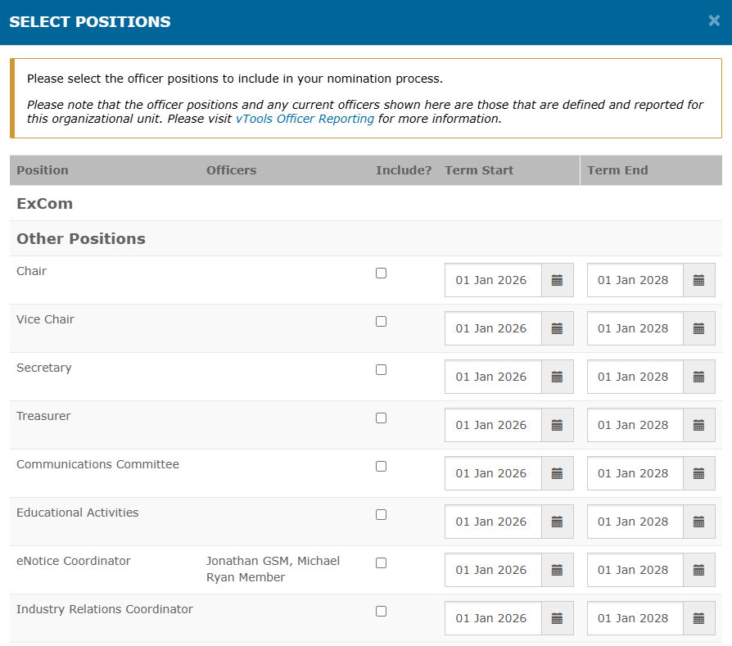
Call for Nominations Responsible: Election Committee member(s)
Select positions
Under “Positions,” click the link to select your officer positions.
In the pop-up box, select the positions you want to include in this nomination, along with the term dates. Select as many as desired/needed.
You can change or remove the term dates if you don’t want to select them at this time.
This modal will show if any of the positions are currently filled by displaying the name of the volunteer in that role. Any rows where the Officers column is blank are roles that are currently vacant.
When done, click “Save” at the bottom of the modal.

Slide 18
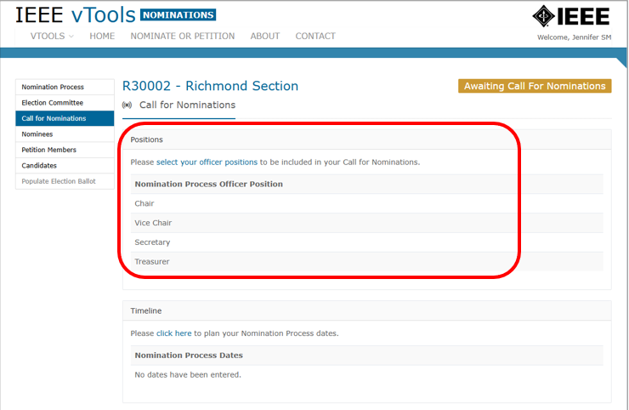
Call for Nominations Responsible: Election Committee member(s)
You will see that the positions have been added:

Slide 19
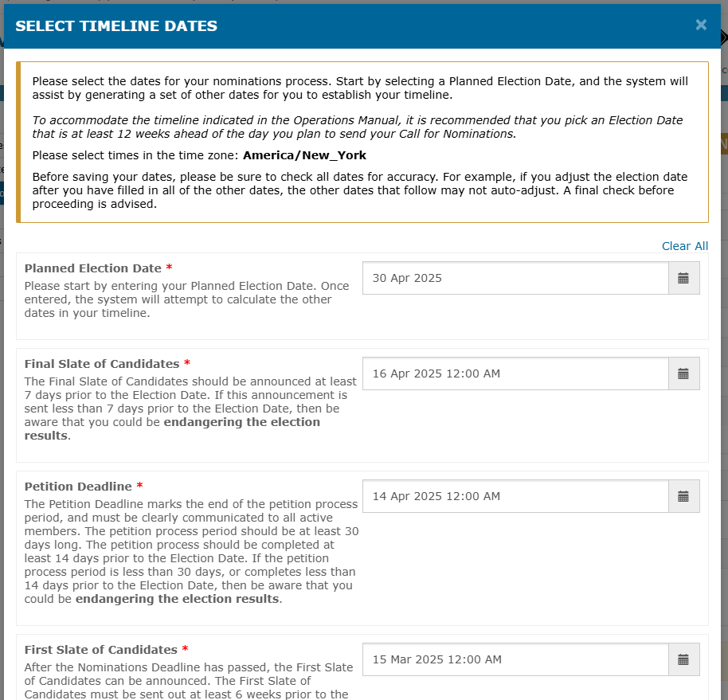
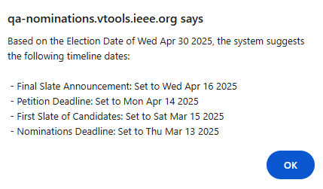
Call for Nominations Responsible: Election Committee member(s)
Create Timeline
Under “Timeline,” click on the link to enter your Nomination Process dates.
Start by selecting a Planned Election Date that is at least 12 weeks from today’s date (to allow enough time to complete the nominations process). The system will assist by automatically generating the other dates for you to establish your timeline.
Click OK to accept; these dates can be edited later.

Slide 20
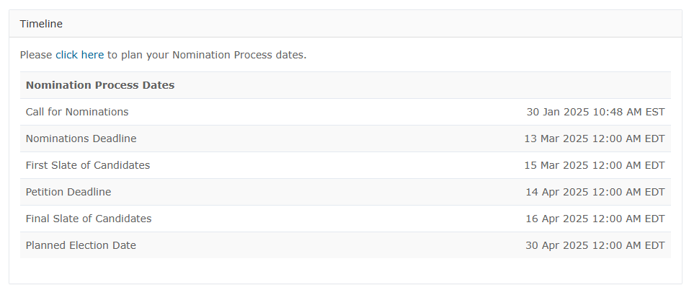
Call for Nominations Responsible: Election Committee member(s)
Create Timeline
The dates you selected are now reflected in the Timeline.
You may adjust the dates and times as needed.

Slide 21
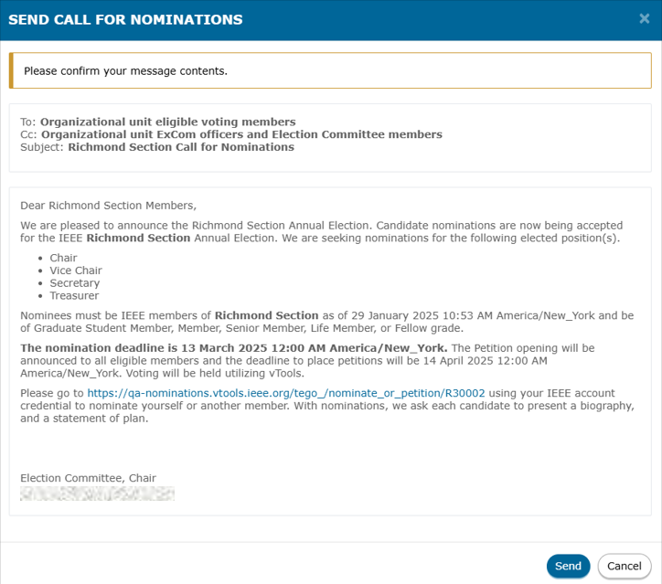
Call for Nominations Responsible: Election Committee member(s)
Send Call for Nominations
After selecting positions and setting the timeline, you can now send the Call for Nominations. Click the button at the bottom of the page to do so.
Review the content in the pop-up box. You may edit this text as needed.
Once done, click “Preview” at the bottom of the window, and, if satisfied, click “Send” on the next screen.

Slide 22
Call for Nominations Responsible: Election Committee member(s)
Send Call for Nominations
You will now see that the Call for Nominations has been sent and is set to “Submitted,” which means it has been queued for delivery. It will eventually change to “Sent”:

Slide 23
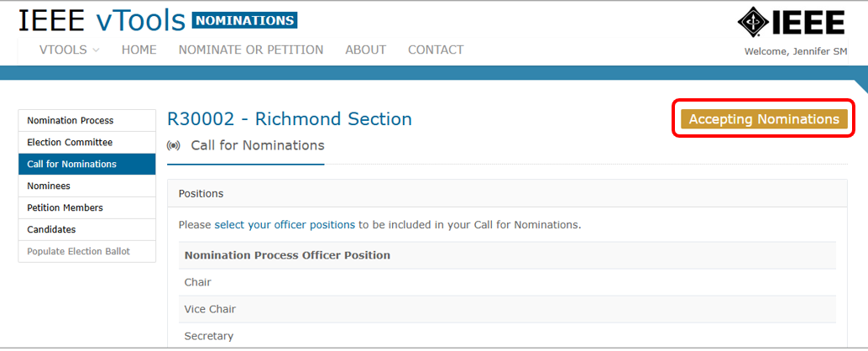
Call for Nominations Responsible: Election Committee member(s)
Send Call for Nominations
The banner at the top of the page will now show “Accepting Nominations”
You can now log out of the application.

Slide 24
Nominations by Members
Responsible: Members of the OU

Slide 25
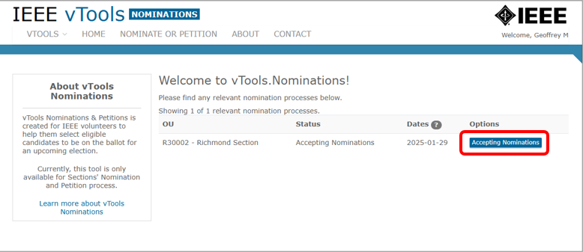
Nominations by Members Responsible: Members of the OU
Currently, members can self-nominate, nominate another member, or be nominated by another member of the Section.
IEEE MGA Staff can also nominate a candidate from the “Nominees” admin page (if needed).
Members should log in to https://nominations.vtools.ieee.org using their IEEE Account.
Once logged in, click on the blue button that says “Accepting Nominations”:

Slide 26
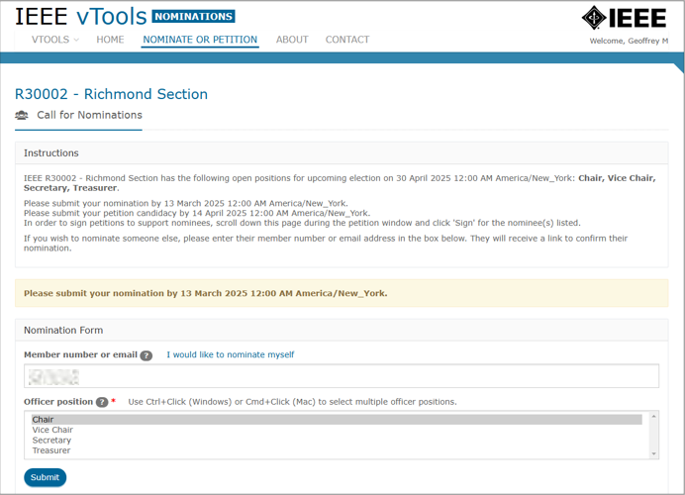
Nominations by Members Responsible: Members of the OU
You will be presented with a form where you can nominate yourself or enter another member number to nominate someone else.
You may select as many positions as desired for yourself or the member you are nominating.
Complete the form and click “Submit” at the bottom of the page.
Note: In this example, the member has nominated themselves for Chair

Slide 27
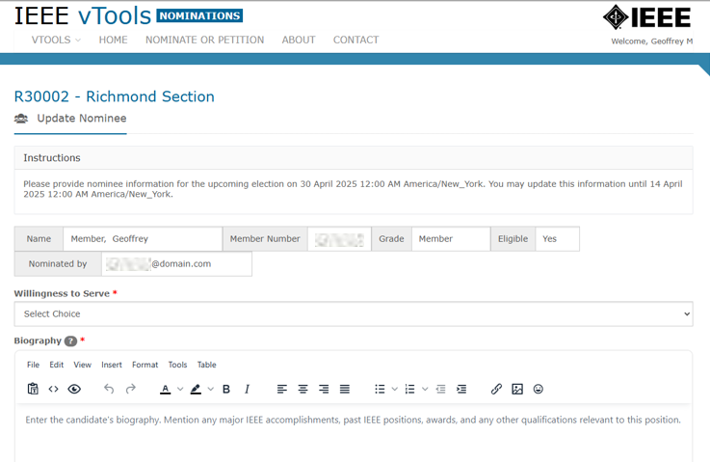
Nominations by Members Responsible: Members of the OU
When you submit your nomination, you will be brought to the page where you can add your bio and position statement(s).
If you nominated someone else, they would get a notification with a link to update their own bio and position statement(s).
Add your information to this page – you can come back to it anytime before the final slate is announced.

Slide 28
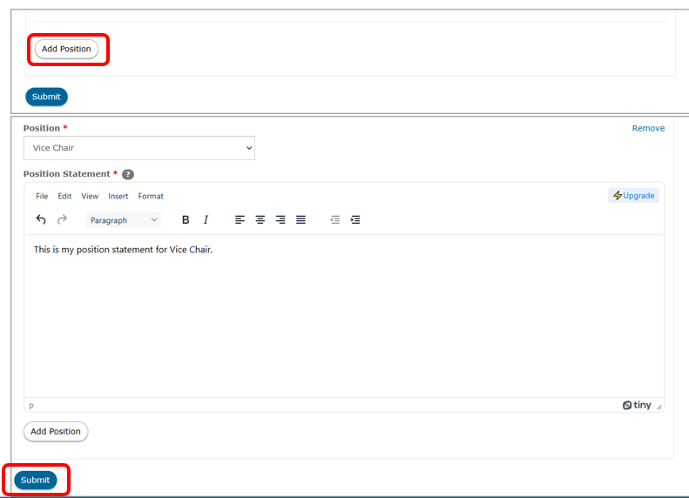
Nominations by Members Responsible: Members of the OU
If desired, you may also add another position to your nomination. To do this, click the “Add Position” button, select the new position from the drop-down menu, and complete your position statement for the new position.
Complete the form and click “Submit” at the bottom of the screen. You will see a banner saying that your changes have been submitted. You can update your information anytime before the deadline listed in the banner:
If you are done, you can now log out of the application.

Slide 29
Nominations by Members Responsible: Members of the OU
You will then be presented with a screen that shows you have submitted your self-nomination, or, if you nominated someone else, the banner would show that your nomination has been submitted, and that the nominee will receive an email to confirm their nomination:

Slide 30
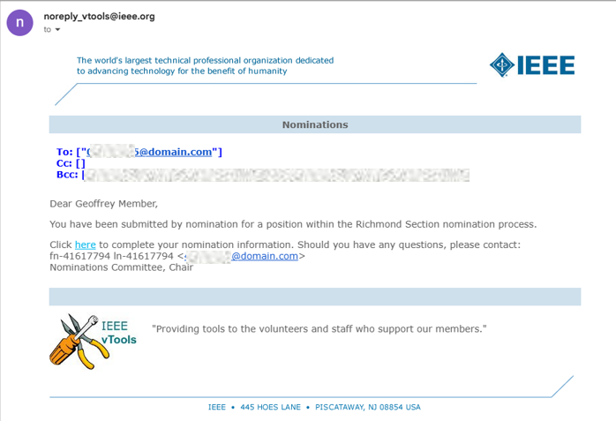
Nominations by Members Responsible: Members of the OU
The email you (or your nominee) receive will look similar to this:

Slide 31
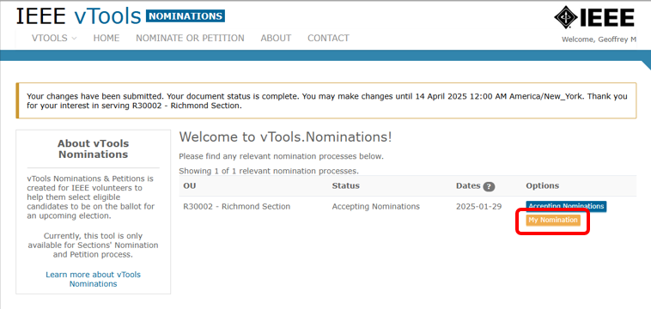
Nominations by Members Responsible: Members of the OU
If at any point you want to come back to your bio and position statement to edit it or add it (if you did not do so in the first step), sign into the tool and click on the yellow “My Nomination” button.

Slide 32
Announce First Slate of Candidates
Responsible: Election Committee Member(s)

Slide 33
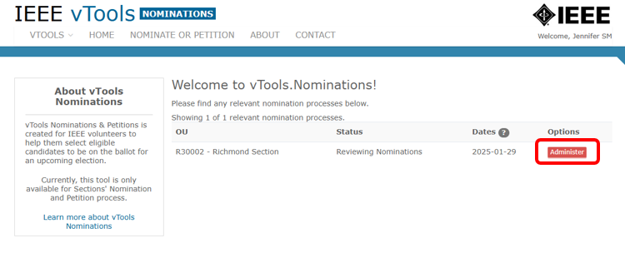
Announce First Slate of Candidates Responsible: Election Committee Member(s)
Once the Nominations Deadline has passed (based on the timeline entered earlier) and members have completed their nominations, log in to https://nominations.vtools.ieee.org using your IEEE Account.
Click the red button that says “Administer” next to your Section name and click on “Nominees” in the menu on the left. Note: You may see a message at the top of the screen showing that the First Slate of Candidates is ready to be announced (if it hasn’t already been done).

Slide 34
Announce First Slate of Candidates Responsible: Election Committee Member(s)
In the menu on the left, click on “Nominees”
You will see the list of Nominees towards the bottom of the screen, and the button to Announce First Slate of Candidates.
You may make any changes as needed, including selecting positions, or removing candidates from the ballot. If you need to update a candidate for any reason – either to add another position or update their bio/position statement – you may also do that here.
Click the blue “Update” button to do so.
If you need to remove candidates from the first slate, click the red “Remove” button. That candidate will move to the bottom of the page under “Deactivated Nominees.”
If you would like to reactivate the candidate, simply click “Reactivate.”

Slide 35
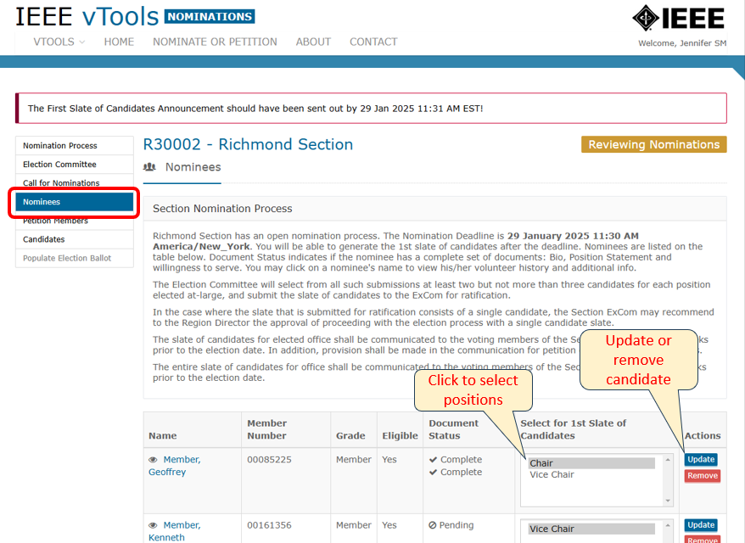
Announce First Slate of Candidates Responsible: Election Committee Member(s)

Slide 36
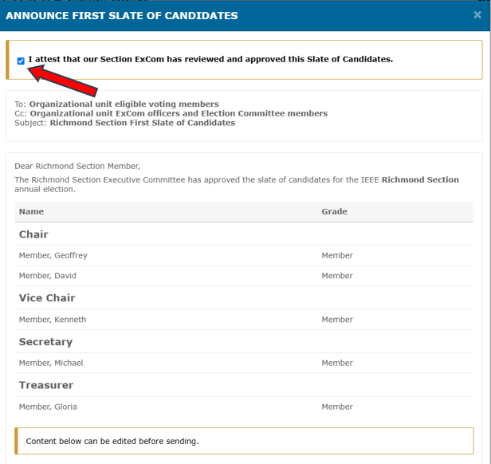
Announce First Slate of Candidates Responsible: Election Committee Member(s)
When you are ready to announce the first slate of candidates, click the button at the bottom of the page.
NOTE: Your Section ExCom must review and approve the Slate of Candidates before sending the announcement. Click the checkbox at the top to confirm.
Click “Preview” at the bottom to see a preview of the message.

Slide 37
Announce First Slate of Candidates Responsible: Election Committee Member(s)
If it looks good, click “Send.” You will now see that the announcement has gone out. It will show as “Submitted” until it is actually sent. Then it will show as “Sent.”

Slide 38
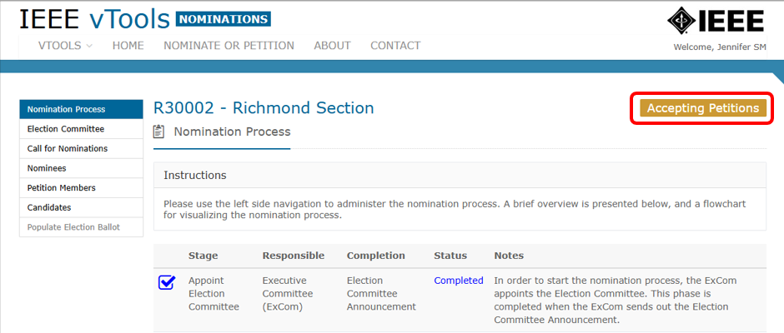
Announce First Slate of Candidates Responsible: Election Committee Member(s)
The banner at the top of the page will show that it is now accepting petitions.
You can now log out of the application.

Slide 39
Petition Candidates
Responsible: Members of the OU

Slide 40
Petition Candidates Responsible: Members of the OU
The petition process serves as a “second chance” for members of the OU to nominate themselves for the positions that have been posted.
This process happens only after the first slate of candidates has been announced, and members can only self-petition; they cannot petition for other members.
Candidates who petition at this stage will need to gain signatures from other members of the Section in order to qualify as an eligible candidate. The number of signatures needed is a percentage based on the number of members in the Section. The larger the Section, the more signatures will be required.

Slide 41
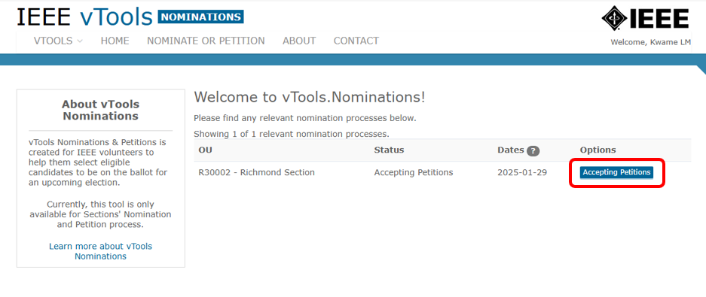
Petition Candidates Responsible: Members of the OU
Log in to https://nominations.vtools.ieee.org using your IEEE Account.
Click the blue button that says “Accepting Petitions” next to your Section name.

Slide 42
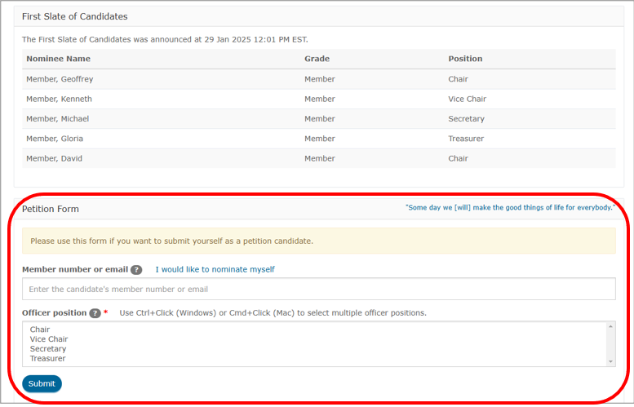
Petition Candidates Responsible: Members of the OU
Scroll to the bottom of the page and complete the Self-Petition Form. Click “Submit” once done.

Slide 43
Petition Candidates Responsible: Members of the OU
On this same page, you can also sign petitions for members that may have already been submitted. Note: To sign petitions for other members, all you need to do is click “Sign.” You do not need to fill out any additional forms to sign a petition.
You can now log out of the application.

Slide 44
Announce Final Slate of Candidates
Responsible: Election Committee Member(s)

Slide 45
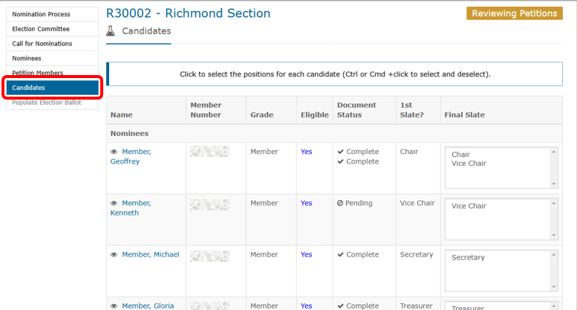
Announce Final Slate of Candidates Responsible: Election Committee Member(s)
Once the petition deadline has been reached, the Election Committee can review and announce the final slate of candidates.
Log in to https://nominations.vtools.ieee.org using your IEEE Account. Click the red button labeled “Administer” next to your Section name and select “Candidates” from the menu on the left.

Slide 46
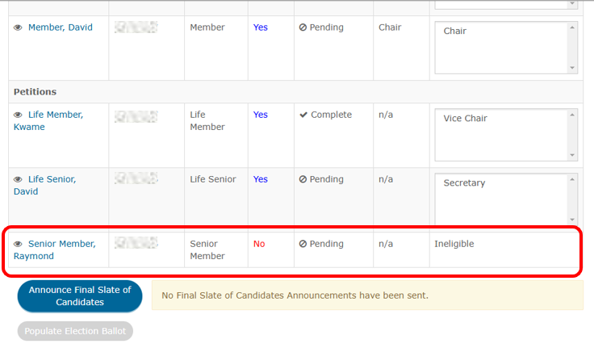
Announce Final Slate of Candidates Responsible: Election Committee Member(s)
You will be shown the list of candidates, and that the process is in the “Reviewing Petitions” phase. The first slate of candidates will be shown at the top of the page, and any petitions that were submitted will be at the bottom.
The page will also show whether the petition candidates are eligible or not. Ineligible candidates did not obtain the required number of signatures and are therefore not an eligible candidate for the ballot. You will not be able to select them for the Final Slate.

Slide 47
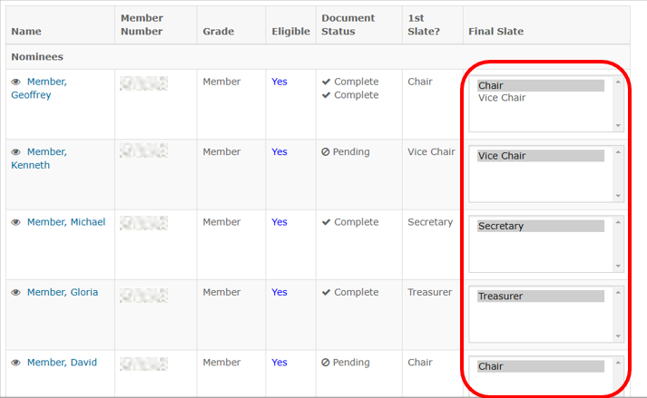
Announce Final Slate of Candidates Responsible: Election Committee Member(s)
For the candidates who are eligible, select the Final Slate position in the Final Slate column. You do not have to select the same position from the first slate, but you must select at least one position before proceeding. To select multiple positions, hold Ctrl+click (PC) or Cmd+click (Mac).

Slide 48
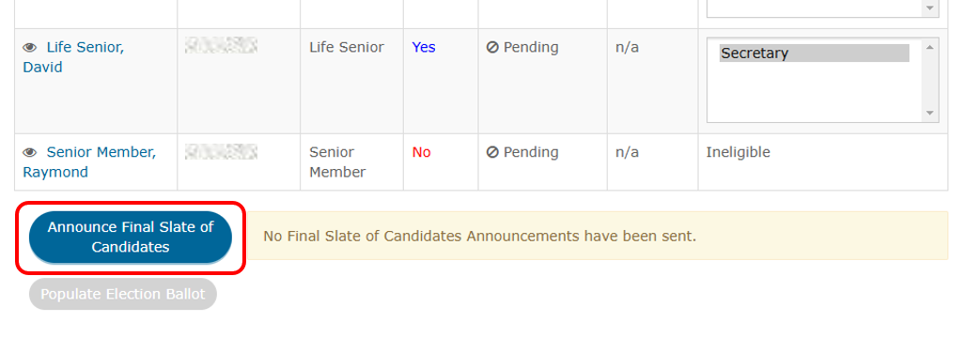
Announce Final Slate of Candidates Responsible: Election Committee Member(s)
When the final slate of candidates is ready, click the button at the bottom of the page to Announce the Final Slate of Candidates.

Slide 49
Announce Final Slate of Candidates Responsible: Election Committee Member(s)
NOTE! If you have any positions on your ballot that have only one candidate, approval from the respective Region Director is required.
A popup modal will appear allowing you to request approval for your ballot.
Click the button to do so.

Slide 50
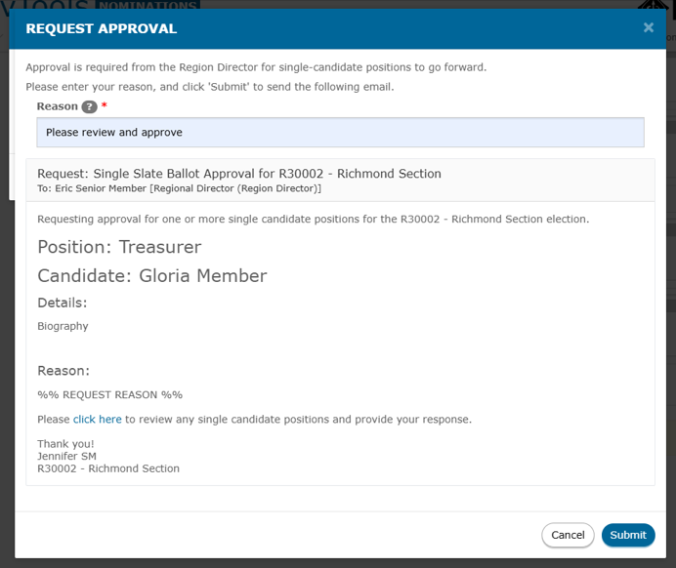
Announce Final Slate of Candidates Responsible: Election Committee Member(s) / Region Director
Another modal will appear where you can type a brief* message and submit the approval request.
When ready, click “Submit.”
The Region Director will receive an email with a link to either approve or deny the request.
*This field is not meant to type out an entire email. You only need to enter a sentence or two for the Region Director.

Slide 51
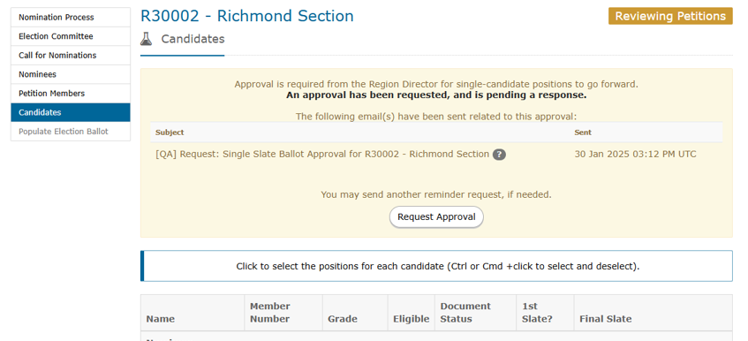
Announce Final Slate of Candidates Responsible: Election Committee Member(s) / Region Director
At the top of the page, you will see that the approval request has been sent, and that it is awaiting approval.
You can send a reminder request if you have not received approval after a few days.

Slide 52
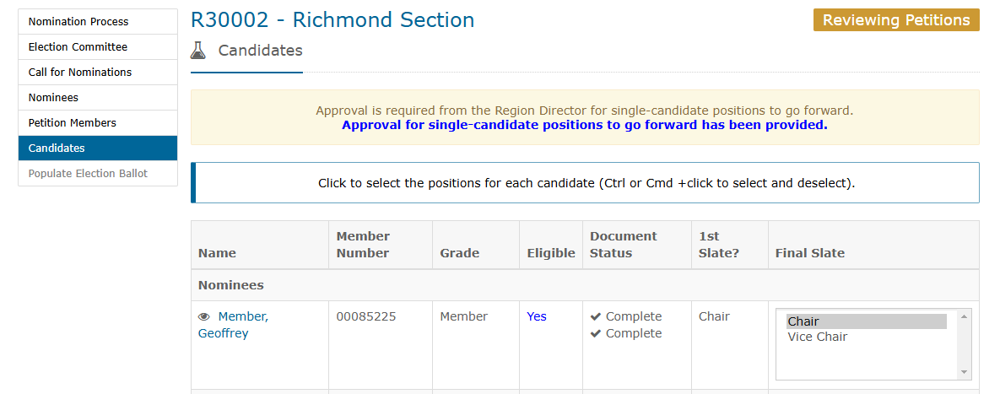
Announce Final Slate of Candidates Responsible: Election Committee Member(s) / Region Director
When approval is gained, the Election Committee will receive an email indicating the approval.
You can sign back into the application, go back to the “Candidates” page, and you will see that you now have approval.
Scroll to the bottom of the page and click the button to Announce the Final Slate.

Slide 53
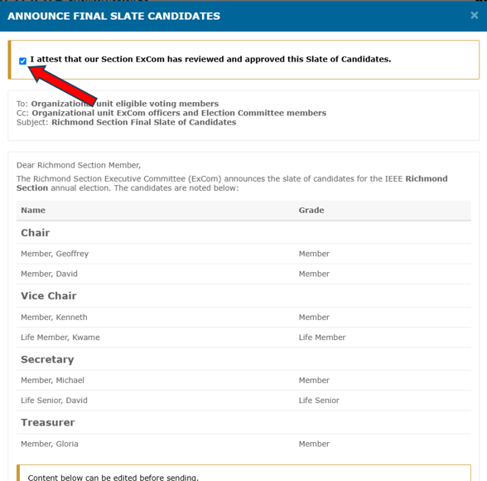
Announce Final Slate of Candidates Responsible: Election Committee Member(s)
Review the message in the pop-up box and check the box at the top of the page.
Again, ExCom review and approval is needed before sending the announcement.
Click “Preview” at the bottom of the page when ready.

Slide 54
Announce Final Slate of Candidates Responsible: Election Committee Member(s)
If the content looks good, click “Send” at the bottom of the page to send the Final Slate Announcement.
The page will show that the Final Slate of Candidates Announcement has been sent. It will initially show as “Submitted” and will change to “Sent” once it actually sends.

Slide 55
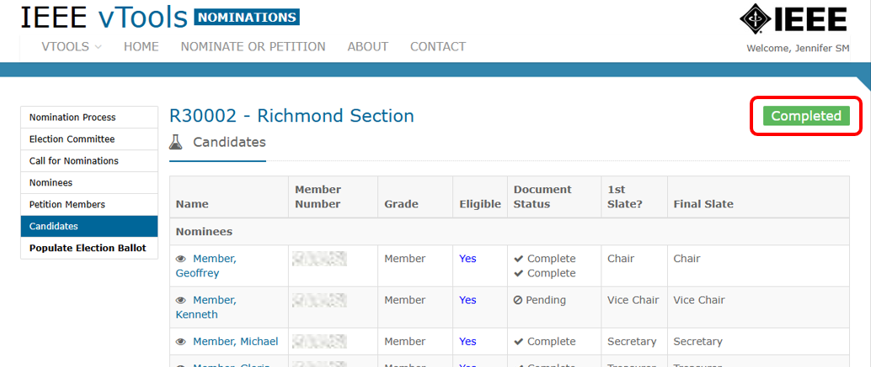
Completed Nominations Process
At the top of the page, you will see that the Nomination Process is Complete.

Slide 56
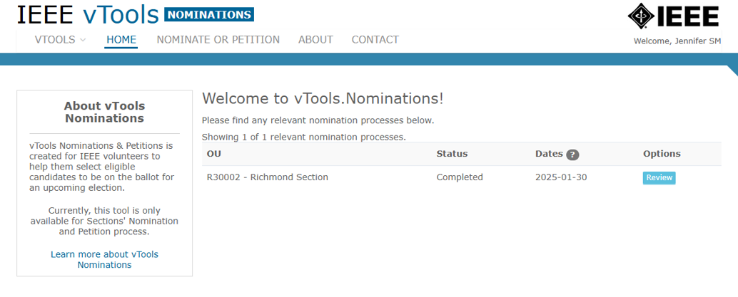
Completed Nominations Process
If you navigate to the Home page, the process will now show as Completed. You will also see a blue “Review” button that you can click to review the nominations process. Since the process is now complete, you will not be able to make any changes to any part of the process.

Slide 57
Completed Nominations Process
Congratulations! The Nomination Process is now complete!

Slide 58
Populate Election Ballot
To move the winning candidates over into vTools Voting to start your election, simply click “Populate Election Ballot” in the menu.

Slide 59
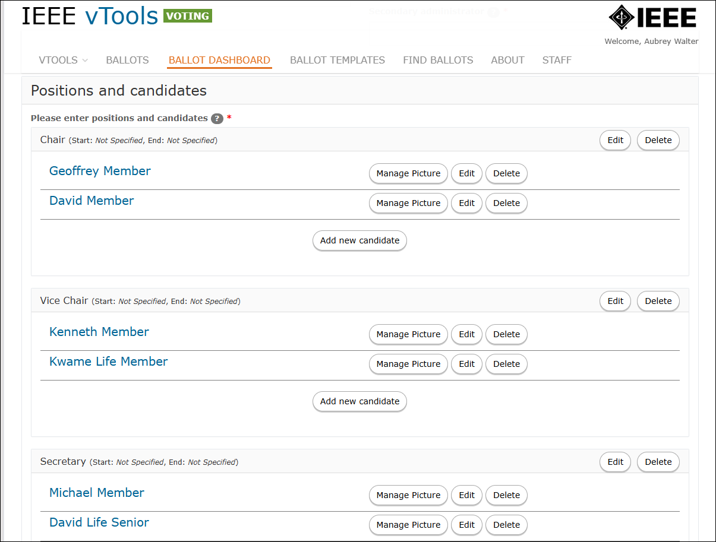
Populate Election Ballot
Your candidates will automatically populate into a new ballot. Make any necessary edits to the ballot and Save & Activate it when you’re ready.

Slide 60
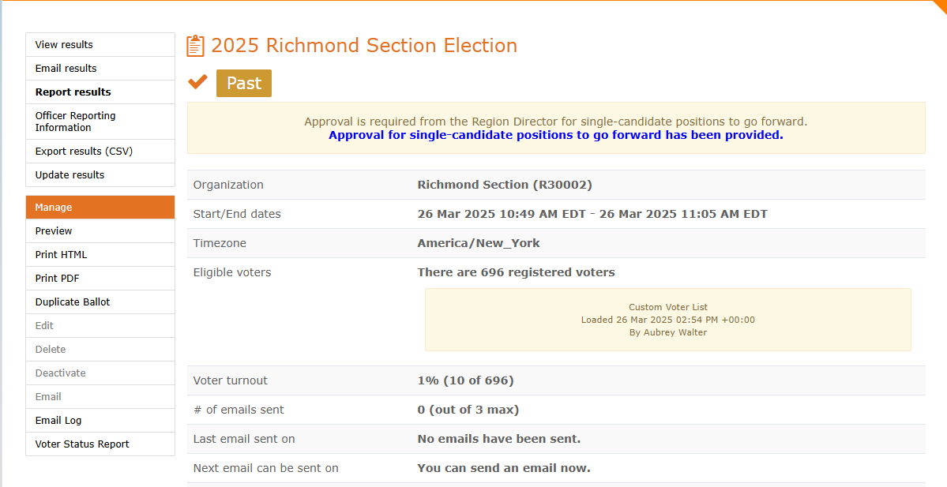
Collect Votes from Members
Members from the Section will vote as usual.
When all votes are collected, and the election has passed, you can view the results, email the results to the voters, update any manual votes, and send the results to Officer Reporting.

Slide 61
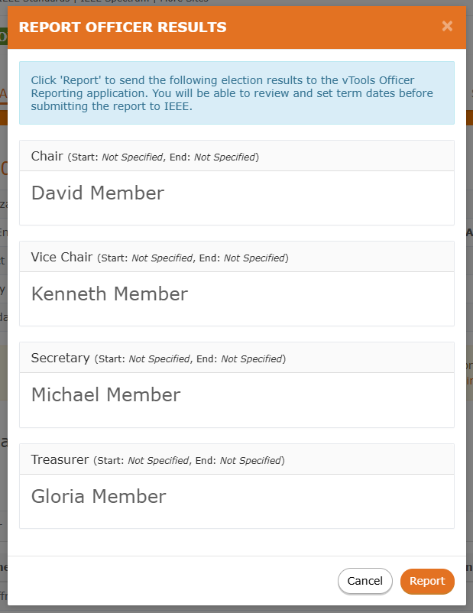
Report Results to Officer Reporting

