Slide 1
Conference Committee IEEE SoutheastCon 2027 Approval Request
30 March 2025

Slide 2
Summary
Conference Name | IEEE Region 3 SoutheastCon 2027
Location | Hilton Daytona Beach Oceanfront Resort, Daytona Beach, FL
Date | 15-18 April 2027
Theme | Launching a Space Coast Odyssey: The intersection of Technology for Humanity and the Cosmos
Financial Summary (Normalized) | Revenue: $339,315 Expenses: $259,960 Surplus: $79,355 (23% of Revenue)

Slide 3
IEEE SoutheastCon 2027 Timeline
The Conference Committee received 2 proposals for IEEE SoutheastCon 2027
Jamaica Section, 11-14 March 2027, Hilton Rose Hall and Montego Bay Convention Centre, Montego Bay, Jamaica
Joint Canaveral, Daytona, and Orlando Sections, 14-17 April 2027, Hilton Daytona Beach Oceanfront Resort, Daytona Beach, Florida
Endorsements/Approvals:
Conference Committee – Endorsed Canaveral, Daytona, and Canaveral proposal on 9 December 2024
Finance Committee – Endorsed Conference Committee decision on 14 January 2025
Executive Committee – Endorsed Conference Committee decision on 27 January 2025
While finances were a key factor in the decision, a major factor was the ability to sustain the student programs and to support students attending the regional conference outside of the United States
In addition, the committee saw logistics challenges in having providing meals and transportation for students to an off-site convention center that is not adjacent to the property
Finally, security concerns including the Department of State threat level, resulting in restrictive university policies, and the need for travel documents would impact how many students and authors would be able to attend an international conference

Slide 4
IEEE SoutheastCon 2027 Timeline
SEP 24 | OCT 24 | NOV 24 | DEC 24 | JAN 25
Evaluation Criteria and Templates
Site Visits
Proposal Preparation
Evaluate Proposals
10/16 Proposals Due
12/9 ConfCom Vote
1/27
R3 ExCom Review
1/14 FinCom Review
Questions
11/1 Questions to OUs
Prepare Presentations
11/18 Present to ConfCom

Slide 5
Local Organizing Committee
The 2027 committee draws upon experiences from the Orlando Section, which has hosted 4 previous SoutheastCons (1974, 1998, 2012, and 2023), as well as local Space Coast knowledge from Canaveral and Daytona Sections
Role | Committee Member
Chair | Macaulay Osaisai (Canaveral)
Vice Chair | Varadraj Gurupur (Orlando)
Secretary | Vincent Socci (Canaveral)
Treasurer | Jianhua Liu (Daytona) William Nutter (Assistant - Canaveral)
Technical Programs | Varadraj Gurupur (Orlando) Paul Neffenegger (Vice-Chair Canaveral)
Logistics | Keith Garfield (Daytona)
Tutorials, Workshops, and Demonstrations | Paul Neffenegger (Canaveral)
Student Programs | Giji Skaria (Orlando)

Slide 6
IEEE SoutheastCon 2027 Host Universities

Slide 7
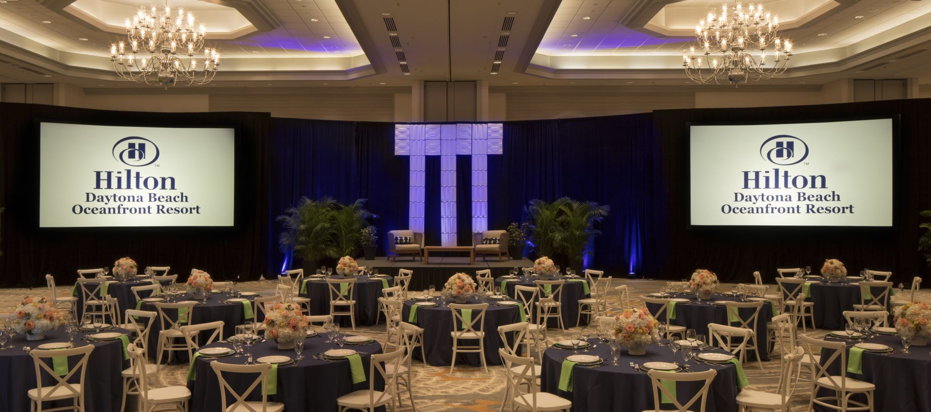
Hotel Information
The Hilton Daytona Beach Oceanfront Resort is a short drive from Daytona Beach International Airport
We have been offered a $219/night rate for IEEE SoutheastCon 2027
Orlando-Sanford (SFB) is a 50-minute drive Orlando International airport is a 75-minute drive
The conference is being offered the entire conference space (approximately 50,000 square feet) including
17,000 square foot Coquina Ballroom with 5,000 square feet of pre-function space
8,500 square foot Grand Ballroom

Slide 8
Financial Summary
Based on current budget, we anticipate a 23% surplus on revenue assuming exhibitor and patron support for the conference
Revenue | $339,315
Expenses | $259,960
Surplus | $79,355
Revenue Item | Amount
Registration | $310,875
Tutorials | $2,690
Exhibits | $15,750
Loans | $10,000
Total | $339,315
Expense Item | Amount
Registration | $33,600
Conference Logistics | $49,000
Food and Beverage | $114,908
Conference Admin | $52,542
Total | $259,960

Slide 9
Motion from Conference Committee
Motion to Approve the Canaveral, Daytona, and Orlando Sections as the Host OUs of IEEE SoutheastCon 2027

