Slide 1
Accreditation in Latin America
Tariq Durrani, VP Educational Activities
IEEE Region 9
7 April 2011
Salvador, Bahia, Brazil

Slide 2
Contents
Background to IEEE Educational Activities Board (EAB)
University level Activities
IEEE role in Accreditation of Programs
Why Program Accreditation
Proposal for establishing an Accreditation Advisory Board in IEEE Region 9 -sample body components
Discussion

Slide 3
IEEE’s Organizational Chart
IEEE Members
IEEE Board of Directors
IEEE Assembly
Chaired by the President and CEO
IEEE Major Boards
Publication Services and Products
Technical Activities
Member and Geographical Activities
Educational
Activities
Technical Societies
IEEE USA
Standards Association
Regions & Local Sections

Slide 4
EAB’s Duties
Broad planning of educational activities of the IEEE
Development and delivery of continuing education products and activities
Development of guidelines for IEEE representatives to accreditation bodies
Monitoring of accreditation activities
Coordination of pre-university education programs
Development and delivery of university education programs
Representation of the IEEE in matters regarding engineering education

Slide 5
EAB’s Guiding Principles
IEEE is obligated to provide its members, and others concerned with IEEE’s technical fields of interest, with high quality educational opportunities
IEEE needs to educate and foster a dialog with the public on technological and engineering questions, with an emphasis on young people who may consider engineering as a career path

Slide 6
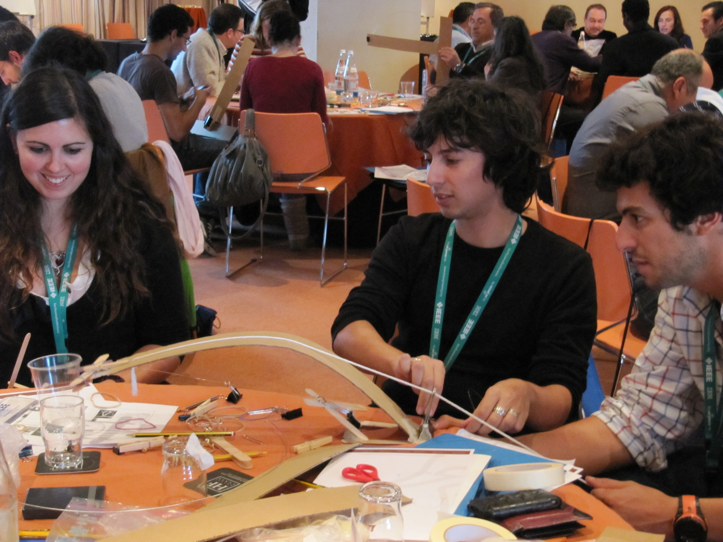
EAB Principal Activities
Pre-University Education
TryEngineering.org
Teacher In-Service Program
Engineering Projects in Community Service (EPICS)
University Education
Accreditation (US and non-US)
Technical English Program (on-site training workshops for volunteers)
IEEE HKN

Slide 7
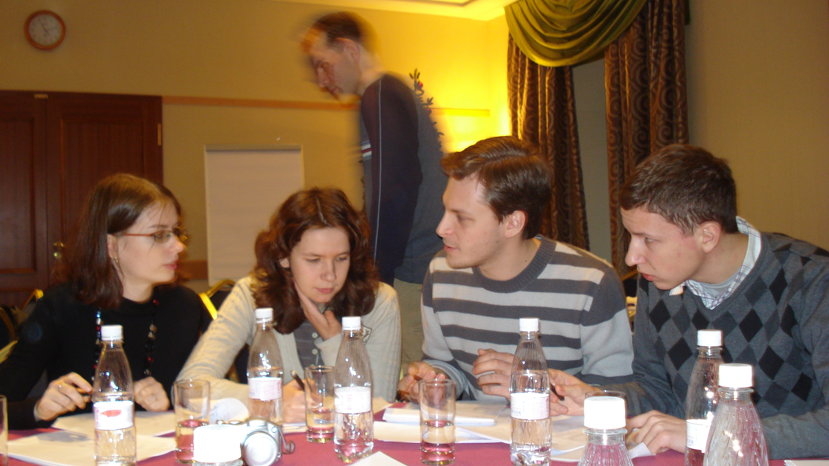
EAB Principal Activities
Women In Engineering
WIE Magazine (August & Dec issues)
Standards Education
IEEE Position Paper on Standards in the Curriculum
To expand and promote an on-line presence focused on education about standards

Slide 8
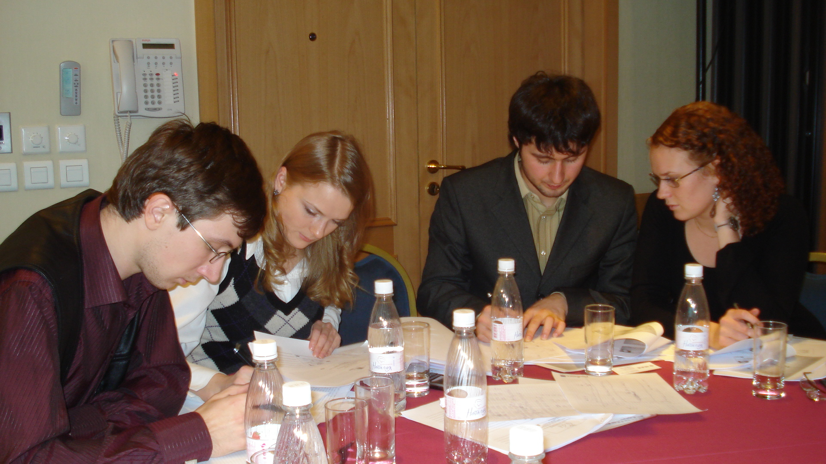
EAB Principal Activities
Continuing Education
IEEE eLearning Library
Professional Certification
English for Technical Professionals (on-line)
Expanding Continuing Education across IEEE

Slide 9
University Level Activities
T

Slide 10
University-level Activities
Objectives:
Improve academic curricula and ensure their purposeful adaptation to the changing technical and business climate
Improve delivery and effectiveness of engineering education
Improve retention of engineering and technology students

Slide 11
University Level Activities
T
Accreditation Outside the US

Slide 12
IEEE’s Role in Accreditation (1)
IEEE considers accreditation a key vehicle to ensure active involvement of the Institute in maintaining the quality and relevance of an engineering, computing and technology education
IEEE seeks a leadership role in program accreditation within all the areas of its technical activities

Slide 13
IEEE’s Role in Accreditation (2)
IEEE seeks leadership in accreditation worldwide
Including support in development and administration of accrediting bodies
IEEE seeks to develop and support local accrediting bodies where such bodies do not exist at the present time

Slide 14
EAB’s Recent Accreditation Projects
Development of IEEE’s policy on accreditation
Development of a comprehensive on-line resource on accrediting bodies and mutual recognition agreements
Assistance to emerging accrediting bodies and accreditation projects worldwide:
China, the Caribbean, and Peru

Slide 15
Inventory of Activities
Regional workshops on trends in accreditation
In the past: Bangkok, Bratislava, Helsinki, Lima
- Nomenclature Workshop in Lima
Assistance to existing accrediting bodies
Formation of new accrediting bodies
“follow the volunteers”
Address all aspects of ECT

Slide 16
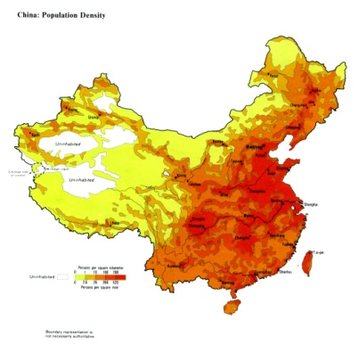
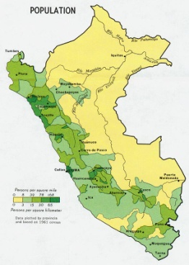
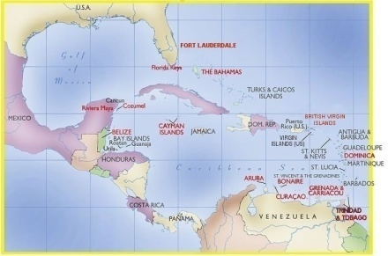
Where do we operate now? (1)
Ongoing Areas:
China: “Working Group on Education in China” with the Ministry of Education and China Association of Science and Technology (CAST)
Peru: ICACIT, evaluation visits are happening
The Caribbean: new accrediting body for programs taught in English (CACET)

Slide 17
Where do we operate now? (2)
Work in progress areas include:
India, in conjunction with the National Accreditation and Assessment Council
Middle East, involving 6-7 countries
5-7 countries in southern/eastern Africa
Computing nomenclature effort in Region 9

Slide 18
Where do we operate now? (3)
Future possibilities:
Thailand
Spain
Advise/support on Region/continent wide accreditation in Latin America
ARCU-SUR on IEEE Fields of Interest (engineering & technology).
Indonesia

Slide 19
Training session for Peruvian program evaluators, Lima – December 2006

Slide 20
Training session for Peruvian program evaluators, Arequipa – December 2007

Slide 21
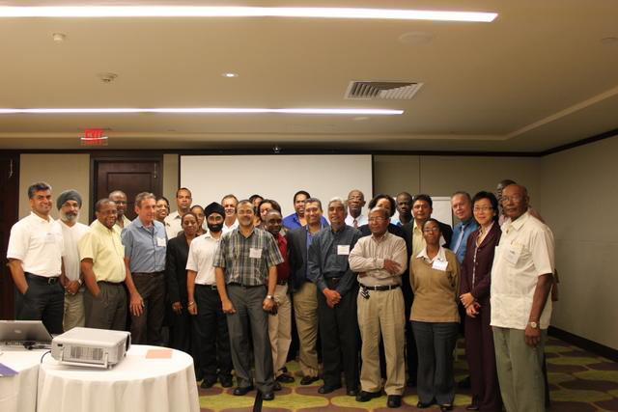
CACET Program Evaluator Training , May 2010

Slide 22
Why Program Accreditation? (1)
Help Institutions:
- assess the quality of their engineering, computing and technology degree programs
- develop and apply their own strategies for continuous program improvement
Provide opportunities for Industry to:
- reflect their particular needs and expectations for the knowledge and skills of new graduates
- participate in the formation and application of accreditation criteria

Slide 23
Why Program Accreditation? (2)
Allow Nations to seek membership in various global accords that support the mutual recognition of degree programs in engineering, computing and technology
Enable cross-national academic program alliances and partnerships
For individual student -Ease of admission to Masters Degree Program when coming from an Accredited undergraduate program

Slide 24
Why Program Accreditation? (3)
Facilitating the movement of faculty, students and ideas more easily among institutions and across national boundaries
Providing assurance to:
- prospective students and parents that a degree program has met threshold quality standards for curriculum content, admission and degree requirements, and institutional stability
- prospective faculty that a program has adequate financial and intellectual resources to support its stated mission

Slide 25
Why Program Accreditation? (4)
Facilitate the evaluation and transfer of course credits and other academic credentials across geographic boundaries
Assuring employers, graduate admissions officers and some licensing bodies in other nations about the integrity of degrees awarded by an accredited institution in the “home” country
Creating a culture of continuous improvement

Slide 26
Accreditation Advisory Board and Supporting Organisations
Advisory
Board
Country
1
Country 2
Org.3
Org 4

Slide 27
Why an Accrediting Advisory Board for Latin America? (1)
Providing various forms of support to entities and individuals in a single country or a small group of countries that wish to create an accrediting body, to include:
informing key constituents about the meaning and significance of program accreditation
facilitating meetings of academic, business and/or government organizations with a shared interest in accreditation

Slide 28
Why an Accrediting Advisory Board for Latin America? (2)
assisting in the design of accreditation criteria and procedures
helping develop processes to identify and train volunteers to serve as evaluators on campus visit teams and on accreditation policy committees
helping develop organizational governance structures
helping to develop their own evaluators and/or interchange evaluators with other countries

Slide 29
Why an Accrediting Advisory Board for Latin America? (3)
Providing support, as needed, to existing independent accrediting agencies
Sponsoring and/or facilitating region-wide dialog and cooperative activities on accreditation, to include:
Organizing efforts to create mutual recognition agreements among member organizations,
helping to find program evaluators from outside one nation when conflict of interest requirements cannot be resolved within a country.

Slide 30
Sample Accrediting Advisory Board Components
A Board of Directors:
IEEE members and
Representatives of National Accreditation Boards
Subcommittees responsible for advice on:
Creating accreditation criteria
Program evaluator recruitment and training
Finance
Governance
Operations
Administrative Staff

Slide 31
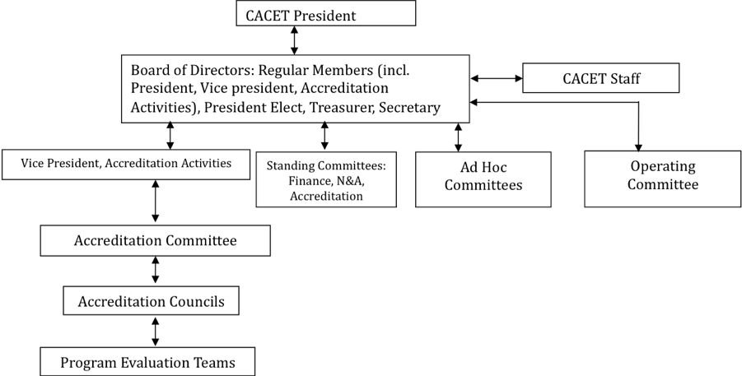
Sample Organizational Structure

Slide 32
Our Request
The R9 Committee agrees to work with IEEE EAB to investigate the need, benefits, processes and resources needed to establish an Accreditation Advisory Board for Latin America

Slide 33
Thursday 7 April 2011 16.10-16.40 pm.
TRACK C Salon A
Development of Accreditation Programs in R9 countries.

Slide 34
Questions or comments?

