Slide 1
Summary Status of ICOPS-2011
The 38th IEEE International Conference on Plasma Science
June 26 – 30, 2011, Chicago, USA
(24th IEEE Symposium on Fusion Engineering)
Ahmed Hassanein
Presented at
IEEE NPSS-PSAC ExCom
Salt Lake City – 13 November, 2011

Slide 2
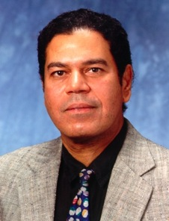
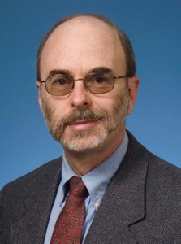
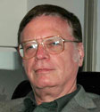
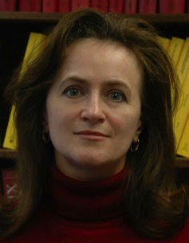
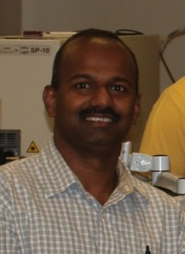
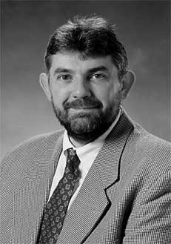
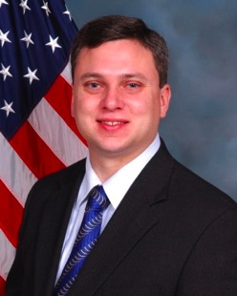
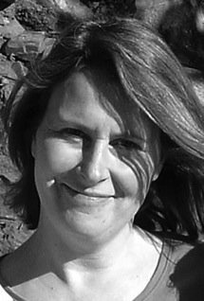
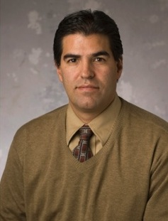
ICOPS Committee
Ahmed Hassanein
General Chair
Steven Gold
Technical Chair
Jeffrey Brooks
Treasurer
Tatyana Sizyuk
Secretary
Sivanandan Harilal
Local Committee Chair
Christopher Deeney
Students Awards
Keith Cartwright
Student Travel Grant
Christine Coverdale
Students Awards
Jean Paul Allain
Mini Course

Slide 3


















Our Sponsors and Supporters

Slide 4
Our Sponsors and Supporters
Purdue University
Princeton Plasma Physics Laboratory
Department of Energy
Air Force Office of Scientific Research
Atomic Energy Society of Japan
ITER International Organization
ITER-China
ITER-India
ITER-Korea
ITER US
Lawrence Livermore National Laboratory
National Nuclear Security Administration
National Science Foundation
Naval Research Laboratory
NumerEx
Sandia National Laboratories
Institute of Electrical and Electronics Engineers
IEEE - Nuclear and Plasma Sciences Society

Slide 5
Conference Format
Was a joint ICOPS and SOFE conference:
One registration fee for both meetings
Separate Technical Program
Three Joint ICOPS/SOFE Plenary talks
Separate Banquets
One mini-course

Slide 6
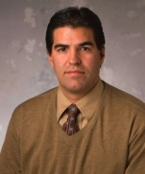
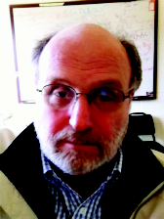
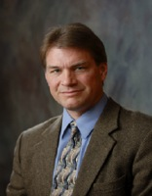
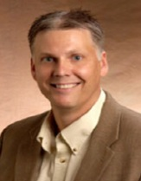
Mini-Course
Plasma-Material Interactions in Fusion and Industrial Plasmas
Total of 15 attendees
Jean Paul Allain, Associate Professor
Purdue University
Dr. Predrag S. Krstic, Physicist
Oak Ridge National Laboratory
David Ruzic, Professor
University of Illinois, Urbana-Champaign
Brian Wirth, Professor,
University of Tennessee Knoxville

Slide 7
ICOPS Technical Program
536 papers accepted
5 plenary talks (3 joint ICOPS/SOFE, 2 ICOPS)
208 oral presentations
326 poster presentations
38 Countries represented
80 Student Papers
Eligible for Student Paper awards

Slide 8



Joint Plenary Talks
Monday 8:30
Dr. Donald L. Cook ”The Importance of High Energy Density Plasma Science to NNSA's Defense Programs Mission”
Tuesday 8:00
Dr. Bryan J. Rice “EUV Lithography: A Semiconductor Industry Application of Plasma Physics”
Tuesday 8:45
Dr. Jiangang Li “The Future of Fusion”

Slide 9
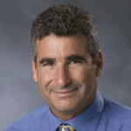

Two ICOPS Plenary Talks
Wednesday 8:00
Dr. Thomas Katsouleas “Hanging Ten to the Tenth on a Plasma Wave: the Grand Challenge of Extending the High Energy Frontier”
Thursday 8:00
Dr. Paul Bernhardt “Probing the Ionosphere with Rockets and Radio Waves: A Study of Plasma Waves and Instabilities in the Upper Atmosphere”

Slide 10
IEEE Awards and Complimentary Registration
IEEE Curie Award to Ned Birdsall
PSAC Award to Tom Katsouleas
NPSS Early Achievement Award to Kostantyn Ilyenko
PSAC Outstanding Student in Plasma Science Award to Chao Chang
Complimentary Registration for IEEE Life Members (4)

Slide 11
Two FTC Awards
2011: Remmelt Haange, ITER International Organization
2010: Michael Ulrickson, Sandia National Laboratories

Slide 12
Student Awards and Support
Two best student submissions received cash awards of $500 each and a Certificate ($1000)
Two runners-up received a Certificate
One best paper award for SOFE ($500)
Two Phelps Grants to attend Mini-Course ($750)
25 Students from 9 countries received the Travel Grants (25K)
75 applications were received
Grants covered registration fee
And 4 hotel nights

Slide 13
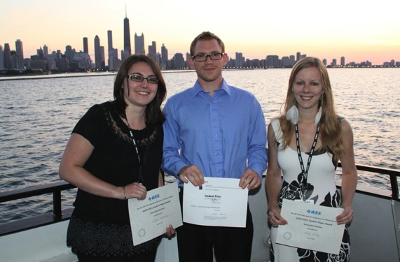
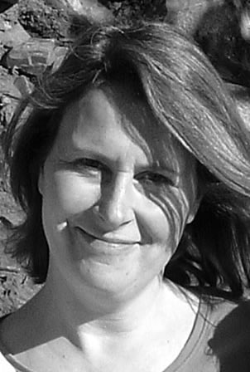
Student Awards Recipients
27 nominations for Student Paper awards
Winners:
B.B. Yang (not in photo), University of Wisconsin-Madison
E.H. Martin, ORNL/NCSU
Runners-up
E. Nedanovska, Queen's University Belfast, UK
K. McKay, Loughborough University, UK

Slide 14
Technical Program
Status Report
Notes:
14

Slide 15
Technical Program
Status Report
Notes:
15

Slide 16
ICOPS Program

Slide 17
ICOPS Program

Slide 18
ICOPS Registrations
ICOPS registrations | 497
Life Fellow | 4
IEEE Student member/Retired/Unemployed | 116
Non-Member Student | 53
Student travel grant recipient | 25
IEEE Members pre-paid (includes IEEE Student member / Retired / Unemployed) | 220
IEEE Members on-site (includes IEEE Student member / Retired / Unemployed) | 46
Non-members pre-paid | 160
Non-members on-site | 42

Slide 19
ICOPS Publications
Conference abstracts were distributed on USB memory stick.
Manuscripts of plenary and invited oral presentations will be published in a special issue of the IEEE Transactions on Plasma Science in 2012.
Guest Editors for this Special Issue:
A. Hassanein (Purdue), S. Gold (NRL), Harilal (Purdue)

Slide 20
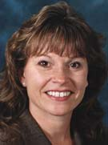
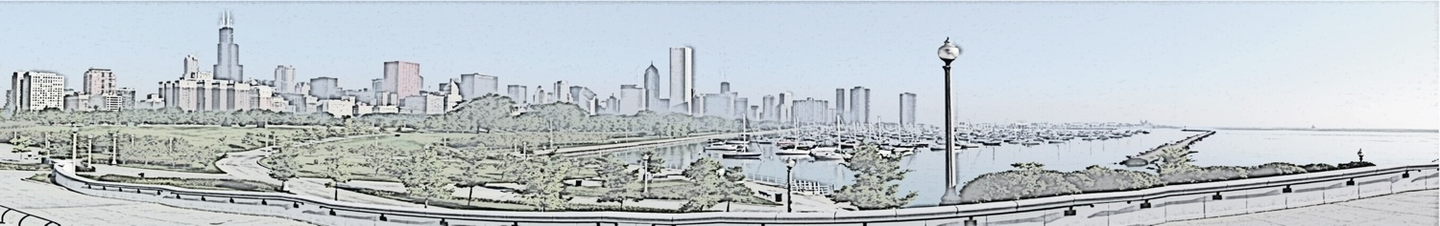
Free Reception & Social Events
(No charge to attendees)
Sunday Evening: Welcome Reception for Attendees
Monday Evening: Reception for Women in Engineering and IEEE members
Dr. Jane Lehr, Keynote Speaker
Monday Evening: Students Reception

Slide 21
Joint ICOPS/SOFE Social Events
Sunday and Monday Receptions:
$40,000 for Food & Beverage
$8,000 for Entertainments

Slide 22
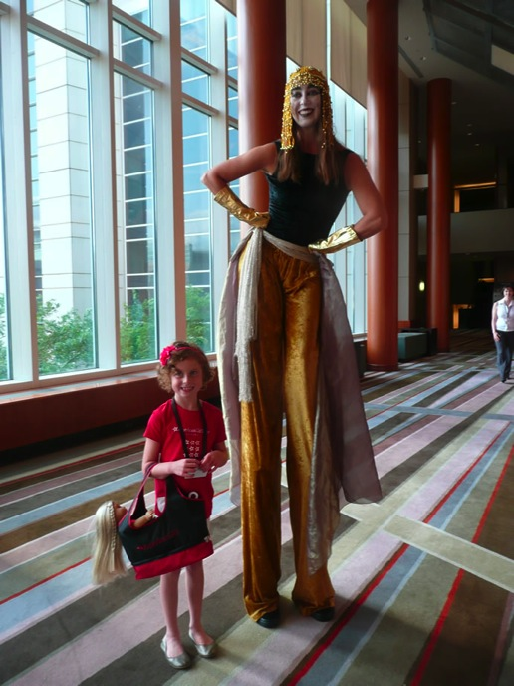
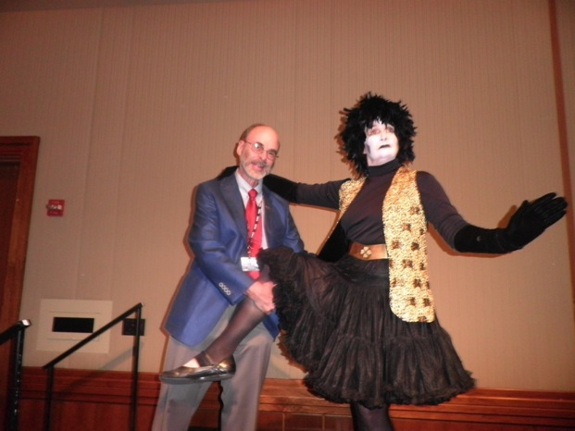
Joint ICOPS/SOFE Social Events
Sunday and Monday Receptions:
$40,000 for Food & Beverage
$8,000 for Entertainments

Slide 23
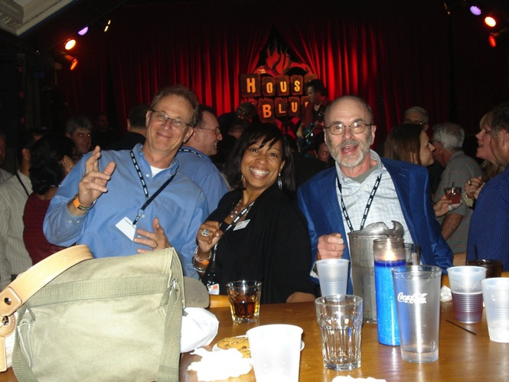
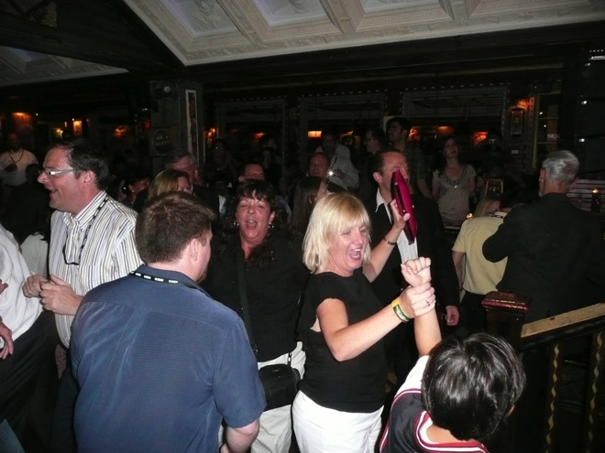
Tuesday Social Event
Tuesday Evening: House of Blues - ICOPS/SOFE Restaurant Exclusive
($30 ticket)
Total for House of Blues: $15,600 for Food & Beverage
$5,000 for Entertainments

Slide 24
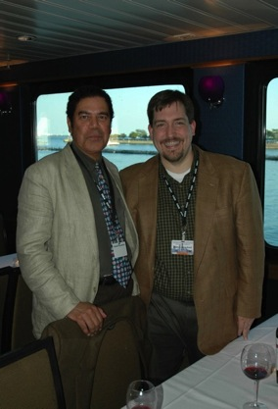
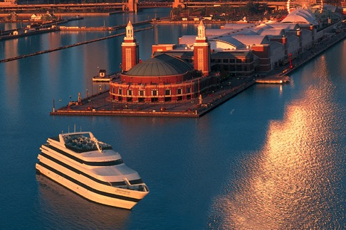
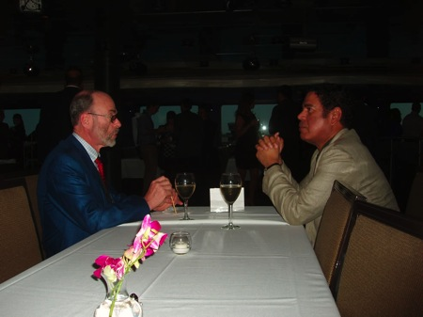
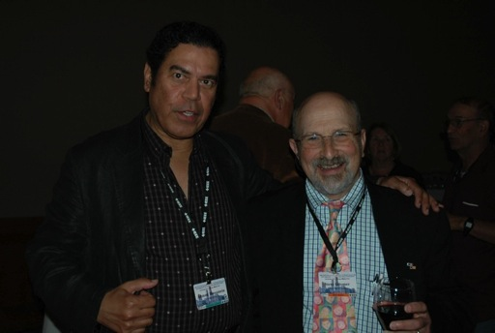
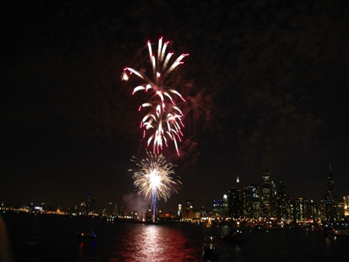
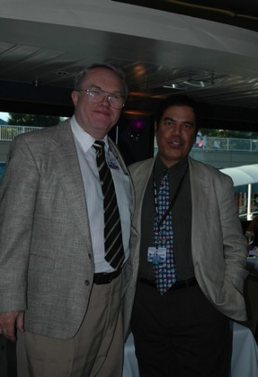
ICOPS Banquet
Odyssey Cruise with Live Music and Fireworks
Total for ICOPS banquet: $45,000

Slide 25
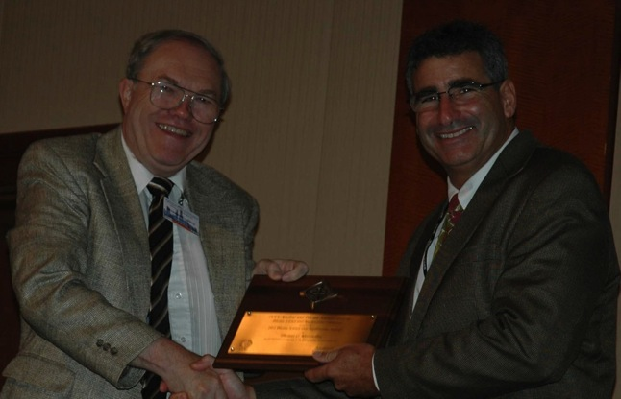
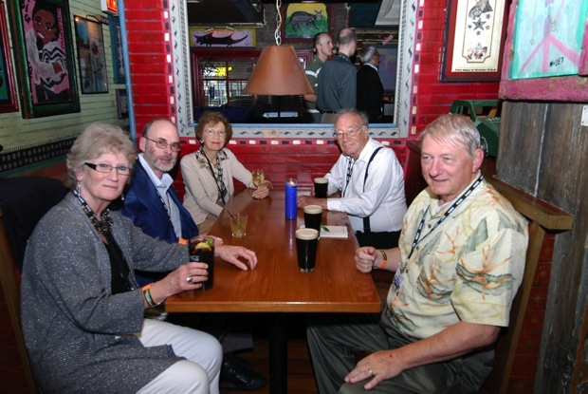
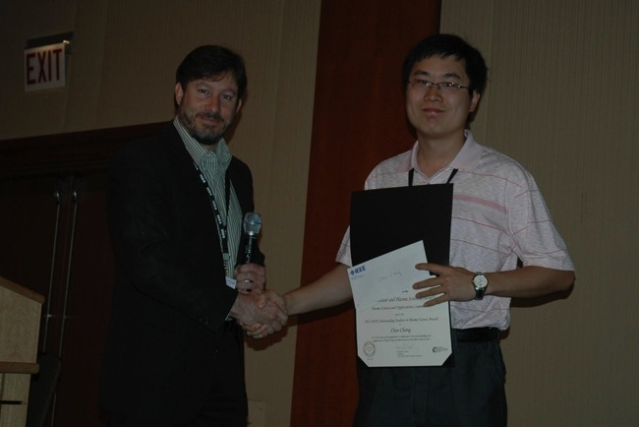
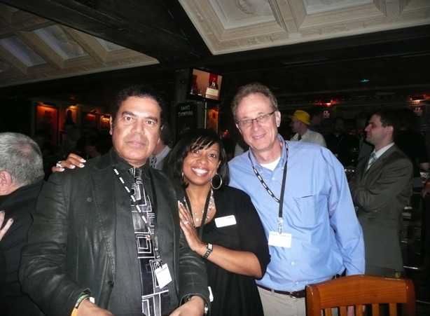
Minutes from ICOPS

Slide 26
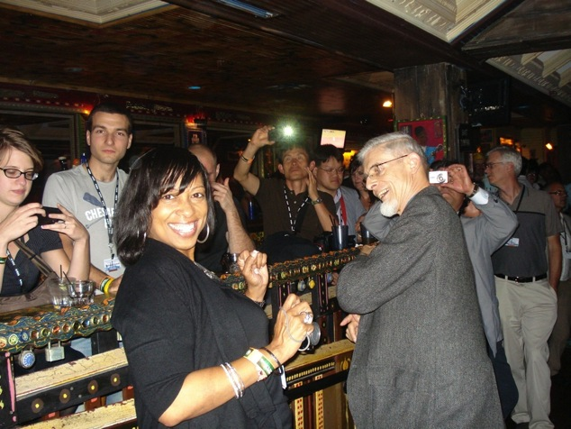
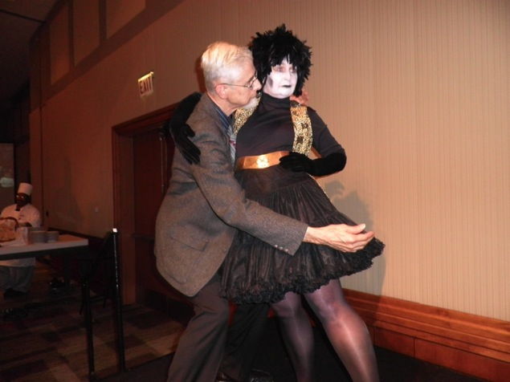
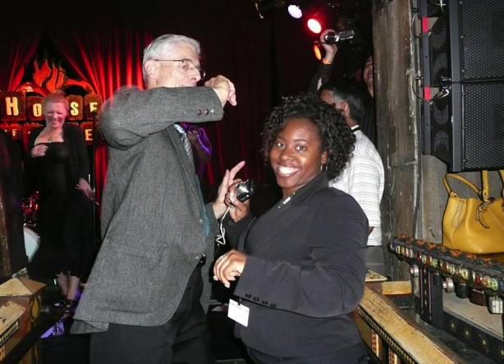
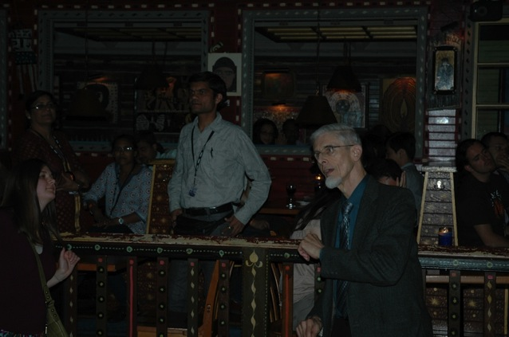
Most Energetic Person Award

Slide 27
Balance Sheet ICOPS/SOFE 2011
Preliminary numbers:
$650 k income
$440 k expenses
$60 k surplus, in the order of 15% of expenses
Cover several new items from our budget:
Phelps grants, Travel Grants, and Awards ($27K)
Two FTC Awards ($6+K)
MCM Management ($60K)
Current standing issues
SOFE Publication Costs
MCM final cost
IEEE A/V cost
Excom, Audit fees, etc

