Slide 1
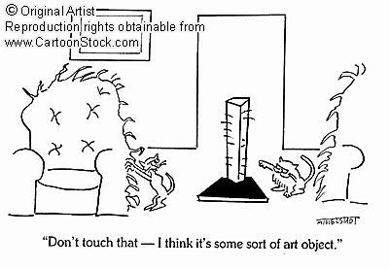

Designing Haptic Interaction for Individuals who are Blind and Visually Impaired
Dianne Pawluk
Virginia Commonwealth University
Contact Information
Department of Biomedical Engineering
Engineering East Hall, Rm. 2240
Virginia Commonwealth University
PO Box 843067
Richmond, VA 23284
E-mail: dtpawluk@vcu.edu

Slide 2
Outline
Simple Motivating Example
User Population
Other Issues
Weaknesses of haptics
Strength of haptics
Designing for haptics’ strengths
Designing to avoid haptics’ weaknesses
Summary

Slide 3
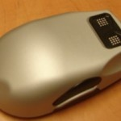
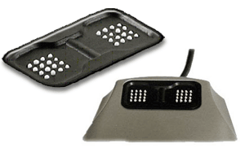
Motivating Example: Tactile Mice
With vision,
What problems?
Problems when haptics alone (Rastogi et al., 2009; Jansson et al., 2006, Wall and Brewster, 2006):
  Inaccurate position information:
  - sensitive to path length, speed, mouse orientation, borders
  Optical sensor not co-located with position of the pins
  - rotation of the mouse not taken into account

Slide 4
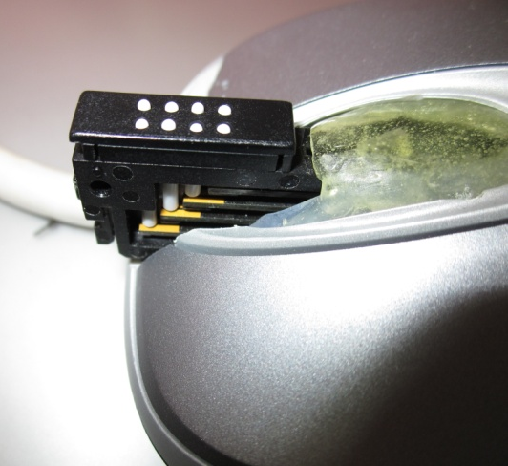
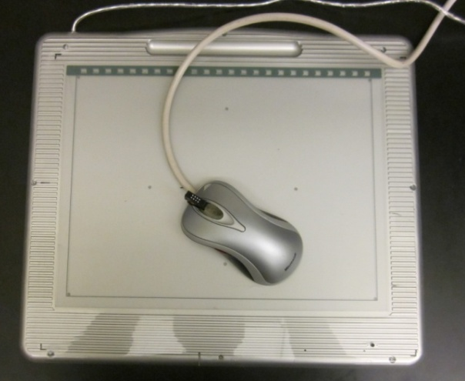
Motivating Example: Tactile Mice
Solutions:
  Use a graphics tablet with a stylus in one hand and a stationary tactile mouse in the other hand (e.g., Wall and Brewster, 2006)
  Put an RF transmitter to the tablet immediately under the mouse pins
  - avoids increased mental load of having to integrate information from two hands (Rastogi et al., 2009)
  - typically a factor of:
  10x decrease in translation position errors
  20x decrease in rotation errors
Notes:
Also showed that these translated into perceptual errors in an angle discrimination task. An increase of 80%
In the number correct and the amount of time taken decreased by 28%.

Slide 5
Variations in the User Population
Degree of Blindness
  Low vision: individuals with reduced vision even when using the best possible glasses or contact lens correction available
  Totally blind: no light or form perception
  Different Effects:
    Loss of resolution usually both
    Contrast sensitivity
    Degradation of the center of the field
    Degradation of the peripheral field
    Degradation of random parts of the field
Low vision
Totally blind

Slide 6
Variations in the User Population
Degree of Blindness
  Design Considerations:
    Do provide redundant, correlated visual feedback as well as tactile feedback
    Visual items/diagrams should provide (Edman, 1992):
      Good contrast of color value
        Colors can be adjusted for individual’s preference
      Simplification of the display
        “Clutter” can be confusing
Low vision
Totally blind
Notes:
To check for contrast, use a black and white photocopying machine

Slide 7
Variations in the User Population
Multiple Impairments
  Deaf-blind
    Can span the range of hearing impairment as well as vision
    Do not have access to one of the common senses used to substitute for vision – i.e., audition
  With tactile impairments
    Many people become blind as a result of diabetes, this can also lead to neuropathy in the peripheral nerves which causes them to lose sensation in the fingers
  With cognitive impairments
    e.g., TBI

Slide 8
Variations in the User Population
Multiple Impairments
  Deaf-blind/Lack of touch-blind
    Does suggest that redundantly encoding information both haptically and with audition would be best
    However, there may be some benefit to distributing the cognitive load between senses depending on the task
  With cognitive impairments
    The learning process for your system is important for all users

Slide 9
Variations in the User Population
Using Braille
  Only a small percentage (10%) of individuals who are visually impaired are Braille readers
Experience with Touch
  The effects of blindness on the sense of touch is much less clear than for other sensory modalities (Norman and Bartholomew, 2011):
    Mixed results for tactile acuity (even with the same method)
    Mixed results for 2-D raised line drawings
    3-D shape recognition: those who were blind after having some visual experience seemed to perform the best
  With training/experience, individuals who are visually impaired may perceive better with touch – this may only be of benefit for the particular task trained on.
  There is an even greater amount of variability between individuals
Notes:
Van Boven and Sathians experiments both used matched in age and sex, and both used Braille readers.

Slide 10
Variations in the User Population
Experience with Touch
  One must design for a great variability between individuals, which may not depend on experience
  As individuals have a greatly varying amplitude threshold, allowing an amplitude adjustment for individuals may minimize fatigue and adaptation
Notes:
Van Boven and Sathians experiments both used matched in age and sex, and both used Braille readers.

Slide 11
Variations in the User Population
Previous Experience with Vision
  Congenitally blind – blind since birth
  Adventiously blind – blind later in life
  1 year, experience with reaching and moving
  Later, experience with graphics and words
Possible that those who are adventiously blind have improved performance for raised-line drawings over those who are congenitally blind or sighted (Heller, 1989)
  Visual exposure combined with tactile experience are important
  Has been suggested that this is due to visually mediation of the picture (e.g., Lederman et al., 1990) but recent work (Behrman and Ewell, 2003) does not support this reasoning
  The importance of visual exposure may be due to learning the rules of pictorial representations (Heller, 1989)
Notes:
Note that Kennedy and Fox in an earlier study found that the blind (both congenital and adventiously blind) performed
Worse than sighted. In this experiment congenitally and sighted were equal.
In this study, some late blind did say used visual imagery some did not. Think that would get the same results if had same exposure
to learning tactile diagrams.

Slide 12
Variations in the User Population
Previous Experience with Vision
  Visual exposure combined with tactile experience are important
  The importance of visual exposure may be due to learning the rules of pictorial representations (Heller, 1989)
  Suggests that having a methodical, rules based representation that can be taught easily would work best
Notes:
Note that Kennedy and Fox in an earlier study found that the blind (both congenital and adventiously blind) performed
Worse than sighted. In this experiment congenitally and sighted were equal.
In this study, some late blind did say used visual imagery some did not. Think that would get the same results if had same exposure
to learning tactile diagrams.

Slide 13
Other Considerations
User centered design is crucial
  A large number of devices/systems for individuals who are blind and visually impaired are rejected by them
  Interaction with the target population throughout the design process
Cost and portability
  Most individuals who are blind and visually impaired live below the poverty line
Reliability and Maintainability
  Best to use a universal device as much as possible
  - both can be crucial to an individual who cannot afford a slow turn around time on fixing the device due to small quantities being made

Slide 14
Weaknesses of Haptics
Lower spatial resolution as compared to vision
  For touch:
    for the fingertips, approximately 1mm (Johnson and Phillips, 1981)
    for the back, approximately 40mm (Weinstein, 1968)
  For vision:
    for the fovea, 1 arc minute for 20/20 vision or, i.e., approximately 0.15mm from a distance of 0.5m (Wikipedia,, 2012).
  Approach of Manual Tactile Diagram Makers (Hasty,2012):
    Eliminate unnecessary details
    Have multiple diagrams, some of which are enlarged versions of certain parts which one cares about the details

Slide 15
Weaknesses of Haptics
Limitations when determining geometry
  Detailed geometry is determined using contour following (Lederman and Klatzky, 1990)
  Most likely a limited field of view (i.e., number of fingers that can be used at once) for 2-D graphics
    Loomis et al., 1991 – little difference between one and two fingers held together
    Jansson and Monaci (2003) – found no difference even when trying to facilitate this by having two fingers track opposite sides of a diagram
    Craig (1985) – better with one finger than two fingers of the same hand or different hands.
    Klatkzy et al. (1993) – better with 5 freely moving fingers than 1
      Alternately could be due to guided exploration by the remaining fingers

Slide 16
Weaknesses of Haptics
Limitations when determining geometry
  Contour following with a single finger is a slow, laborious process and is very demanding on higher levels of perceptual processing
  Problems with manual raised line drawings:
    Difficult to determine which line belongs to outside or inside an object part
    Difficult to determine which lines are for perspective
    Interpreting raised line drawings of common objects is very poor (e.g., Loomis et al., 1991)
    Unless cued in some way such as by category (Heller et al., 2005), Way and Barner (1997).

Slide 17
Strengths of Haptics
Availability of Object Properties:
  (Klatkzy et al., 1987)
  Looked at texture and hardness (material properties); shape and size (geometric)
  Free sort under haptic unbiased and biased conditions
    Texture and hardness more salient
  Free sort under haptics w vision, or haptic w visual bias
    Shape (and to some extent size for haptics w vision) more salient
  Texture and hardness more salient than shape and size for unbiased haptics

Slide 18
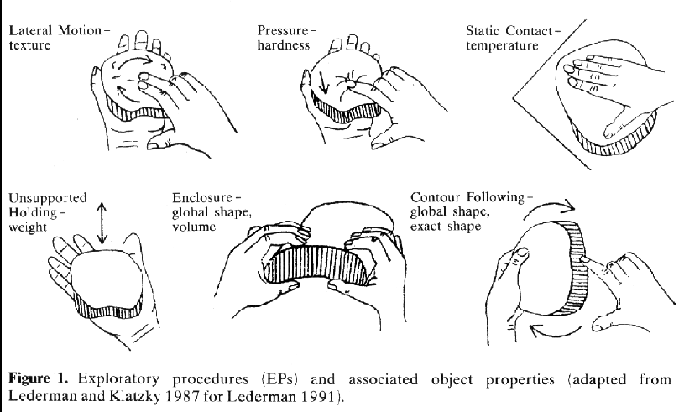
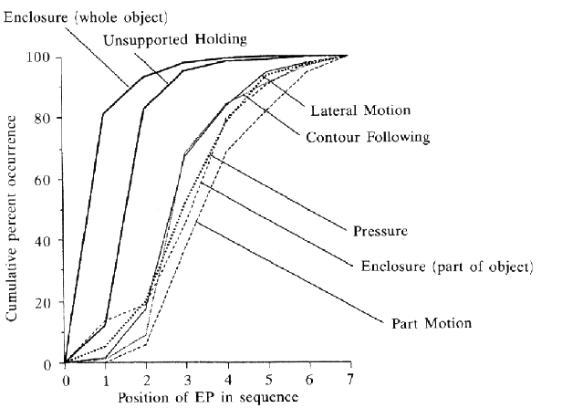
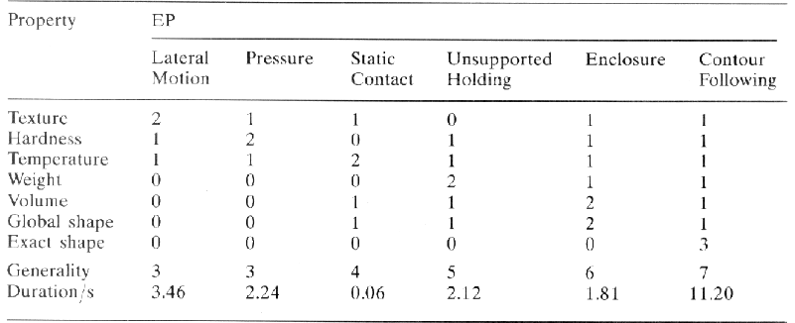
Strengths of Haptics
Availability of Object
Properties
  Modeling the exploratory
  procedures to extract them
  (Klatkzy and Lederman, 1993)
  The exploratory procedures that are used under unbiased haptic encoding
  are generally found to be rapid and accurate
Notes:
Also note that to get the benefit of some of these EPs, we need a whole hand1
Also note that enclosure requires the whole hand rather than one finger

Slide 19
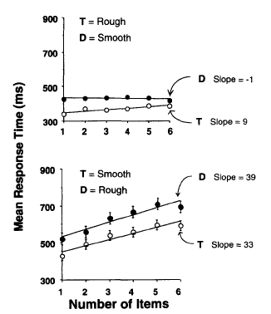
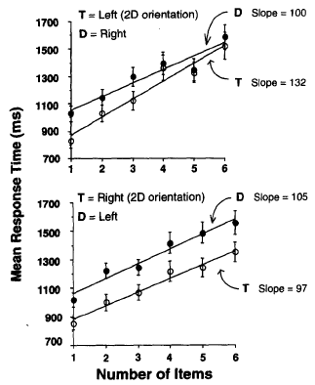
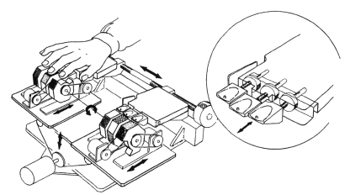
Strengths of Haptics
Availability of Object Properties (Lederman and Klatzky, 1997)
  Task: search for a target amongst distractor objects
Apparatus
Rough vs Smooth Left vs Right Planar Orientation
E.g., of parallel E.g., of serial
Notes:
T Rough amongst smooth
D distrators only
Then bottom diagram is for the reverse

Slide 20
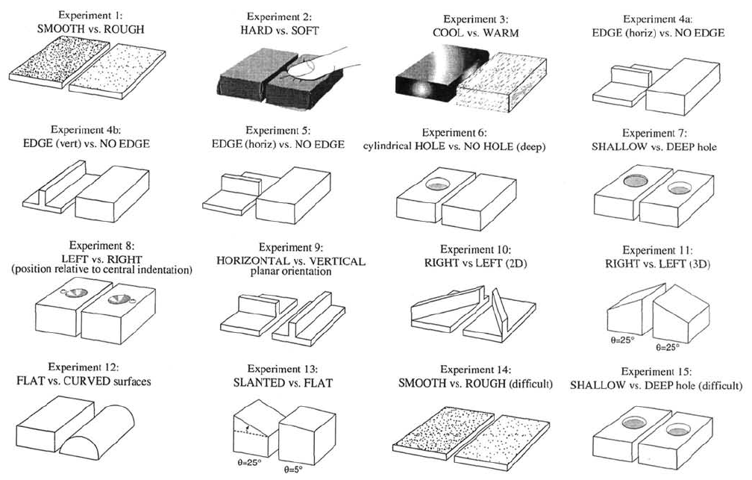
Strengths of Haptics
Availability of Object Properties (Lederman and Klatzky, 1997)
  Material properties and abrupt discontinuities are processed earlier and in parallel, as compared to detailed shape information
Most in parallel
material properties
abrupt
discontinuities
detailed shape
Most serial
Intensive
Spatial
The “one-time” processing component was significantly more for detailed shape too.
Notes:
T Rough amongst smooth

Slide 21
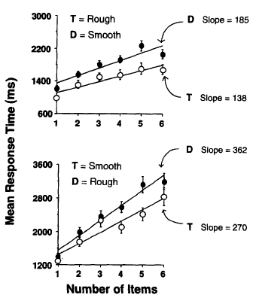
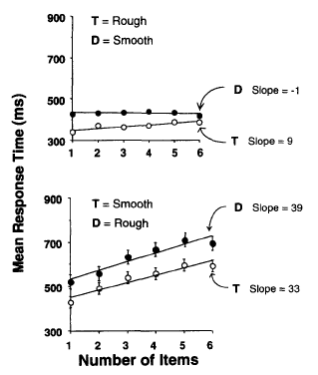
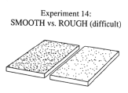
Strengths of Haptics
Availability of Object Properties (Lederman and Klatzky, 1997)
  Caveat: for more difficult discriminations => becomes more serial in nature, one-time processing increases
Difficult, in terms of
ratio of spacing between
dots
2:1 4:1
How easy it is to discriminate your items will affect performance!
Notes:
T Rough amongst smooth

Slide 22
Haptic Exploration of 3-D Shape
Lakatos and Marks, 1999
In the beginning, use distinguishing local features (like sharp points or deep surface occlusions) more to determine similarity
Later, uses more global shape to determine similarity
Plaisier et al., 2009
Edges and vertices were most salient
Performance did not depend on the number of them
We have similarly noticed for raised line drawings on a tactile display:
participants will look for easily discriminable features first
they will only explore more globally if the first method doesn’t work
If possible, use distinguishing local features to discriminate objects/icons

Slide 23
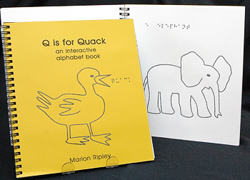
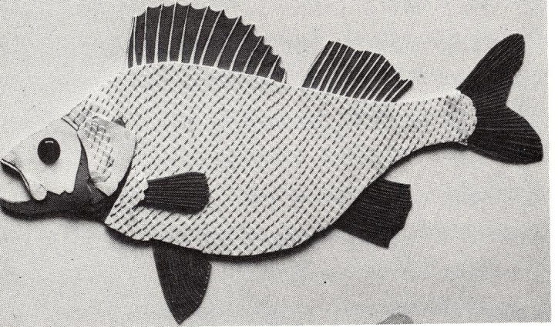
Designing for Haptic’s Strengths
Material Properties:
Lessons From Manually Created Diagrams (Edman, 1992)
  Raised line diagrams
  Serially processing so….
    Difficult to determine parts
    Which lines are perspective
  Tactile experience pictures
    Solid textures delineate parts
    Potential parallel processing
    Much more effective than raised
    line drawings

Slide 24
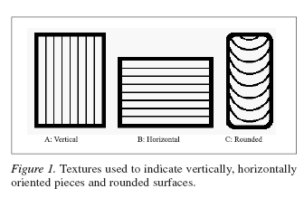
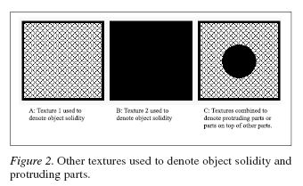
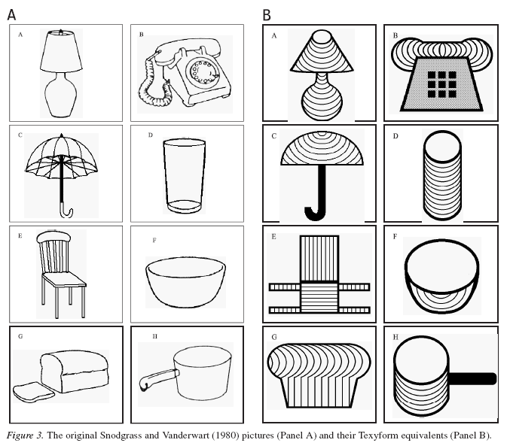
Designing for Haptic’s Strengths
Material Properties:
Encoding Information with Texture (Thompson et al., 2006)

Slide 25
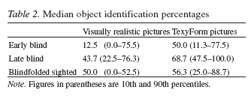
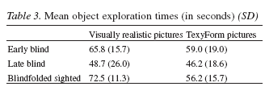
Designing for Haptic’s Strengths
Material Properties:
Encoding Information with Texture (Thompson et al., 2006)
Limitations:
- Cannot distinguish different parts and 3-D orientation at the same
time
- Did not investigate on how this impacted performance with
varying number of fingers (used 5 fingers always)

Slide 26
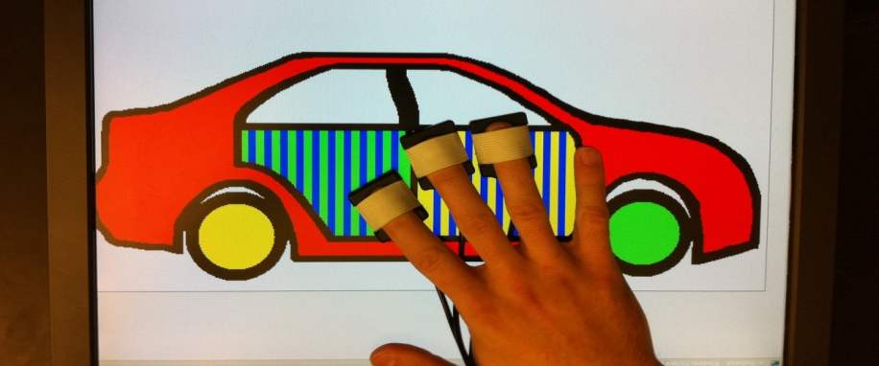
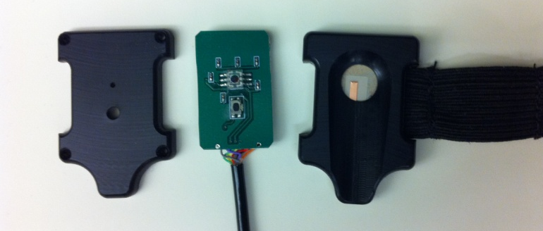
Designing for Haptic’s Strengths
Material Properties:
Using texture to encode information on a haptic display (Burch & Pawluk, 2011)
Three finger display
Scanning over a computer
monitor
(A) the pinhole aperture;
(B) the RGB sensor;
(C) pushbutton switch; and
(D) piezoelectric actuator

Slide 27
Designing for Haptic’s Strengths
“Texture” Set Chosen:
(Burch and Pawluk, submitted a,b)
Determined through extensive evaluation
Temporal frequencies (12, 25 and 50 Hz) to represent separate parts
Spatial frequency modulation of the temporal frequency and a 100 Hz square wave
  With orientations of horizontal, vertical, diagonal and none to represent part orientation
94% accuracy of identifying parts, 90% accuracy identifying part orientation
Selection of Texture Set
Wanted two dimensions
  1st dimension separate into parts (at least 3 distinct values)
  2nd dimension part orientation (horizontal, vertical, curved, unspecified)
High saliency/discrimination is necessary to:
  Processing information quickly and easily
  Potentially lead to parallel processing (at least for search tasks)

Slide 28
Designing for Haptic’s Strengths
Experiment
Using texture to encode information on a haptic display (Burch and Pawluk, 2011)
Two factors:
  Raised line or texture representations
  One finger or three fingers
Asked to identify common objects from one of four (equalized) sets of 8 objects for each condition
Recorded answer and exploration time
7 participants: (3) totally blind, (4) visually impaired
Hypotheses:
Improved accuracy from one finger raised-line to one finger textured due to enriched representation; times will both be long due to serial nature of processing information
2. Improved accuracy and shorter time from one finger textured to three fingers textured due to parallel processing
3. No improvement from one finger raised line to three fingers raised line (only detailed geometry)

Slide 29
Designing for Haptic’s Strengths
Results:
Significant difference between 1 and 3 fingered textured graphics
No difference between 1 and 3 fingers raised line graphics
Nominal difference between 1 finger raised line and 1 finger textured
Suggests parallel processing occurred for texture even though not a search task
Results with POINT CONTACT displays approach that of Thompson et al.

Slide 30
Designing to Overcome Haptic’s Weaknesses
Lower spatial resolution as compared to vision
  Approach of Manual Tactile Diagram Makers (Hasty,2012):
    Eliminate unnecessary details
    Have multiple diagrams, some of which are enlarged versions of certain parts which one cares about the details
  Design Solutions:
    Eliminate unnecessary details
    Provide a zoom function that is available on-demand
      Allows user to: - have independent access to all information
      - active control

Slide 31
Designing to Overcome Haptic’s Weaknesses
Zooming:
  Walker and Salisbury (2003) – smooth zooming, with force feedback “detents”
  Magnuson and Rassmus-Grohn (2003 – logarithmic step zooming
  Ziat et al. (2007) – linear step zooming
  The first two studies implemented panning
    Magnuson and Rassmus-Grohn (2003) looked at:
      Pressing on the edge (limit box) to scroll
      Arrow keys
      Drag
      surprisingly the Arrow keys were liked the best
      (but note: only one participant blind of the six)
Notes:
The blind subject thought the drag function was the most natural

Slide 32
Designing to Overcome Haptic’s Weaknesses
Zooming: Potential New Weakness with Haptics Only
  Serial nature of tactile processing
  Determining appropriate zoom levels
    Cannot take a quick glance as in vision, must process info serially
    Chosen level may not reveal new detail
    May not be any further detail to look at
    Wijntjes and his colleagues (2008) also showed better identification rates with larger pictures even when smaller pictures are perceptible
      Mean Accuracy: 0.84 cf. 0.77, Mean Response Latency: 51 cf. 47 sec
  Displays may be cropped
    Cannot easily infer that are cropped as no parallel processing
    How much to pan?

Slide 33
Designing to Overcome Haptic’s Weaknesses
“Intelligent Zooming”
  Schmitz and Ertl (2010) with street maps
    Basic zooming steps
      all streets, remove residential road, remove all road and leave towns or suburbs
    Found no fixed zooming levels were effective to deal with “clutter”
      Instead based on the density of streets, main streets or suburbs in the observed region
      No clear results on use (also small sample size, between factor)
  Rastogi and Pawluk (submitted) with pictures
    Navigate zoom levels based on relational grouping of objects
    Scale object/sub-object to optimally fit display area

Slide 34
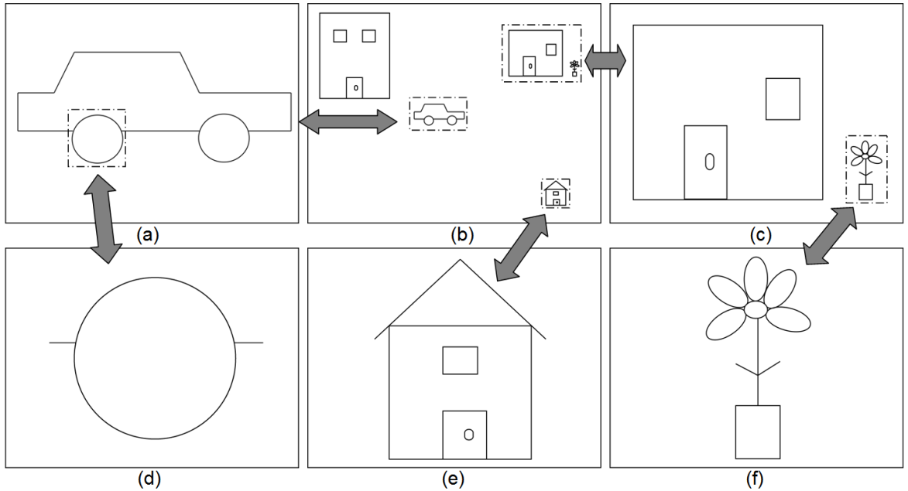
Designing to Overcome Haptic’s Weaknesses
Rastogi and Pawluk
    Navigate zoom levels based on relational grouping of objects
    Scale object/object part to optimally fit display area
    If no object/object part, do not zoom, give feedback
    Object close together are considered a meaningful cognitive component

Slide 35
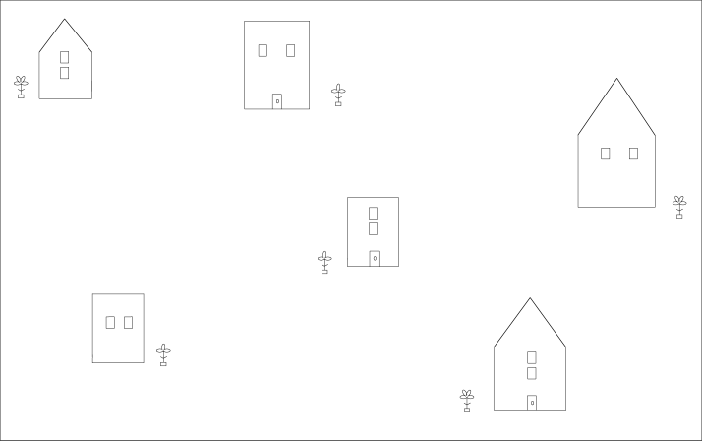
Designing to Overcome Haptic’s Weaknesses
Comparison to Logarithmic and Linear Step Zooming
Example Diagram
Tablet
Haptic Device
What type of roof does the house have?
How are the windows oriented?
Is there a door in the house?
Which side of house is the plant located?
How many petals are there on the flower?

Slide 36
Designing to Overcome Haptic’s Weaknesses
Comparison to Logarithmic and Linear Step Zooming
Experimental Design
    17 individuals who were blind or visually impaired
    Each participant were presented with all 3 methods counterbalanced in presentation order
        6 diagrams, 2 each per condition, counterbalanced across conditions
        Response variables: number of correct answers
        time taken per question
        system usability survey (Brooke, 1986)

Slide 37
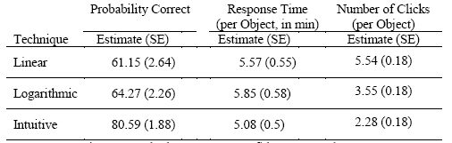
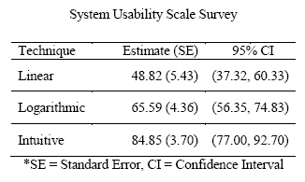
Designing to Overcome Haptic’s Weaknesses
*SE = Standard Error, CI = Confidence Interval
Comparison to Logarithmic and Linear Step Zooming
“Intuitive” zooming holds potential for improvements when using pictures

Slide 38
Designing to Overcome Haptic’s Weaknesses
Limitations in Processing Geometry
  Approach of Manual Tactile Diagram Makers (Hasty,2012):
    Simplify boundaries
    Eliminate unnecessary detail for the task at hand
    Both are designed to avoid overwhelming the user with information
  Design Solutions:
    Can do the above dynamically
      Allows user to: - have independent access to all information as
      they need it
      - don’t have to feel it all at once
      - active control

Slide 39
Designing to Overcome Haptic’s Weaknesses
Limitations in Processing Geometry
  Exploration of different types of simplification for tactile diagrams (Ravi and Pawluk, submitted)
    Experiments designed to examine the potential usefulness of:
      Boundary simplification
        Observation: - straight lines are easier to track than
        convoluted lines and likely easier to
        process as well
        - more details may be necessary for some
        queries
      Contextual simplification
        Dynamically remove content not needed for that instance
        Similar to visual “filter” and “relate” (Dykes et al., 2005)

Slide 40
Designing to Overcome Haptic’s Weaknesses
Experiments
  Used geographical maps for their complexity and frequency of use
    Imaginary countries were used to avoid bias
  Used the tactile device shown previously
  Presented diagrams with no simplification and the specific type of simplification to assess performance differences
  Recorded: accuracy of answers, time needed, perception of difficulty and confidence in use
  8 participants who were blind or visually impaired

Slide 41
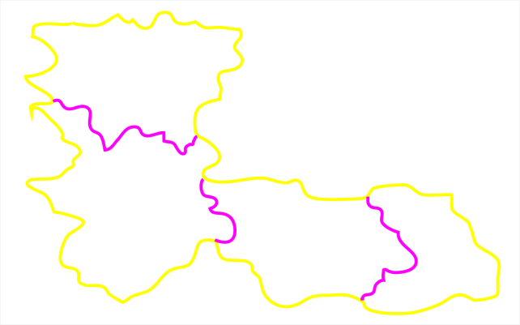
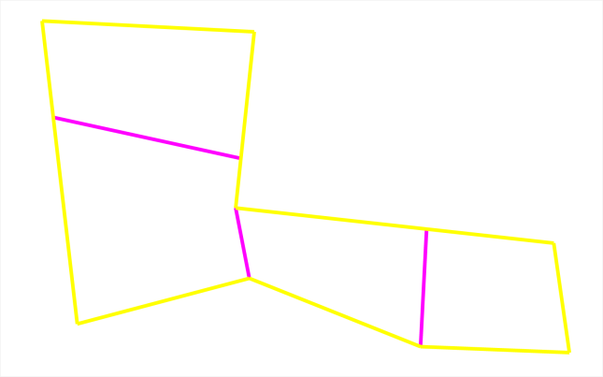
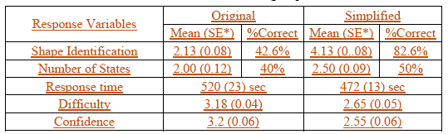
Designing to Overcome Haptic’s Weaknesses
Is Boundary Simplification Helpful?
Helpful for shape identification but not for number of states
Difficulty and Confidence differences were statistically significant
Questions Asked:
1) General shape of country
2) Number of states

Slide 42
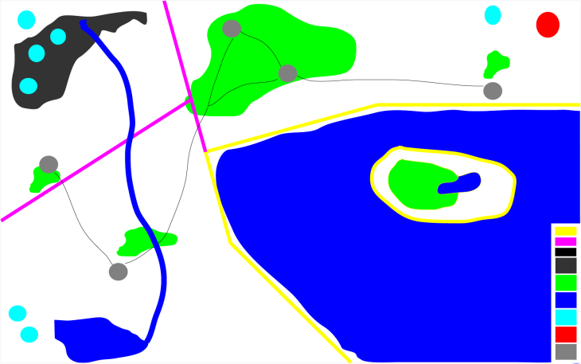
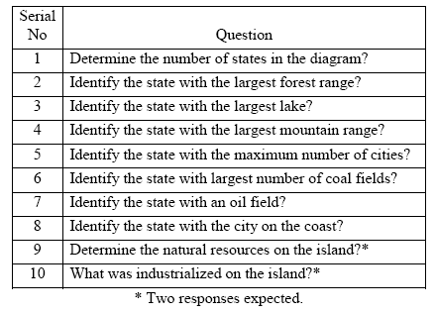
Designing to Overcome Haptic’s Weaknesses
Is Contextual Simplification Helpful?
Alternatives:
- Whole map or
- Only relevant feature sets for questions
Feature sets:
Boundaries (country and state)
Political features (cities and roads)
Physical features (water bodies, mountains and forests)
Industrial features (coal mines and oil fields)

Slide 43
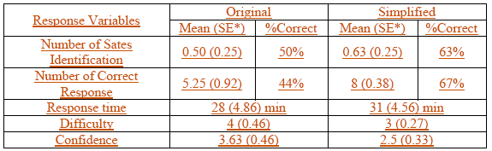
Designing to Overcome Haptic’s Weaknesses
Is Contextual Simplification Helpful?
Helpful for answering the context dependent questions, not for number of states
Other response variables were not statistically significant

Slide 44
Summary
Designing a display for haptics alone vs. haptics + vision can lead to different approaches
Haptic’s strength is in processing material properties and abrupt discontinuities (both 2-D and 3-D)
  It is both fast and can be done in parallel if discrimination is easy
  Can lead to greatly improved performance of displays
  May not see an improvement with multiple fingers otherwise
Haptic’s weaknesses
  Lower spatial resolution than vision
  Slow, serial, memory intensive processing of processing detailed geometry
  Dynamic computing environments have the potential to manage the effects of these weaknesses for more effectively

